Slide 1
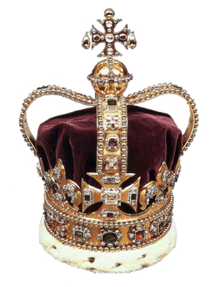



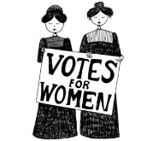
British Values

Slide 2

What are values?
Honesty
Courage
Kindness
Respect
Charity

Slide 3

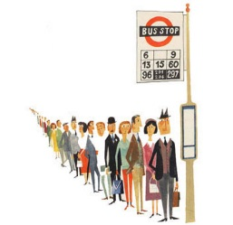
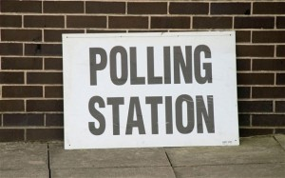
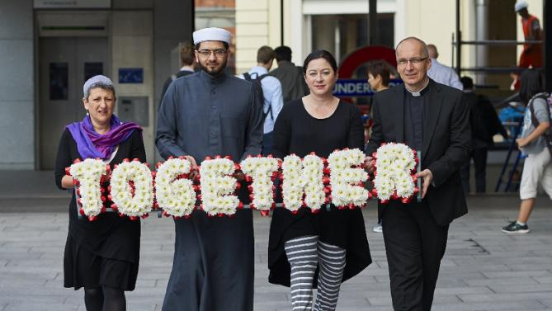
What are British values?

Slide 4
Government’s list of Fundamental British Values
The government has produced the following list of fundamental British values:
Democracy
The Rule of Law
Individual Liberty
Mutual Respect
Tolerance of those with different faiths and beliefs

Slide 5
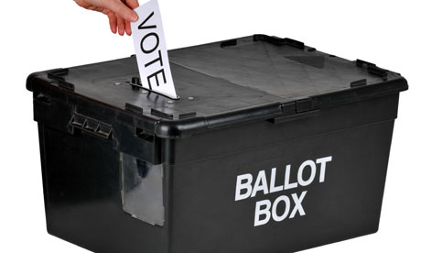
British Values and You
Your teacher will allocate one of these values to you:
Democracy
The Rule of Law
Individual Liberty
Mutual Respect
Tolerance of those with different faiths and beliefs
What do you think this value means?
How is this value promoted in this school and in our country today?

Slide 6
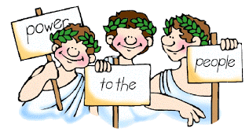
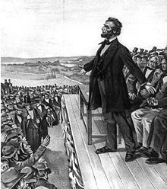

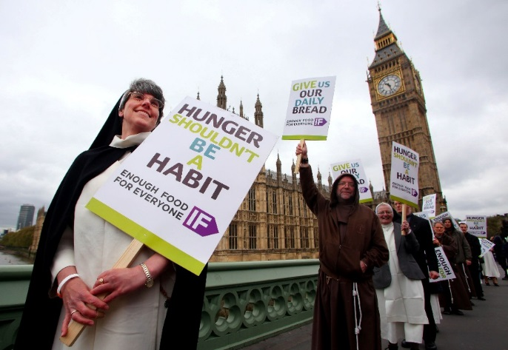
Democracy
What is it?
“Demos” is the Greek word for “people”. “Crat” is the Greek word for “power” so democracy is “people power”.
In his Gettysburg Address (1863) Abraham Lincoln described “government of the people, by the people, for the people”.
How could you tell your Member of Parliament (MP) what you think about our country and the world?
Watch this video showing how some people contact their MPs.
What changes would you campaign for?
How could we promote democracy?
Take part in the School Council
Hold mock elections
Take part in debating competitions
Invite MPs and other speakers to the school
Visit parliaments, assemblies and local councils
Participate in the UK Youth Parliament

Slide 7
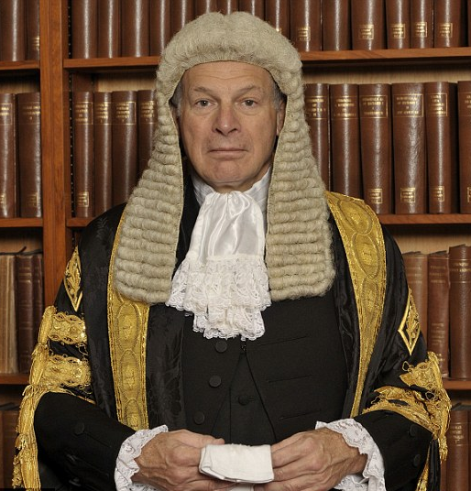

Rule of Law
What is it?
Everyone has to obey the law. Anyone who breaks the law will be held to account fairly. The rich and powerful do not get special treatment.
How could we promoted the Rule of Law?
Create some “class rules” together
Obey school rules
Organise visits from the police service to reinforce the message of right and wrong
Hold a mock trial – visit this website to find a step by step guide, including a script, guidance for each role and mock evidence. (http://www.citizenshipfoundation.org.uk/lib_res_pdf/0122.pdf)

Slide 8

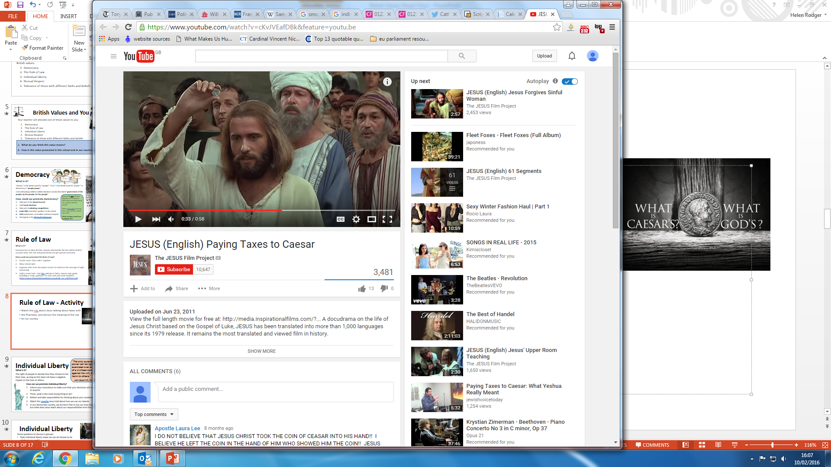
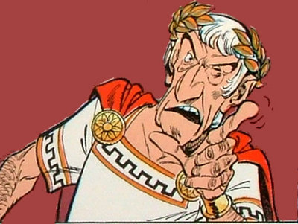
Activity: Rule of Law
Jesus told the Pharisees to ‘render unto Caesar the things that are Caesar’s, and unto God the things that are God’s’: watch this video.
Who was Caesar?
What does Jesus tell the Pharisees to give to Caesar?
What does Jesus mean by giving God the things that are God’s?

Slide 9

Individual Liberty
“The only purpose for which power can be rightfully exercised over any member of a civilised community, against his will, is to prevent harm to others.”
John Stuart Mill, On Liberty (1859)
What is it?
The right of people to decide how they choose to live their lives, as long as this does not have a negative impact on the lives of others.
How can we promote individual liberty?
Inform your conscience to make sure that your decisions will not be harmful to anyone.
Think, what is the most loving thing to do?
Reflect and take responsibility for thinking about your vocation.

Slide 10
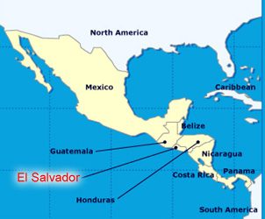
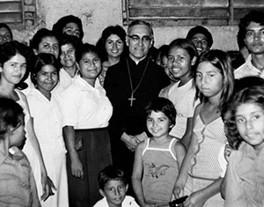
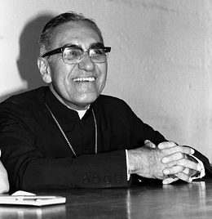
Individual Liberty – Blessed Oscar Romero
Blessed Oscar Romero was a priest and then Archbishop in El Salvador from 1942 to 1980. He spoke out against the actions of the military regime in El Salvador and defended the rights of the poor.
Watch this video to find out more about the life of Blessed Oscar Romero. Why was he killed? Please note some students may find images in this video upsetting.
Oscar Romero stood up for the rights and liberties of the people of El Salvador with great courage, as an example for all.

Slide 11
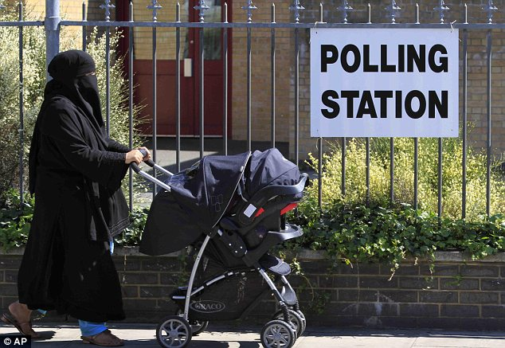
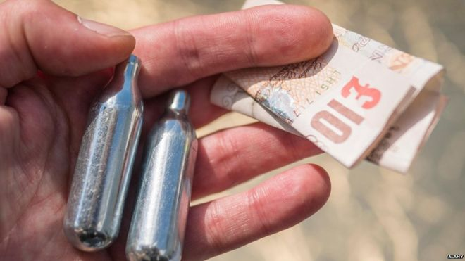
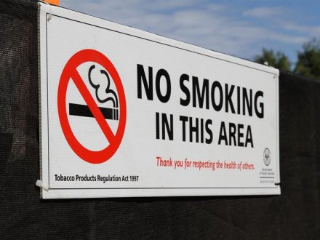
Individual Liberty
Questions for class discussion:
Does individual liberty mean we have the right to do whatever we want?
Should women have the right to cover their faces with the veil?
Should people have the right to buy legal highs like ‘laughing gas’?

Slide 12
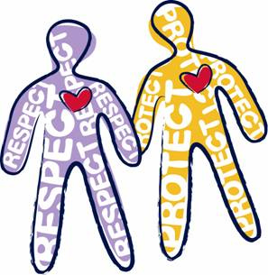
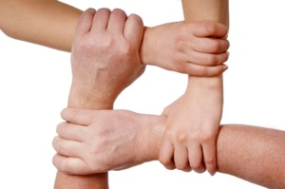
Mutual Respect
What is it?
People listening to and valuing the views of each other.
How can we promote mutual respect?
Follow Jesus’ example by being friendly and loving to your neighbour
Our individuality and our differences are something to be celebrated. Take the time to get to know others.
Promote respect for others as good manners
Value your classmates’ opinions
Support charitable works

Slide 13
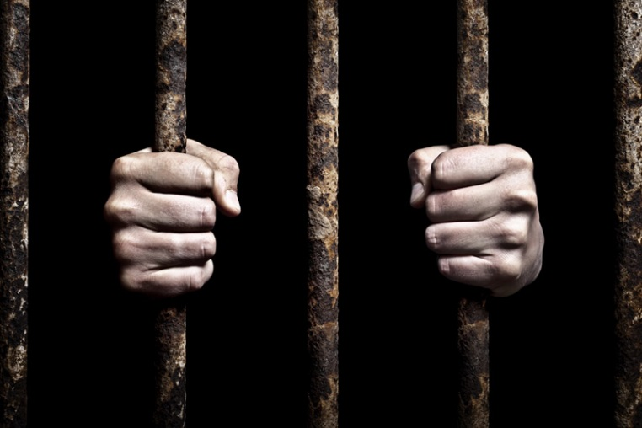
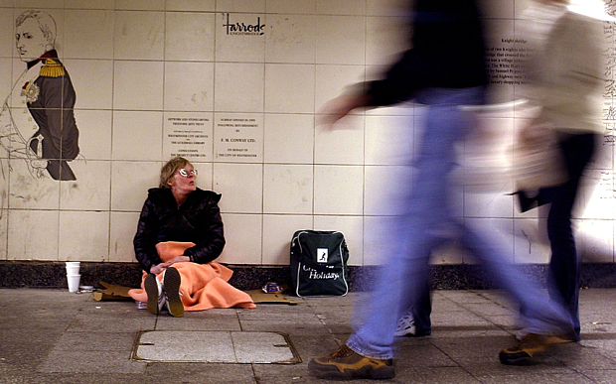
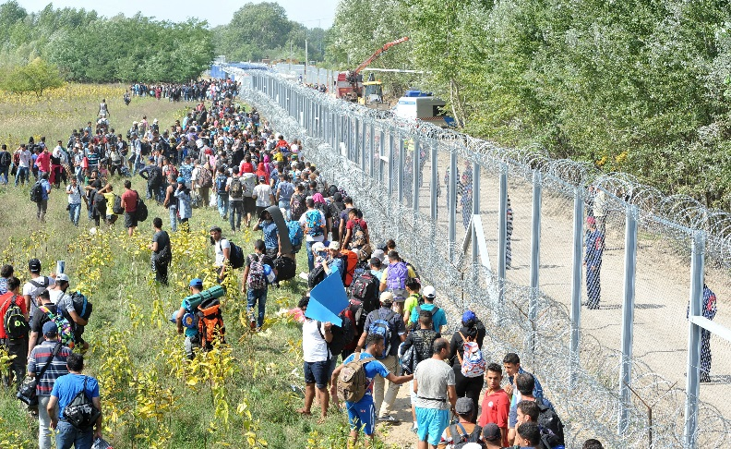
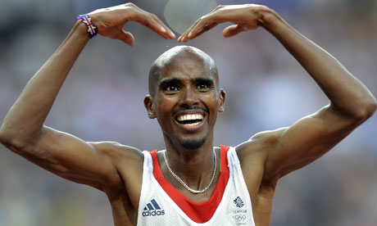

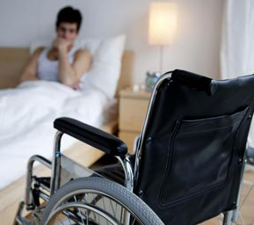
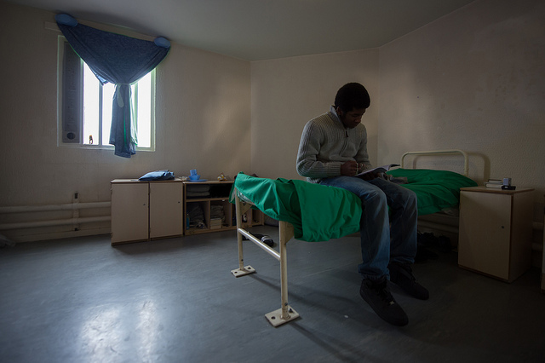
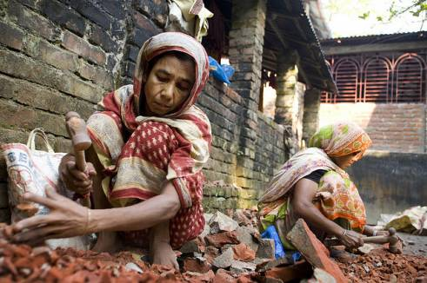
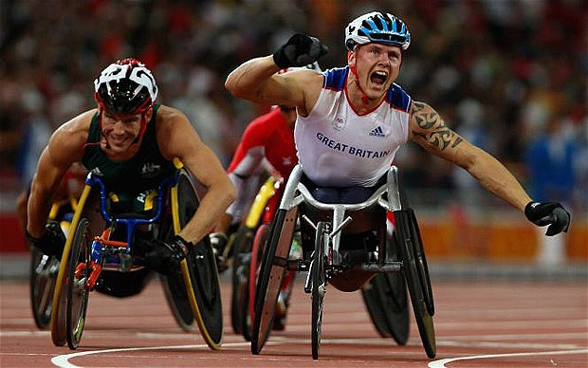
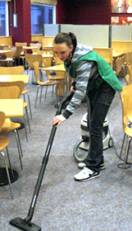
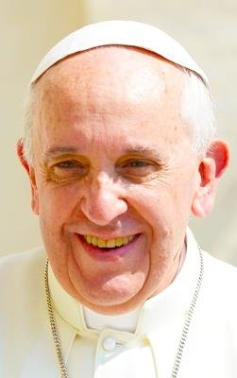
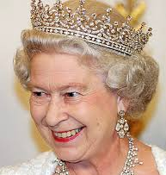
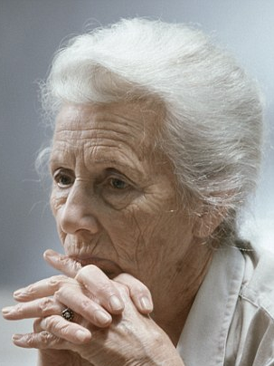
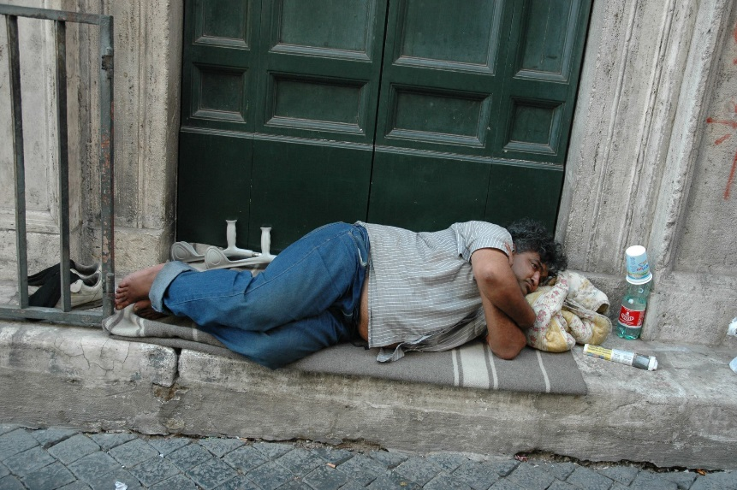
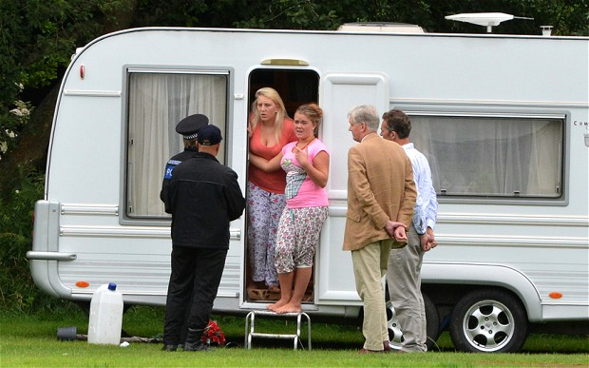
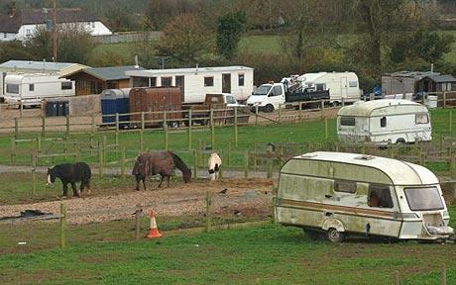
Do you think society respects all these people equally?

Slide 14
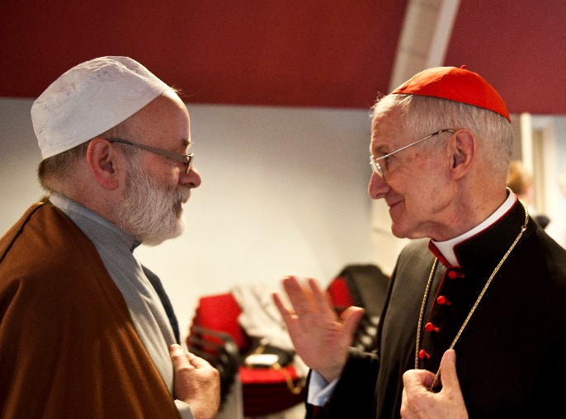
Tolerance of those with different faiths and beliefs
‘I disapprove of what you say, but I will defend to the death your right to say it.’
S G Tallentyre on Voltaire, 1906
What is it?
Respecting people’s right to freely practice any religion they choose or to live without any religion at all.
How can we promote tolerance of those with different faiths and beliefs in our school?
Do you think everyone’s views should be tolerated?
Should we respect the views of people who are intolerant of others?
Make a list of all the different religions you can think of as a class. TASK: Do some research to find out more about the one of these.

Slide 15
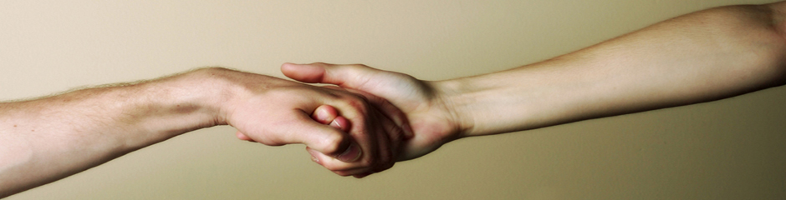
Activity: Tolerance of those with different faiths and beliefs
Watch this video about the Parable of the Good Samaritan.
Who were the Samaritans?
In the time of Jesus, would his disciples have viewed Samaritans as people that it was worth helping?
What is Jesus trying to teach us in the parable about people from other religions? How can we behave like the Good Samaritan in our lives?
Notes:
Samaritans were from the North of Israel, and held partly Jewish, part pagan beliefs. They were despised by the Jewish people for their heretical beliefs. Jesus and his apostles encouraged the Church to welcome Samaritans to convert to Christianity in the same way as they did the Jewish people, breaking down the stigma between the two groups.

Slide 16
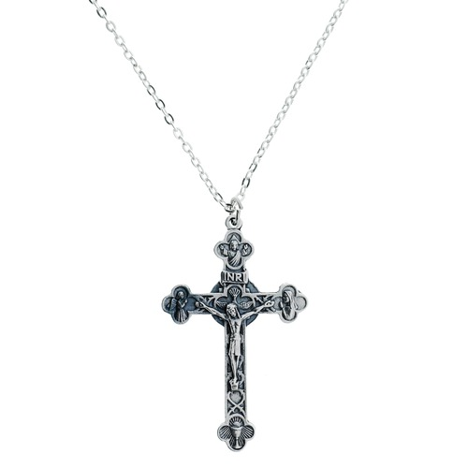
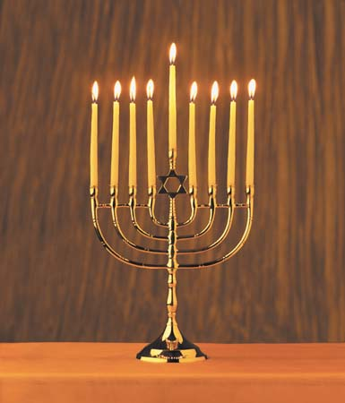

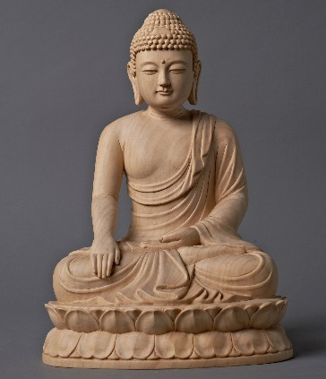
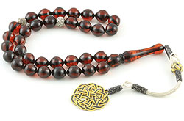
Prayer for respect and understanding
Pope Francis recently released this short video on YouTube, bringing together people of different faiths to pray together for peace, respect and understanding.

Slide 17


Debating British Values
Do you agree with this list?
Are there any values here that you think are not British?
Would you add any other values to this list?
Democracy
The Rule of Law
Individual Liberty
Mutual Respect
Tolerance of those with different faiths and beliefs

Slide 18
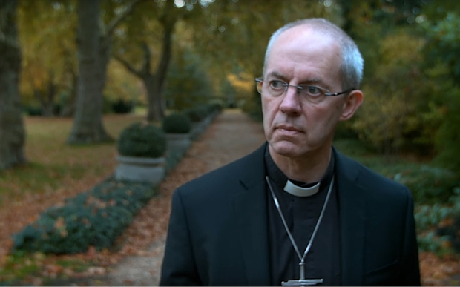

Debating British Values: Case Study
Before Christmas, the Church of England released an advert with different people saying the Lord’s Prayer. It was supposed to be played in cinemas before the new Star Wars film. You can watch it here.
The Digital Cinema Media agency refused to show the ad before the film. They said it might ‘cause offence’ to some of their customers.
What is the message of the ad?
Do you think the ad is inappropriate for viewing before a film?

Slide 19
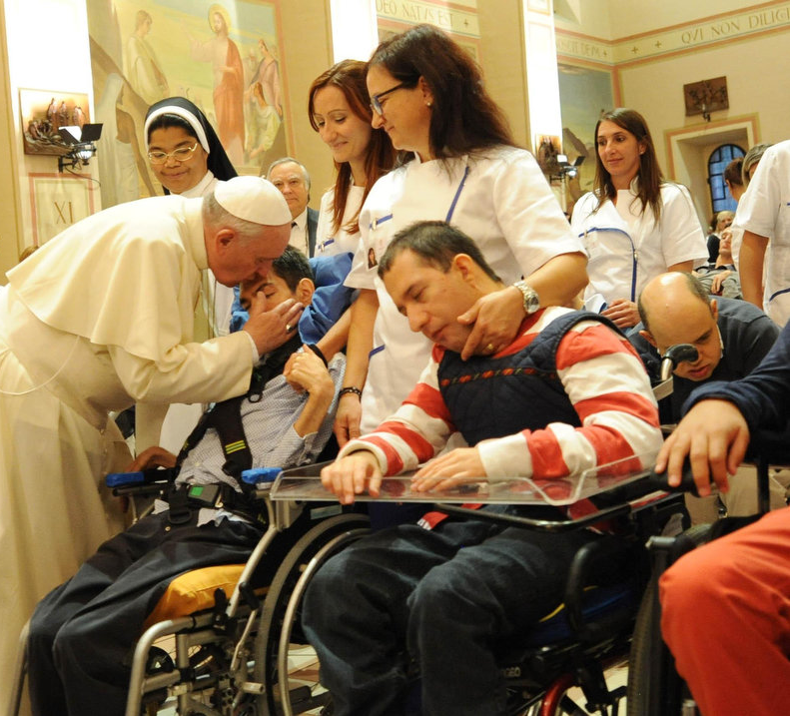
?
Catholic Values
British Values
Vs
What are Catholic values?
Dignity
Love
Mercy
Integrity
Golden Rule
Is there a conflict between Catholic Values and British Values?
Catholic school communities promote values that are both Catholic and British. By our words and actions we live out the ‘British’ values listed by the government. However, we do much more than that, seeking to base all that we do on the teachings of Jesus Christ.

