Slide 1
Opening prayer: Visio Divina
Put simply, Visio Divina is a form of prayer based on the contemplation of an image, it is done in silence although it can be helpful to share your thoughts on an image at the end.

Slide 2
Spend a minute focussing prayerfully on the picture on the following slide.

Slide 4
Share your thoughts on the ‘picture’ with those around you.
Your thoughts might have been
There’s no picture there!
All I see is a black background.
It’s really sad!
It’s just a blank screen!

Slide 5
If your thoughts focussed on there being nothing there, then you have just begun to appreciate the content of this lesson.

Slide 6
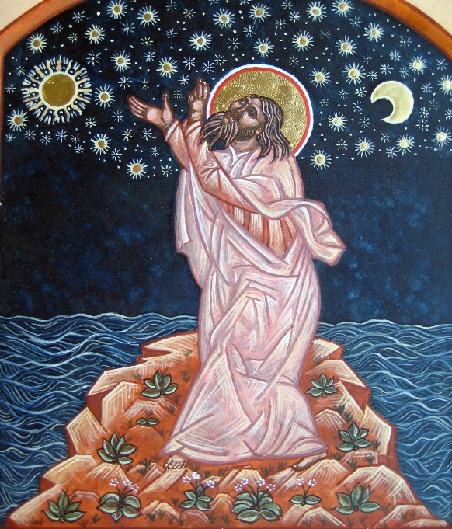
Creatio Ex Nihilo Creation out of nothing
L.O: Could our universe have been created out of nothing?

Slide 7
What is ‘ex nihilo’?
Ex nihilo is the theological belief that God created the Universe and the world from nothing.
It is an idea that comes from the first three verses of the Old Testament.

Slide 9
In pairs: Look at this passage carefully, which parts of it support the idea of ex nihilo and are there any that do not?

Slide 10
Doe Science support the Ex Nihilo Belief?
Well, yes!
In GCSE Science, you will have studied the Big Bang theory, it is part of the Core Science course.
In case you don’t remember, read the handout. As you read it, highlight any ex nihilo statements or ideas in one colour. In another colour, highlight words or ideas that are new to you or that you don’t understand.

Slide 11
Does the Big Bang need God?
The last paragraph of the text says:
“This fact begs the question: is there anything else which exists outside of the natural realm? Specifically, is there a master Architect out there? We know that this universe had a beginning. Was God the "First Cause"?”
What do you think?

Slide 12
What do scientists think?
Many scientists think that there is a Creator. Their reasoning is that the conditions in our Universe are just right for life and that couldn’t have just happened by chance.
Professor Paul Davies describes this series of conditions as
“The Goldilocks Enigma”
A few small changes to the constants of nature would have profound effects on the way that the Universe developed.

Slide 13
The Goldilocks Enigma
Think about the ‘sub-atomic’ parts of an atom, the protons and neutrons.
If protons and neutrons were a different size or mass could atoms still exist?
If such atoms existed, could hydrogen, helium or carbon etc. exist?
If these elements did not exist, could life (as we know it) exist?

Slide 14
So are there alternatives to Goldilocks?
Other scientists believe so. They think that our Universe is one of an infinite number that were created at the Big Bang. The theory is called
The Multiverse Theory
As you watch the clip that follows, think about which of the models might match the idea of ours being the Universe that is ‘just right’ for life
Do we live in a multiverse?
Notes:
https://www.youtube.com/watch?v=Rx7erWZ8TjA

Slide 15
So what do you think?
Get into groups of four.
Discuss the answer to the question:
“Did God create the Universe ex nihilo?”
One person from each group needs to feedback your groups ideas

Slide 16
Questions for further thought
1. If science can explain the creation without the need for God, we should accept that.
2. Read John 1:1-5. Do John’s thoughts on Jesus as the Incarnate Word, change your views on today’s subject matter?
3. The Book of Genesis is just a myth or legend, its creation story doesn’t matter.

Slide 17
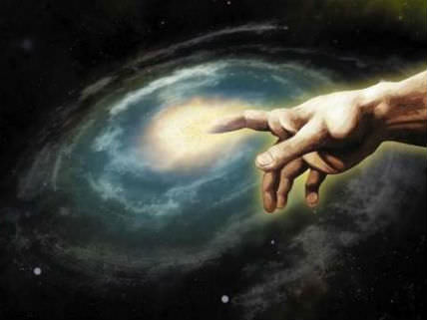
Reflection
Describe the impact of the Awe ins When I consider your heavens,
the work of your fingers,
the moon and the stars,
which you have set in place,
what is mankind that you are mindful of them,
human beings that you care for them?
You have made them a little lower than the angels
and crowned them with glory and honour
(Psalm 8:3-5).

