Slide 1
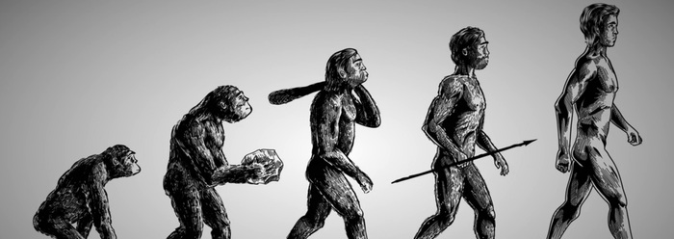
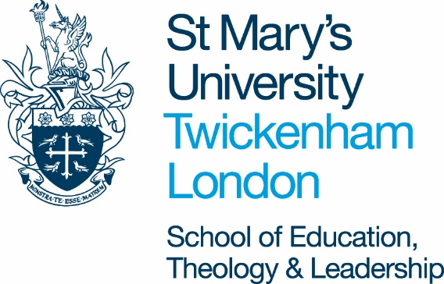
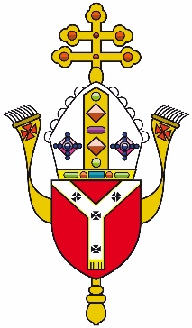
The Church and Evolution
L.O: Is Evolution compatible with Catholic Church teaching?

Slide 2
There are 4 main views which a person can hold about evolution.
Which view do you hold, and why?
Special Creation:
Natural evolution explains the way animals have developed, but man’s spiritual soul was given directly by God.
Creationism: God made all animals, and man, directly, by an omnipotent act. (all on Day 6 in the story)
Darwinism: evolution from a common ancestor.
Man is descended from apes.
Intelligent Design
Evolution happens, but God guides the process to create what He intends

Slide 3
There are 4 main views which a person can hold about evolution.
Which do you think is the Catholic Church’s view?
Special Creation:
Natural evolution explains the way animals have developed, but man’s spiritual soul was given directly by God.
Creationism: God made all animals, and man, directly, by an omnipotent act. (all on Day 6 in the story)
Darwinism: evolution from a common ancestor.
Man is descended from apes.
Intelligent Design
Evolution happens, but God guides the process to create what He intends
Work out what the Church’s view must be, based on the quotes you have been given.

Slide 4
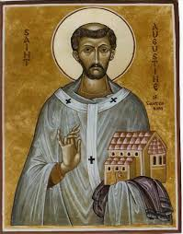
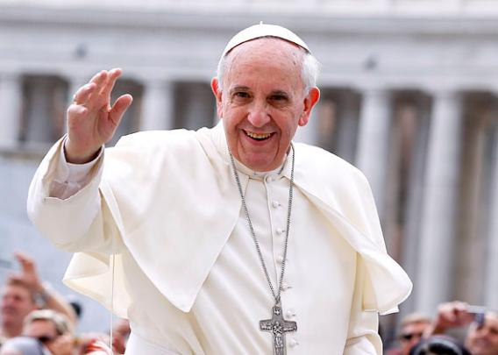
Catechism of the Catholic Church, 366
“The Church teaches that every spiritual soul is created immediately by God - it is not "produced" by the parents - and also that it is immortal: it does not perish when it separates from the body at death, and it will be reunited with the body at the final Resurrection”.
Pope Pius XII (150, Humani Generis The doctrine of evolution…inquires into the origin of the human body as coming from pre-existent and living matter – but the Catholic faith obliges us to hold that souls are immediately created by God.
Pope Francis
“When we read the account of Creation in Genesis, we risk imagining that God was a magician, complete with an all powerful magic wand. But that was not so. He created beings and he let them develop according to the internal laws with which He endowed each one, that they might develop, and reach their fullness. He gave autonomy to the beings of the universe at the same time He assured them of his continual presence.”
St. Augustine, 4th A.D.
“God has implanted in each organism an organising principle, a ratio seminalis, that ensures its change and development, according to a latent pattern laid down, once for all, at the time of Creation.”

Slide 5
There are 4 main views which a person can hold about evolution.
Which of these views would you describe as scientific?
Special Creation:
Natural evolution explains the way animals have developed, but man’s spiritual soul was given directly by God.
Creationism: God made all animals, and man, directly, by an omnipotent act. (all on Day 6 in the story)
Intelligent Design
Evolution happens, but God guides the process to create what He intends
Darwinism: evolution from a common ancestor.
Man is descended from apes.

Slide 6
If people consider this to be the only Christian position, there is an incompatibility between Christianity and a belief in evolution.
Special Creation:
Natural evolution explains the way animals have developed, but man’s spiritual soul was given directly by God.
Creationism: God made all animals, and man, directly, by an omnipotent act. (all on Day 6 in the story)
Darwinism: Evolution from a common ancestor.
Man is descended from apes.
Intelligent Design
Evolution happens, but God guides the process to create what He intends
Catholics are not fundamentalists.
Therefore, there can be a compatibility between a belief in God and evolution
Christians who hold these beliefs are called fundamentalists.

Slide 7
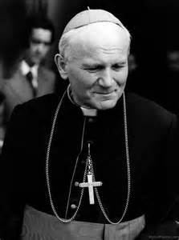
Evolution and Faith
In Humani GenerisPope Pius XII considered the doctrine of evolution a serious hypothesis, worthy of investigation and in-depth study equal to that of the opposing hypothesis.
In 1996 John Paul II stated “Today almost half a century after the publication of the encyclical [Humani Generis], new knowledge has led to the recognition that the theory of evolution is no longer a mere hypothesis”.

Slide 8
The Church & Evolution
What does the Church believe about evolution?
It rejects it, because it believes God made living things according to the story in Genesis
It refuses to express an opinion about it, because Catholics are free to choose what they believe about creation
It accepts it, because science can give us a truer understanding of the world. Religion, including Genesis, is about God and man’s relationship to God.

Slide 9
Evolution and Science
Although scientists may differ in their views regarding the details of evolutionary processes they do agree that physical and biological evolution occurs.
It is best to think of evolution as the ‘survival of the best fit’ rather than the ‘survival of the fittest’. Those organisms best suited are most likely to survive, thrive and reproduce, therefore passing on their characteristics and traits.

Slide 10
Evolution and Science
Do you remember this?
It is noted that:
Evolution is a process of natural selection that can account for biodiversity and how organisms are all related to varying degrees.
Evolution is a change in the inherited characteristics over time which may result in the formation of a new species.
Common ancestry can explain the similarities between all living organisms, such as common chemistry (proteins are made from the same 20 amino acids) or similar anatomy (pentadactyl limbs).

Slide 11
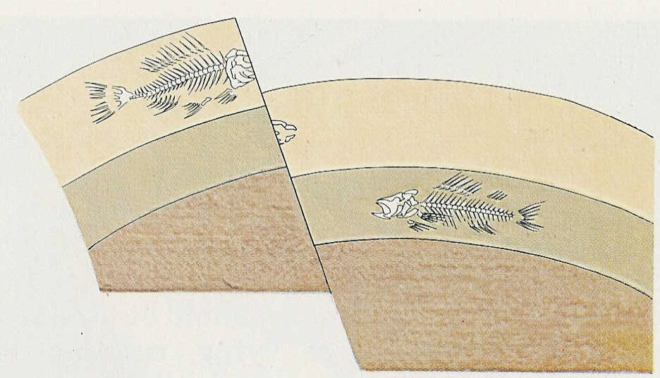
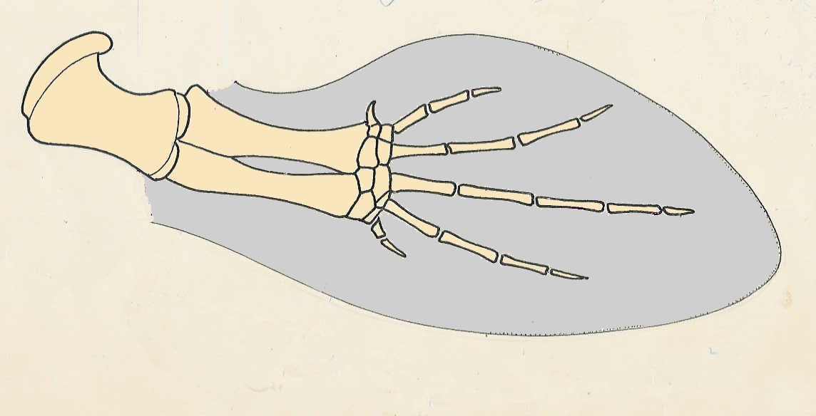
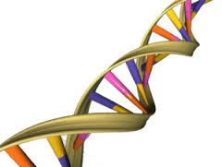
Evidence for Evolution
Do you remember this?
3 types of evidence for evolution
Fossils
Comparative anatomy
Genetics
How could these three things prove evolution?
Notes:
Depending on the class this can be a very brief recap.
Fossils: Ancient fossils show many basic similarities with similar organisms living today, but also differences – there has been evolution.
Comparative anatomy: You can investigate such similarities by comparing bone structures (comparative anatomy). The fact that bone structure is similar, suggests these species had a common ancestor.
Genetics: species share much of their DNA in common. This does suggest they are closely related, i.e. they have evolved from a common ancestor.

Slide 12
NOTE TO TEACHER
The following slides (13-15) contain evidence that is used to support evolution.
If your students require more evidence that is presented on slide 10 or do not recall GCSE level evolution you might want to recap it in more detail

Slide 13
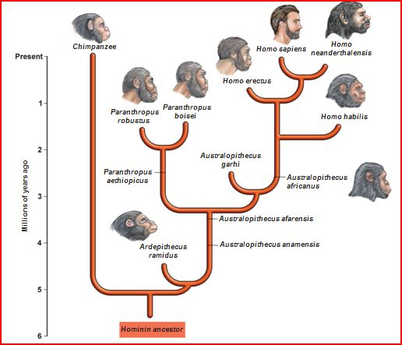
The process of evolution
From simple to more complex organisms
Through natural selection: survival of the ‘best fit’.
Those that are adapted to ‘fit’ in, will reproduce and pass on their genes to their offspring.

Slide 14
Fractured rock
1. Fossils & Comparative anatomy
Fossils are only formed when parts resistant to decay are preserved (skeletons & shells)
Despite gaps, the fossil record shows that organisms have become more developed and more complex over time.
Ancient fossils show many basic similarities with similar organisms living today, but also differences.
You can investigate such similarities by comparing bone structures (comparative anatomy). The fact that bone structure is similar, suggests these species had a common ancestor.
fossilised skeleton exposed
earth movements
fracture rock
On your sheet, choose a bone and colour it the same colour in each species.

Slide 15
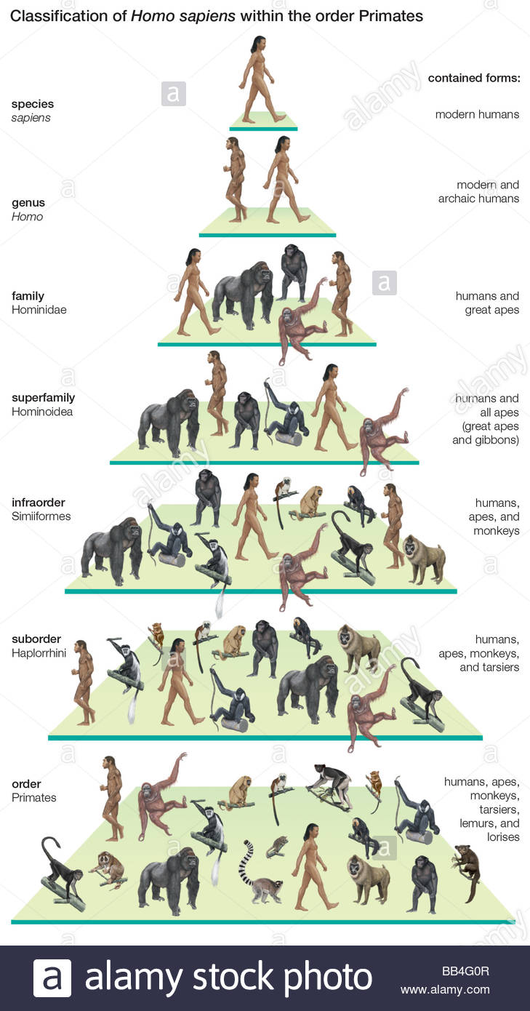
Evidence from Genetics
The fact that organisms share similar bone structures, might not necessarily mean they had a common ancestor. Maybe they just “hit” on this perfect limb design independently of each other.
But then how do you explain they such organisms also share much of their DNA in common? This does suggest they are closely related, i.e. they have evolved from a common ancestor.
For example, humans and chimpanzees have 98% of their DNA in common which suggests a fairly ‘recent’ divergence from a common ancestor
- Cows
Chickens
Cats
mouse
fruit fly
banana
80%
60%
90%
75%
60%
50%
What percentage of genes do we have in common with…

Slide 16
Does the evidence persuade you that evolution is for real? Or are you a creationist?

Slide 17
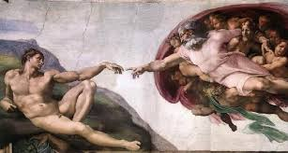
If human beings are biologically so similar to other creatures, can we still consider ourselves unique?

Slide 18
The Divine Image
Star those features which stand out as making humans unique.
From the Catechism of the Catholic Church, 1702ff:
The divine image is present in every man.
In having a spiritual and immortal soul, the human person is the only creature on earth that God has willed for its own sake.
From his conception, he is destined for eternal beatitude and participates in the light and power of the divine Spirit.
By his reason, he is capable of understanding the order of things established by the Creator.
He is endowed with freedom, an "outstanding manifestation of the divine image. By free will, he is capable of directing himself toward his true good.
He finds his perfection "in seeking and loving what is true and good.
Man is capable of recognizing the voice of God which urges him "to do what is good and avoid what is evil.”
Man can exist in such a communion with others, that he reflects the loving, self-giving unity that exists among God as three Persons.

Slide 19
The Divine Image
From the Catechism of the Catholic Church, 1702ff:
The divine image is present in every man.
In having a spiritual and immortal soul, the human person is the only creature on earth that God has willed for its own sake.
From his conception, he is destined for eternal beatitude and participates in the light and power of the divine Spirit.
By his reason, he is capable of understanding the order of things established by the Creator.
He is endowed with freedom, an "outstanding manifestation of the divine image. By free will, he is capable of directing himself toward his true good.
He finds his perfection "in seeking and loving what is true and good.
Man is capable of recognizing the voice of God which urges him "to do what is good and avoid what is evil.”
Man can exist in such a communion with others, that he reflects the loving, self-giving unity that exists among God as three Persons.
Did you star all those highlighted in blue?
How do you see human beings? As basically an animal, or also different from an animal?

Slide 20
One way of seeing the difference…
St. Catherine thought of herself as being a mirror, in whom she could see and reflect God. The purer her soul, the clearer the image, and then the more aware she would be of the great gulf between herself, as the image, and the perfection of God. (a bit like a really good telescope makes you realise how many and far the stars really are)
So maybe being human, means that God has given one species of human, a soul, which gives us the ability to recognise ourselves as being the image of God.
So while other animals may be similar to us in having evolved “higher” capacities for reason, affection, even self-sacrifice; we alone can see and know God in a way that can make us different, and more like Him.
What do you think?
Think about pets that you know. What aspects of their behaviour show the difference between them, and us?
Is a soul what separates human beings from animals?

Slide 21
Evolution and Creation
Using the sources from today’s lesson
Explain how a Catholic can believe:
God created the world
Evolution is happening
Human beings are unique

Slide 22
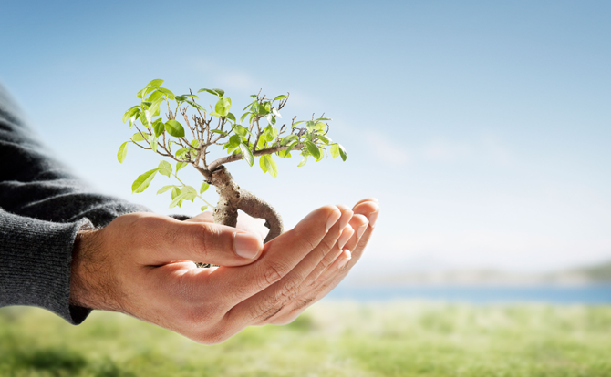
Reflection
A Prayer for our Earth
All-powerful God, you are present in the whole universe and in the smallest of your creatures.
You embrace with your tenderness all that exists.
Pour out upon us the power of your love, that we may protect life and beauty.
Fill us with peace, that we may live as brothers and sisters, harming no one.
O God of the poor, help us to rescue the abandoned and forgotten of this earth, so precious in your eyes.
Bring healing to our lives, that we may protect the world and not prey on it,
that we may sow beauty, not pollution and destruction.
Touch the hearts of those who look only for gain at the expense of the poor and the earth.
Teach us to discover the worth of each thing, to be filled with awe and contemplation,
to recognize that we are profoundly united with every creature as we journey towards your infinite light.
We thank you for being with us each day.
Encourage us, we pray, in our struggle for justice, love and peace
By Pope Francis

