Slide 1
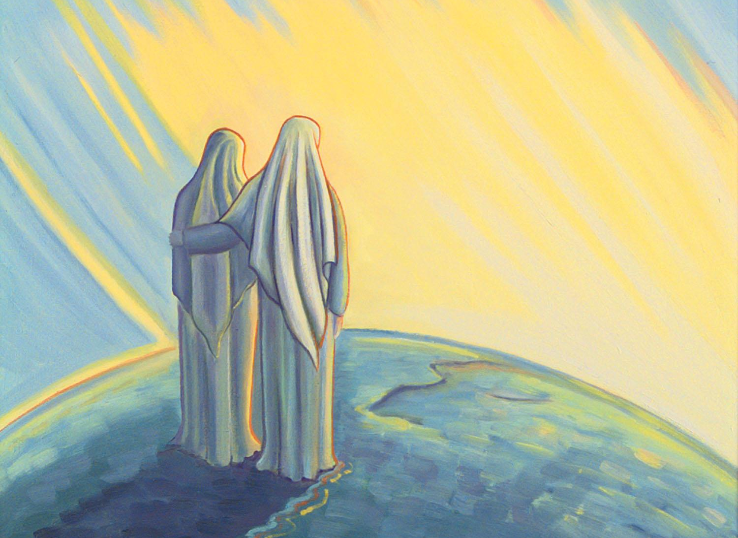
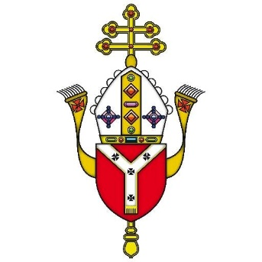
Mary Our
Mother
DIOCESE OF WESTMINSTER
Notes:
This PowerPoint supports the document ‘Catholicism Unpacked: Mary’ and should be used alongside it as the PowerPoint only contains a small amount of information. It is essential for candidates to have their own copies of this during the session(s).
This resource can be used either:
- for ONE training session
for THREE training sessions
Before delivering the session(s), the leader should choose carefully which parts will be used to suit their context/audience and then amend and adapt as necessary. Some extra links/resources will be recommended throughout the PowerPoint so that teachers can deepen their own theological knowledge independently.
For the ONE training session, all video links do not need to be used due to time but a small selection could be used throughout the training instead. For the THREE sessions, it is recommended that all videos are used. These can be found by clicking on the images which have hyperlinks (those which do not have refection/discussion opportunities).
Prayer is included at the beginning of each of the three sections but only one needs to be used at the beginning of the ONE training session. These can also be found by clicking on the hyperlinks on the images.
There are THREE activities for staff provided so the leader can decide which (if not all) of these can be used.

Slide 2
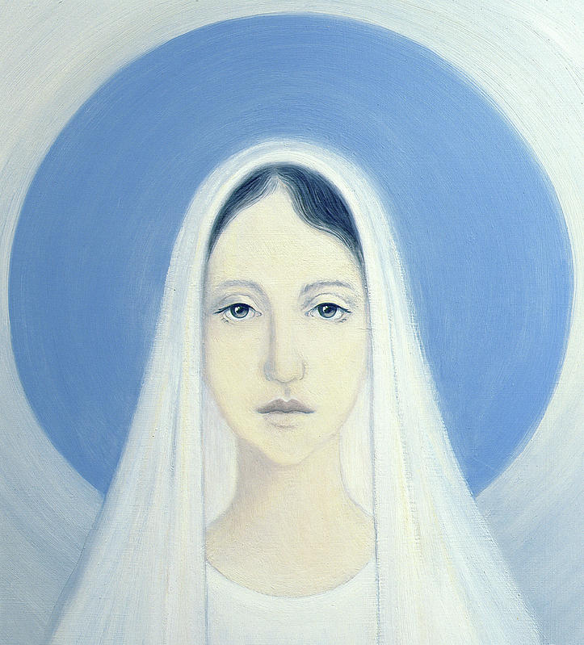
LET US
PRAY
Notes:
This resource can be used either:
- for ONE training session
- for THREE training sessions
If it is ONE, then only the first prayer will be used and the others ignored.
If it is THREE, then all links to prayer can be used.
Teachers can certainly use alternative prayers if they wish.

Slide 3
Outline of this Presentation:
What do
Catholics
believe
about Mary?
1. HAIL MARY, FULL OF GRACE
- The Immaculate Conception
- Mary's choice
- Mary, Mother of God and ever-virgin
2. THE LORD IS WITH YOU
- The Assumption
- Marian prayer and worship
- Mary in the Bible
3. BLESSED ARE YOU AMONG WOMEN
- Honour, titles and beliefs
- May, the month of Mary
- Importance of colour blue and symbols

Slide 4
SECTION 1
HAIL MARY
FULL OF GRACE

Slide 5
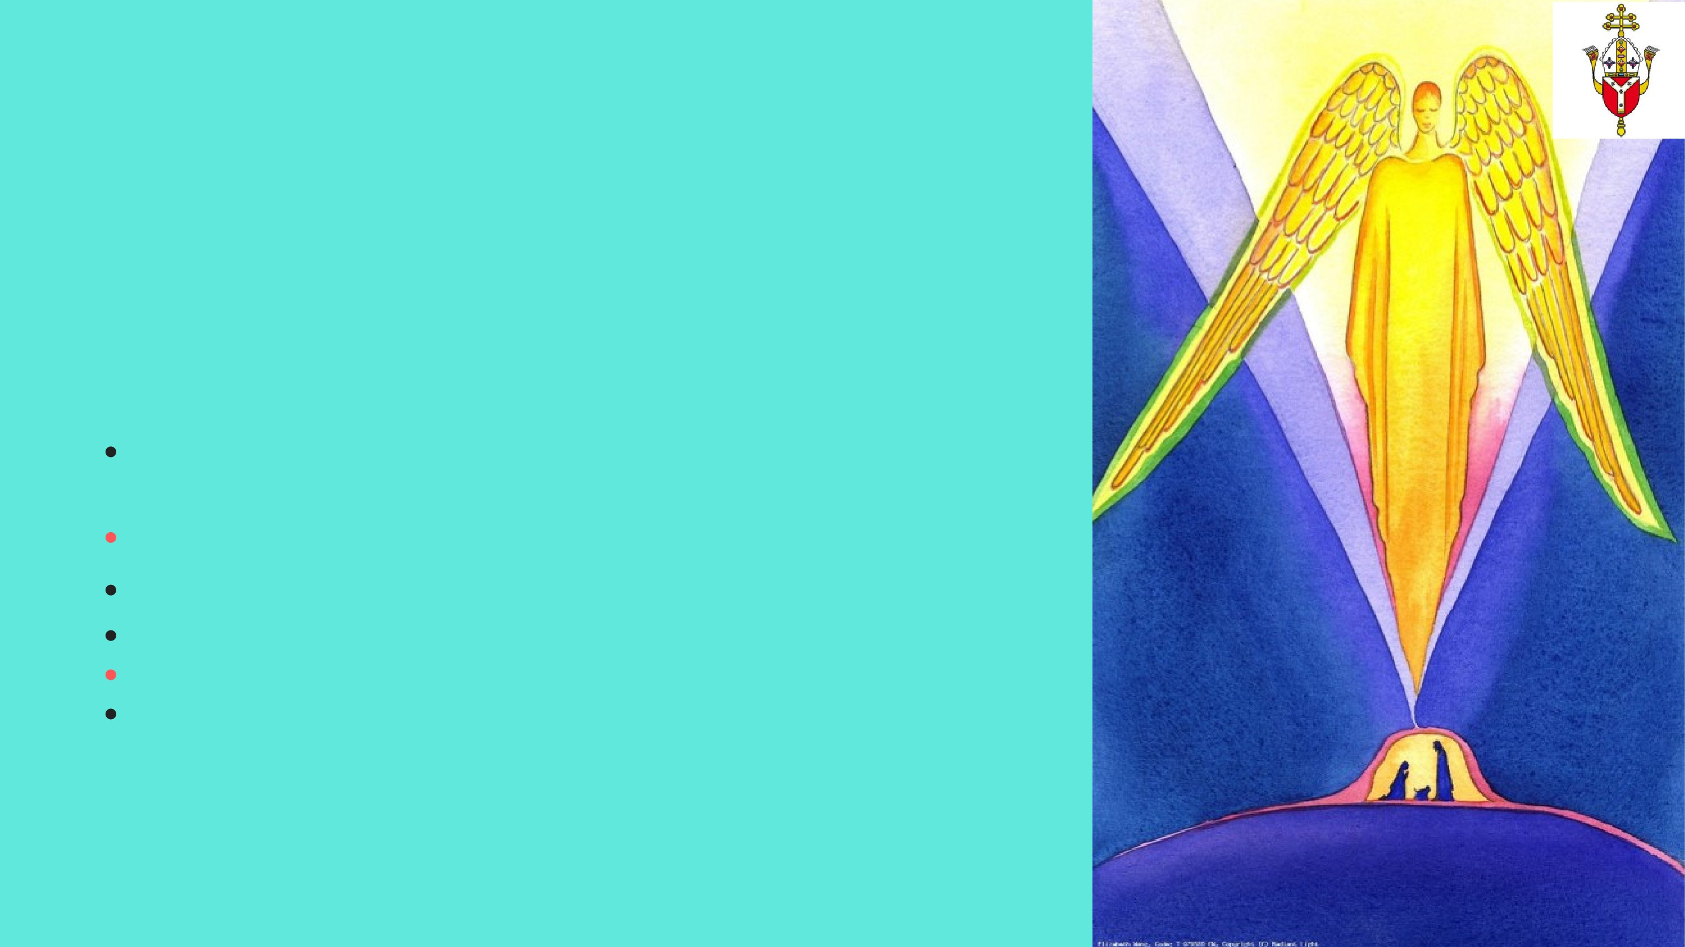
TRUE OR FALSE?
Mary became the Immaculate Conception when she conceived Jesus
Mary is the mother of God – the Father, Son and Spirit
Mary is the only female who is worshipped by Catholics
Mary had a choice in God’s plan of salvation
Jesus had siblings
Mary was the first living tabernacle
Notes:
The answers (which are provided) to these can be given at the end of the session. This is the same with all three activities.
Teachers can use the ‘Catholicism Unpacked: Mary’ document for support.

Slide 6
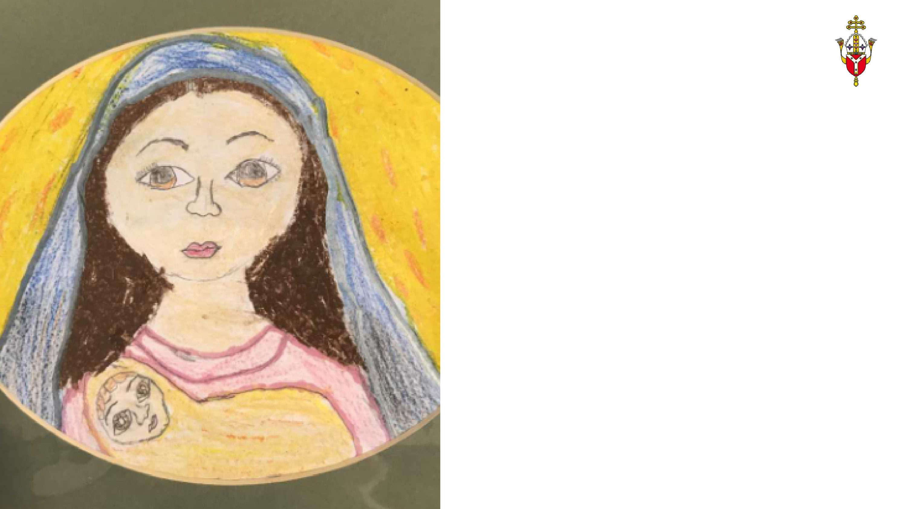
WHO WAS MARY?
Woman of great faith
‘Ask His mother to take you to Him.’
Mary was a woman of great faith, courage and strength.
The key beliefs the Catholic Church holds about Mary can be best understood as expressions of what is believed about Christ, in particular his humanity and his divinity.was a
When Pope Francis visited Naples and spoke to a group of religious men and women, he told them that the best way to make sure that Jesus remained at the centre of their lives was to “ask his mother to take you to him.”
Notes:
See ‘Catholicism Unpacked: Mary’ p1
PLEASE CLICK ON THE IMAGE FOR THE LINK. Sound is required
More information Mary: a historical, geographical and political context
Mary was a young Jewish woman of great faith who lived in a time of Roman rule. She was most likely born in Nazareth which was a place of little importance (“Can anything good come out of Nazareth?” John 1:46). She belonged to the peasant class and so life was grinding with a triple tax burden to Rome. There was a great deal of political revolts and atrocities with Romans burning cities and taking people into slavery, or killing infants.
Like most people at that time, they probably lived in an extended family unit where domestic animals also lived. Like other women then and now in some parts of the world, Mary probably spent in average 10 hours a day on domestic chores. In Palestine at that time women ordinarily married at about 13 years so it is likely that the birth of Jesus happened when she was very young.
She was a woman of deep faith, courage and strength who suffered a great deal and who put others’ needs before her own; she put herself completely into the hands of God. She has very clearly been an inspiration and source of strength to countless believers throughout history as well as today.

Slide 7
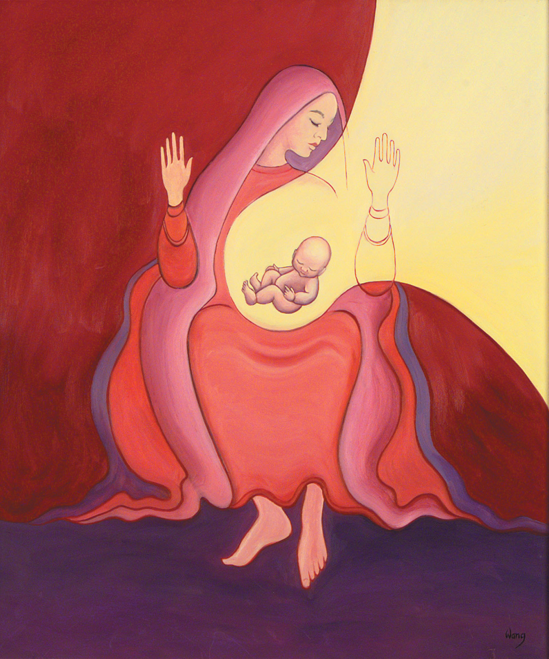
WHAT IS THE IMMACULATE CONCEPTION?
‘I am Mary the Immaculate Conception
‘Hail Mary, full of grace...’ (Luke 1:28)
"Mary benefited first of all and uniquely from Christ's victory over sin:
She was preserved from all stain of original sin and by a special grace of God committed no sin of any kind during her whole earthly life." (CCC411)
Jesus is NOT the Immaculate Conception. It is Mary who owns this title. She is the Immaculate Conception because she herself was conceived without sin. She was the pure and spotless ‘vessel’ like the Tabernacle in the Old Testament.
Many people confuse the Immaculate Conception with the Incarnation (‘virgin birth’). Another misconception is to think that Mary herself was conceived without sexual intercourse but she was conceived in the natural way.
Notes:
See ‘Catholicism Unpacked: Mary’ p2-3
PLEASE CLICK ON THE IMAGE FOR THE LINK. Sound is required

Slide 8
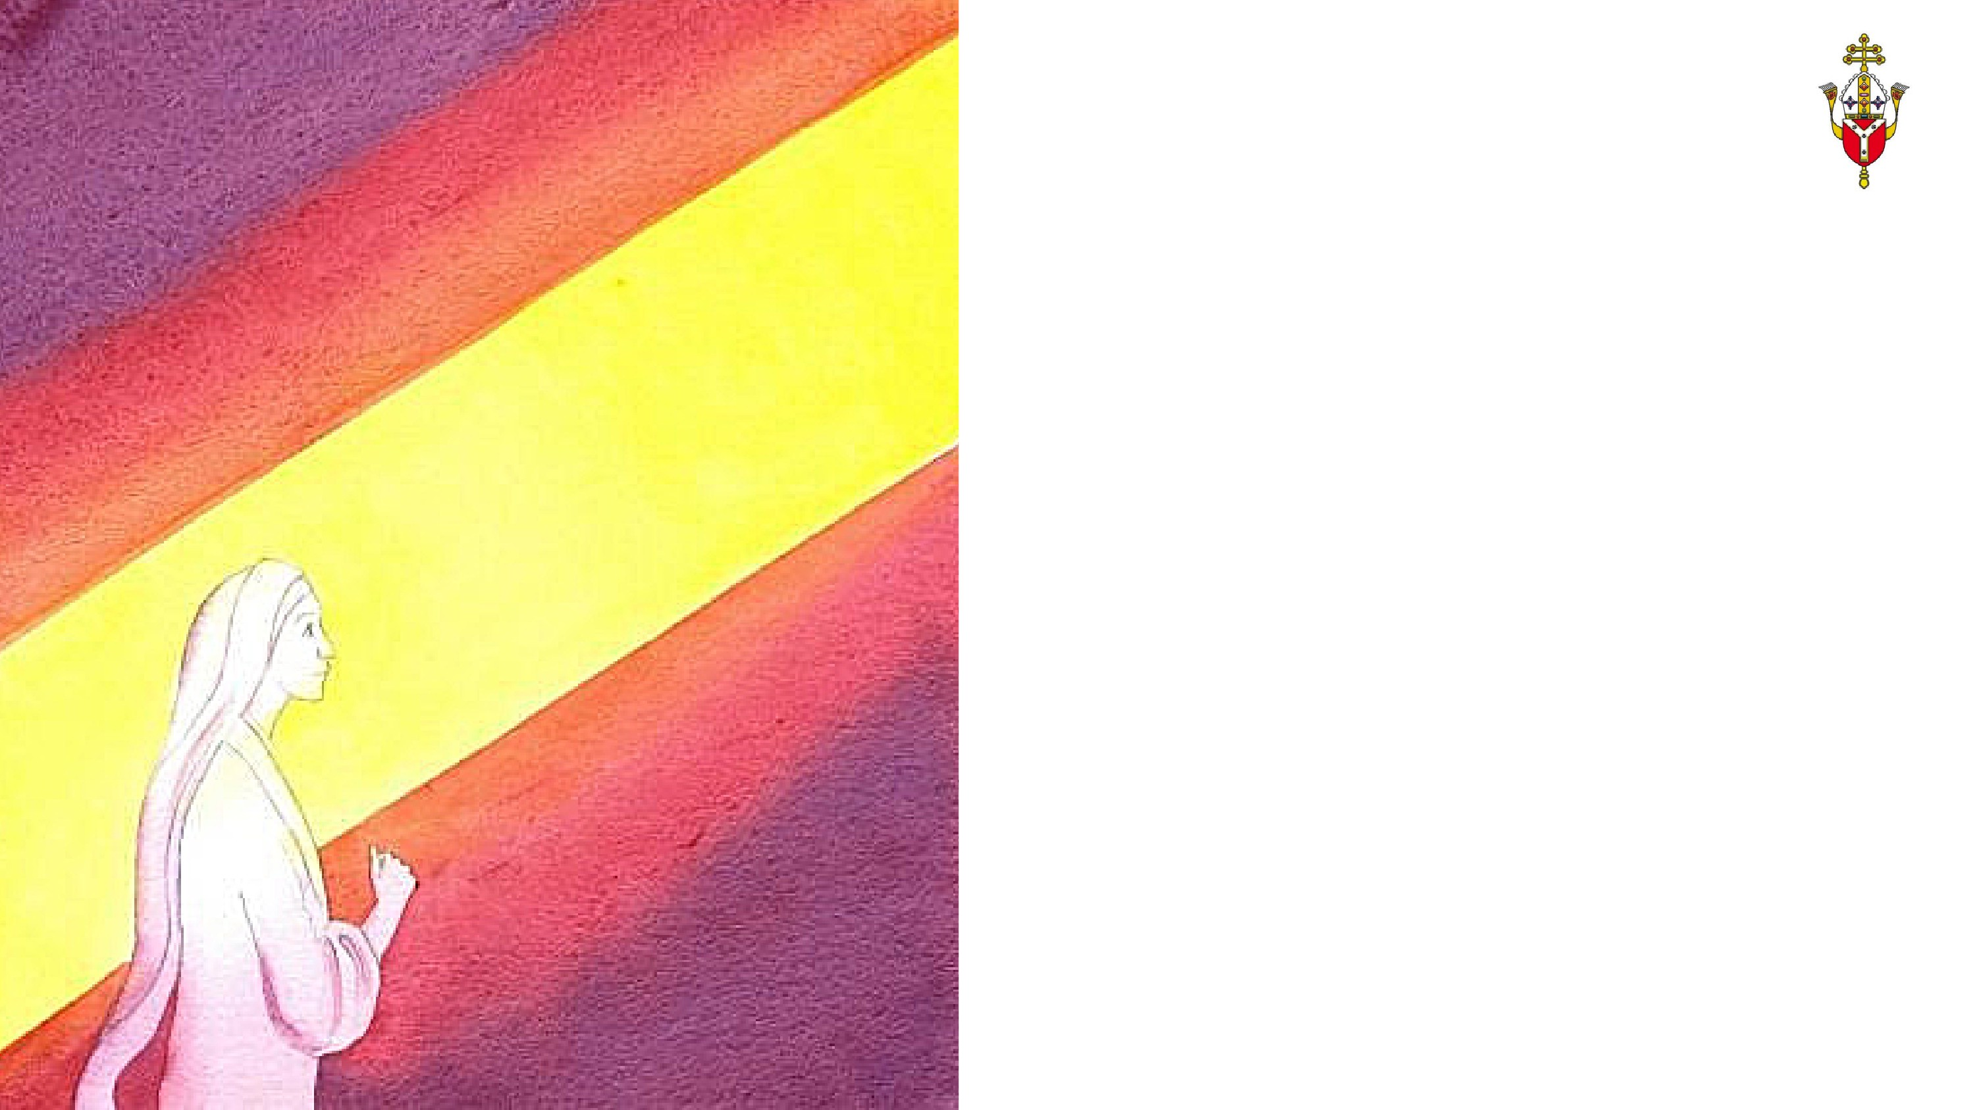
DID MARY HAVE FREE CHOICE?
Let it be done unto me according
to your word (Luke 1:38)
Mary's 'yes' changed the world!
God has given all people free choice and Mary was no exception. She is the new Eve – where Eve chose to disobey God and brought sin into the world, Mary accepted God’s will whole-heartedly and brought Jesus into the world to conquer sin and death.
REFLECT/DISCUSS:
What were the implications of this choice for Mary? What challenges did she face throughout her life?
Notes:
See ‘Catholicism Unpacked: Mary’ p4
At the bottom of this slide (and others) is an idea for reflection - this may be for quiet personal reflection or to share and discuss with others.
For the ONE training session, these reflections do not need to be used due to time, although the leader could select one/two if appropriate.

Slide 9
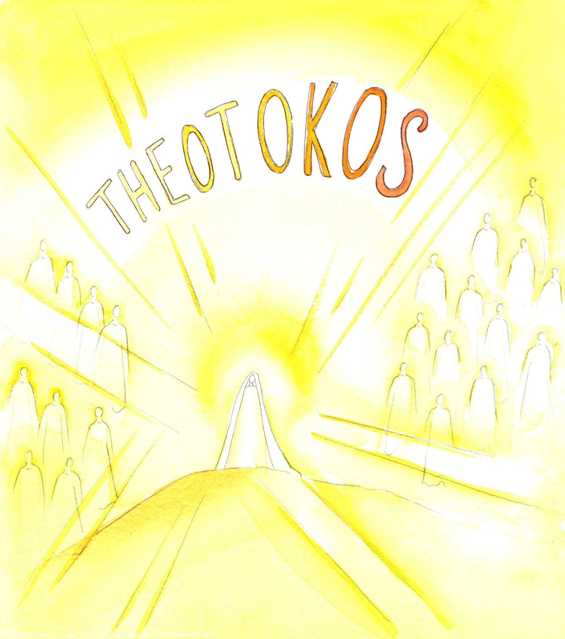
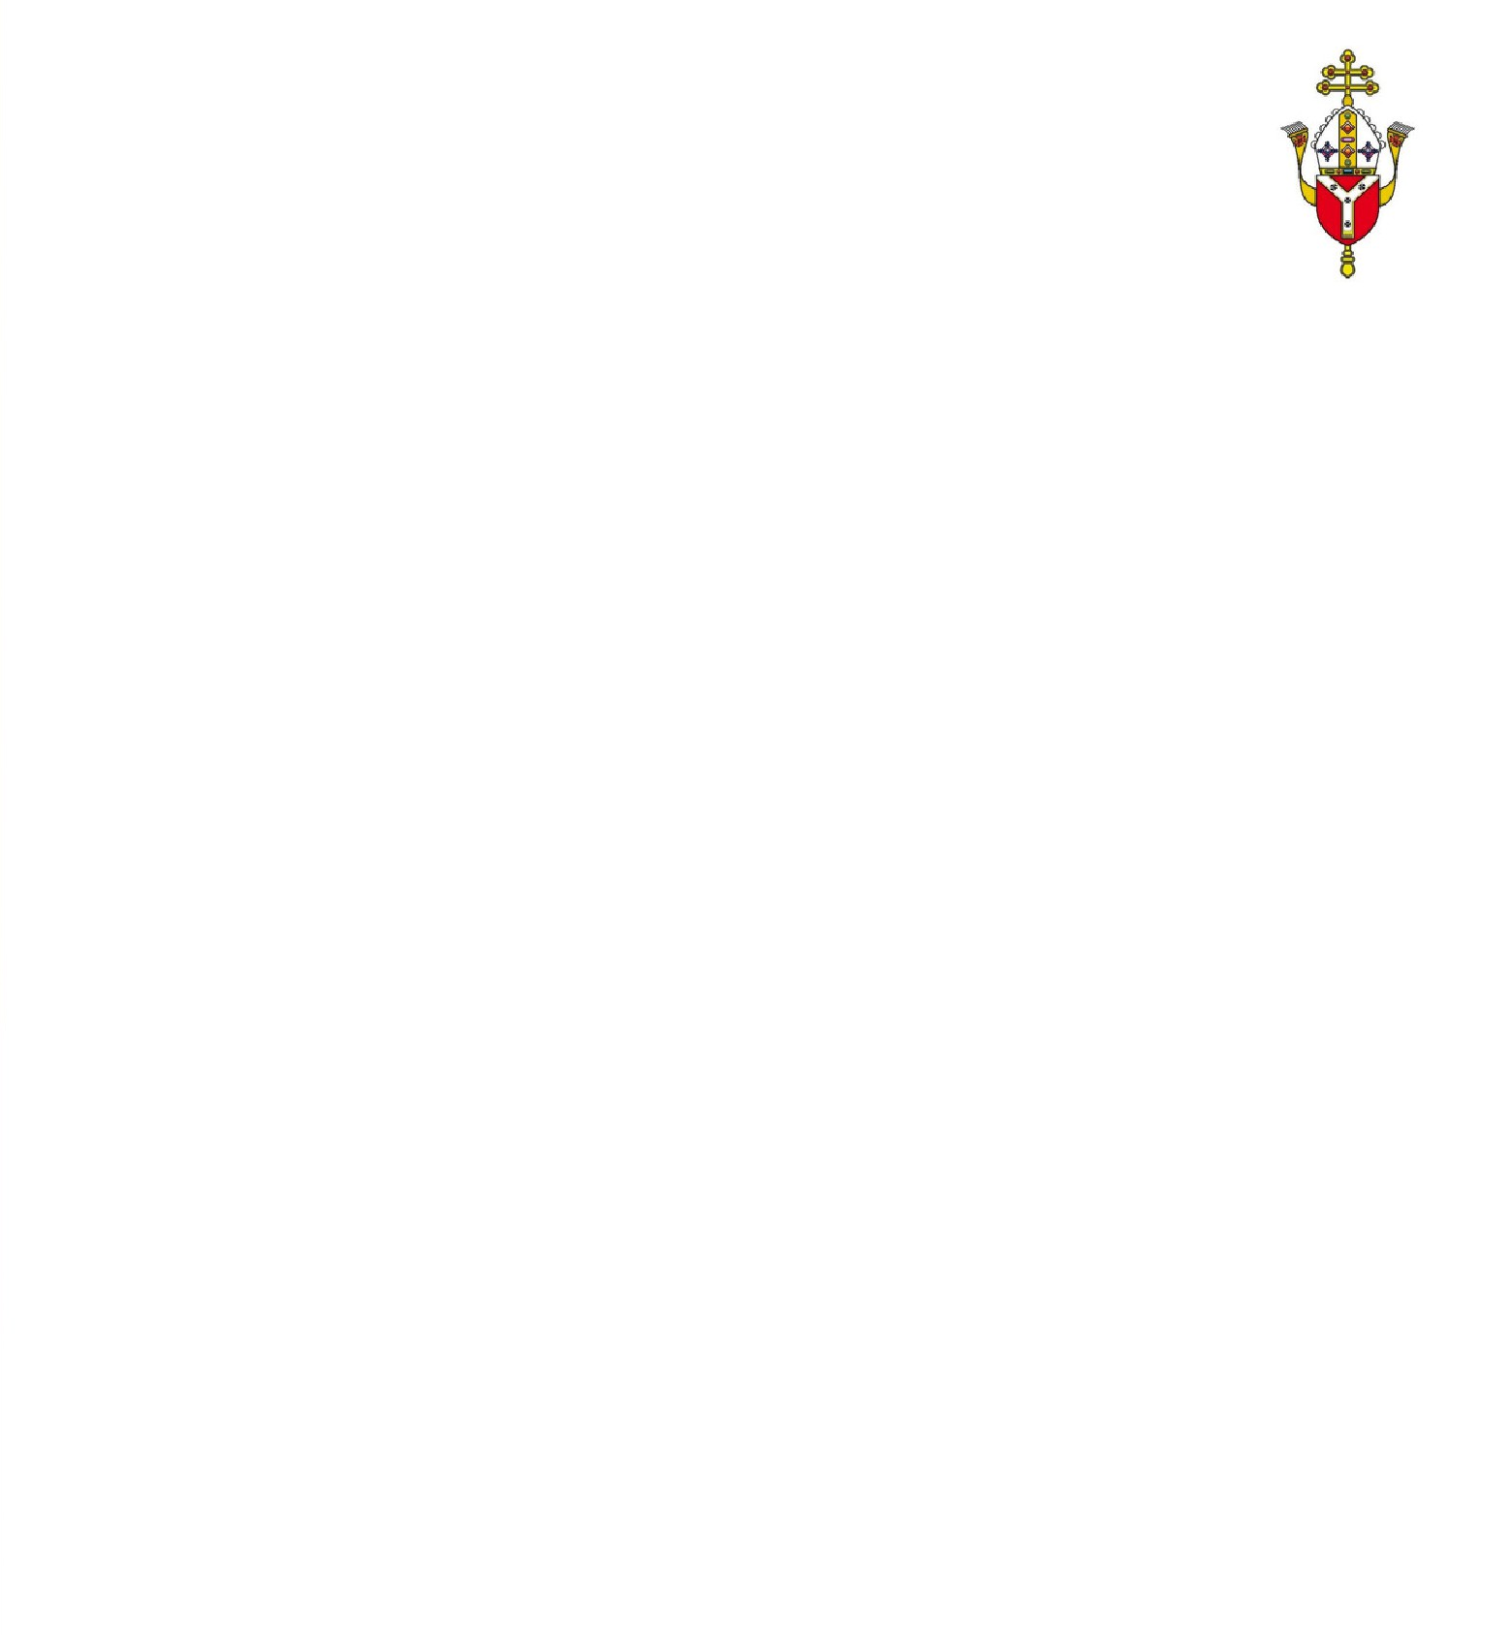
HOW CAN MARY
BE THE MOTHER
OF GOD?
‘God-Bearer' - Theotokos
The very first Eucharistic tabernacle
Since Jesus is God, Mary must be recognised as the one who bore God in her womb. She is not the mother of God the Father or the Trinity but of Jesus Christ who was true God and true man.
'For us men and for our salvation he came down from heaven, and by the Holy Spirit was incarnate of the Virgin Mary, and became Man.'(Nicene Creed)
Notes:
See ‘Catholicism Unpacked: Mary’ p5-6
PLEASE CLICK ON THE IMAGE FOR THE LINK. Sound is required

Slide 11
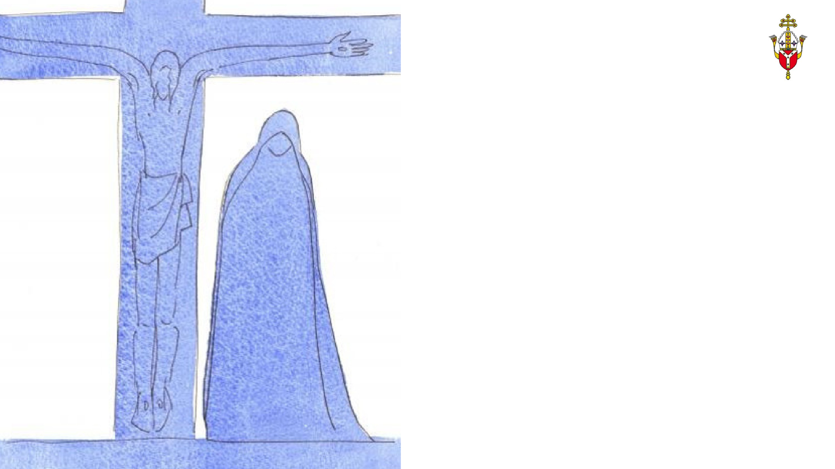
HOW WAS MARY 'EVER-VIRGIN'?
‘Woman, here is your son’, and to the disciple, ‘Here is your mother.’
(John 19:26-7)
Mother of the Church
Although the Bible refers to brothers and sisters of Jesus, it is important to remember that there is only one word in Aramaic for sibling, cousin, aunt, uncle, niece and nephew.
When Mark mentions 'brothers and sisters' of Jesus, it refers to close relatives.
The fact that Jesus entrusted Mary into the care of John at the foot of the cross implies Jesus did not have siblings.
REFLECT/DISCUSS:
What does it mean to be 'full of grace' and pure in heart? What would that have looked like then and now
for those of all ages?
Notes:
See ‘Catholicism Unpacked: Mary’ p7
At the bottom of this slide (and others) is an idea for reflection - this may be for quiet personal reflection or to share and discuss with others.
For the ONE training session, these reflections do not need to be used due to time, although the leader could select one/two if appropriate.

Slide 12
TRUE OR FALSE?
Mary became the Immaculate Conception when she conceived Jesus - FALSE
Mary is the mother of God – the Father, Son and Spirit - FALSE
Mary is the only female who is worshipped by Catholics - FALSE
Mary had a choice in God’s plan of salvation - TRUE
Jesus had siblings - FALSE
Mary was the first living tabernacle - TRUE
Notes:
Links for further reading:
https://dynamiccatholic.com/5-million-rosaries/what-catholics-believe-about-mary
http://www.ewtn.com/library/mary/maryinsc.htm (Mary in Scripture)
https://www.americamagazine.org/issue/555/article/historical-mary (Mary in History)
http://www.bbc.co.uk/religion/religions/christianity/history/virginmary_1.shtml (Why Mary is a central figure to Christians)
http://www.bbc.co.uk/religion/religions/christianity/beliefs/immaculateconception.shtml

Slide 13
SECTION 2
THE LORD IS
WITH YOU

Slide 14
LET US
PRAY

Slide 15
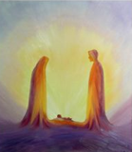
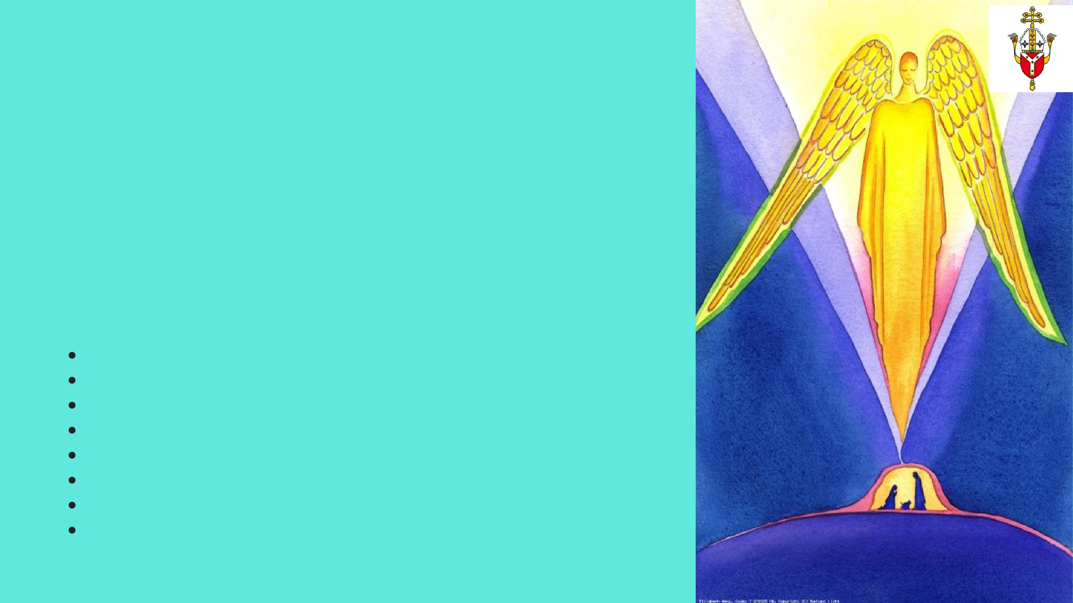
MATCH THE
MYSTERIES
Joyful
Sorrowful Luminous Glorious
The Institution of the Eucharist Agony in the Garden
The Visitation
The Resurrection
The Crucifixion
The Crowning of our Lady as Queen of Heaven
The Presentation
The Baptism of Our Lord
Notes:
This activity could be done as a whole group/small group etc
The answers are shared in a slide at the end of the session but are not in the Q and A document. They can also be found on the Busted Halo video which is included (it will need to be stopped at the relevant points) and are very easily accessible.
The Luminous Mysteries are also know as the Mysteries of Light.

Slide 16
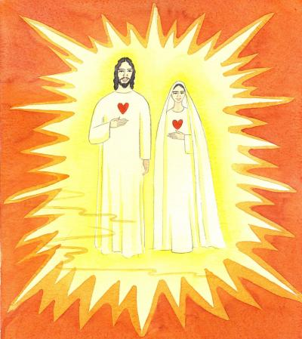
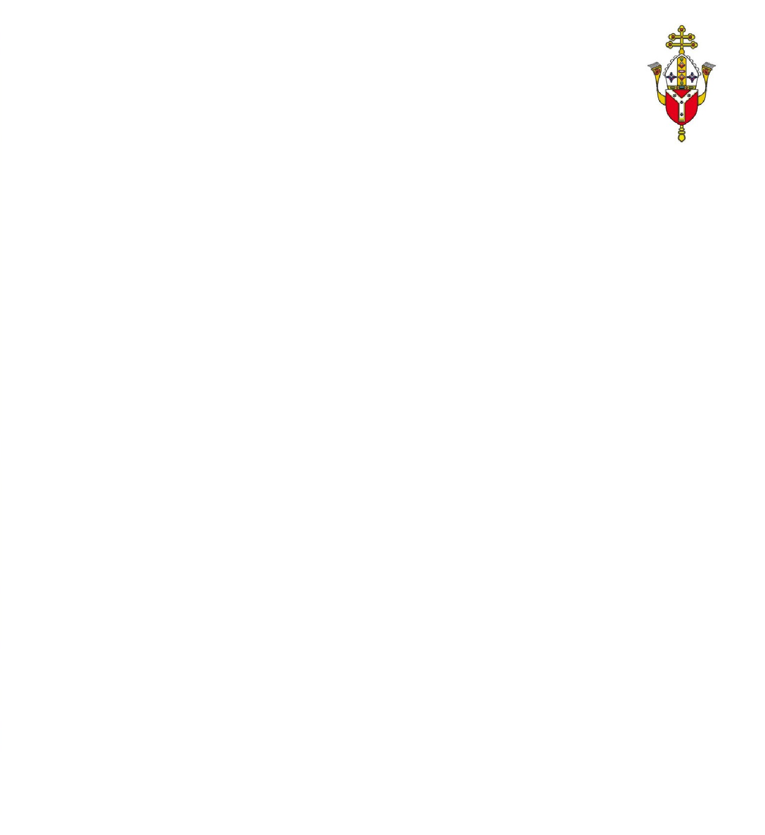
WHAT IS THE ASSUMPTION?
Mary was assumed – taken up into heaven whereas Jesus ‘ascended’ by his own power
Queen of Heaven
Mary "having completed the course of her earthly life, was assumed body and soul into heavenly glory". (Pope Pius XII).
It is not made clear whether she 'fell asleep' or 'died' before she was taken up but it is believed that her body was not left on earth to decay and that she did not die with original sin.
Notes:
See ‘Catholicism Unpacked: Mary’ p8
PLEASE CLICK ON THE IMAGE FOR THE LINK. Sound is required

Slide 18
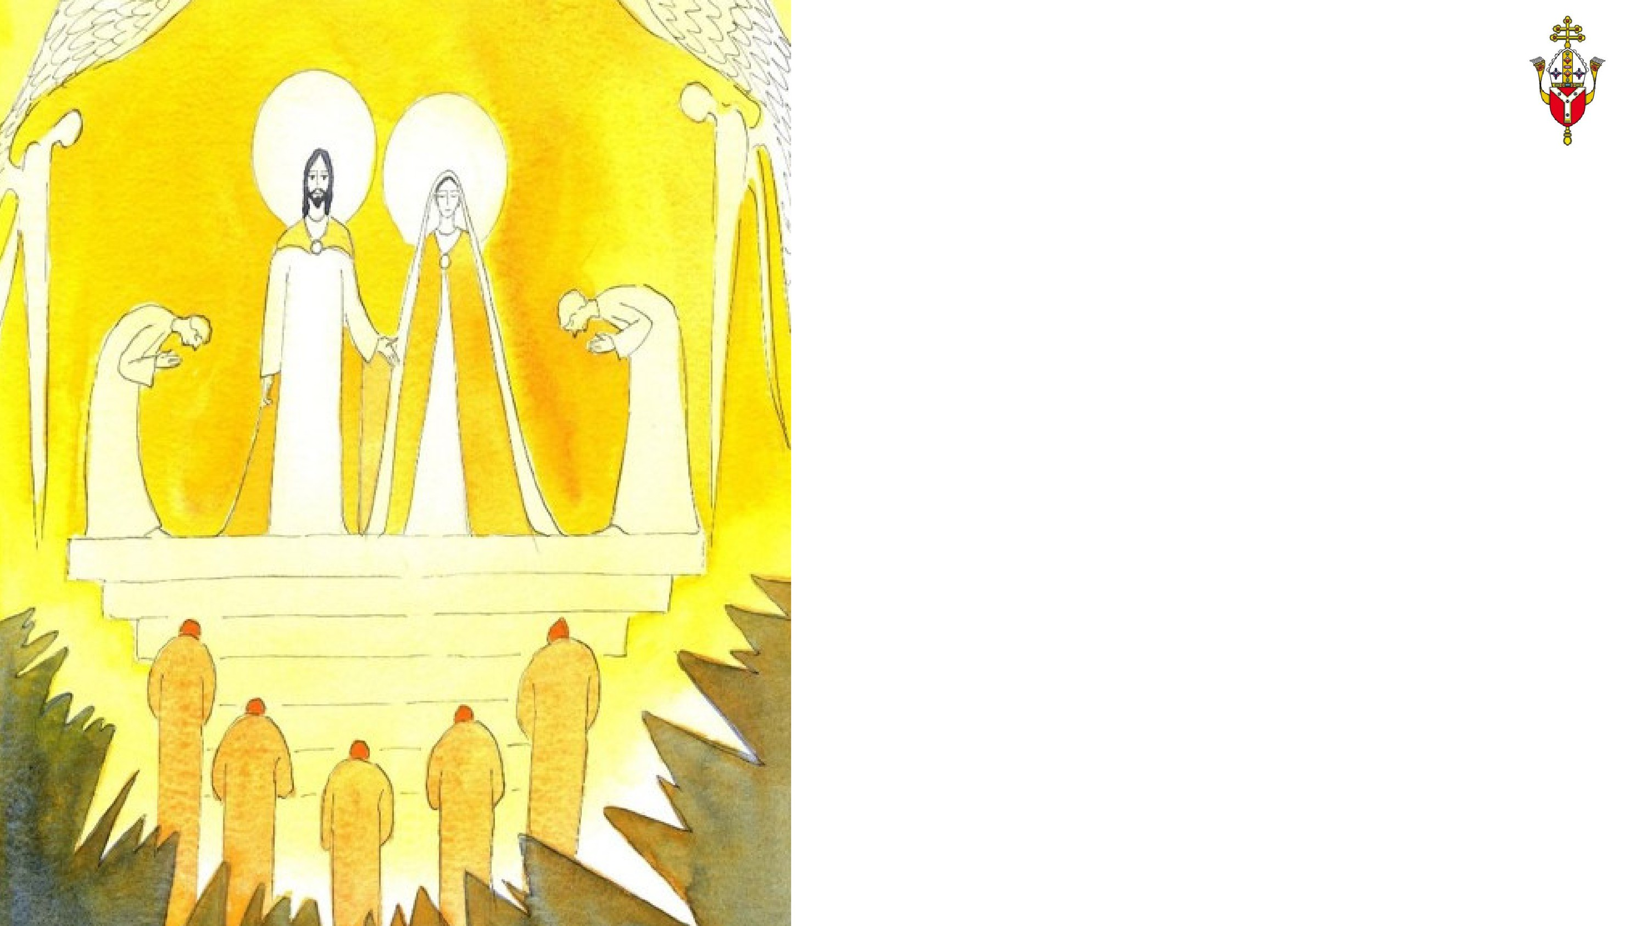
DO CATHOLICS
WORSHIP MARY?
Only God is worthy of worship
No Mary, no Jesus!
Catholics do not, under any circumstances, worship Mary.
"For no creature could ever be counted as equal with the Incarnate Word and Redeemer" (Lumen Gentium, No 62)
The Second Council of Nicea in 787 made a clear distinction between the worship due to God alone and the veneration that can be given to Mary, the angels and the saints.
Because Mary is 'Queen of the Saints' and 'Queen of the Angels‘ and 'Mother of God', she can be accorded high veneration but can never receive the worship due to God alone.
REFLECT/DISCUSS:
What is your experience of veneration to Our Lady in your school/parish environment? How might this
influence you/others positively?
Notes:
See ‘Catholicism Unpacked: Mary’ p9
At the bottom of this slide (and others) is an idea for reflection - this may be for quiet personal reflection or to share and discuss with others.
For the ONE training session, these reflections do not need to be used due to time, although the leader could select one/two if appropriate.

Slide 19
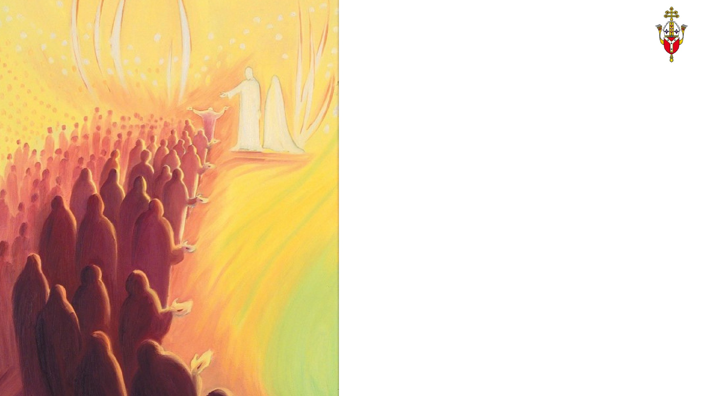
DO CATHOLICS PRAY TO MARY?
The ‘close and indissoluble tie’ that unites Mary to Jesus.
'The safest, easiest, shortest and most perfect way of approaching Jesus.’
Mary prays or intercedes for us as she has always been close to Jesus on earth and can help to lead us to Him now.
She can make requests to Him as she did at the wedding feast of Cana.
The most popular prayer is the Hail Mary which is based on Scripture (Luke 1:28 and Luke 1:43)
The Rosary includes many Hail Marys and Our Lady has appeared to various people holding a Rosary and asked that we continue this prayer. It is based on the life of Jesus.
The Magnificat is taken from Luke's Gospel and is Mary's hymn of praise to the Lord.
There are many other prayers dedicated to Mary included Hail Holy Queen, the Angelus and the Memorare.
Notes:
See ‘Catholicism Unpacked: Mary’ p10-13
PLEASE CLICK ON THE IMAGE FOR THE LINK. Sound is required
There is also link in the third section (Slide to Loyola Press materials which has many of the prayers listed here as well as many others. There are also support materials included.

Slide 20
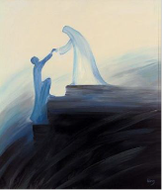
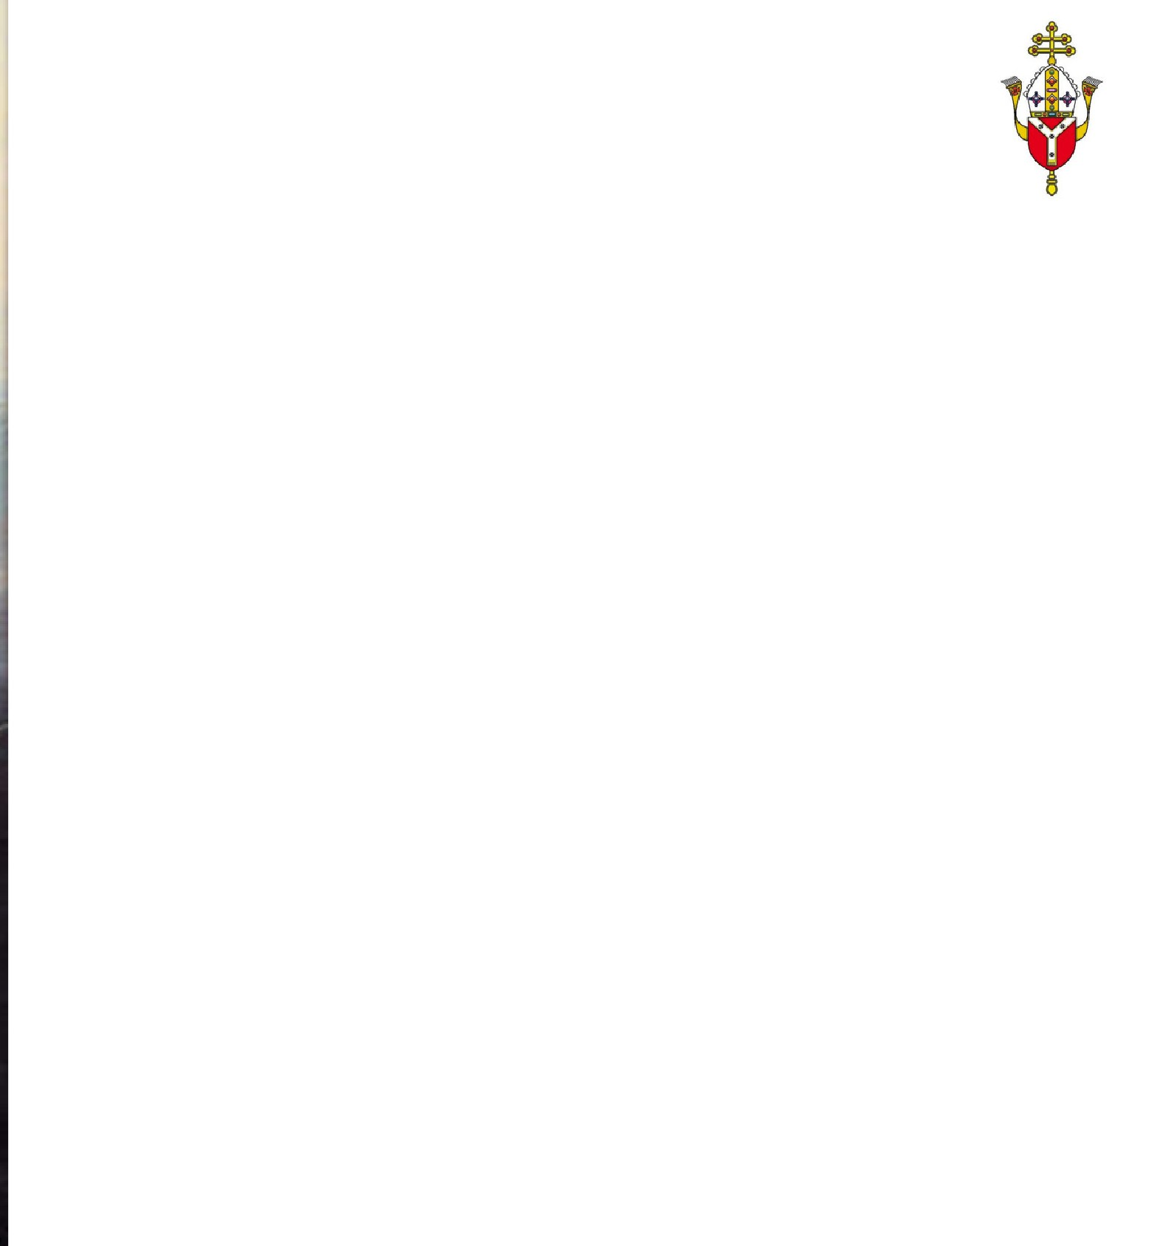
WHAT ARE MARIAN APPARITIONS?
Revelations and Messages
Prophecies and calls to prayer and conversion
"Throughout the ages, there have been so-called 'private' revelations, some of which have been recognised by the authority of the Church. They do not belong, however, to the deposit of faith. It is not their role to improve or complete Christ's definitive Revelation, but to help live more fully by it in a certain period of history." (CCC 67)
These include among many others:
Our Lady of Fatima
Our Lady of Guadalupe
Our Lady of Lourdes
All apparitions are investigated and some are confirmed by the Holy See. Ultimately it is up to Catholics how much thought they give to these apparitions and messages. Some find that they are a nudge towards conversion, repentance and prayer while others do not and may have a vibrant faith life all the same.
REFLECT/DISCUSS:
How might the knowledge of revelations and messages affect the lives of believers, including those in your school environment?
Notes:
See ‘Catholicism Unpacked: Mary’ p14-15
At the bottom of this slide (and others) is an idea for reflection - this may be for quiet personal reflection or to share and discuss with others.
For the ONE training session, these reflections do not need to be used due to time, although the leader could select one/two if appropriate.

