Slide 1
Blessed be the gentle For primary schools
Click here to play instrumental music
Notes:
Find a suitable place to pray where you can avoid distractions.
You may be alone or with others in your family. If you are with adults, you may wish to use a candle. If not, close your eyes and imagine one.
Ask Jesus, the light of the world, to come into your heart as you pray.
You may wish to simply listen to this music or watch the images at the same time, reflecting on God’s beautiful world as you relax.
Breathe in and out 3 times quietly.
Parents: you can alternate between the PowerPoint presentation and the YouTube clips using 'Alt/Tab to make it easier for your children.

Slide 2
GATHER
Father,
Thank you for your word.
Help us to listen
And show your love.
Amen
Notes:
Make the sign of the cross and say the prayer. You may also wish to pray for your own intentions.
We will be hearing the Word of God. If you would like to use your own Bible, have it ready (Matthew 5:5)

Slide 3
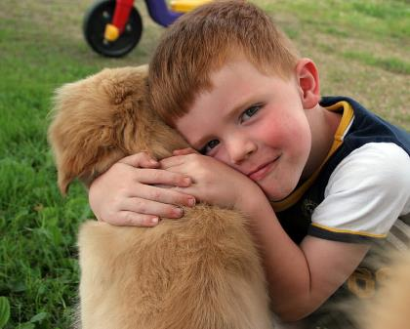
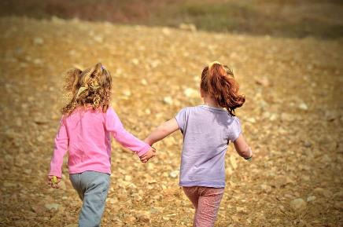
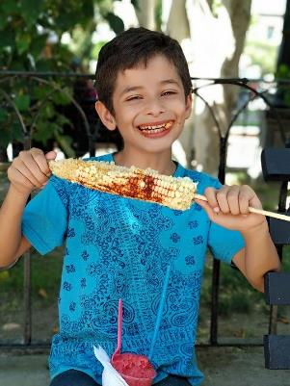
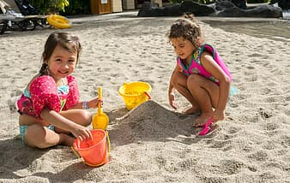
What is happiness? What makes you happy?
Notes:
Think about what makes you happy. Is it:
Being alone or with others?
Being with your pet?
Being somewhere special like the beach or a play park?
Having food?
Being creative?
Listening to music?
Being at school?
Something else?
What makes other people in your family happy?
Who do you think will get to heaven?

Slide 4
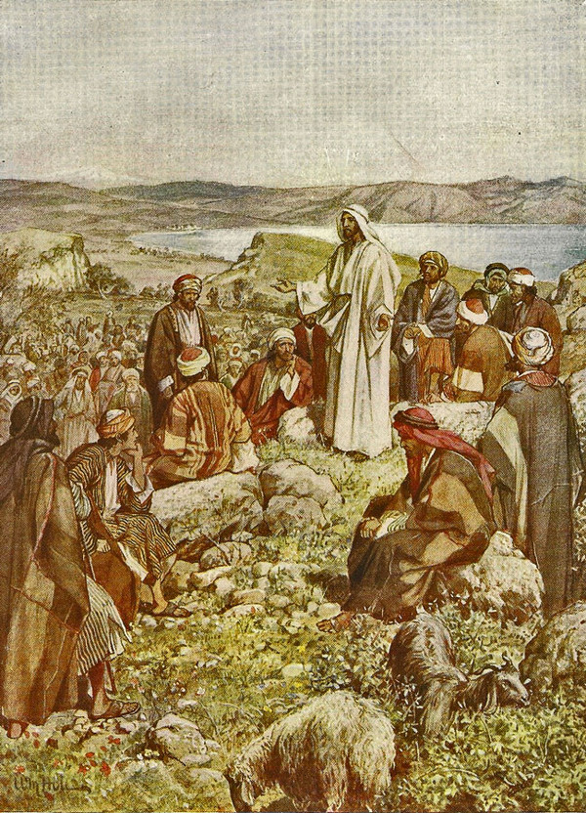
LISTEN
Jesus knew what brings real happiness so he taught us how to be truly happy or ‘blessed’.
He did this by giving a special talk to lots of people on a mountain.
It is called ‘The Sermon on the Mount’.
He taught us about 8 attitudes which are called the Beatitudes.
Click here to watch the Sermon on the Mount
Notes:
For younger pupils: You may wish to explain that many people would come to listen to Jesus who would tell them all about God, in the same way that a priest does at Mass.
Look at the picture. What can you see? Families would have gone to see Jesus and there would have been animals there too as it was on a mountain.
Listen carefully to what Jesus said. Can you remember who he said was ‘blessed’? Was it those who were rich? Or had trendy clothes? Or were popular?
For older pupils: https://www.youtube.com/watch?v=wxWCspyE7lg (alternative)

Slide 5
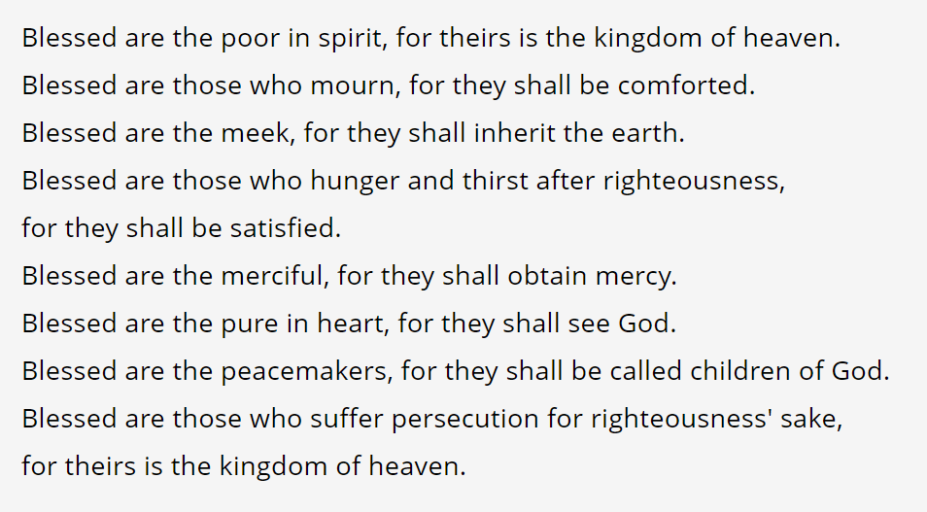
This is what Jesus said (Matthew 5)
Notes:
For younger pupils you could translate:
Happy are the poor…
Happy are those who are sad
Happy are the gentle
Happy are those who do what is right
Happy are those who forgive
Happy are those who have a loving heart
Happy are the peaceful
Happy are those who suffer for doing God’s will…
The Kingdom of Heaven is theirs.
For older pupils:
Which attitude do you show?
Which one might you want most?
You may wish to use a Bible, if not the words are included on the screen.

Slide 6
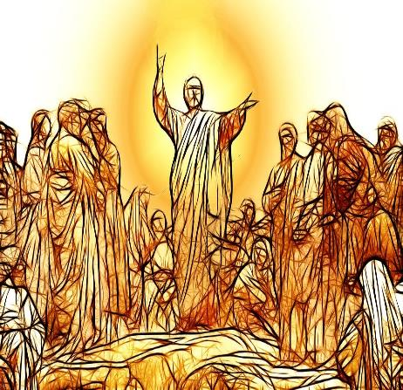
Can you remember who Jesus said was ‘blessed’?
Was it those who were rich? Or had designer clothes?
Or were popular?
What was Jesus trying to teach his followers then and now?
Notes:
Older pupils could watch -
https://www.youtube.com/watch?v=wxWCspyE7lg

Slide 7
LISTEN: Be gentle
The third beatitude tells us:
‘Blessed are the meek for they shall inherit the earth.’
Click here to find out about being gentle
Notes:
What does it mean to be gentle?
Think about times when you were gentle such as:
- When looking after your pets/animals
- Holding a new baby/younger child
- Holding in your anger
For younger pupils: you may wish to discuss this with them instead of watching the video as this may be too long.

Slide 8
What does it mean to be ‘meek’?
Meek also means to be:
Gentle
Humble
Lowly
Mild
We are going to use the term gentle.
It requires great inner strength and is not the same as being quiet or just letting others do whatever they want.
Notes:
Look at the other words – do you recognise any of them?
Older pupils:
‘Jesus was humbler yet, even to accepting death, death on a cross…’ Have you heard these words before?
‘Once in royal David’s city stood a lowly cattle shed’ – Who was born here? When?

Slide 9
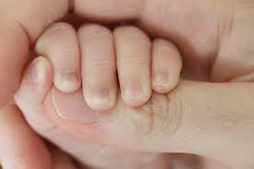
RESPOND : ‘Blessed are the gentle’
What does this mean for you?
How can you be gentle?
Notes:
Spend a minute talking to Jesus in your heart about these questions.

Slide 10
RESPOND : ‘Blessed are the gentle’
DO
Be gentle to others and yourself
Be gentle to the world and all creatures
Use your power carefully
Work hard and do your best
Notes:
Look at this list. Which ones do you do?
Spend a minute talking to Jesus in your heart about them.

Slide 11
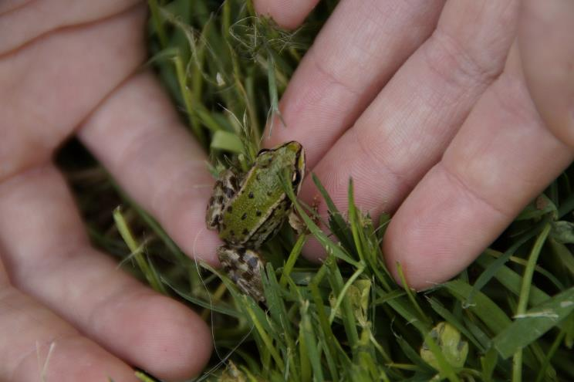
RESPOND: ‘Blessed are the gentle’
TRY NOT TO:
Be the loudest or the proudest
Show off or brag
Be a bully
Take your anger out on others
Harm other people, the earth or God’s creatures
Notes:
Now look at this list. Can you think of times when you have not been gentle?
Speak to Jesus again and ask for his help not to do it again. Think about what you could do instead.

Slide 12
RESPOND - Prayer
God our Father,
I am sorry for the times when I have not had a meek attitude and hurt others.
Help me to live like Jesus and be gentle in my words and actions.
Send your Holy Spirit to guide me so that I can use my power and my gifts carefully and humbly.
This I ask in Jesus’ name. Amen
Notes:
Say this prayer – or make up your own prayer – about following Jesus’ teaching and being gentle.
In the name of the Father and of the Son and of the Holy Spirit. Amen.

Slide 13
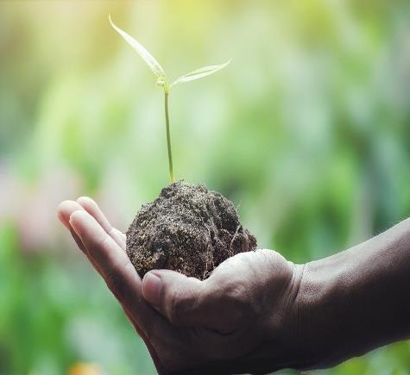
MISSION
Choose:
Write and decorate the words Jesus said about being gentle and learn them.
Find out about gentle saints. Say a prayer of/to your favourite one.
Research what Pope Francis said about being gentle and how we should treat others and the earth.
Find out what else the Bible tells us about gentleness.
Be gentle in your home today.
Notes:
For a poster to colour and decorate on meekness: https://ministry-to-children.com/beatitudes-lesson-four/
For other references to meekness in the Bible see: http://www.creativeyouthideas.com/resources/youth-sermons/blessed-are-the-meek/
For gentle saints and those linked to the environment see https://aleteia.org/2017/06/18/5-saints-to-inspire-us-to-take-care-of-our-planet/
For information about Laudato Si (Pope Francis’ letter) see:
https://cafod.org.uk/Education/Primary-teaching-resources/Laudato-Si-animation

Slide 14
be gentle
Click here to play instrumental music
Notes:
You may wish to continue playing the music while you complete your mission.

