Slide 1
Praying the Rosary with the Diocese of Westminster
Pentecost: Friday 1st May 2020

Slide 2
‘The Rosary is the prayer of the humble and of the saints. In its mysteries, they contemplate, along with Mary, the life of Jesus, the merciful face of the Father. O, how much we all need to be truly comforted, to be wrapped in loving presence!
Pope Francis (April 2020)

Slide 3
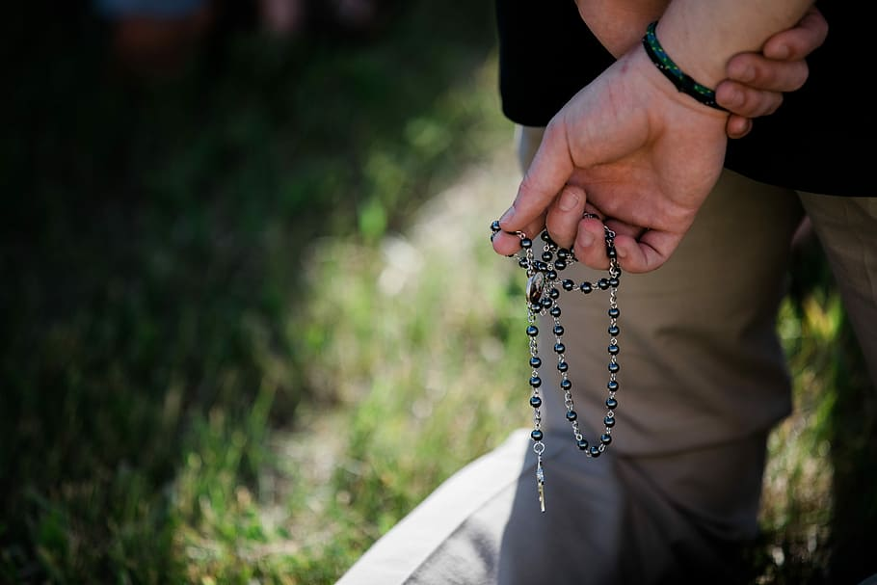
We offer this decade of the Rosary for all those affected by the coronavirus and we ask the help of Our Blessed Mother, Mary, to take our prayers to her beloved son, Jesus.
-

Slide 4
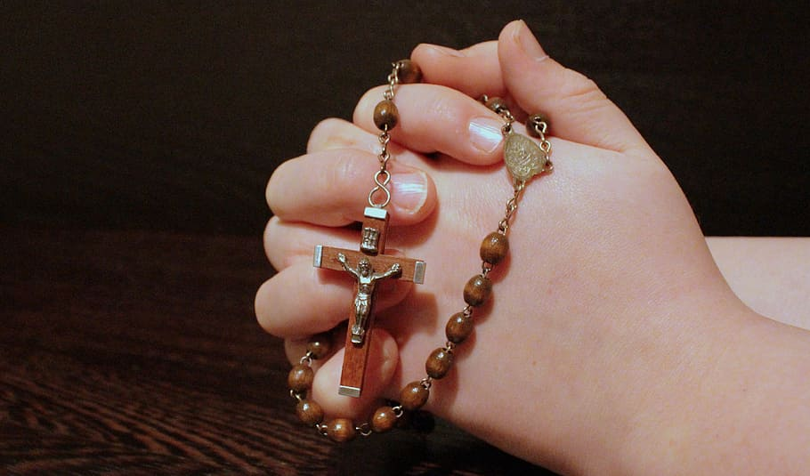
Our Father
Who art in heaven
Hallowed be thy name
Thy kingdom come
Thy will be done
On earth as it is in heaven
Give us this day our daily bread
And forgive us our trespasses
As we forgive those
who trespass against us
And lead us not into temptation
But deliver us from evil.
Amen.

Slide 5
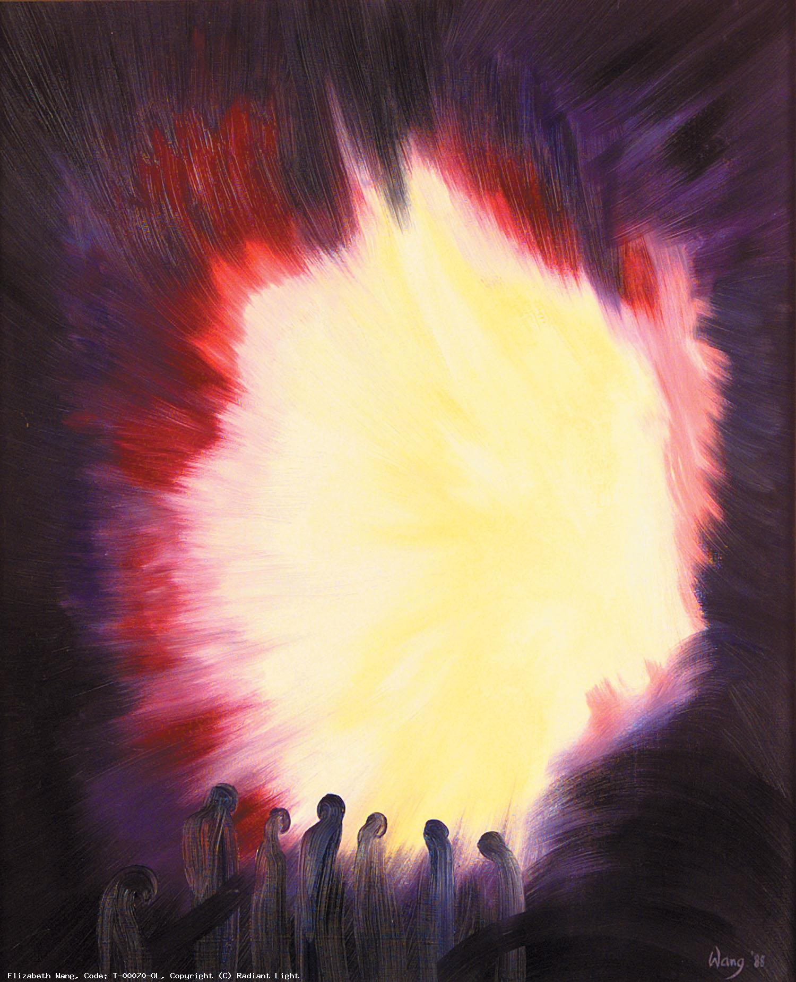
1. The apostles were gathered in the upper room where Jesus had held the Last Supper.
We pray for all those in our community who have been separated from loved ones.
Help us to come together and support those who are alone and isolated.

Slide 6
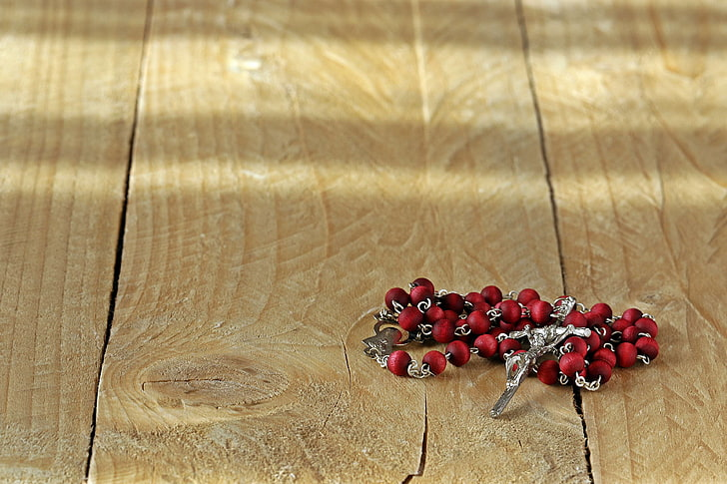
Hail Mary, Full of Grace
The Lord is with thee
Blessed art thou amongst women
And blessed is the fruit
of thy womb, Jesus,
Holy Mary, Mother of God,
Pray for us sinners
Now and at the hour
Of our death.
Amen.

Slide 7
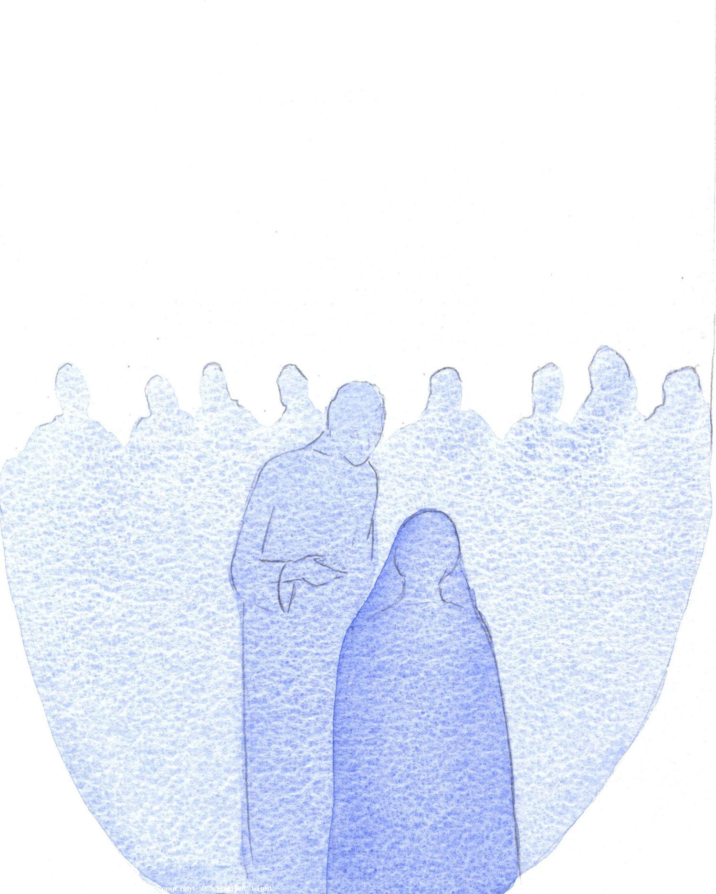
2. They were deep in prayer with Mary the Mother of Jesus.
We pray for all mothers during these challenging times. Bring them strength, patience and compassion as they seek to care for their families.

Slide 8
Hail Mary, Full of Grace
The Lord is with thee
Blessed art thou amongst women
And blessed is the fruit
of thy womb, Jesus,
Holy Mary, Mother of God,
Pray for us sinners
Now and at the hour
Of our death.
Amen.

Slide 9
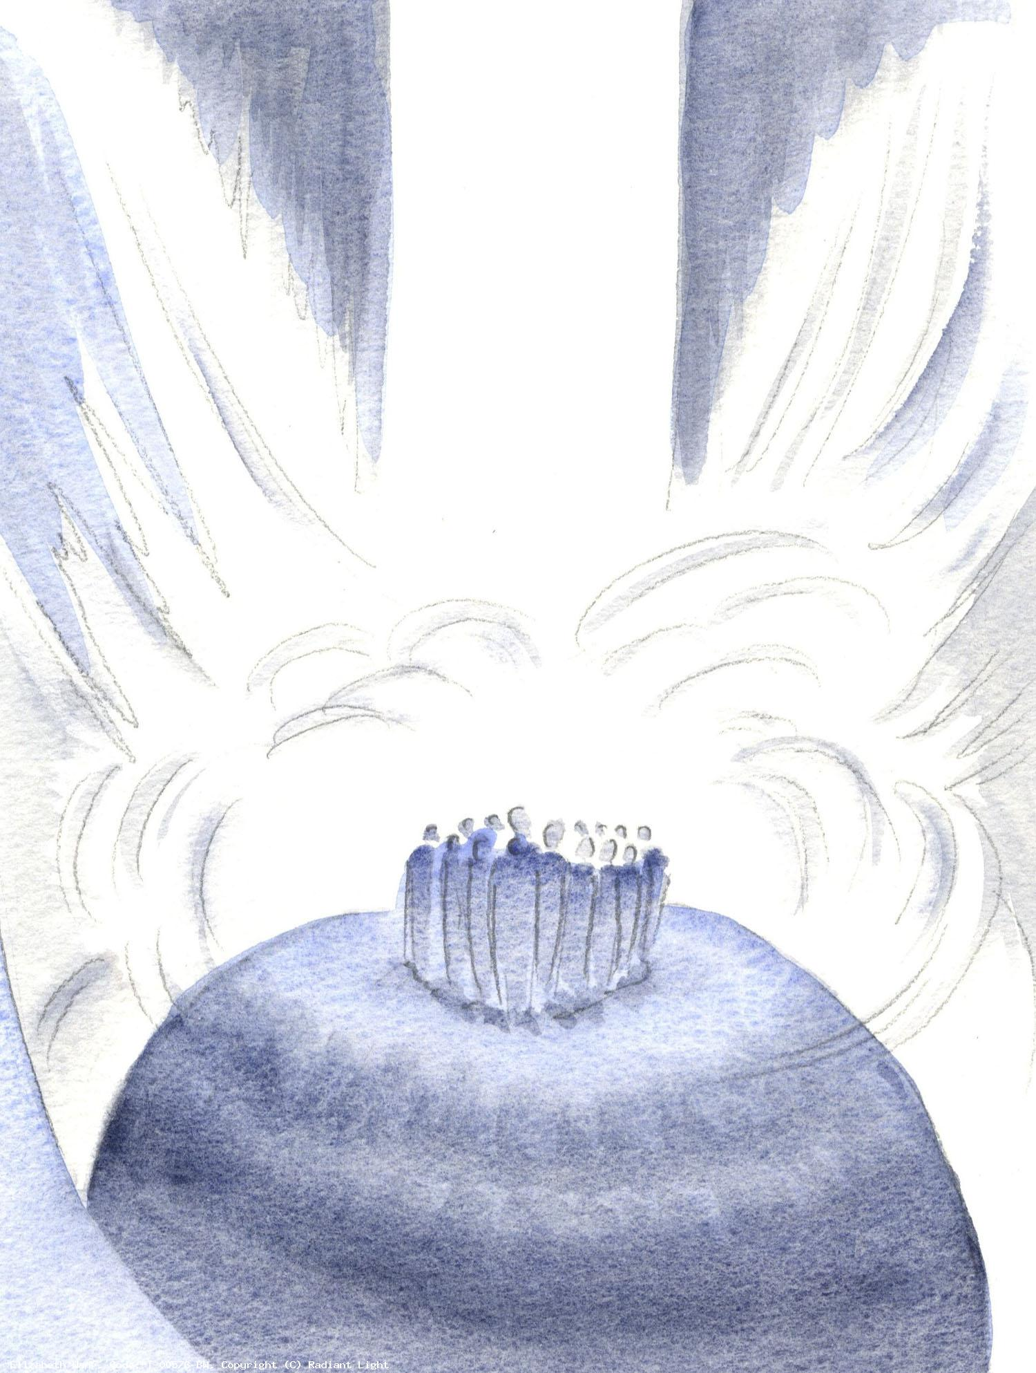
3. Then a sound came from heaven like the rush of a mighty wind, and it filled the whole house.
May the Holy Spirit fill all our homes, bringing courage and comfort to our families as they remain separated from others.

Slide 10
Hail Mary, Full of Grace
The Lord is with thee
Blessed art thou amongst women
And blessed is the fruit
of thy womb, Jesus,
Holy Mary, Mother of God,
Pray for us sinners
Now and at the hour
Of our death.
Amen.

Slide 11
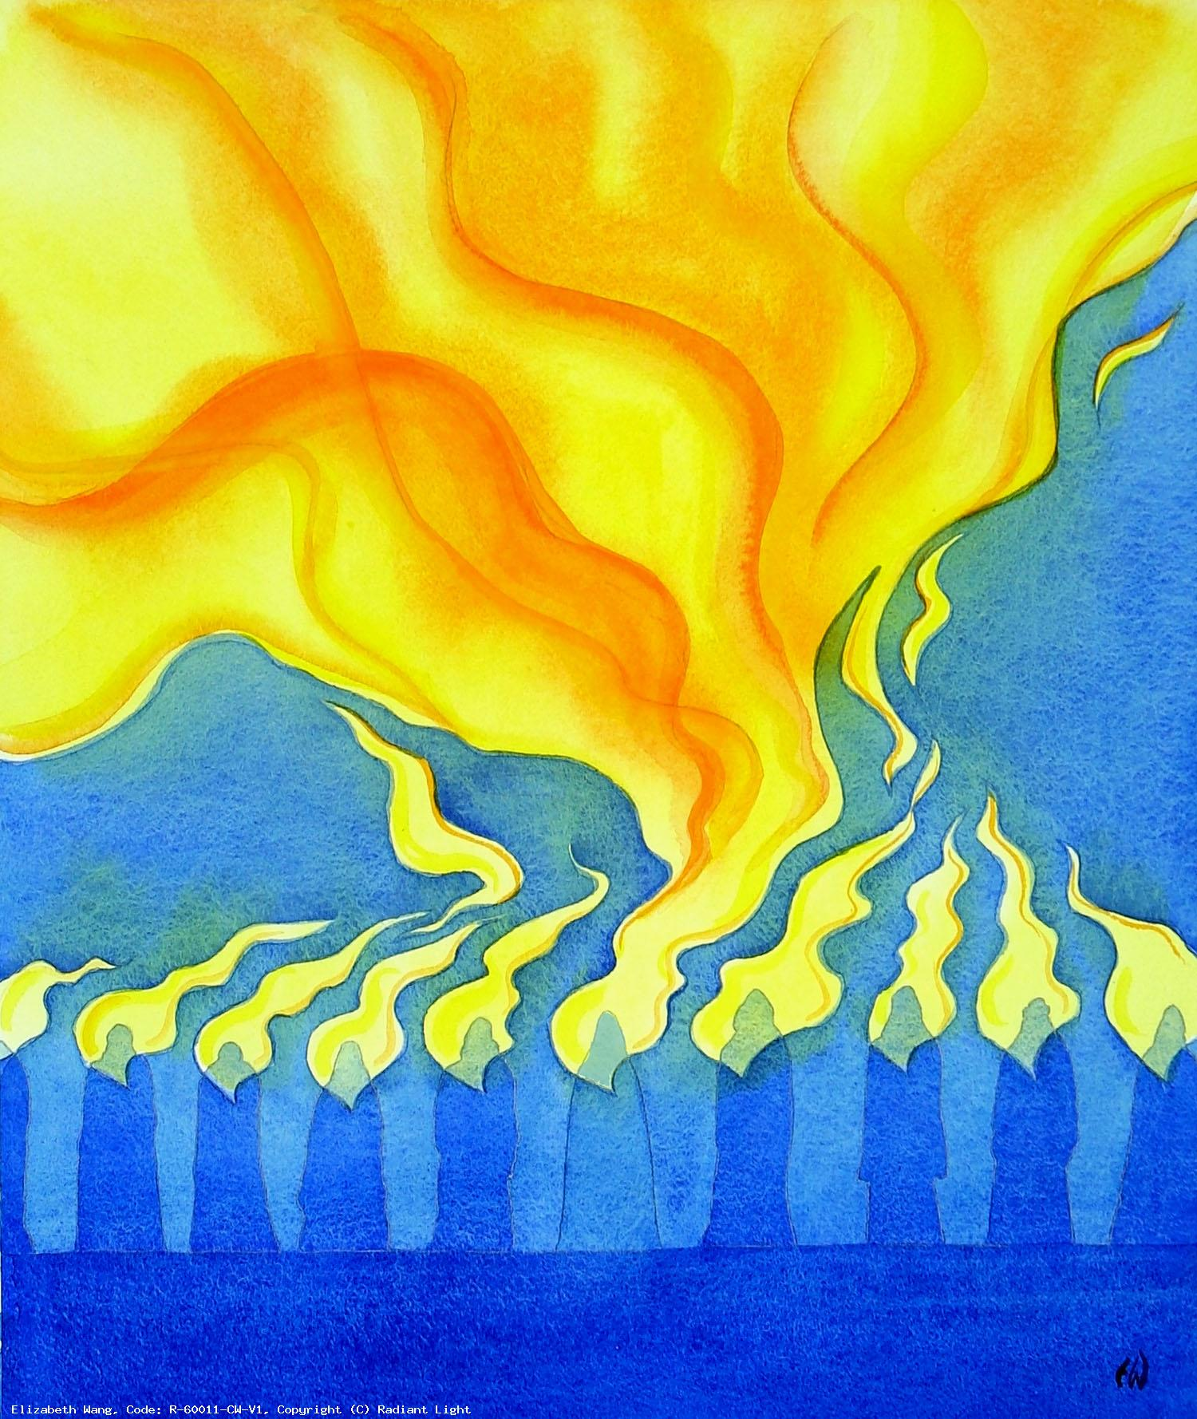
4. The Holy Spirit descended on each of them in the form of tongues of fire.
We pray that the gifts of the Holy Spirit will empower us with the virtues and skills to work through these difficult times, supporting each other and striving for a better future.

Slide 12
Hail Mary, Full of Grace
The Lord is with thee
Blessed art thou amongst women
And blessed is the fruit
of thy womb, Jesus,
Holy Mary, Mother of God,
Pray for us sinners
Now and at the hour
Of our death.
Amen.

Slide 13
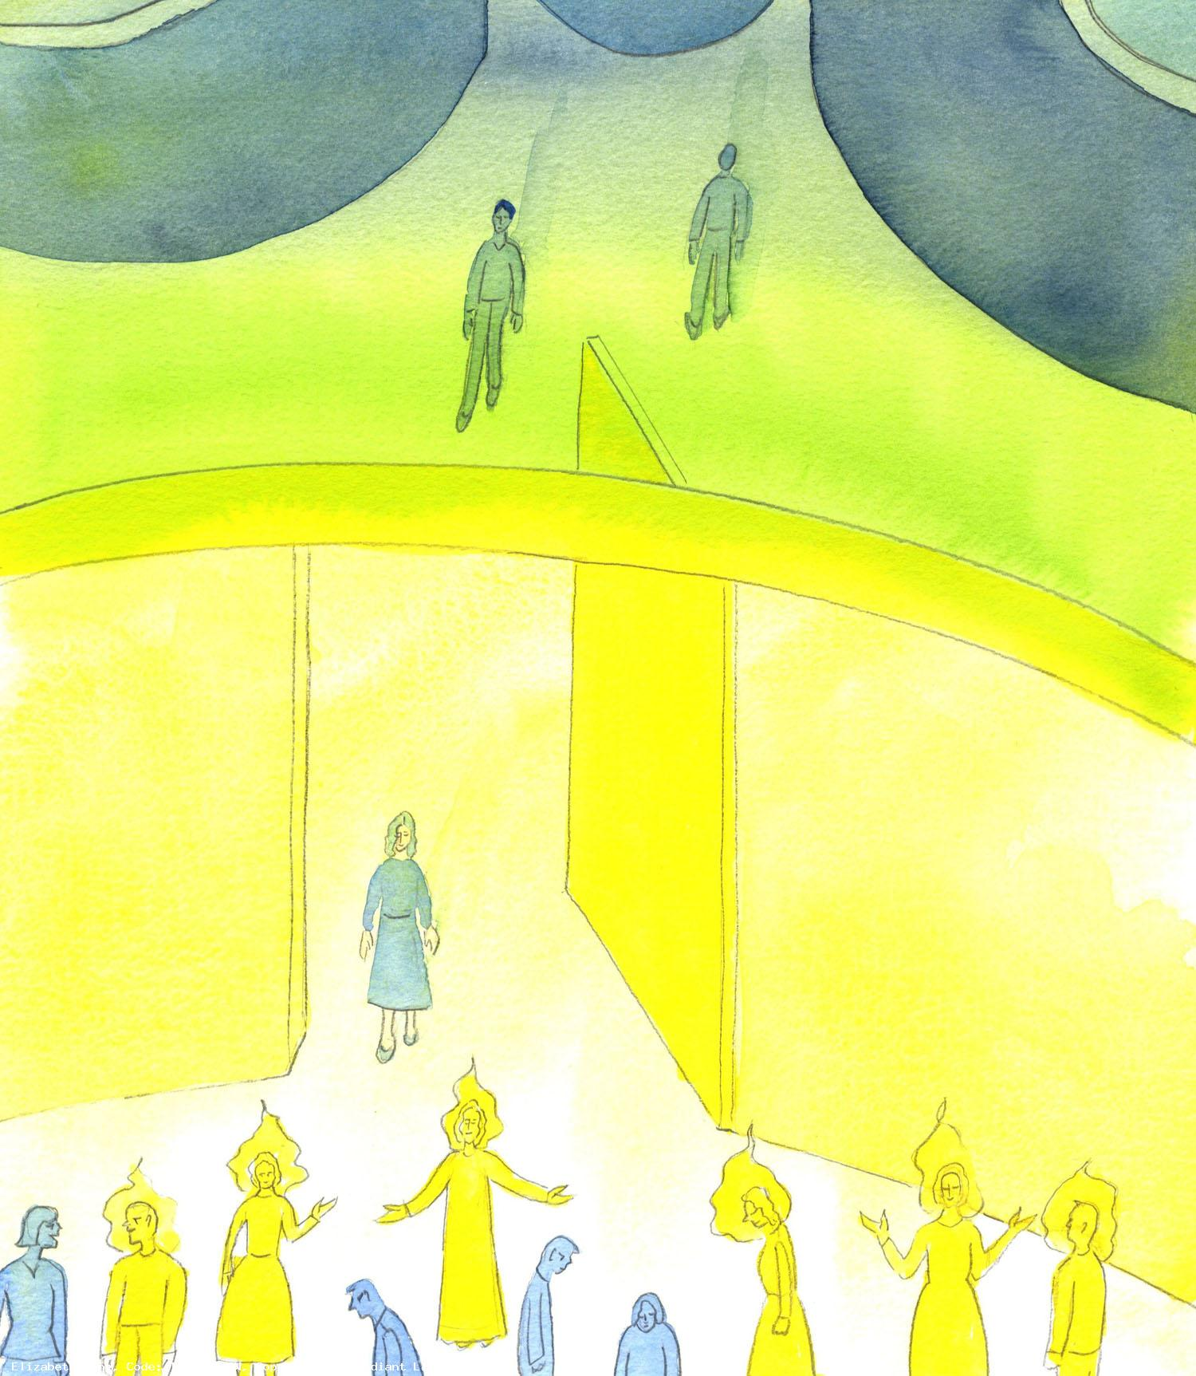
5. Filled with the Gifts of the Holy Spirit, they were enlightened and strengthened to spread the Gospel.
We pray for all those who work tirelessly to bring an end to this pandemic. God of wisdom, grant all those involved in the fight against the coronavirus knowledge and wisdom.

Slide 14
Hail Mary, Full of Grace
The Lord is with thee
Blessed art thou amongst women
And blessed is the fruit
of thy womb, Jesus,
Holy Mary, Mother of God,
Pray for us sinners
Now and at the hour
Of our death.
Amen.

Slide 15
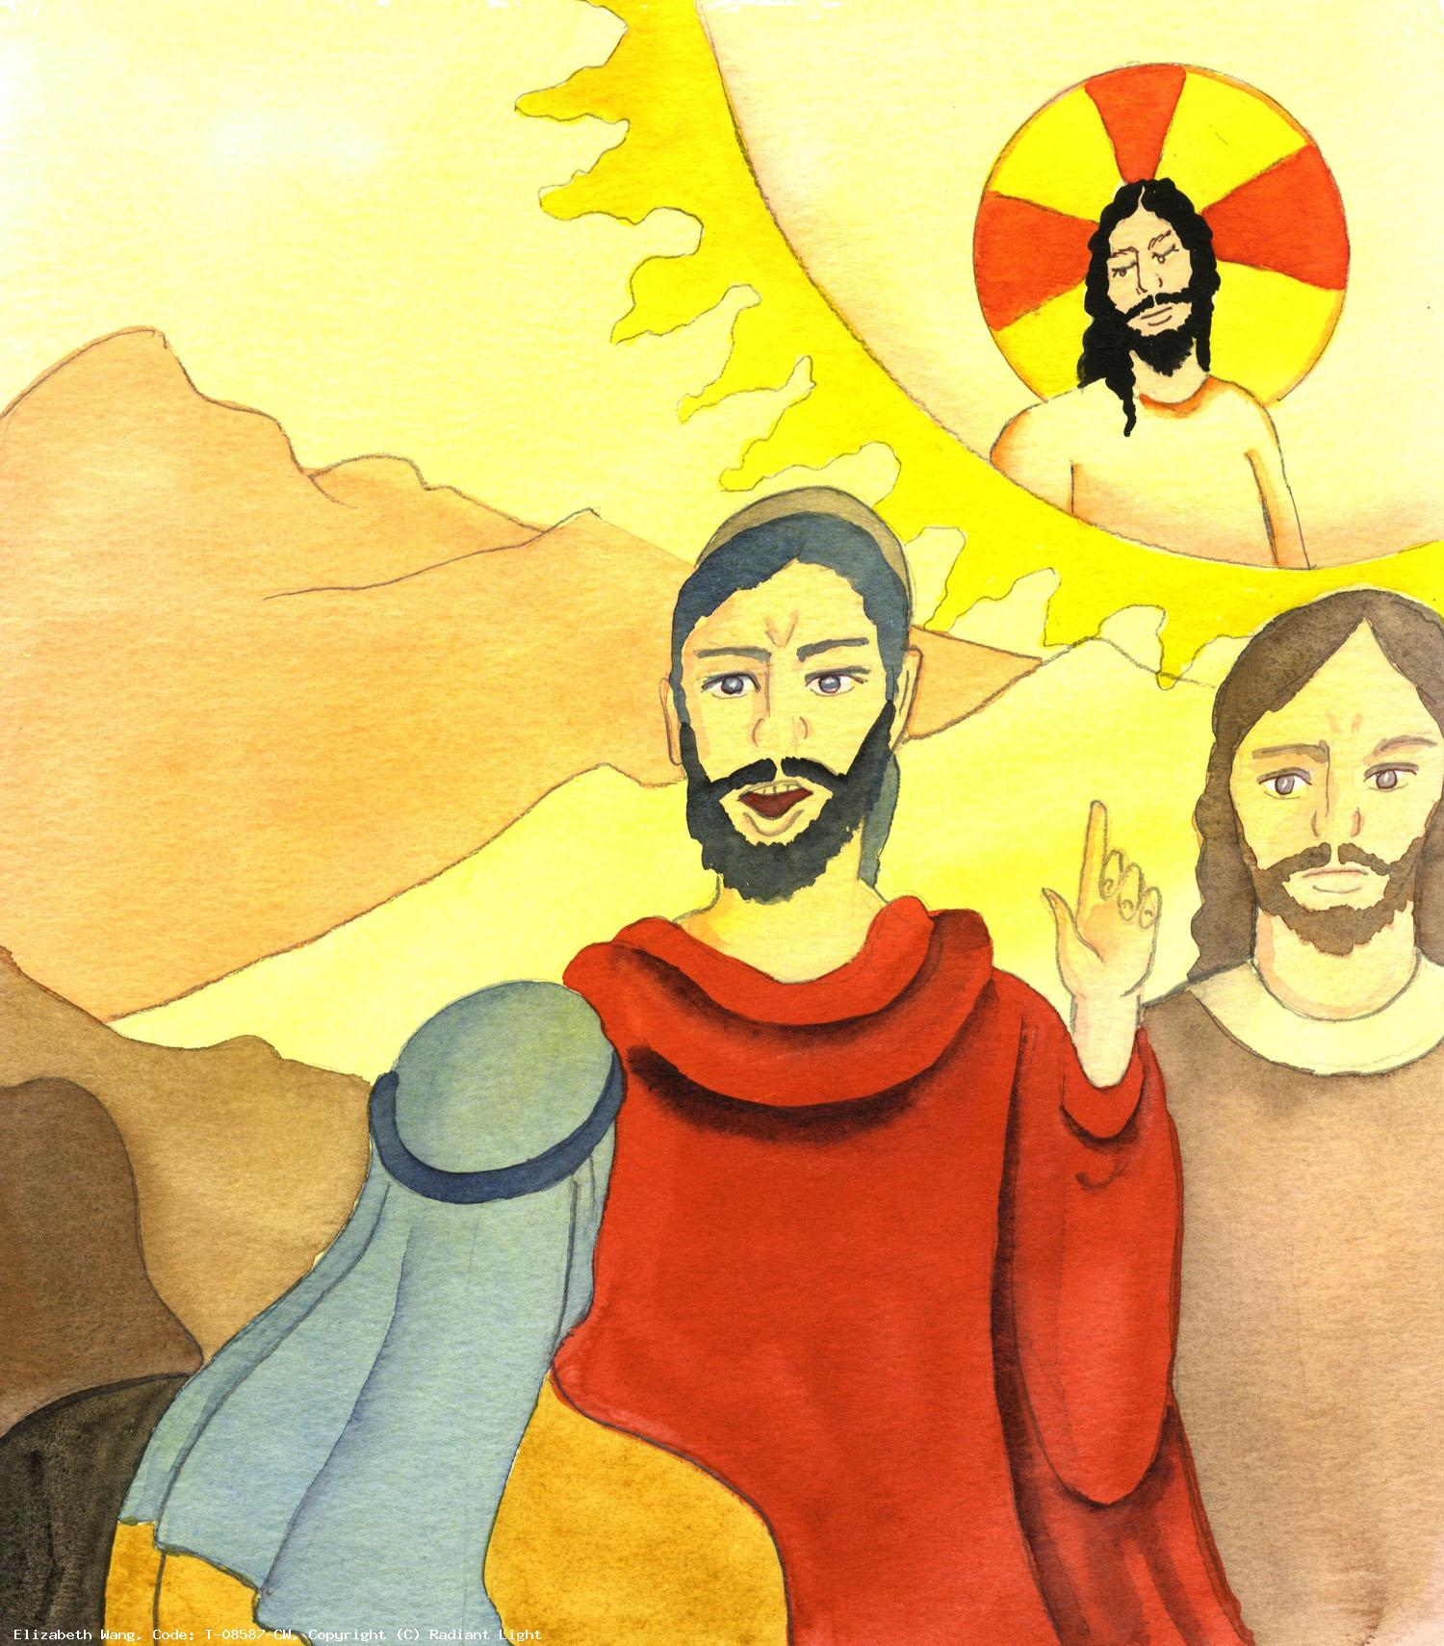
6. Having lost all fear of the Jewish leaders, the apostles boldly preached about Christ crucified.
We pray for all those who live in fear that they will receive the gift of courage in these times of uncertainty and anxiety.

Slide 16
Hail Mary, Full of Grace
The Lord is with thee
Blessed art thou amongst women
And blessed is the fruit
of thy womb, Jesus,
Holy Mary, Mother of God,
Pray for us sinners
Now and at the hour
Of our death.
Amen.

Slide 17
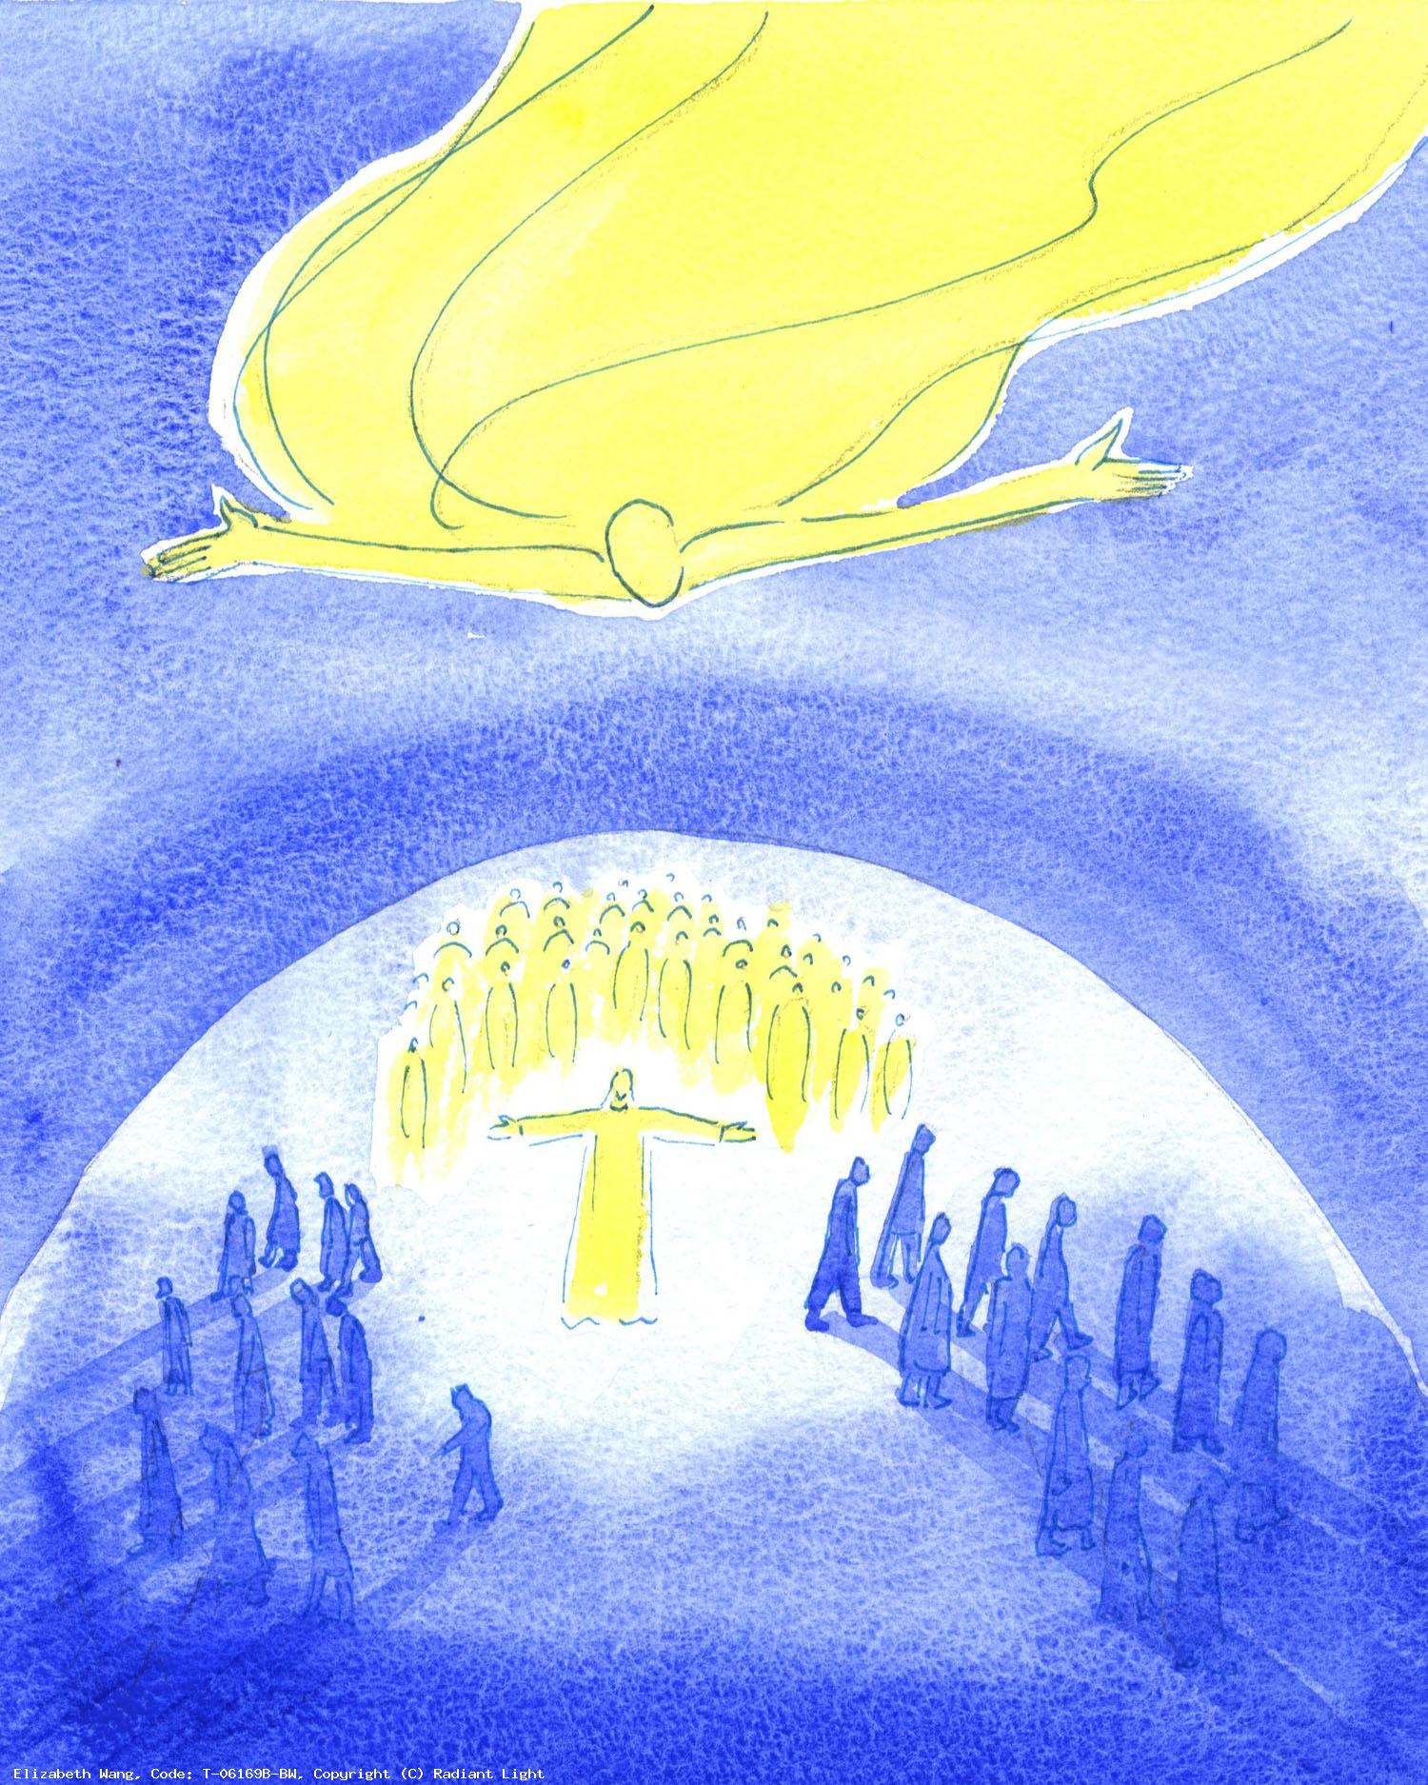
7. The multitudes were confounded because every man heard them speak in his or her own tongue.
We pray for all those who serve us with such love and generosity in the medical profession and in all our healthcare facilities. We ask you to bless them, strengthen them and guide them with your abundant goodness.

Slide 18
Hail Mary, Full of Grace
The Lord is with thee
Blessed art thou amongst women
And blessed is the fruit
of thy womb, Jesus,
Holy Mary, Mother of God,
Pray for us sinners
Now and at the hour
Of our death.
Amen.

Slide 19
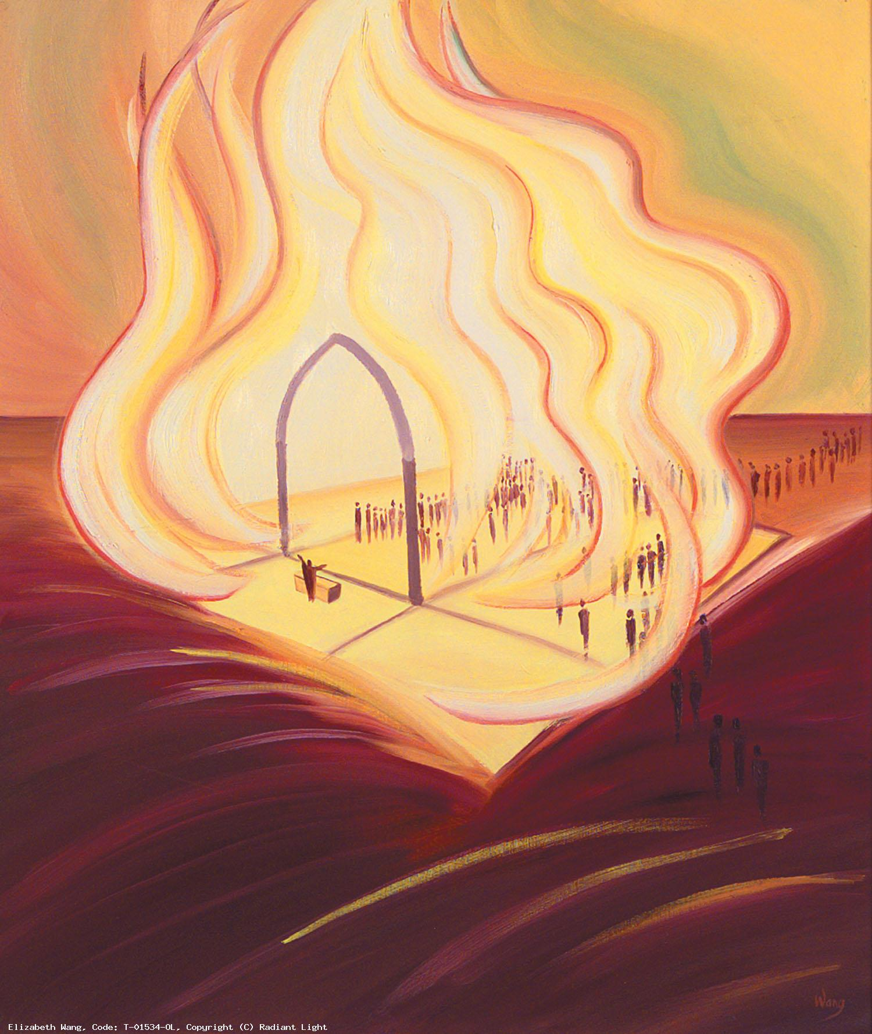
8. The Holy Spirit comes upon the Infant Church never to leave it.
We pray for all the clergy and religious within the Diocese of Westminster. Grant them strength, fortitude and comfort as they continue in their ministry to the faithful in this time of isolation.

Slide 20
Hail Mary, Full of Grace
The Lord is with thee
Blessed art thou amongst women
And blessed is the fruit
of thy womb, Jesus,
Holy Mary, Mother of God,
Pray for us sinners
Now and at the hour
Of our death.
Amen.

Slide 21
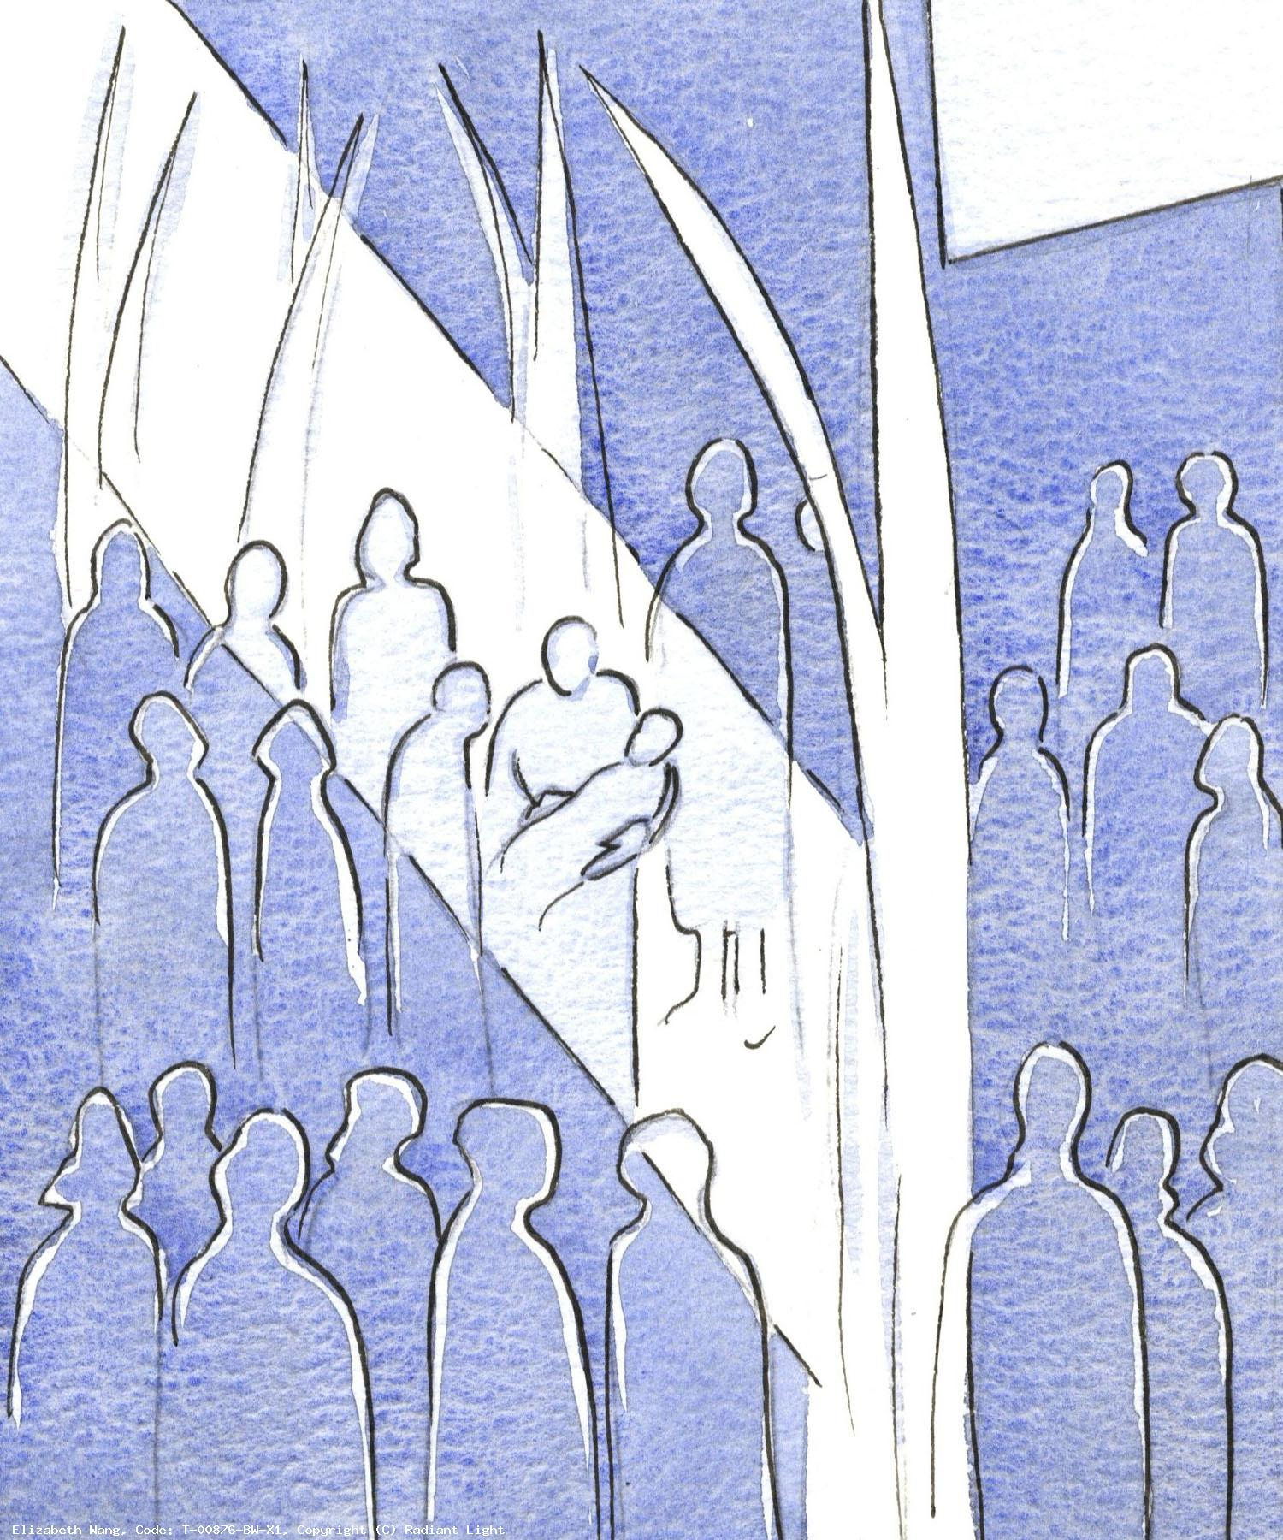
9. That first day Peter went forth to preach and baptize three thousand.
Healing God, bring healing and comfort to those who are sick or affected by the coronavirus. We pray especially for those isolated and separated from their families in hospitals or care homes.

Slide 22
Hail Mary, Full of Grace
The Lord is with thee
Blessed art thou amongst women
And blessed is the fruit
of thy womb, Jesus,
Holy Mary, Mother of God,
Pray for us sinners
Now and at the hour
Of our death.
Amen.

Slide 23
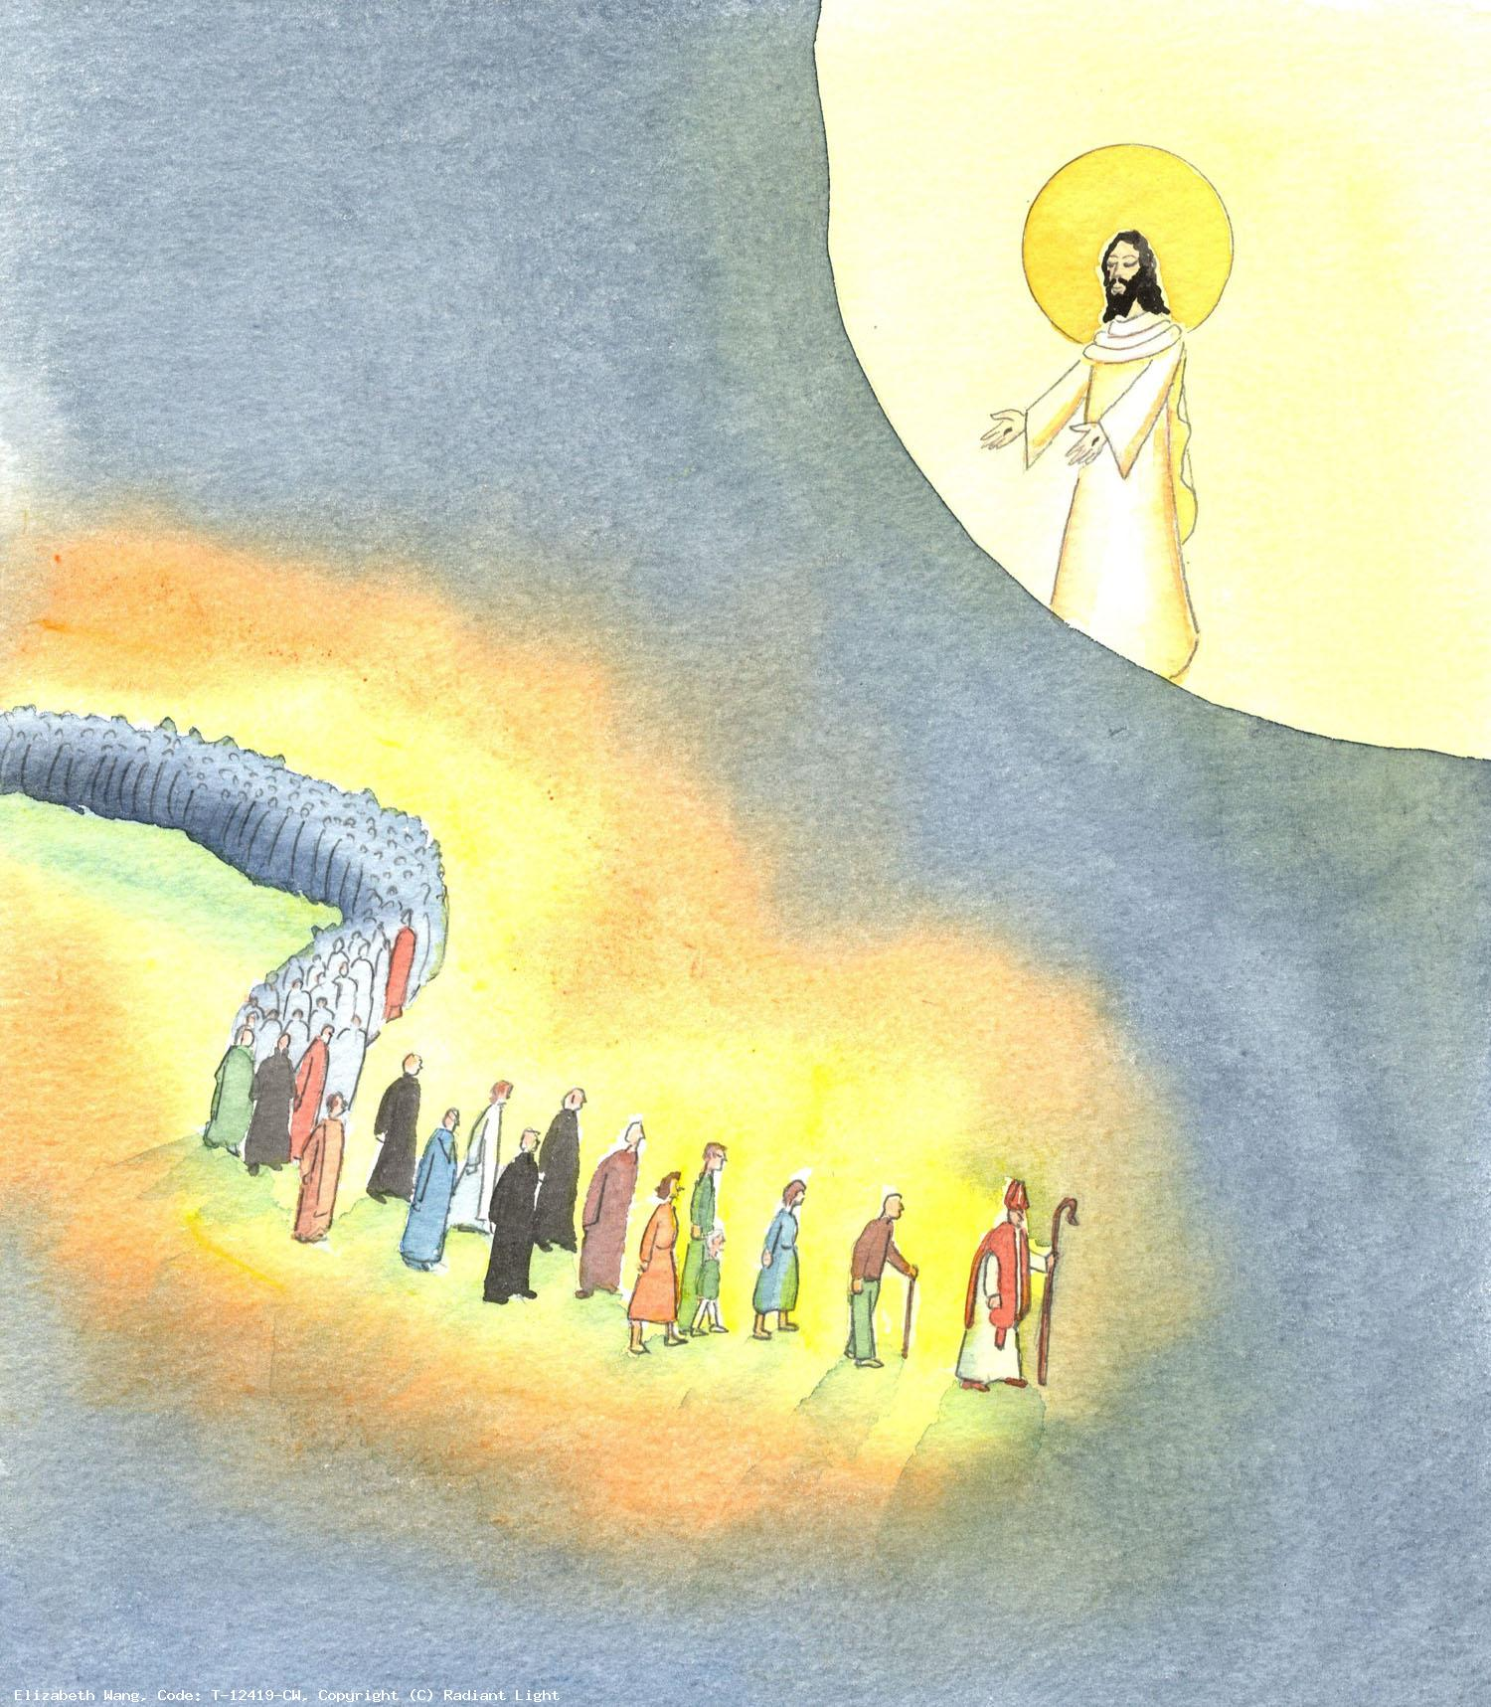
10. The feast of Pentecost is the birthday of the Church, from that day on it begins to grow.
God of Love, we the people of the Diocese of Westminster turn to you with prayerful hearts. We stand before you as a people of hope, trusting in your care and protection. May we be comforted by your love in these anxious times.

Slide 24
Hail Mary, Full of Grace
The Lord is with thee
Blessed art thou amongst women
And blessed is the fruit
of thy womb, Jesus,
Holy Mary, Mother of God,
Pray for us sinners
Now and at the hour
Of our death.
Amen.

Slide 25
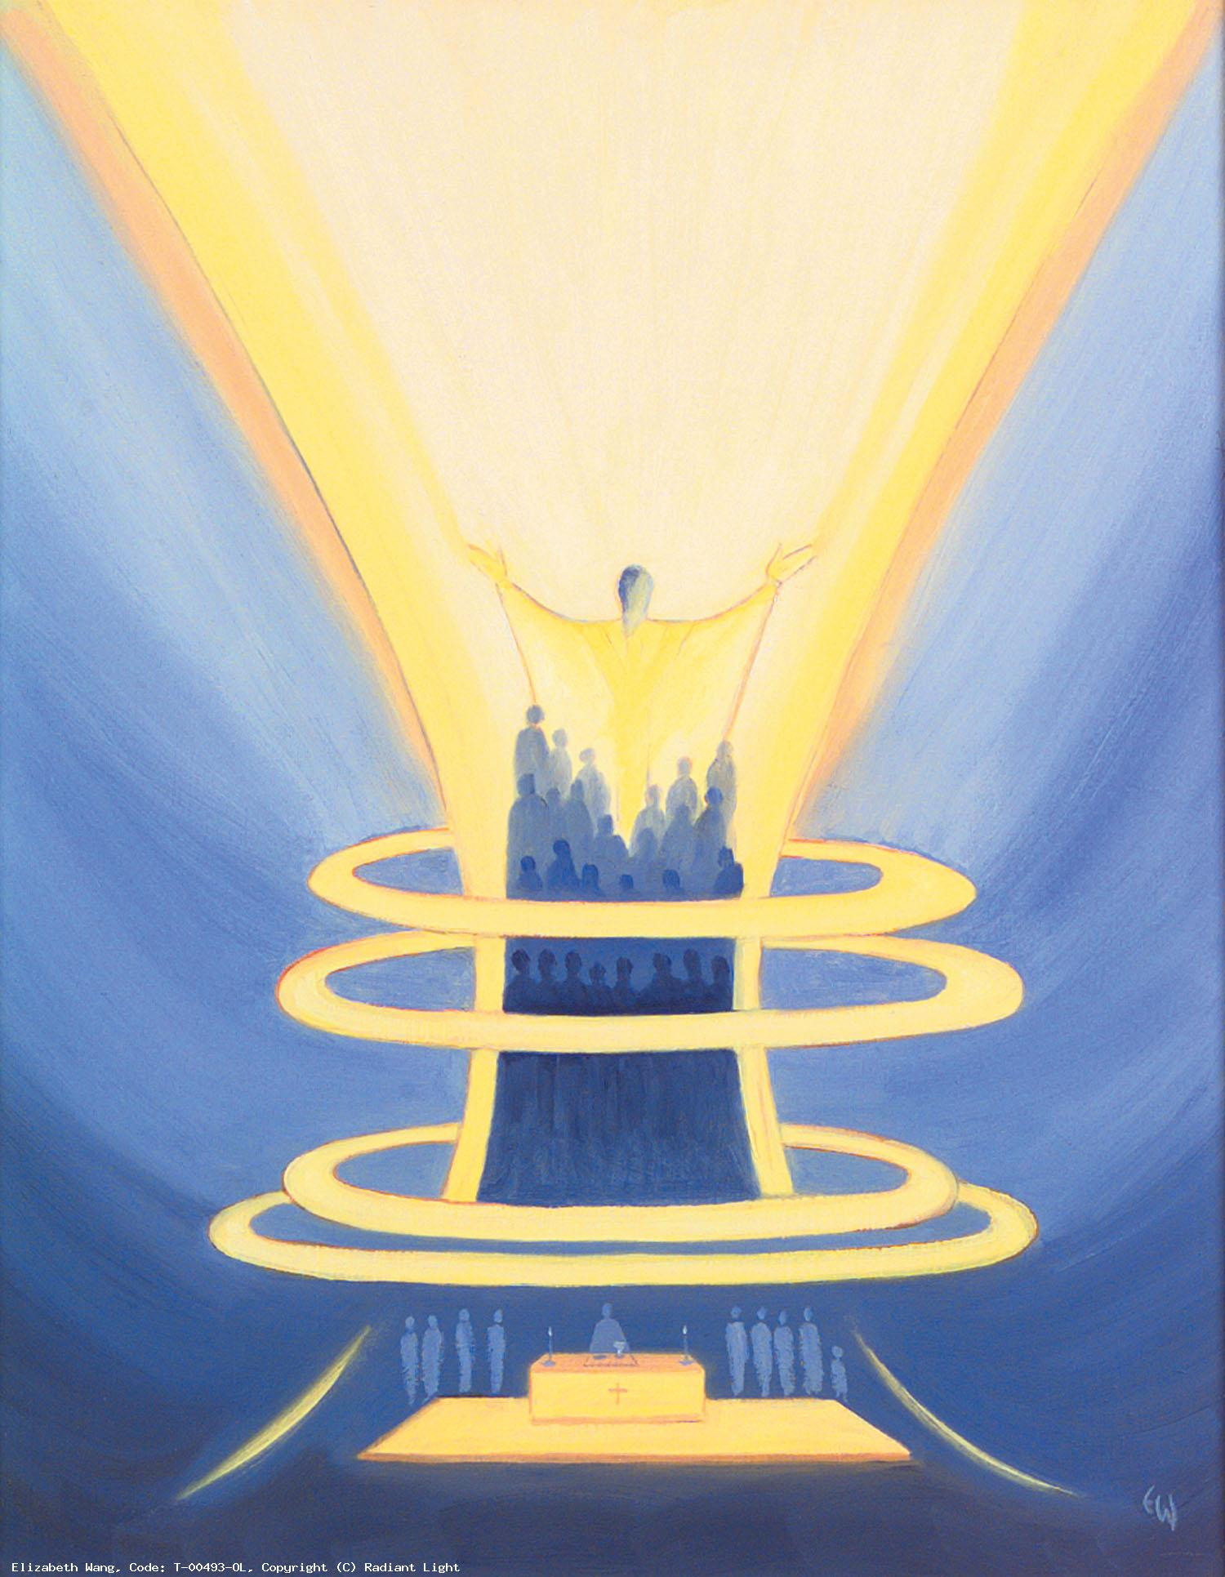
We trust that God who is all-knowing and compassionate will hear our prayers and send us his Holy Spirit so that we can offer ourselves completely to the will of God following the example of our Lord and Saviour, Jesus Christ.

Slide 26
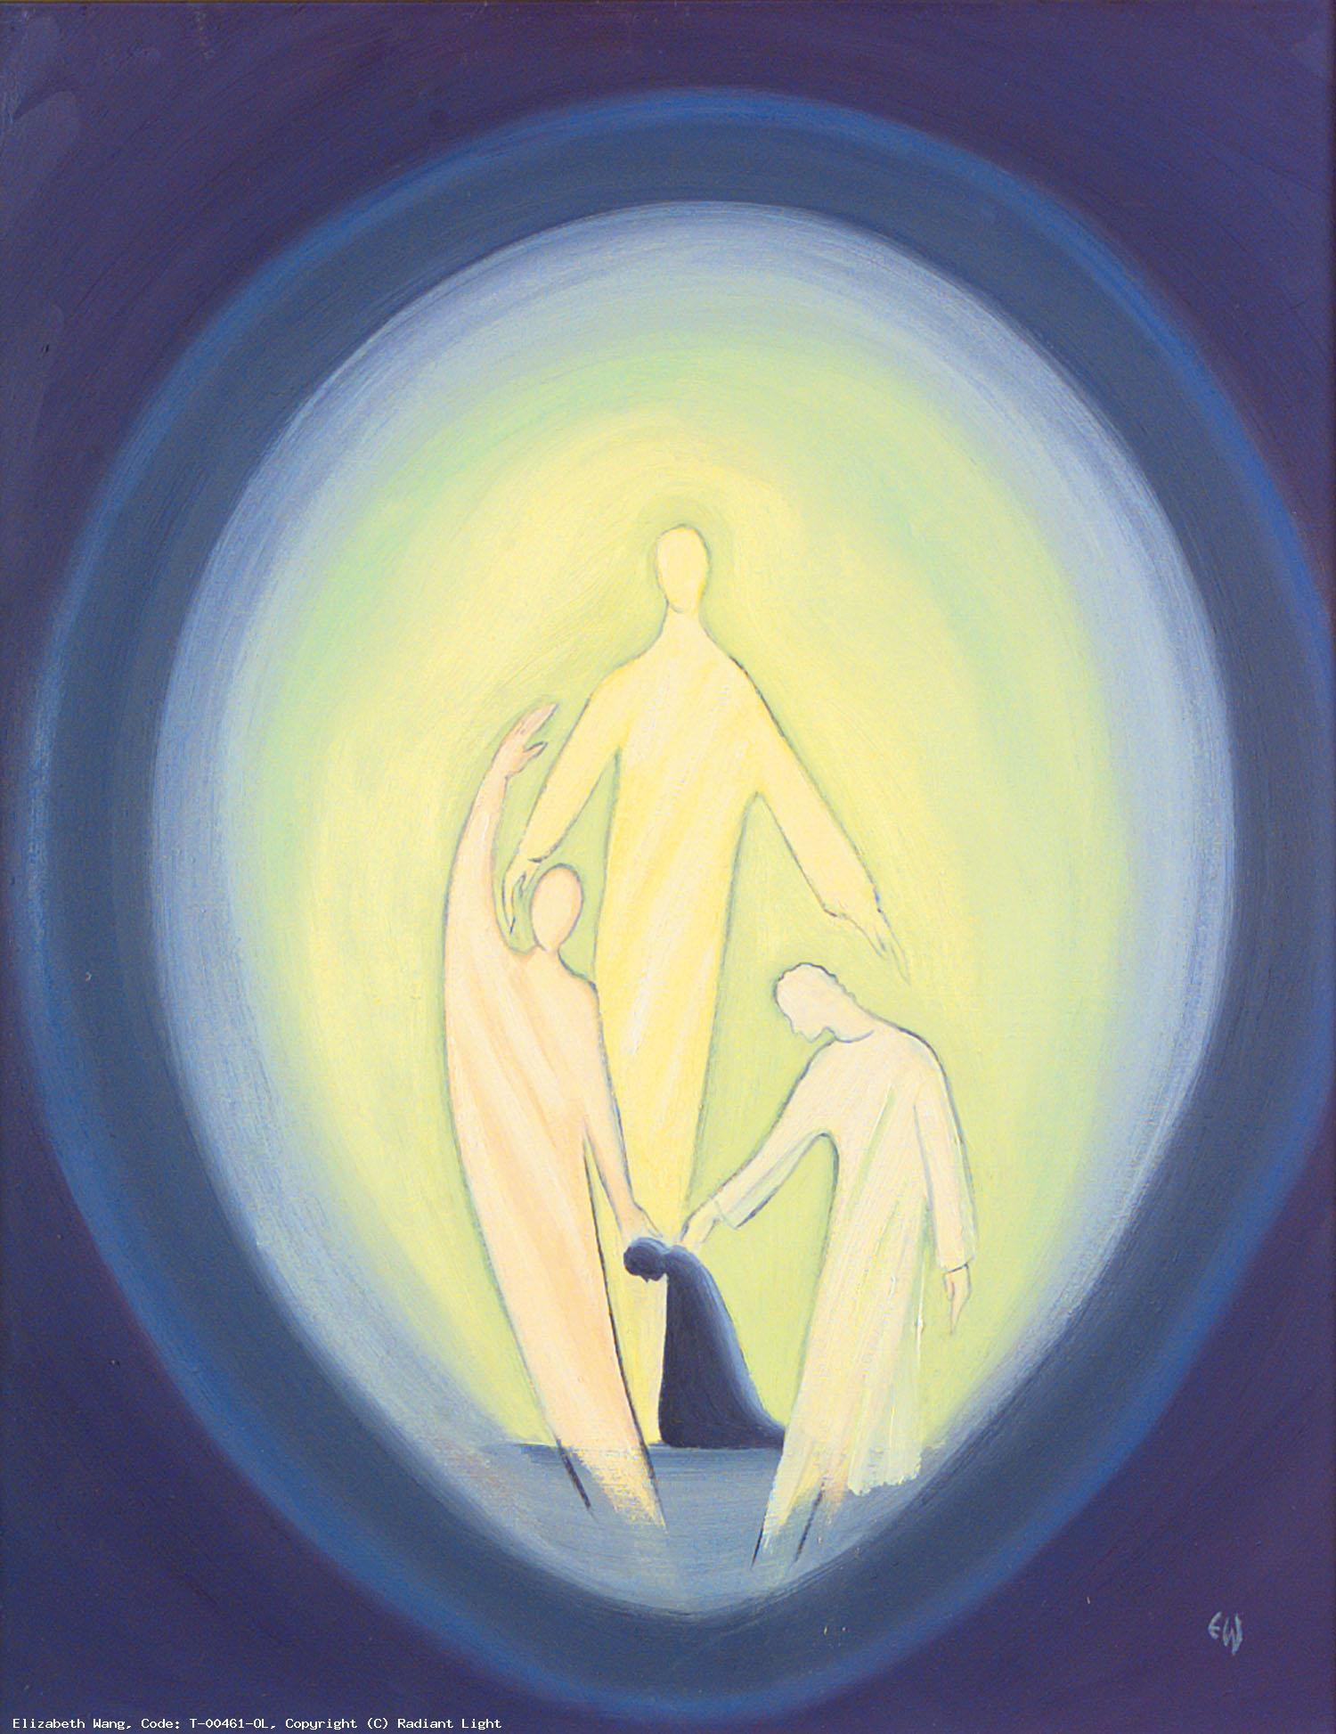
Glory be to the Father
And to the Son
And to the Holy Spirit
As it was in the beginning
Is now and ever shall be
World without end.
Amen.

Slide 27
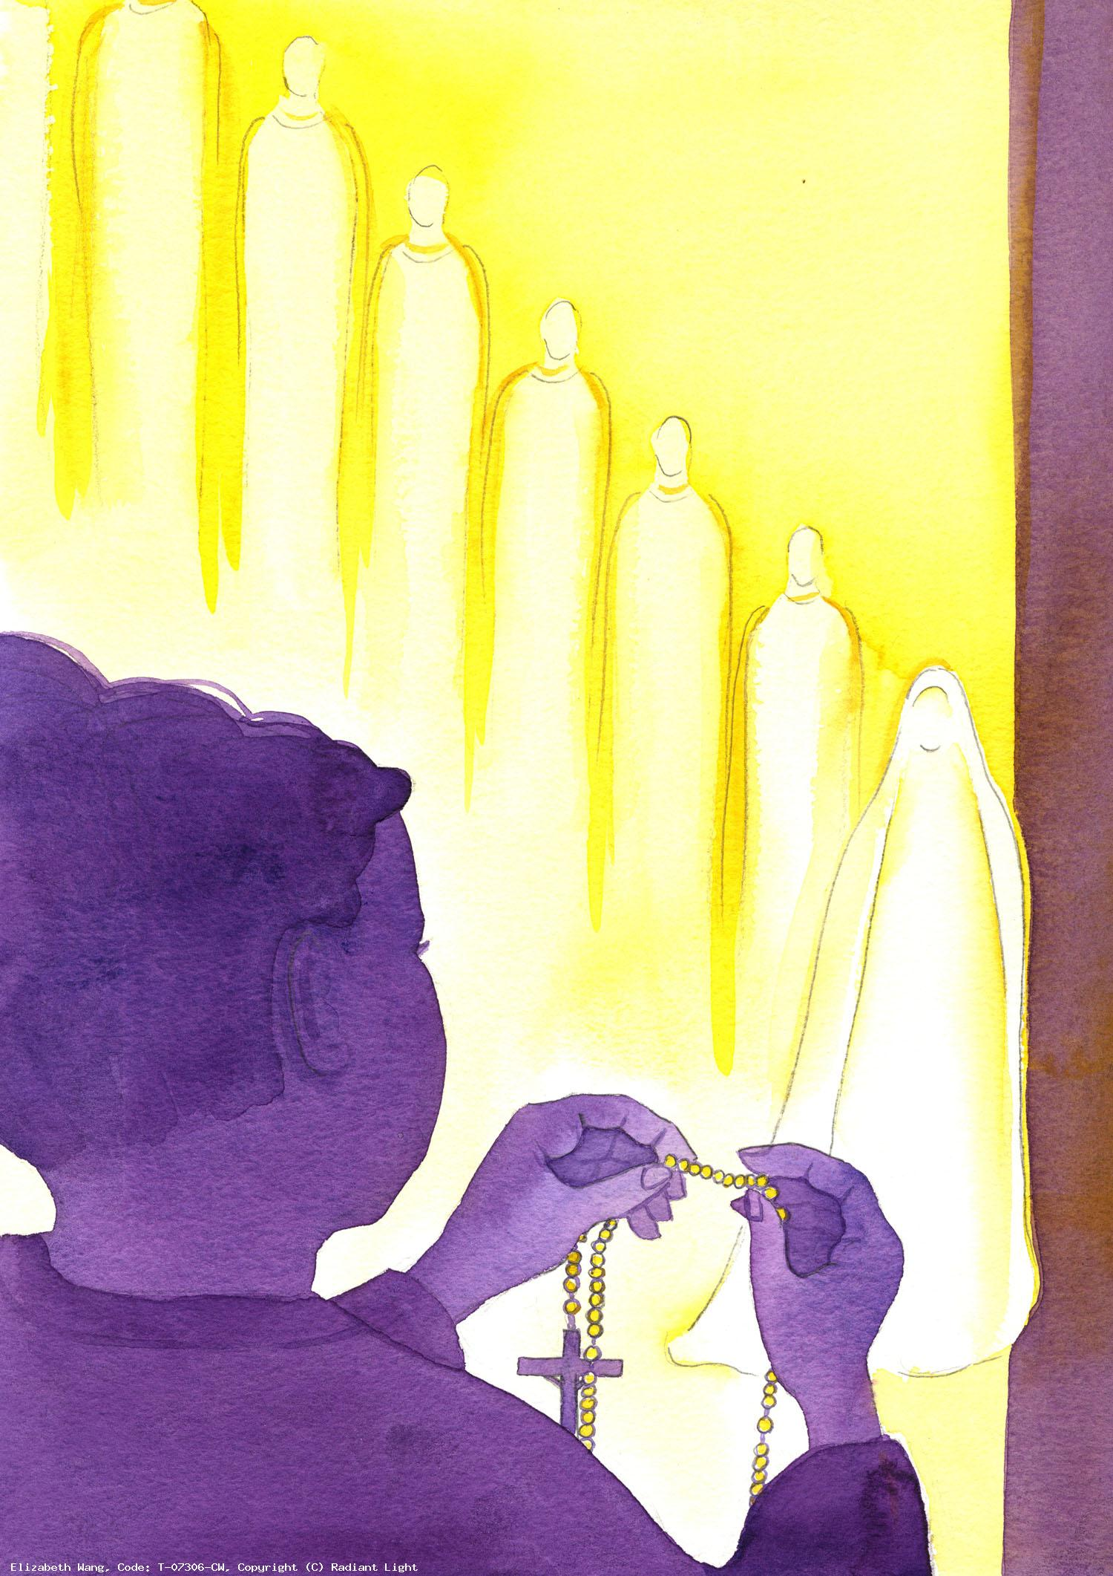
(Optional: The Prayer of Fatima)
Let us pray:
O my Jesus, forgive us our sins and save us from the fires of hell. Lead all souls to heaven, especially those who are in most need of your mercy.

Slide 28
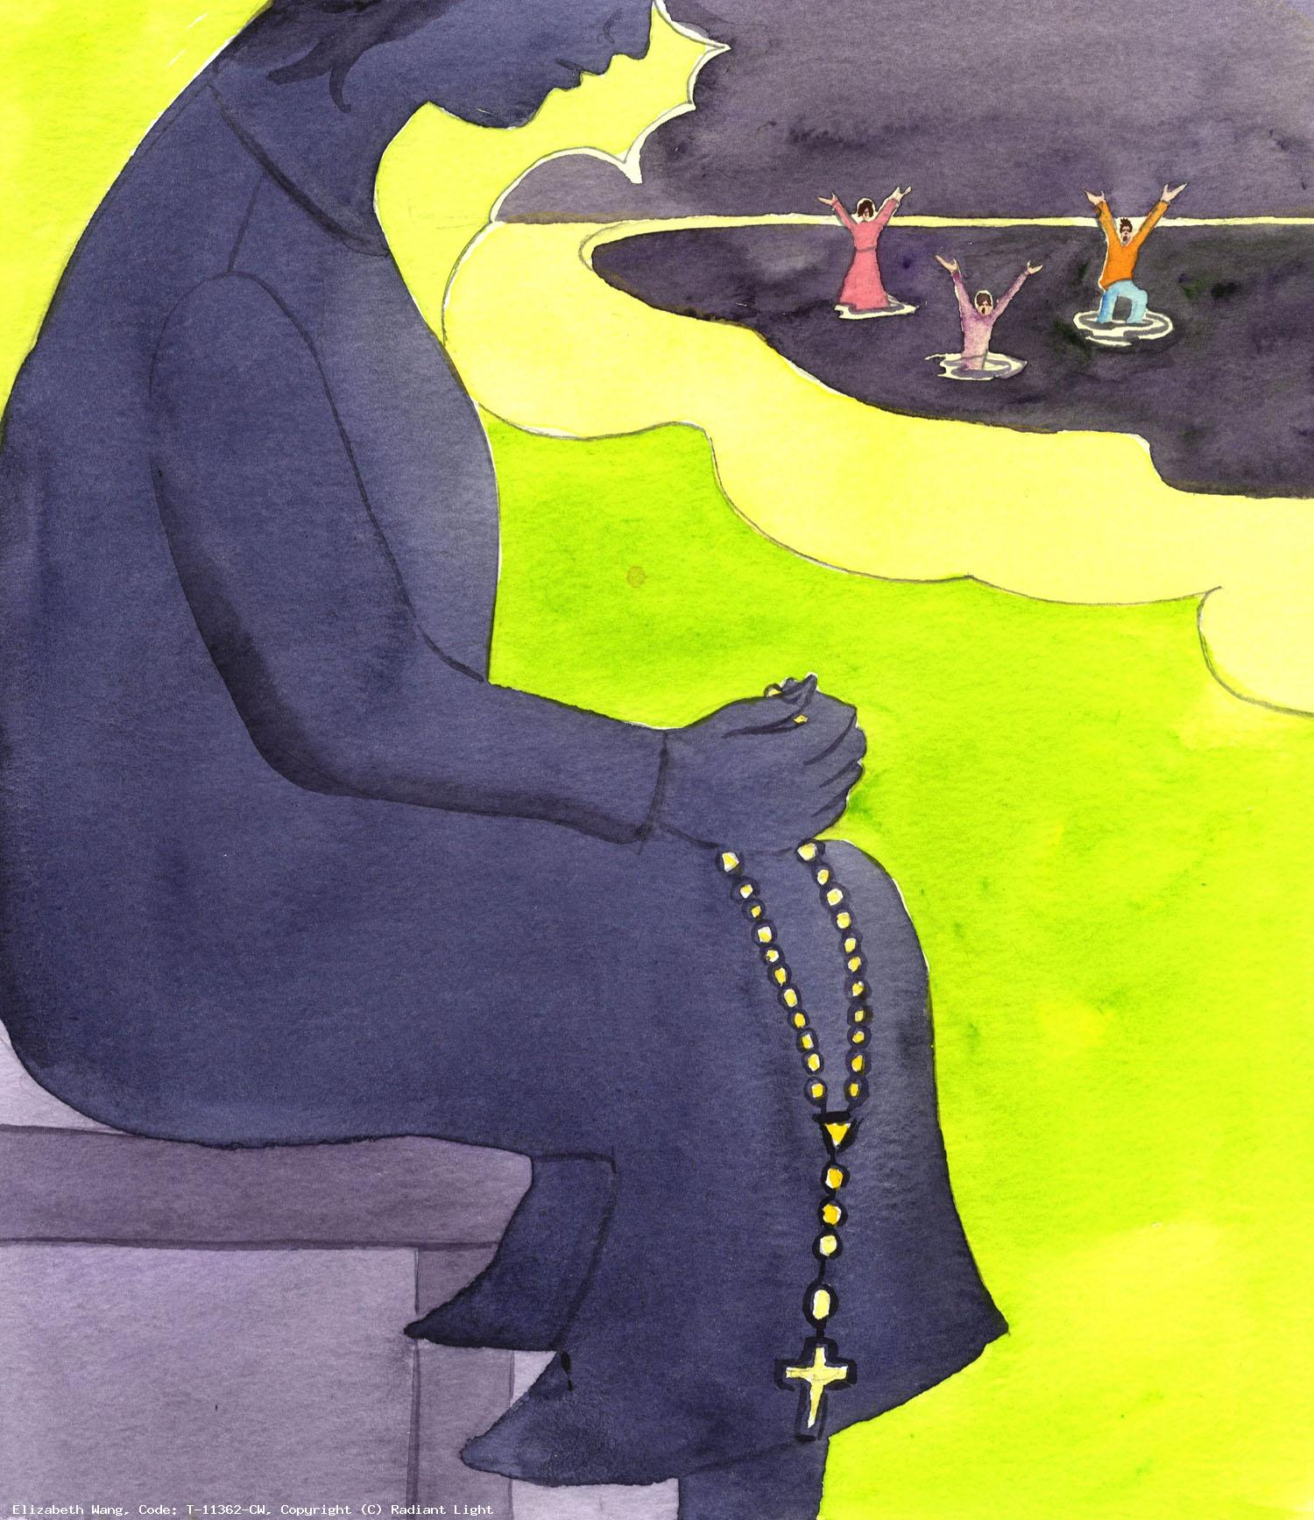
Painted images by Elizabeth Wang .
To view and download images by Elizabeth Wang (and about Christian faith in general) please visit the Radiant Light website and use the search button to search by topic:
https://radiantlight.org.uk/

Slide 29
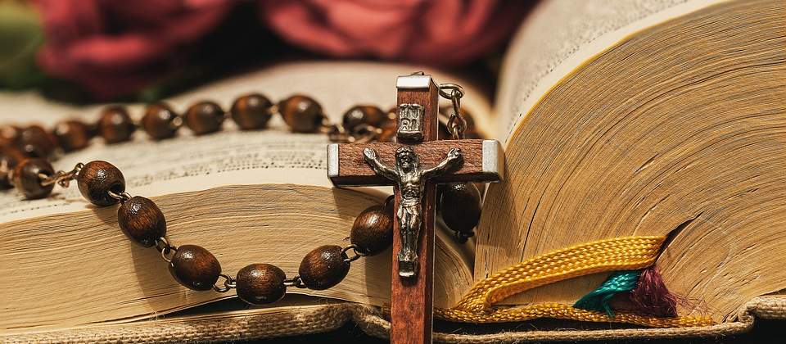
Thank you for joining us today…

