Slide 1
a gentle saint: st JOSEPH For secondary schools
Click here to play instrumental music
Notes:
Find a suitable place to pray where you can avoid distractions.
You may be alone or with others in your family. If you are with adults, you may wish to use a candle. If not, close your eyes and imagine one.
Ask Jesus, the light of the world, to come into your heart as you pray.
You may wish to simply listen to this music or watch the images at the same time, reflecting on God’s beautiful world as you relax.
Breathe in and out 3 times quietly.
Parents: you can alternate between the PowerPoint presentation and the YouTube clips using 'Alt/Tab to make it easier for your children.

Slide 2
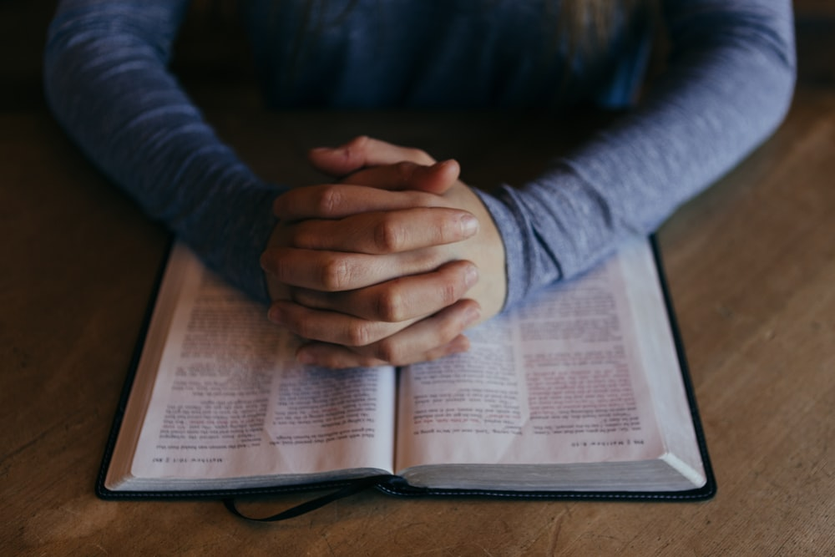
GATHER
Father,
Thank you for your word.
Help us to listen
And show your love.
Amen
Notes:
Make the sign of the cross and say the prayer. You may also wish to pray for your own intentions.
We will be hearing the Word of God. If you would like to use your own Bible, have it ready (Matthew 5:5)

Slide 3
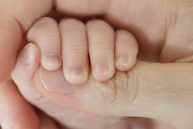
LISTEN: Be gentle
The third beatitude tells us:
‘Blessed are the meek for they shall inherit the earth.’
Notes:
What does it mean to be gentle or meek?
Think about what you learned last week

Slide 4
LISTEN
Small?
Old ?
Peaceful ?
Weak?
What comes to mind when you think of a gentle person?
Notes:
For younger pupils you will need to help them with the words.
Older pupils may want to look at Belgium on the map.

Slide 5
LISTEN
We can learn form the example of the Saints. Today we are going to look at the example set by St Joseph.
The Bible doesn't tell us a great deal about St Joseph, but we can learn a lot from what it does tell us.
What do you know about St Joseph From the Bible?
Notes:
For younger pupils you will need to help them with the words.
Older pupils may want to look at Belgium on the map.

Slide 6
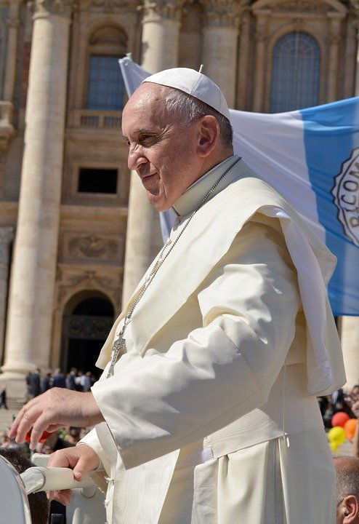
Listen
When he became Pope in 2013, Pope Francis gave a homily about St Joseph and what his example can teach us.
Look at the following extracts from the homily and consider what we can learn from them.

Slide 7
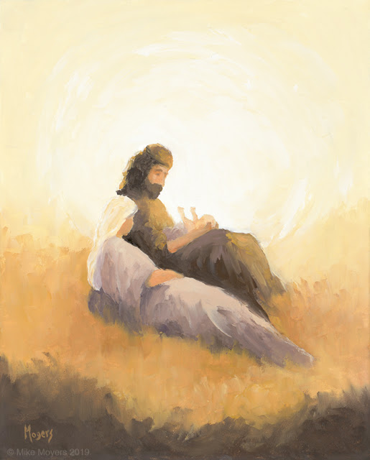
LISTEN
‘In the Gospel we heard that “Joseph did as the angel of the Lord commanded him and took Mary as his wife” (Mt 1:24). These words already point to the mission which God entrusts to Joseph: he is to be the custos, the protector. The protector of whom? Of Mary and Jesus; but this protection is then extended to the Church, as Blessed John Paul II pointed out: “Just as Saint Joseph took loving care of Mary and gladly dedicated himself to Jesus Christ’s upbringing, he likewise watches over and protects Christ’s Mystical Body, the Church, of which the Virgin Mary is the exemplar and model” (Redemptoris Custos, 1).’
What does it take to be a protector?
“Shine" © Mike Moyers. MikeMoyersFineArt.com. Used with Permission.
Notes:
For younger pupils: You may wish to explain the words here:
He was a man who had a mission which means going to a different country to help those in need.
Older pupils may want to find out more about missionaries such as Missio
See:
https://missiontogether.org.uk/
https://missio.org.uk/children-helping-children-during-the-coronavirus/
For videos of saints including St Francis Xavier see
https://www.youtube.com/watch?v=koSWgfvL30c

Slide 8
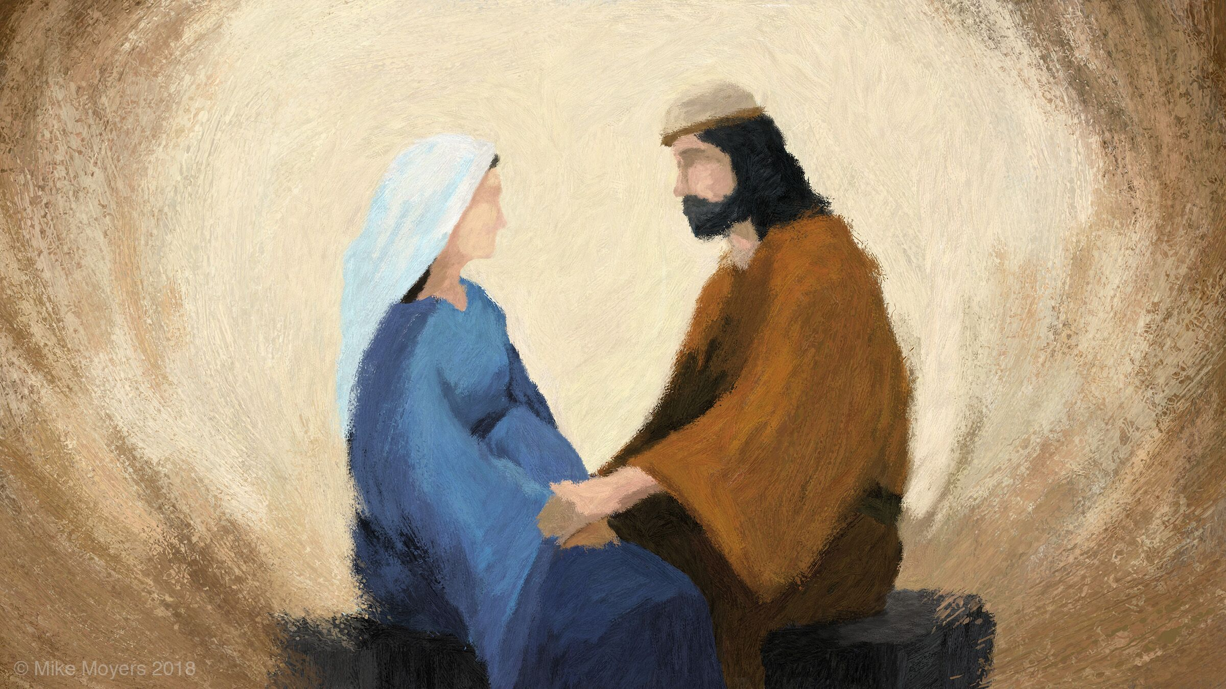
LISTEN
‘How does Joseph exercise his role as protector? Discreetly, humbly and silently, but with an unfailing presence and utter fidelity, even when he finds it hard to understand. From the time of his betrothal to Mary until the finding of the twelve-year-old Jesus in the Temple of Jerusalem, he is there at every moment with loving care. As the spouse of Mary, he is at her side in good times and bad, on the journey to Bethlehem for the census and in the anxious and joyful hours when she gave birth; amid the drama of the flight into Egypt and during the frantic search for their child in the Temple; and later in the day-to-day life of the home of Nazareth, in the workshop where he taught his trade to Jesus.
Look at the words in bold. Does that fit with your thoughts on a protector?
“Discussing Bethlehem" © Mike Moyers. MikeMoyersFineArt.com. Used with Permission.
Notes:
For younger pupils: You may wish to explain that people with leprosy could not be sent to hospitals. No-one would look after them because they would get ill too. So sick people were abandoned on this island with poor food, water and medicines.
For older pupils: Research what leprosy is and how it affects people’s lives. Find out about Jesus healing those with leprosy. There are several true stories about different events.

Slide 9
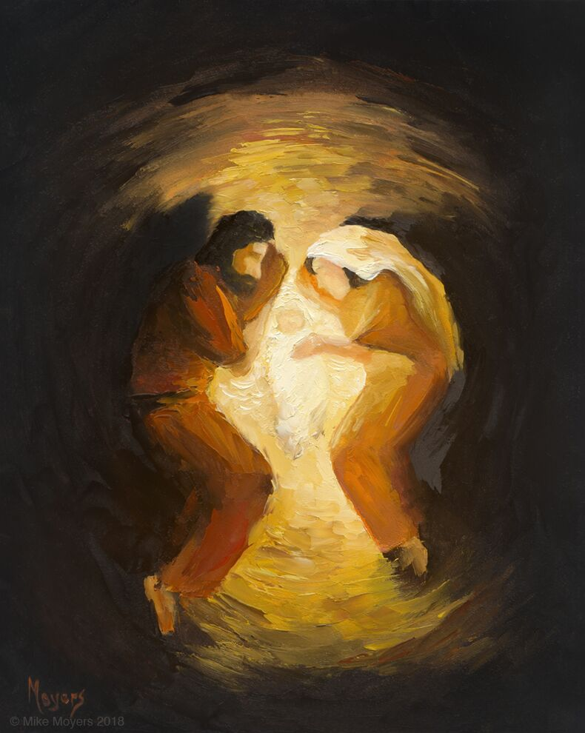
LISTEN
The vocation of being a “protector”……….means protecting all creation, the beauty of the created world, as the Book of Genesis tells us and as Saint Francis of Assisi showed us. It means respecting each of God’s creatures and respecting the environment in which we live. It means protecting people, showing loving concern for each and every person, especially children, the elderly, those in need, who are often the last we think about. It means caring for one another in our families: husbands and wives first protect one another, and then, as parents, they care for their children, and children themselves, in time, protect their parents. It means building sincere friendships in which we protect one another in trust, respect, and goodness. In the end, everything has been entrusted to our protection, and all of us are responsible for it. Be protectors of God’s gifts!
“The Manger" © Mike Moyers. MikeMoyersFineArt.com. Used with Permission.
What or who can you be more caring and gentle towards?

Slide 10
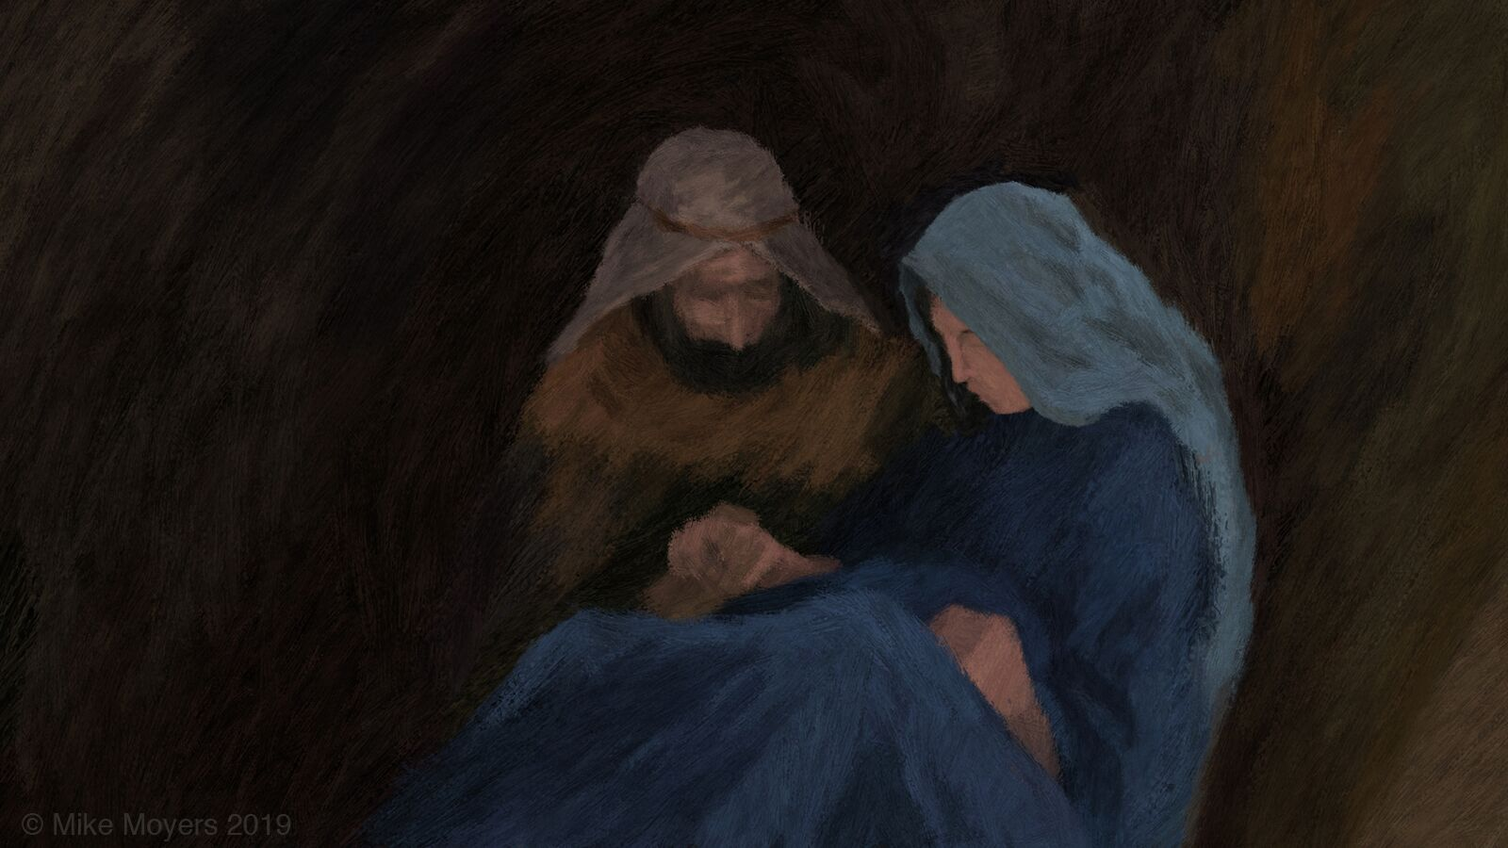
Listen
‘Here I would add one more thing: caring, protecting, demands goodness, it calls for a certain tenderness. In the Gospels, Saint Joseph appears as a strong and courageous man, a working man, yet in his heart we see great tenderness, which is not the virtue of the weak but rather a sign of strength of spirit and a capacity for concern, for compassion, for genuine openness to others, for love. We must not be afraid of goodness, of tenderness!
“Delivery" © Mike Moyers. MikeMoyersFineArt.com. Used with Permission.
Do we sometimes think that gentleness is a weakness rather than a strength? What can you learn from the character of St Joseph?

Slide 11
RESPOND
“Joseph the Carpenter" © Mike Moyers. MikeMoyersFineArt.com. Used with Permission.
Which of these images is your favourite? Why? What does it show about St Joseph?

Slide 12
“The Angel Visits Joseph” © Mike Moyers. MikeMoyersFineArt.com. Used with Permission.
Which of these images is your favourite? Why? What does it show about St Joseph?

Slide 13
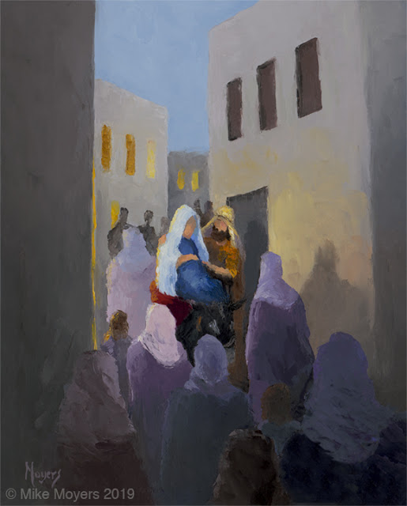
RESPOND
“No Room" © Mike Moyers. MikeMoyersFineArt.com. Used with Permission.
Which of these images is your favourite? Why? What does it show about St Joseph?
Notes:
Find out more:
https://teachingcatholickids.com/st-damien-of-molokai-a-saint-for-the-forgotten-and-abandoned/
https://kids.kiddle.co/Father_Damien
https://www.catholic.org/saints/saint.php?saint_id=2817

Slide 14
“Campfire Dinner" © Mike Moyers. MikeMoyersFineArt.com. Used with Permission.
Which of these images is your favourite? Why? What does it show about St Joseph?

Slide 15
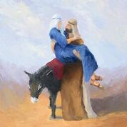
“Embarking for Bethlehem" © Mike Moyers. MikeMoyersFineArt.com. Used with Permission.
Which of these images is your favourite? Why? What does it show about St Joseph?

Slide 16
“Shine" © Mike Moyers. MikeMoyersFineArt.com. Used with Permission.
Which of these images is your favourite? Why? What does it show about St Joseph?

Slide 17
RESPOND - Prayer
Almighty God, in Your infinite wisdom and love, You chose Joseph to be the husband of Mary, the mother of your Son.
As we enjoy his protection on earth, may we have the help of his prayers in heaven.
Help us to be gentle, like St Joseph, to ourselves ,others and the world.
We ask you this through Christ our Lord.
Amen.
Notes:
In the name of the Father and of the Son and of the Holy Spirit. Amen.

Slide 18
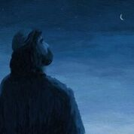
MISSION
St Joseph the Worker: Work hard to develop your gifts and talents for the good of others and the world.
St Joseph the Just: Be fair and honest in your treatment of yourself and others.
St Joseph the Patient: Try to be patient with your family especially while we are locked down together and our patience can be tested!
“Joseph Wonders" © Mike Moyers. MikeMoyersFineArt.com. Used with Permission.

Slide 19
be gentle
Click here to play instrumental music
Notes:
You may wish to continue playing the music while you complete your mission.

