Slide 1
Praying the Rosary with the Diocese of Westminster
The Visitation - Friday 3rd July

Slide 2
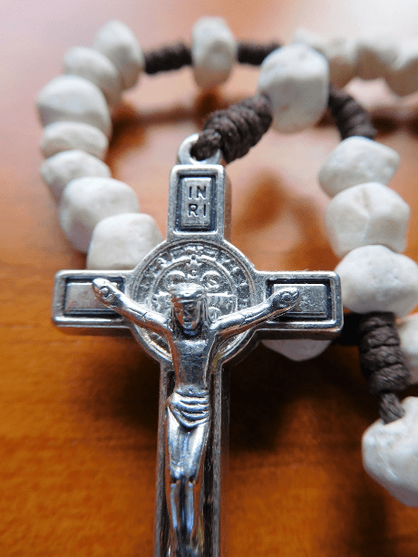
"Contemplating the face of Christ with the heart of Mary, our mother, will make us even more united as a spiritual family and will help us overcome this time of trial.“
Pope Francis (May 2020)
-

Slide 3
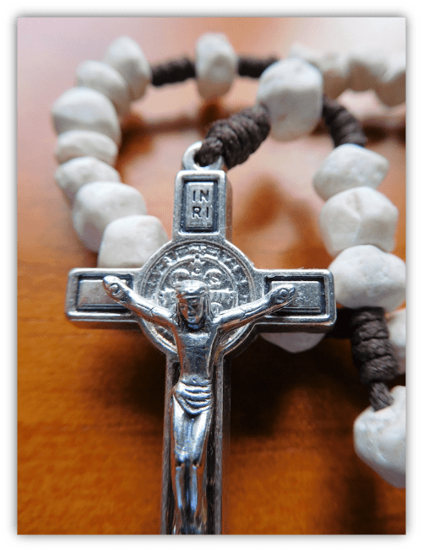
We offer this decade of the Rosary for all those affected by the coronavirus and we ask the help of Our Blessed Mother, Mary, to take our prayers to her beloved son, Jesus.
-

Slide 4
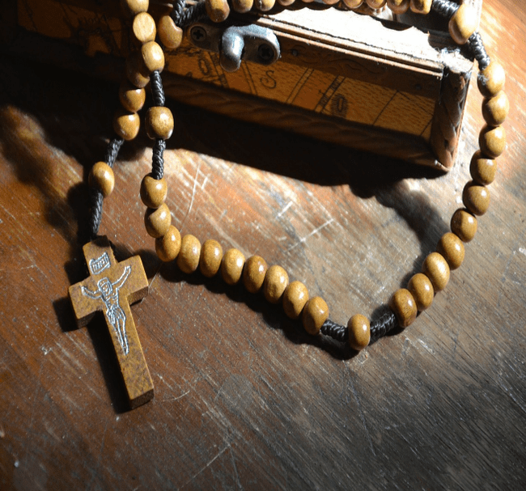
Our Father
Who art in heaven
Hallowed be thy name
Thy kingdom come
Thy will be done
On earth as it is in heaven
Give us this day our daily bread
And forgive us our trespasses
As we forgive those
who trespass against us
And lead us not into temptation
But deliver us from evil.
Amen.

Slide 5
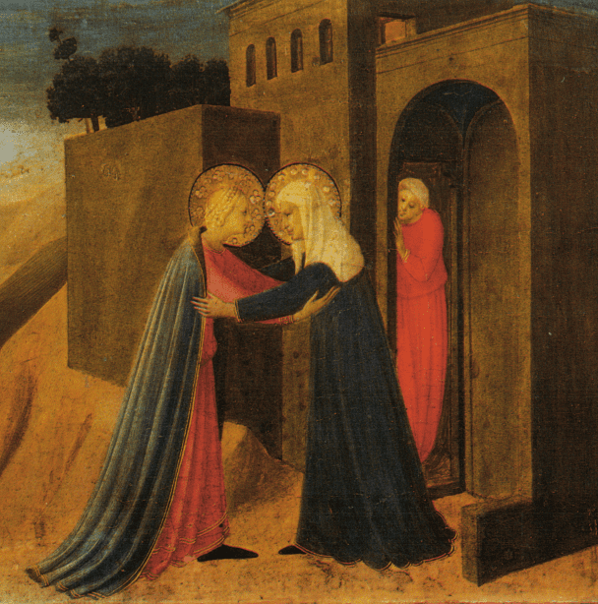
One
Mary set out, proceeding in haste into the hill country to a town of Judah, where she entered Zechariah's house and greeted Elizabeth.
As we begin to slowly open our homes again to family and friends, may we welcome them as warmly as Elizabeth welcomed Mary.
Fra Angelico - John Pope-Hennessy, Beato Angelico, Scala, Firenze 1981.

Slide 7
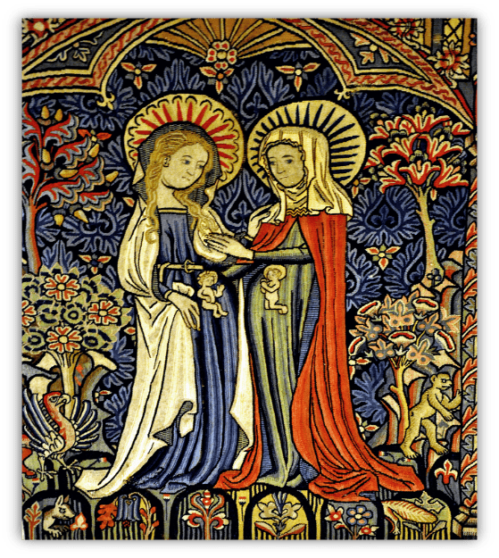
Two
When Elizabeth heard Mary's greeting, the baby leapt in her womb.
May we rejoice with those who are pregnant and comfort those who do not hold their child in their arms.
By Photo: User:FA2010 - Own work, Public Domain, https://commons.wikimedia.org/w/index.php?curid=15258834

Slide 9
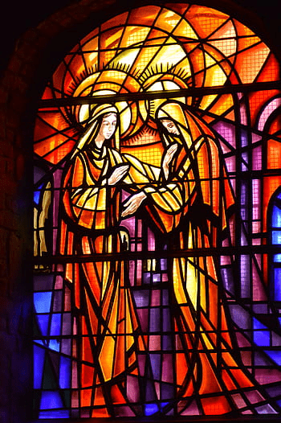
Three
Elizabeth was filled with the Holy Spirit.
We give thanks for older people in our lives who are guided by the Holy Spirit and give us strength and wisdom.

Slide 11
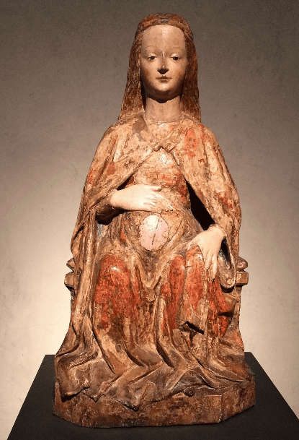
Four
She cried out in a loud voice: "Blessed are you among women and blest is the Fruit of your womb."
Help us to be like Elizabeth and encourage others as they do the work entrusted to them by God.
Maria Gravida, International Gothic

Slide 13
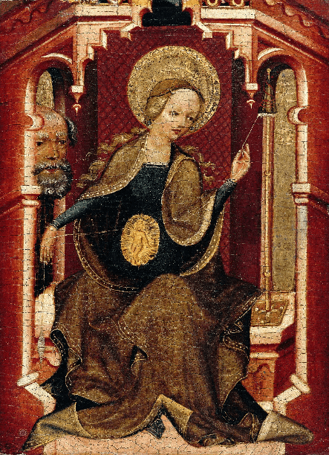
Five
"Blest is she who trusted that the Lord's words to her would be fulfilled.“
During this concerning time of uncertainty, help us to trust in God and remain faith-filled.
The Master of Erfurt, The Virgin Weaving, Upper Rhine, ca 1400. Gemäldegalerie, Staatliche Museen zu Berlin

Slide 15
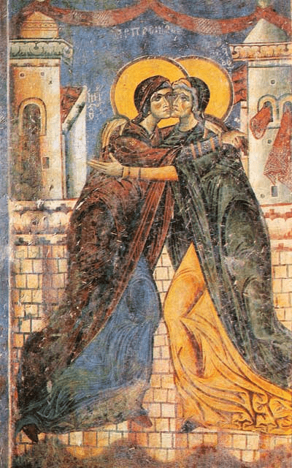
Six
Then Mary said: "My being proclaims the greatness of the Lord, my spirit finds joy in God my Saviour."
Help us to proclaim the greatness of the Lord and fill our spirits with the joy of our salvation.
The Embrace of Elizabeth and the Virgin Mary. St. George Church, Kurbinovo, North Macedonia

Slide 17
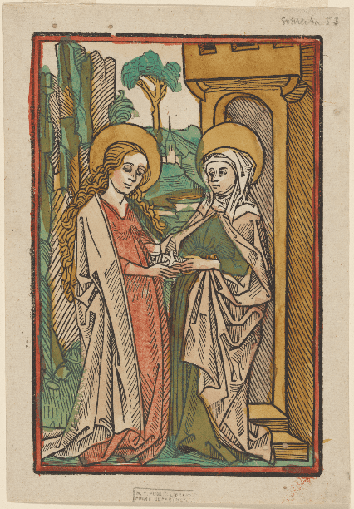
Seven
"For he has looked upon his servant in her lowliness; all ages to come shall call me blessed.”
God can bless us all, even those who feel unworthy.
May we be like Mary and Elizabeth, trusting and open to God’s plan.
Anonymous, Printmaker Bämler, Johann, d. ca. 1508, Printmaker

Slide 19
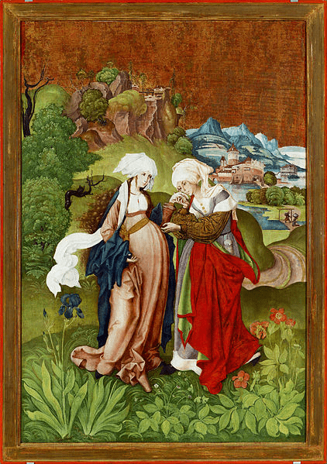
Eight
"God who is mighty has done great things for me, holy is his name."
In the midst of this time of insecurity, may we recognise all the blessings God has given us and praise his name.
Marten Schwartz - The Visitation, from Selmecbánya

Slide 21
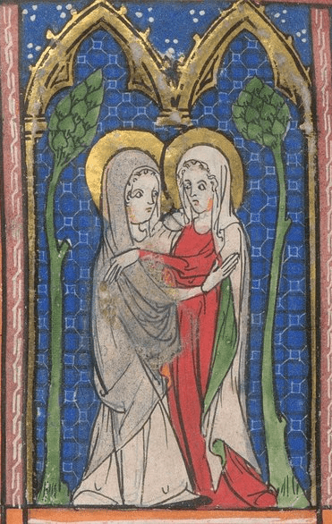
Nine
"His mercy is from age to age on those who fear him."
Oh Lord, we cry out for mercy, may the pandemic continue to ease here and across the world.
Help us to find ways to ensure it does not return and cause so much suffering and grief again.
Annunciation, Visitation, and Nativity from BL Sloane 1977, f. 2

Slide 23
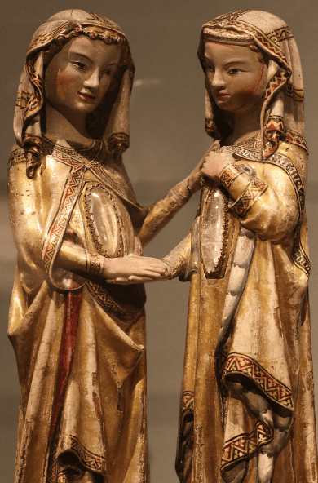
Ten
Mary remained with Elizabeth for about three months and then returned home.
Be with those separated from loved ones due to the pandemic.
Provide them with people who will offer love and support, just as both Elizabeth and Mary did, until they can return home.
This beautiful gilded wood carving of the Visitation dates to 1300, and it was made for the Dominican convent of Katharinenthal.It is attributed to Meister Heinrich of Constance and is now in the Metropolitan Museum of Art in NYC.

Slide 25
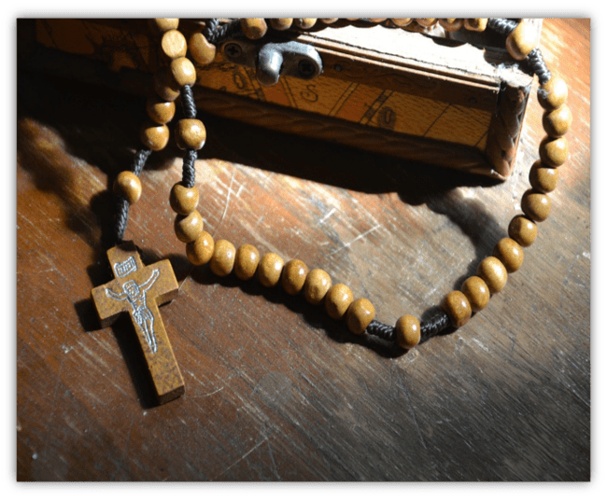
Glory be to the Father
and to the Son
and to the Holy Spirit;
as it was in the beginning
is now and ever shall be
world without end.
Amen.

Slide 26
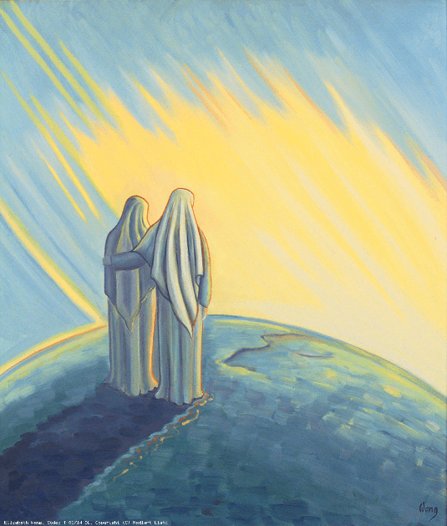
To you, who shine on our journey as a sign of salvation and hope, do we entrust ourselves, O Clement,
O Loving,
O Sweet Virgin Mary.
Amen.

Slide 27
Thank you for joining us today…

