Slide 1
Praying the Rosary with the Diocese of Westminster
The Annunciation - Friday 26th June

Slide 2
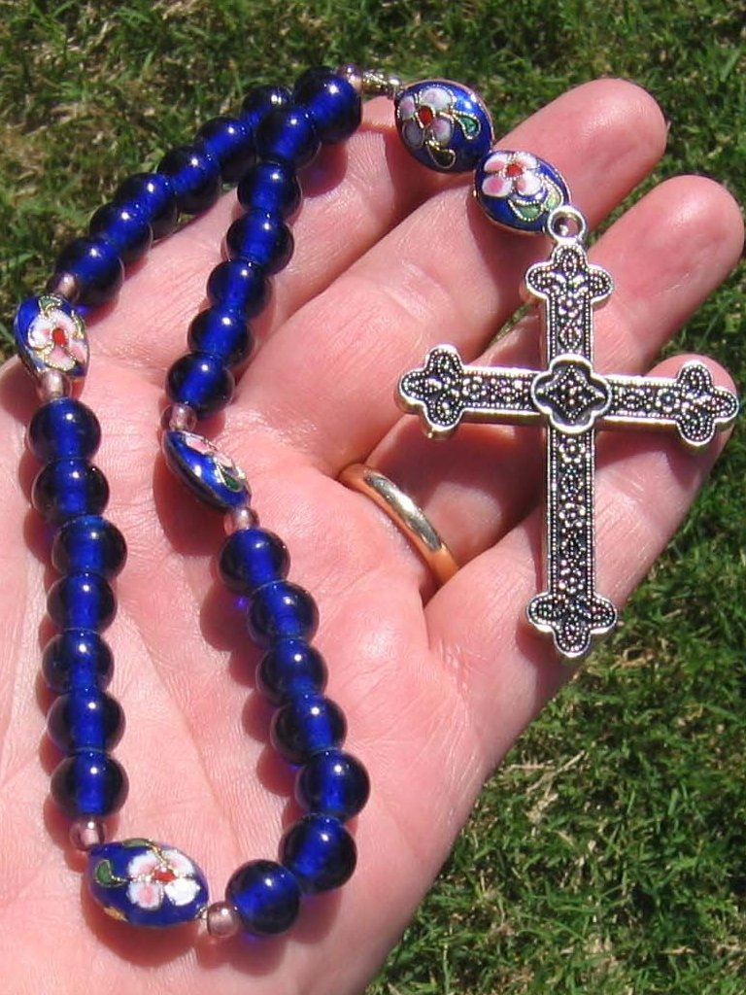
"Contemplating the face of Christ with the heart of Mary, our mother, will make us even more united as a spiritual family and will help us overcome this time of trial."
Pope Francis (May 2020)
-

Slide 3
We offer this decade of the Rosary for all those affected by the coronavirus and we ask the help of Our Blessed Mother, Mary, to take our prayers to her beloved son, Jesus.
-

Slide 4
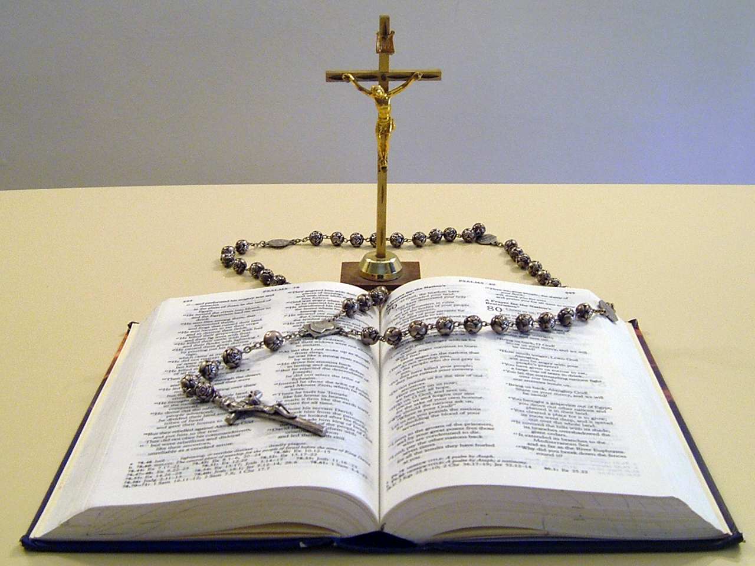
Our Father
Who art in heaven
Hallowed be thy name
Thy kingdom come
Thy will be done
On earth as it is in heaven
Give us this day our daily bread
And forgive us our trespasses
As we forgive those
who trespass against us
And lead us not into temptation
But deliver us from evil.
Amen.

Slide 5
1
The time for the Incarnation is at hand.
In the present tragic situation, when the whole world is prey to suffering and anxiety, we fly to you, Mother of God and our Mother, and seek refuge under your protection.
(Image: Fra Bartolomeo )

Slide 6
Hail Mary, ​ Full of Grace​
The Lord is with thee​
Blessed art thou amongst women​
And blessed is the fruit ​
of thy womb, Jesus,​
Holy Mary, Mother of God,​
Pray for us sinners​
Now and at the hour​
Of our death.​
Amen.​

Slide 7
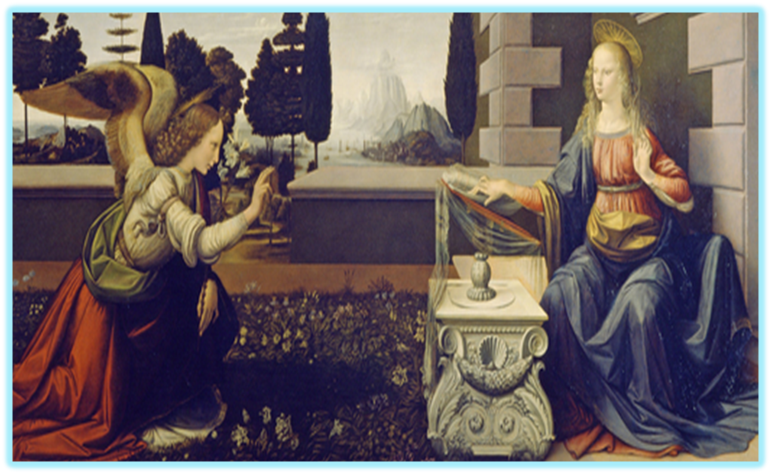
2
Of all women God prepared Mary from her conception to be the Mother of the Incarnate Word.
Virgin Mary, turn your merciful eyes towards us amid this coronavirus pandemic. Comfort those who are distraught and mourn their loved ones who have died, and at times are buried in a way that grieves them deeply.
(Image: Leonardo da Vinci and Andrea del Verrocchio)

Slide 8
Hail Mary, ​ Full of Grace​
The Lord is with thee​
Blessed art thou amongst women​
And blessed is the fruit ​
of thy womb, Jesus,​
Holy Mary, Mother of God,​
Pray for us sinners​
Now and at the hour​
Of our death.​
Amen.​

Slide 9
3
The Angel Gabriel announces: “Hail, full of grace! The Lord is with thee.”
Be close to those who are concerned for their loved ones who are sick and who, in order to prevent the spread of the disease, cannot be close to them. Fill with hope those who are troubled by the uncertainty of the future and the consequences for the economy and employment.
(Image: Juan de Flandes)

Slide 10
Hail Mary, ​ Full of Grace​
The Lord is with thee​
Blessed art thou amongst women​
And blessed is the fruit ​
of thy womb, Jesus,​
Holy Mary, Mother of God,​
Pray for us sinners​
Now and at the hour​
Of our death.​
Amen.​

Slide 11
4
Mary wonders at this salutation.
Be close to those who assist the sick night and day, and to priests who, in their pastoral concern and fidelity to the Gospel, are trying to help and support everyone.
(Image: Jan van Eyck)

Slide 12
Hail Mary, ​ Full of Grace​
The Lord is with thee​
Blessed art thou amongst women​
And blessed is the fruit ​
of thy womb, Jesus,​
Holy Mary, Mother of God,​
Pray for us sinners​
Now and at the hour​
Of our death.​
Amen.​

Slide 13
5
The Angel assures her:
“Fear not . . . you shall conceive in your womb, and give birth to a Son.”
Protect those doctors, nurses, health workers and volunteers who are on the frontline of this emergency, and are risking their lives to save others. Support their heroic effort and grant them strength, generosity and continued health.
(Image: by Sandra Botticelli)

Slide 14
Hail Mary, ​ Full of Grace​
The Lord is with thee​
Blessed art thou amongst women​
And blessed is the fruit ​
of thy womb, Jesus,​
Holy Mary, Mother of God,​
Pray for us sinners​
Now and at the hour​
Of our death.​
Amen.​

Slide 15
6
Mary is troubled for she has made a vow of virginity.
Mother of God and our Mother, pray for us to God, the Father of mercies, that this great suffering may end and that hope, and peace may dawn anew. Plead with your divine Son, as you did at Cana, so that the families of the sick and the victims be comforted, and their hearts be opened to confidence and trust.
(Image: Dante Gabriel Rossetti)

Slide 16
Hail Mary, ​ Full of Grace​
The Lord is with thee​
Blessed art thou amongst women​
And blessed is the fruit ​
of thy womb, Jesus,​
Holy Mary, Mother of God,​
Pray for us sinners​
Now and at the hour​
Of our death.​
Amen.​

Slide 17
7
The Angel answers that she will conceive by the power of the Holy Spirit, and her Son will be called the Son of God.
Blessed Virgin, illuminate the minds of men and women engaged in scientific research, that they may find effective solutions to overcome this virus.
(Image: Claudio Sacchii)

Slide 18
Hail Mary, ​ Full of Grace​
The Lord is with thee​
Blessed art thou amongst women​
And blessed is the fruit ​
of thy womb, Jesus,​
Holy Mary, Mother of God,​
Pray for us sinners​
Now and at the hour​
Of our death.​
Amen.​

Slide 19
8
The Incarnation awaits Mary’s consent.
Beloved Mother, help us realize that we are all members of one great family and to recognise the bond that unites us, so that, in a spirit of fraternity and solidarity, we can help to alleviate countless situations of poverty and need. Make us strong in faith, persevering in service, constant in prayer.
(Image: Fra Angelico )

Slide 20
Hail Mary, ​ Full of Grace​
The Lord is with thee​
Blessed art thou amongst women​
And blessed is the fruit ​
of thy womb, Jesus,​
Holy Mary, Mother of God,​
Pray for us sinners​
Now and at the hour​
Of our death.​
Amen.​

Slide 21
9
Mary answers: Behold the handmaid of the Lord. Be it done unto me according to your word.
Support national leaders, that with wisdom and generosity they may come to the aid of those lacking the basic necessities of life and may devise social and economic solutions inspired by farsightedness and solidarity.
(Image: Anthony van Dyck)

Slide 22
Hail Mary, ​ Full of Grace​
The Lord is with thee​
Blessed art thou amongst women​
And blessed is the fruit ​
of thy womb, Jesus,​
Holy Mary, Mother of God,​
Pray for us sinners​
Now and at the hour​
Of our death.​
Amen.​

Slide 23
10
The Word was made flesh and dwelt among us.
Mary, Consolation of the afflicted, embrace all your children in distress and pray that God will stretch out his all-powerful hand and free us from this terrible pandemic, so that life can serenely resume its normal course.
(Image: William-Adolphe Bouguereau )

Slide 24
Hail Mary, ​ Full of Grace​
The Lord is with thee​
Blessed art thou amongst women​
And blessed is the fruit ​
of thy womb, Jesus,​
Holy Mary, Mother of God,​
Pray for us sinners​
Now and at the hour​
Of our death.​
Amen.​

Slide 25
To you, who shine on our journey as a sign of salvation and hope, do we entrust ourselves, O Clement, O Loving, O Sweet Virgin Mary.
Amen.
(Image: Hans Memling )

Slide 26
Glory be to the Father
and to the Son
and to the Holy Spirit;
as it was in the beginning
is now and ever shall be
world without end.
Amen.

Slide 27
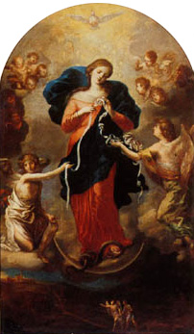
Our Lady, Queen of Peace,
pray for us. Our Lady, Comforter of the Afflicted, pray for us. Our Lady, Help of Christians,
pray for us. Our Lady, Health of the Sick,
pray for us. Our Lady, Seat of Wisdom,
pray for us. Our Lady, Queen of Heaven and Earth, pray for us.
Amen.
(Image: Jan van Eyck)

Slide 28
Thank you for joining us today…

Slide 29
Images: https://useum.org/ https://pixabay.com/images/search/rosary/
Thank you
Prayers : https://mycatholic.life/catholic-prayers/a-prayer-for-healing-and-hope/#rosary
Rosary: https://www.rosarycenter.org/homepage-2/rosary/how-to-pray-the-rosary/joyful-mysteries-without-distractions/

