Slide 1
Praying the Rosary with the Diocese of Westminster
Institution of the Eucharist - Friday 19th June

Slide 2
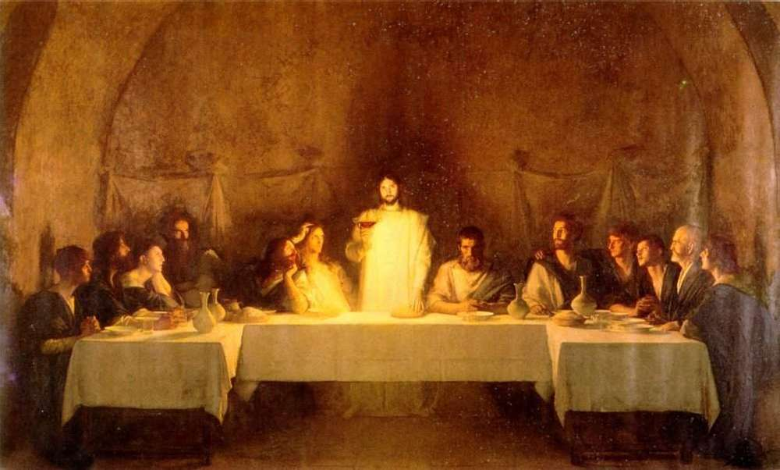
“At every celebration of Mass, our lives, offered in union with Christ’s sacrifice on the cross, become, in him, an offering of praise and thanksgiving pleasing to the Father, for the salvation of the world…At Mass, Jesus becomes truly present and allows us in some way, like the Apostle Thomas, to touch his flesh and renew our faith in him.”
(Pope Francis, 15th November 2017)
Image: Dagnan Bouvere

Slide 3
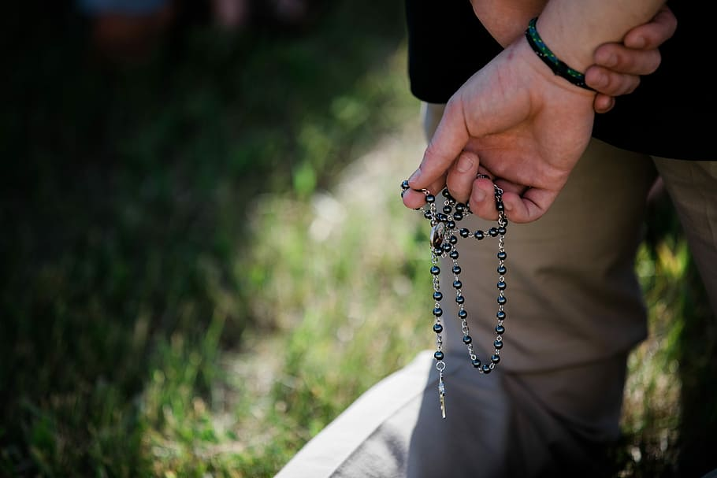
We offer this decade of the Rosary for all those affected by the coronavirus and we ask the help of Our Blessed Mother, Mary, to take our prayers to her beloved son, Jesus.
-

Slide 4
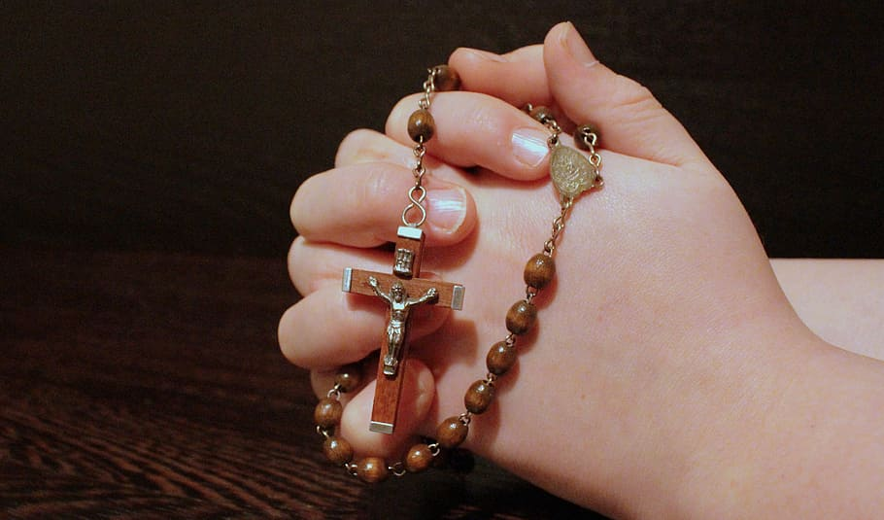
Our Father
Who art in heaven
Hallowed be thy name
Thy kingdom come
Thy will be done
On earth as it is in heaven
Give us this day our daily bread
And forgive us our trespasses
As we forgive those
who trespass against us
And lead us not into temptation
But deliver us from evil.
Amen.

Slide 5
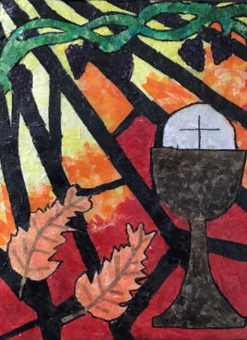
1. Before the feast of Passover, Jesus knew that his hour had come to pass from this world to the Father. He loved his own in the world and he loved them to the end. (Jn 13:1)
We give thanks to God for his great love for us and for all those who are close to us. May we love as Jesus did and remember especially those who feel unloved or unwanted due to social isolation.
Artwork by a pupil in St Cross Primary School, Hoddesdon

Slide 6
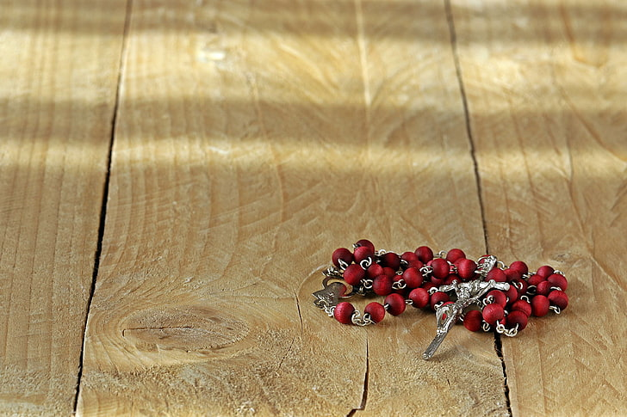
Hail Mary, Full of Grace
The Lord is with thee
Blessed art thou amongst women
And blessed is the fruit
of thy womb, Jesus,
Holy Mary, Mother of God,
Pray for us sinners
Now and at the hour
Of our death.
Amen.

Slide 7
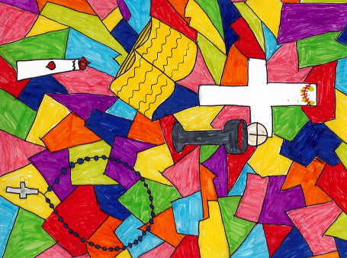
2. “My appointed time draws near; in your house I shall celebrate the Passover with my disciples.” (Mt 26:18)
We thank God for the gift of being able to celebrate with our loved ones and community. May we continue to be mindful about how we gather together and not take this gift for granted.
(Image: Sassetto)
Artwork by a pupil in English Martyrs Primary School, Tower Hamlets

Slide 8
Hail Mary, Full of Grace
The Lord is with thee
Blessed art thou amongst women
And blessed is the fruit
of thy womb, Jesus,
Holy Mary, Mother of God,
Pray for us sinners
Now and at the hour
Of our death.
Amen.

Slide 9
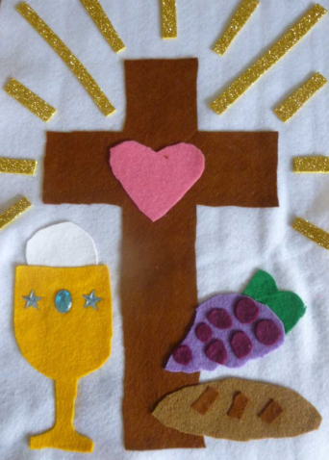
3. “I have eagerly desired to eat this Passover with you before I suffer, for, I tell you, I shall not eat it [again] until there is fulfilment in the kingdom of God.” (Lk 22:15-16)
We thank God for all of our faith traditions and the ability to find creative ways to celebrate the Eucharist together. May we join regularly in spiritual communion with our loving Saviour until we can receive him physically again.
(Image: Fr Laurence Lew)
Artwork by a pupil in St Dominic’s Primary School, St Albans

Slide 10
Hail Mary, Full of Grace
The Lord is with thee
Blessed art thou amongst women
And blessed is the fruit
of thy womb, Jesus,
Holy Mary, Mother of God,
Pray for us sinners
Now and at the hour
Of our death.
Amen.

Slide 11
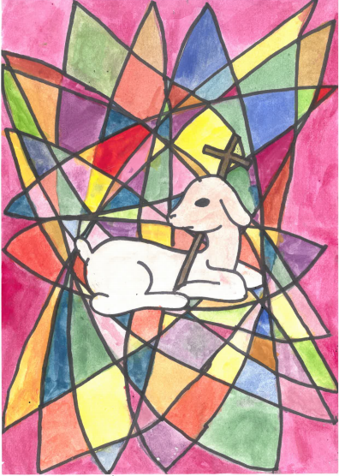
4. “Then he took the bread, said the blessing, broke it, and gave it to them, saying, "This is my body, which will be given for you; do this in memory of me.“ (Lk 22:19)
We thank God for the gift of Jesus and his sacrifice for us. May we follow his example and offer ourselves in loving service to others, especially during this challenging time.
Artwork by a pupil in Sacred Heart Primary School, Ware

Slide 12
Hail Mary, Full of Grace
The Lord is with thee
Blessed art thou amongst women
And blessed is the fruit
of thy womb, Jesus,
Holy Mary, Mother of God,
Pray for us sinners
Now and at the hour
Of our death.
Amen.

Slide 13
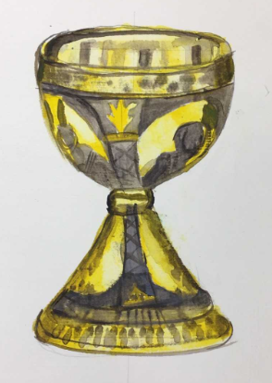
5. And likewise the cup after they had eaten, saying, "This cup is the new covenant in my blood, which will be shed for you." (Lk 22:20)
We thank God for keeping all his promises to us. May we keep our promises to him and know that he offers hope and mercy.
Artwork by a pupil in Westminster Cathedral Choir School

Slide 14
Hail Mary, Full of Grace
The Lord is with thee
Blessed art thou amongst women
And blessed is the fruit
of thy womb, Jesus,
Holy Mary, Mother of God,
Pray for us sinners
Now and at the hour
Of our death.
Amen.

Slide 15
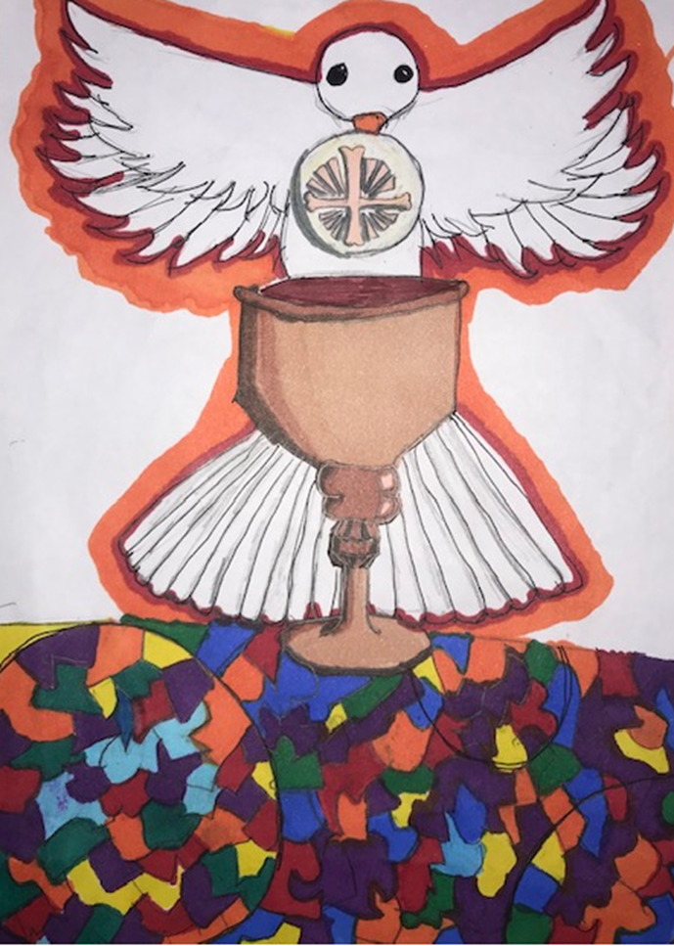
6. “For as often as you eat this bread and drink the cup, you proclaim the death of the Lord until he comes.” (1 Cor 11:26)
We thank God for giving us priests, teachers and parents to guide us in the faith. May they be strengthened in their vocation and continue to proclaim the Lord’s death and resurrection with us virtually until we meet face to face.
Artwork by a pupil in St Vincent’s Primary School, Westminster

Slide 16
Hail Mary, Full of Grace
The Lord is with thee
Blessed art thou amongst women
And blessed is the fruit
of thy womb, Jesus,
Holy Mary, Mother of God,
Pray for us sinners
Now and at the hour
Of our death.
Amen.

Slide 17
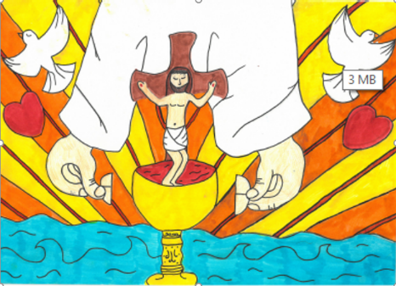
7. “I pray not only for them, but also for those who will believe in me through their word, so that they may all be one . . . that the world may believe that you sent me.”
(Jn 17:20-21)
We thank God for the gift of faith, especially during times of trial and suffering. May we increase our faith through prayer and action so that we can go out to love and serve the Lord.
Artwork by a pupil in St Agnes Primary School, Tower Hamlets

Slide 18
Hail Mary, Full of Grace
The Lord is with thee
Blessed art thou amongst women
And blessed is the fruit
of thy womb, Jesus,
Holy Mary, Mother of God,
Pray for us sinners
Now and at the hour
Of our death.
Amen.

Slide 19
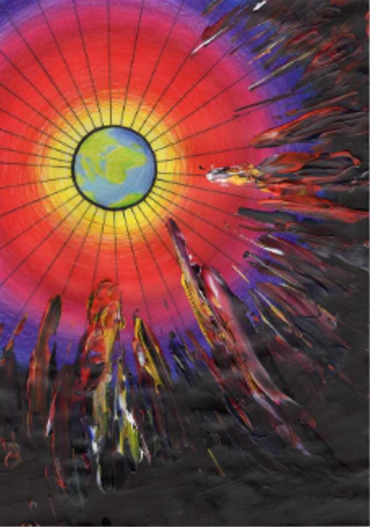
8. Now you are Christ's body, and individually parts of it. (1 Cor 12:27)
We thank God for being our compassionate and ever-present Father and for calling us into union with him. May we try to imitate Christ and be his hands and feet so that we can build up his kingdom on earth.
Artwork by a pupil in Sacred Heart High School, Hammersmith

Slide 20
Hail Mary, Full of Grace
The Lord is with thee
Blessed art thou amongst women
And blessed is the fruit
of thy womb, Jesus,
Holy Mary, Mother of God,
Pray for us sinners
Now and at the hour
Of our death.
Amen.

Slide 21
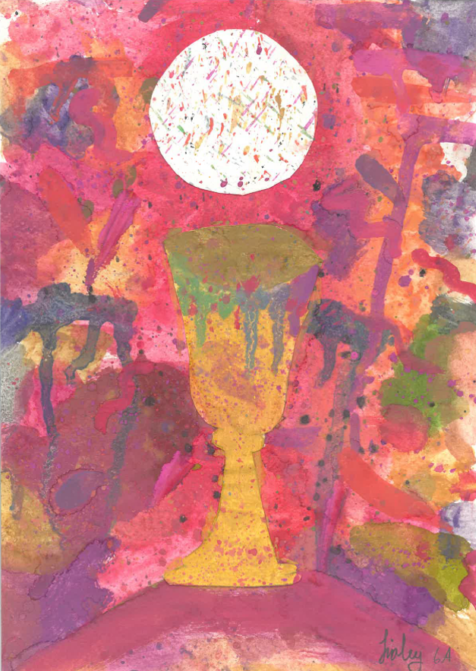
9. For in one Spirit we were all baptised into one body, whether Jews or Greeks, slaves or free persons, and we were all given to drink of one Spirit. (1 Cor 12:13)
We thank God for creating us to live in harmony with others and for loving each one of us personally and completely. May all leaders in the world help to bring about justice, equality and harmony around the world, especially during this time of great turmoil and civil unrest.
Image by a pupil in Holy Cross Primary School, Fulham

Slide 22
Hail Mary, Full of Grace
The Lord is with thee
Blessed art thou amongst women
And blessed is the fruit
of thy womb, Jesus,
Holy Mary, Mother of God,
Pray for us sinners
Now and at the hour
Of our death.
Amen.

Slide 23
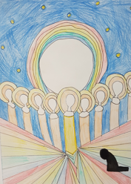
10. If [one] part suffers, all the parts suffer with it; if one part is honoured, all the parts share its joy. (1 Cor 12:26)
We thank God for our friends and families and all those who share our joys and sufferings. May we think of others’ needs before our own and help to spread joy where there is currently sadness, stress and despair.
Artwork by a pupil in St John Fisher Primary School, St Albans

Slide 24
Hail Mary, Full of Grace
The Lord is with thee
Blessed art thou amongst women
And blessed is the fruit
of thy womb, Jesus,
Holy Mary, Mother of God,
Pray for us sinners
Now and at the hour
Of our death.
Amen.

Slide 25
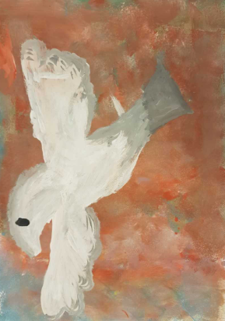
We trust that God who is all-knowing and compassionate will hear our prayers and send us his Holy Spirit so that we can offer ourselves completely to him with thankful hearts following the example of our Lord and Saviour, Jesus Christ.
Artwork by a pupil in St Anne’s Primary School, Tower Hamlets

Slide 26
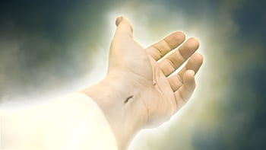
Glory be to the Father
And to the Son
And to the Holy Spirit
As it was in the beginning
Is now and ever shall be
World without end.
Amen.

Slide 27
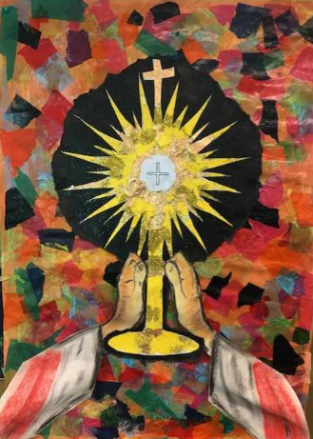
(The Prayer of Fatima)
Let us pray:
O my Jesus, forgive us our sins and save us from the fires of hell. Lead all souls to heaven, especially those who are in most need of your mercy.
Artwork by a pupil in St Teresa’s Primary School, Borehamwood

Slide 28
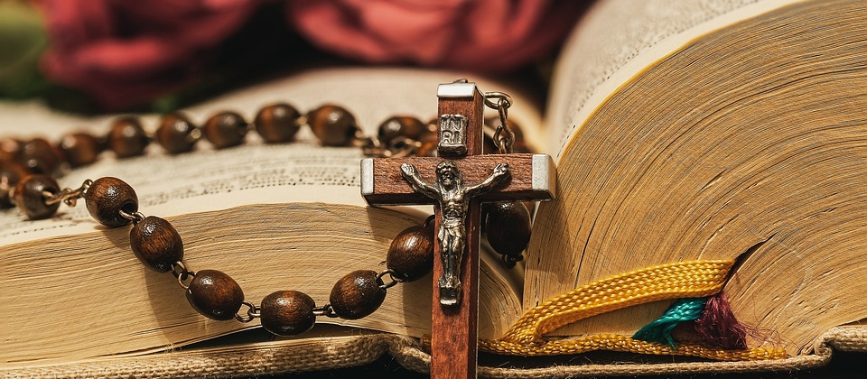
Thank you for joining us today…

