Slide 1
Blessed are the merciful FOR SECONDARY SCHOOLS
Notes:
Find a suitable place to pray where you can avoid distractions.
You may be alone or with others in your family. If you are with adults, you may wish to use a candle.
Breathe in and out 3 times quietly.
Ask God to be with you during this time of reflection.

Slide 2
GATHER
Father,
Thank you for your word.
Help us to listen
And show your love.
Amen
Notes:
Make the sign of the cross and say the prayer. You may also wish to pray for your own intentions.
We will be hearing the Word of God. Get your Bible and have it ready at Matthew 5:1-12

Slide 3
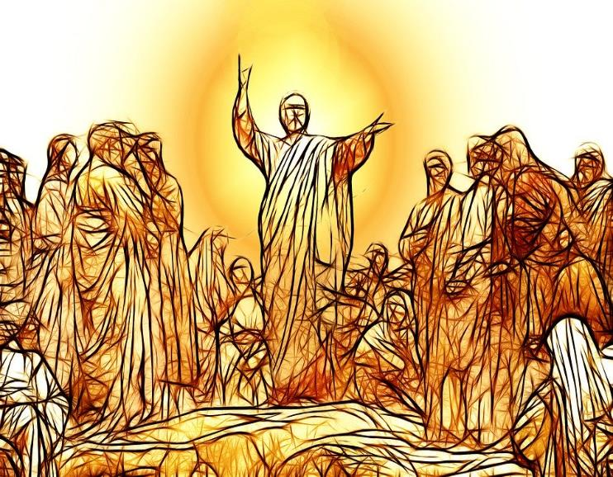
LISTEN
Jesus knew what brings real happiness so he taught us how to be truly happy or ‘blessed’.
He did this when he spoke to a large crowd on a mountain.
It is called ‘The Sermon on the Mount’.
He taught us about 8 attitudes which are called the Beatitudes.
Click here to watch the Sermon on the Mount
Or read Matthew 5:1-12 in your Bible or from the next slide.
Notes:
Be open to what God wants to say to you as you watch and/or read Matthew 5:1-12

Slide 4
LISTEN
Matthew 5:1-12 The Beatitudes
When Jesus saw the crowds, he went up the mountain; and after he sat down, his disciples came to him. Then he began to speak, and taught them, saying:
“Blessed are the poor in spirit, for theirs is the kingdom of heaven.
Blessed are those who mourn, for they will be comforted.
Blessed are the meek, for they will inherit the earth.
Blessed are those who hunger and thirst for righteousness, for they will be filled.
Blessed are the merciful, for they will receive mercy.
Blessed are the pure in heart, for they will see God.
Blessed are the peacemakers, for they will be called children of God.
Blessed are those who are persecuted for righteousness’ sake, for theirs is the kingdom of heaven.
Blessed are you when people revile you and persecute you and utter all kinds of evil against you falsely on my account. 12 Rejoice and be glad, for your reward is great in heaven, for in the same way they persecuted the prophets who were before you.”
Notes:
Can you remember who he said was ‘blessed’? Was it those who were powerful? Or got revenge? Or won?
What was Jesus trying to teach his followers then and now?
What will the merciful receive?

Slide 5
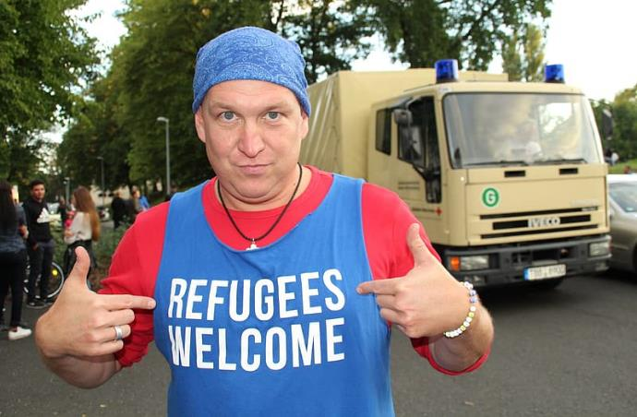
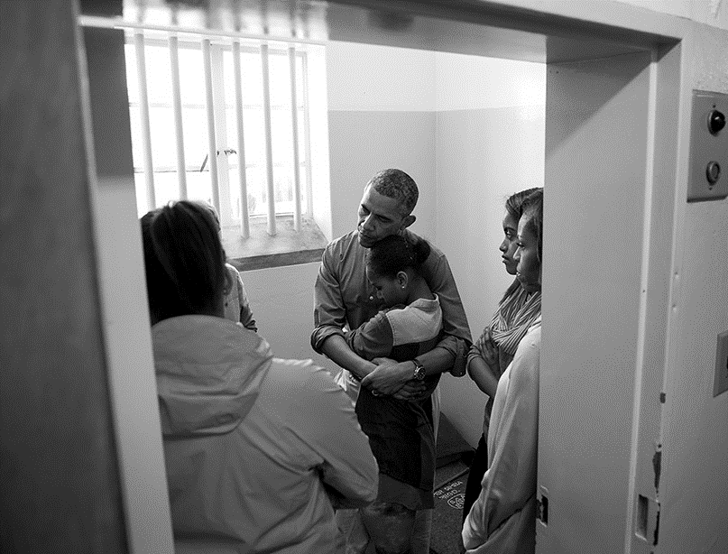
What is mercy?
Notes:
What is mercy?
Forgiving?
Let things go?
Being patient?
Accepting people make mistake?
Something else?
Spend time considering this question

Slide 6
What is mercy?
Mercy is withholding judgement or
punishment that someone deserves.
It is showing compassion or forgiveness towards someone
whom you could punish or harm.
Notes:
Read and think about these definitions of mercy.

Slide 7
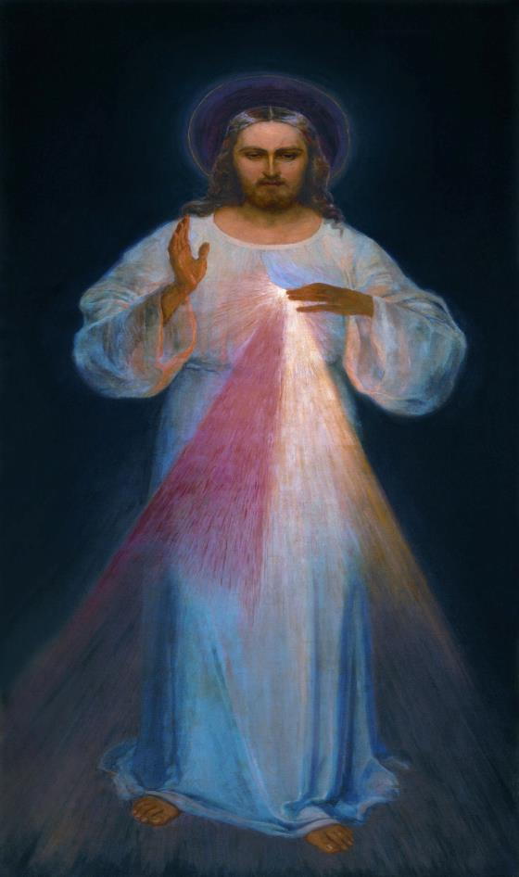
What is mercy?
Watch this video
What did Jesus mean when
he told us to be merciful?
Notes:
Watch this video at least twice and think about what Jesus was asking when he said “Blessed are the merciful…”
https://www.youtube.com/watch?v=QqB53Ojf4J0

Slide 8
Other Biblical Accounts of Mercy
Read Luke 15:11–32 or watch and think about the following questions –
Who showed mercy?
What effect does this mercy have?
How can we also be merciful?

Slide 9
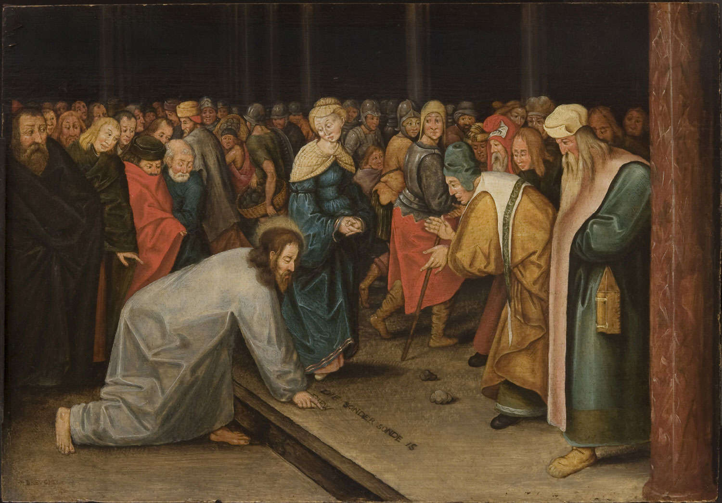
Read John 8:1-11 or watch and think about the following questions -
Who showed mercy?
What effect does this mercy have?
How can we also be merciful?

Slide 10
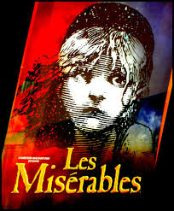
Watch this video clip and reflect on the power of mercy
Les Miserables

Slide 11
RESPOND
Have you ever been shown mercy?
Have you ever been merciful?
What impact did it have?
Notes:
Consider these questions for a few minutes.

Slide 12
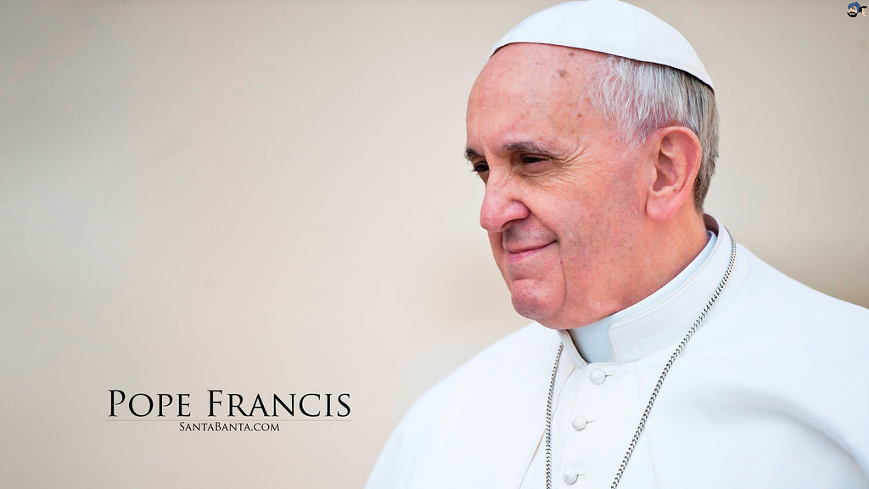
Why mercy?
“The time has come for the Church to take up the joyful call to mercy once more… Mercy is the force that reawakens us to new life and instills in us the courage to look to the future with hope.”
What does the Pope mean?
Notes:
What does the Pope mean?
Spend time consider why the Pope thinks showing mercy is so important.

Slide 13
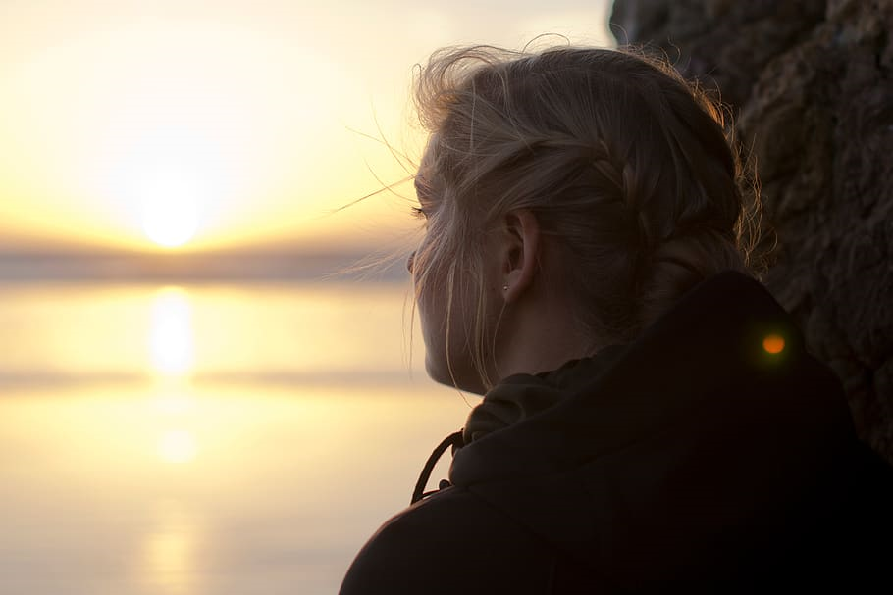
RESPOND - ‘Blessed are the merciful’
What does this mean for you?
How can you be merciful?
Notes:
Spend some time praying about these questions

Slide 14
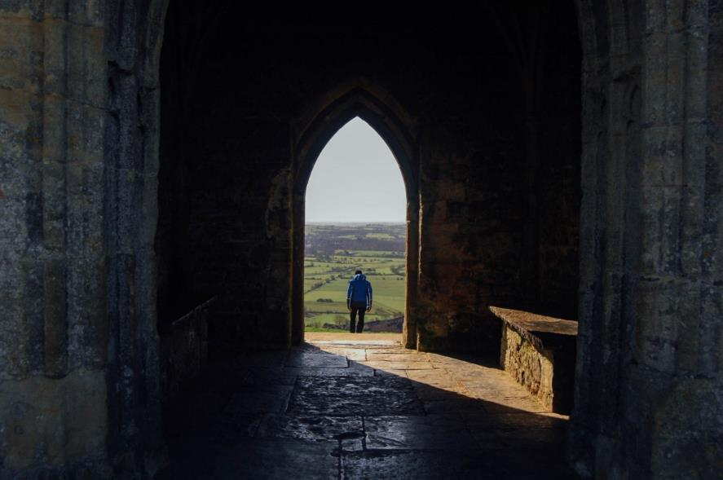
RESPOND - ‘Blessed are the merciful’
DO
Be patient with people
Give people a second chance
Be gentle
Let go of wrong doing
Notes:
Look at this list. Which ones do you do?
Ask God to help you to be merciful

Slide 15
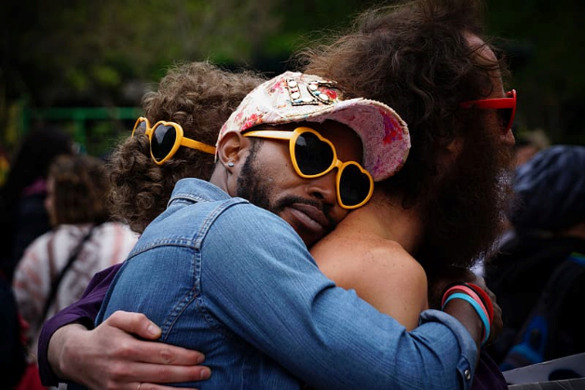
RESPOND - ‘Blessed are the merciful’
TRY NOT TO:
Judge people
Get angry
Berate people who have made mistakes
Forget everyone makes mistakes
Notes:
Ask God to give you the patience, wisdom and grace to be merciful, especially with those who frustrate you the most!

Slide 16
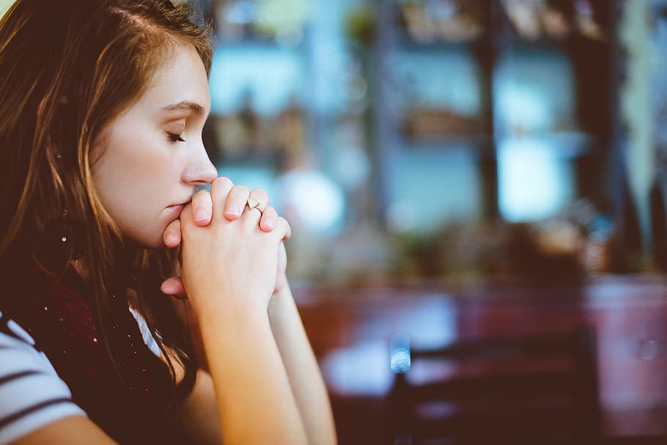
RESPOND - Prayer
Eternal God, in whom mercy is endless and the treasury of compassion — inexhaustible, look kindly upon us and increase Your mercy in us, that in difficult moments we might not despair nor become despondent, but with great confidence submit ourselves to Your holy will, which is Love and Mercy itself.
Amen
Notes:
Say this prayer – or make up your own prayer – about following Jesus’ teaching and being merciful.
In the name of the Father and of the Son and of the Holy Spirit. Amen.

Slide 17
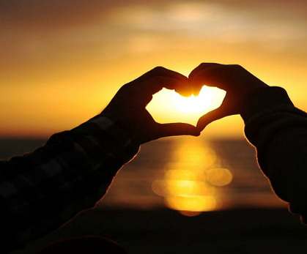
MISSION
Choose:
Write and decorate the words Jesus said about being merciful and learn them.
Find out about saints who were merciful. Say a prayer of/to your favourite one.
Research what Pope Francis said about mercy and how we should treat others.
Find out what else the Bible tells us about mercy.
Be merciful in your home today.
Find out about charities who work for mercy.
Notes:
Choose one of these activities to help you consider further what is means to follow Jesus’ words – “Blessed by the merciful…”

Slide 18
be MERCIFUL
Finish by quietly listening to this song about God's mercy

