Slide 1
A merciful saint saint john paul II
Notes:
Find a suitable place to pray where you can avoid distractions.
You may be alone or with others in your family. If you are with adults, you may wish to use a candle.
Breathe in and out 3 times quietly.
Ask God to be with you during this time of reflection.

Slide 2
GATHER
Heavenly Father
Thank you for the example of holy men and woman who show us how to draw near to you.
Amen
Notes:
Make the sign of the cross and say the prayer. You may also wish to pray for your own intentions.
We will be hearing the Word of God. Get your Bible and have it ready at Matthew 5:1-12

Slide 3
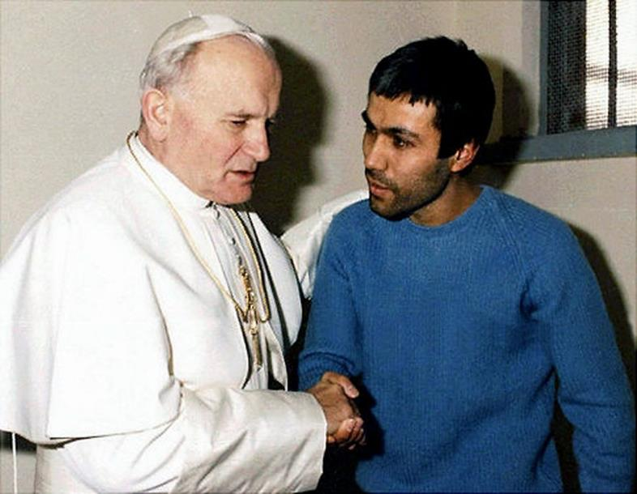
Who are these people?
What is happening here?

Slide 4
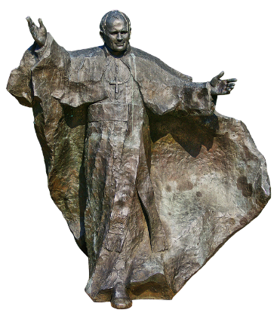
LISTEN
Karol Wojtyła was born in Poland in 1920
He became Pope in 1978, took the name John Paul II and was Pope until his death
in 2005
Among many achievements during his long papacy, John Paul II is recognised as
helping to end Communist rule in his native Poland, and eventually all of Europe.
He also significantly improved the Catholic Church's relations with Judaism, Islam,
and the Eastern Orthodox Church. He established World Youth Day and is now, among other patronages, the patron saint of young Catholics.
He was canonised in 2014 and is now St John Paul II.

Slide 5
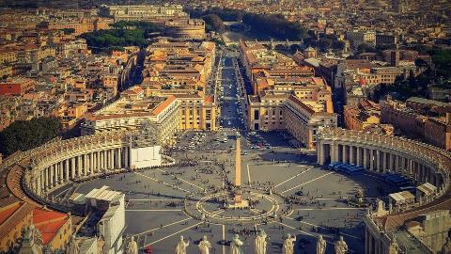
LISTEN
One day in 1981 something extraordinary happened in St Peter’s Square in Rome.
https://News Report
Notes:
Use the link to watch the news report

Slide 6
How do you think most people would react if this happened to them?

Slide 7
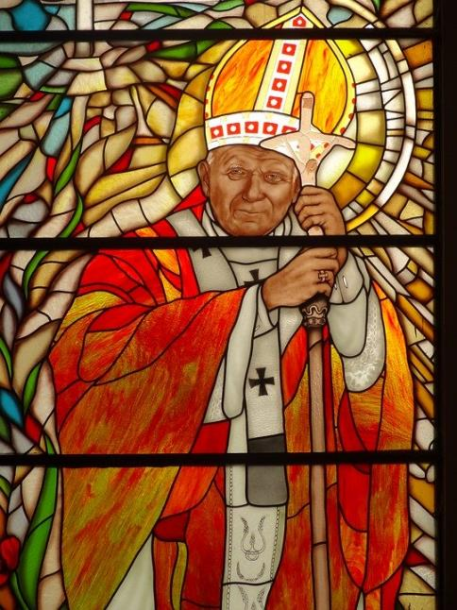
From his hospital bed Pope John Paul II asked for all Catholics to pray for Ağca, whom he had “sincerely forgiven.”
He later visited him in prison where they talked for 20 minutes and the Pope clasped his hands from time to time.

Slide 8
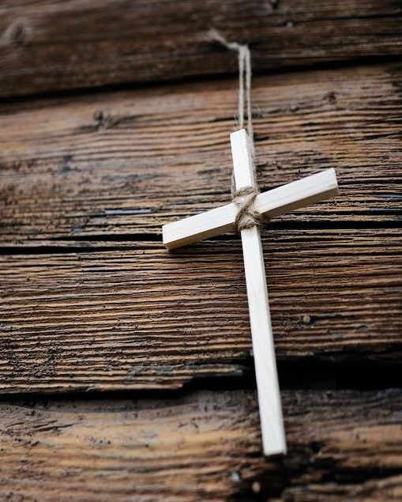
Pope John Paul II said "What we talked about will have to remain a secret between him and me,“……. "I spoke to him as a brother whom I have pardoned, and who has my complete trust.”
In 2000 the Italian president pardoned Ağca after the Pope had requested it for several years.

Slide 9
Respond : What is mercy?
Remember:
Mercy is withholding judgement or
punishment that someone deserves.
It is showing compassion or forgiveness towards someone whom you could punish or harm.
Notes:
Read and think about these definitions of mercy.

Slide 10
RESPOND : Think again …
Who are these people?
What is happening here?

Slide 11
RESPOND
What message does that visit send to you today?
What message can that visit send to the world in 2020?
At the time Time magazine reported that during the visit:
(although) the Pope spoke in whispers, he also meant to proclaim a message to the world.

Slide 12
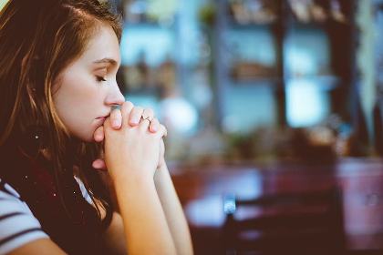
RESPOND - Prayer
Lord,
Help us to show mercy to others in the way that you showed mercy to those you met.
Thank you for the example of St John Paul II so that we may know that forgiveness is possible.
Amen
Notes:
Say this prayer – or make up your own prayer – about following Jesus’ teaching and being merciful.
In the name of the Father and of the Son and of the Holy Spirit. Amen.

Slide 13
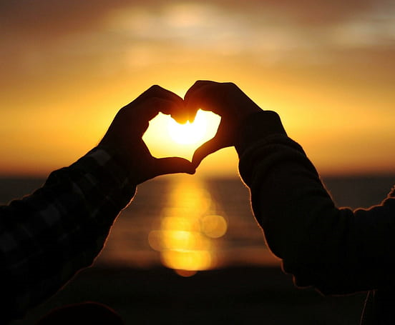
MISSION
Be an example of forgiveness to others.
Think of those you need to forgive. Pray for them and for you.
Learn about charities that help with reconciliation between individuals and groups – can you support their work?
Notes:
Choose one of these activities to help you consider further what is means to follow Jesus’ words – “Blessed by the merciful…”

