Slide 1
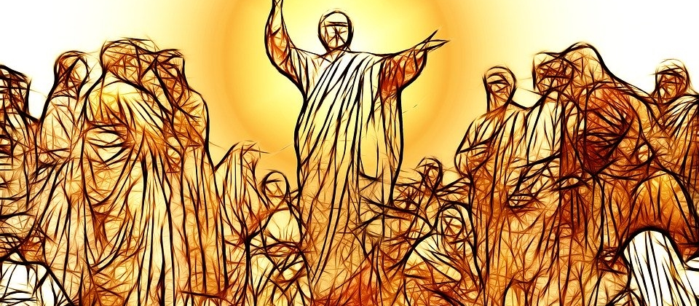
The Beatitudes - Blessed are those who hunger and thirst for Righteousness.
Matthew 5: 1 - 12

Slide 2
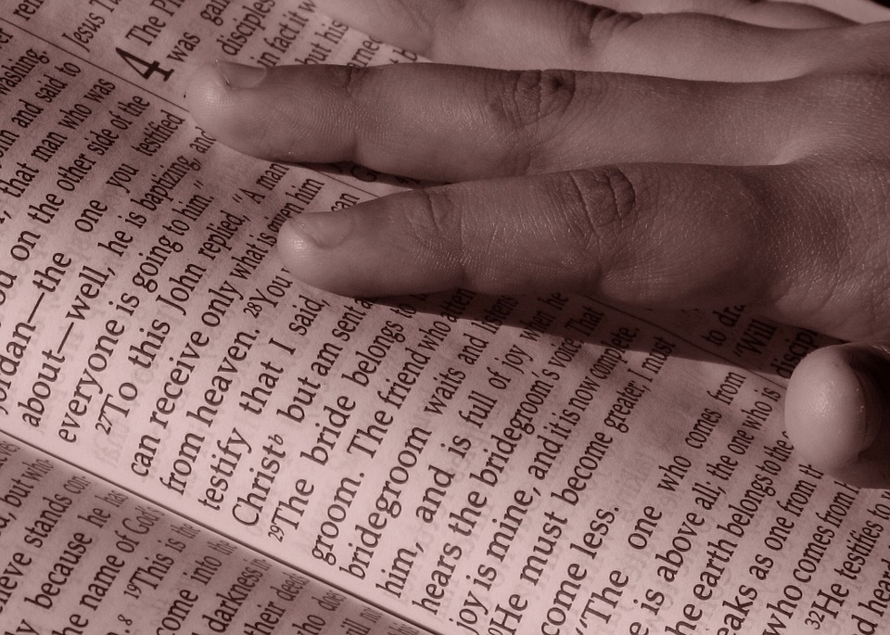
Gather: Hunger for Righteousness

Slide 3
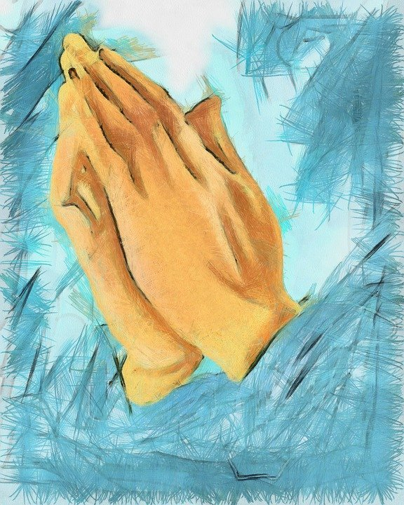
Father,
Thank you for your word.
Help us to listen
And show your love.
Amen

Slide 4
Listen: Hunger for Righteousness

Slide 5
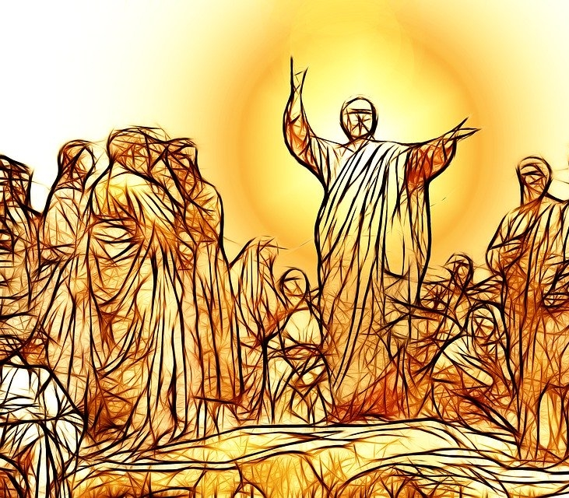
During the Sermon on the Mount, Jesus ‘gave’ us the Beatitudes.

Slide 6
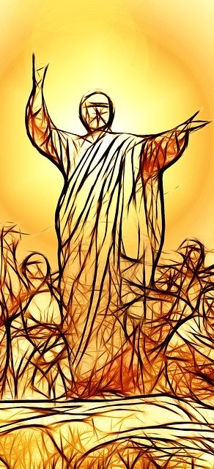
Matthew 5:1-12
The Beatitudes
When Jesus saw the crowds, he went up the mountain; and after he sat down, his disciples came to him.
Then he began to speak, and taught them, saying:

Slide 7
Blessed are the merciful, for they will be shown mercy.
Blessed are the pure in heart, for they will see God.
Blessed are the peacemakers, for they will be called children
of God.
Blessed are those who are persecuted because of
righteousness, for theirs is the kingdom of heaven.
Blessed are the poor in spirit, for theirs is the kingdom of heaven.
Blessed are those who mourn, for they will be comforted.
Blessed are the meek, for they will inherit the earth.
Blessed are those who hunger
and thirst for righteousness, for they shall be satisfied.
Notes:
Background music plays automatically; turn down sound if you would prefer.

Slide 8
“Blessed are those who hunger and thirst for righteousness, for they shall be satisfied.”
Matthew 5:6
The fourth beatitude tells us...

Slide 9
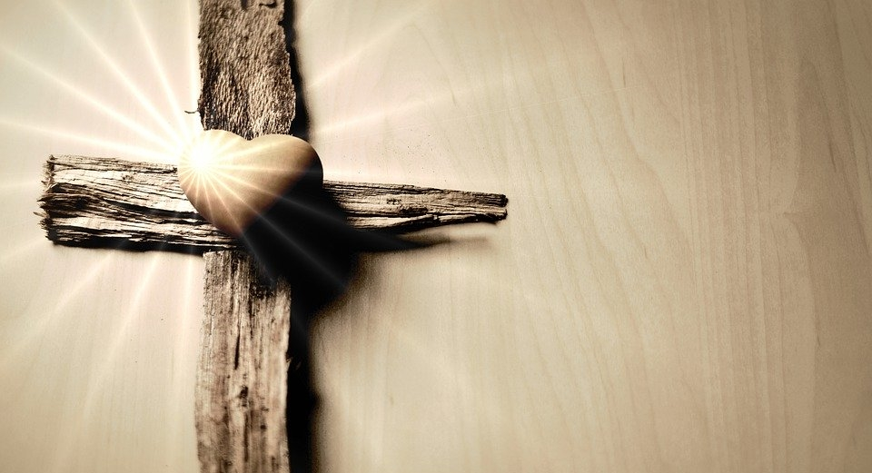
What does it mean to ‘be righteous’...
to ‘thirst for righteousness?

Slide 10
To ‘be righteous’ means to be...

Slide 11
Morally Right/ Just
Doing the right thing
Good
Virtuous

Slide 12
Upright/
Upstanding
Decent
Worthy
Ethical

Slide 13
Which picture do you think best shows ways of ‘being righteous’?
Take a moment to think...

Slide 14
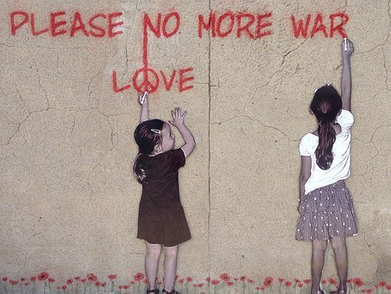
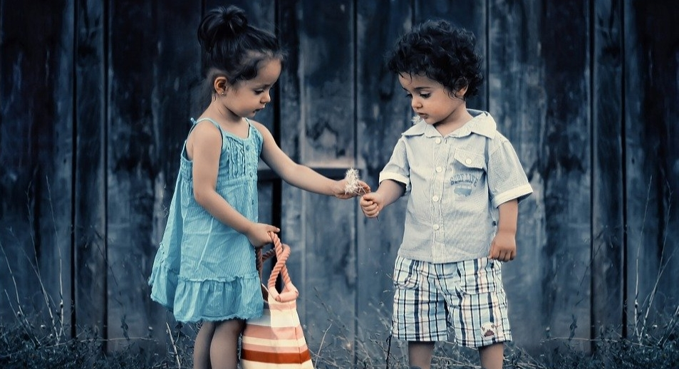
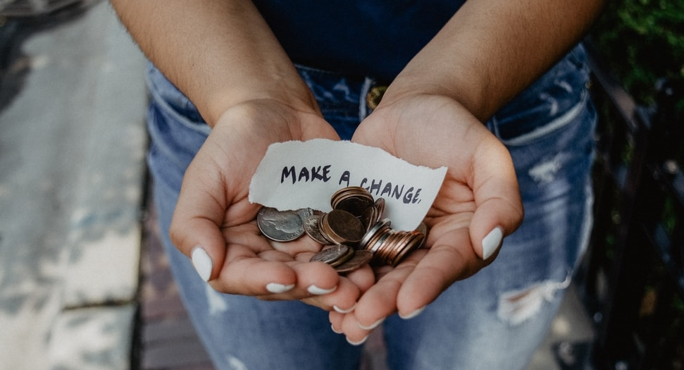
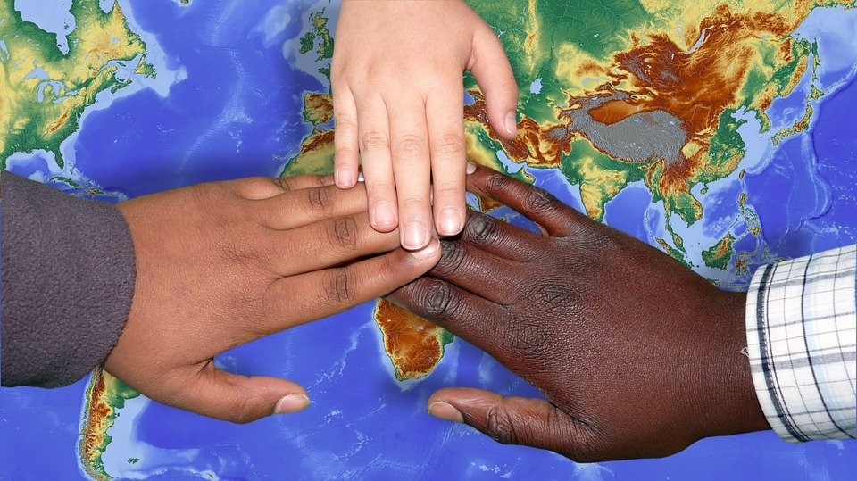

Slide 15
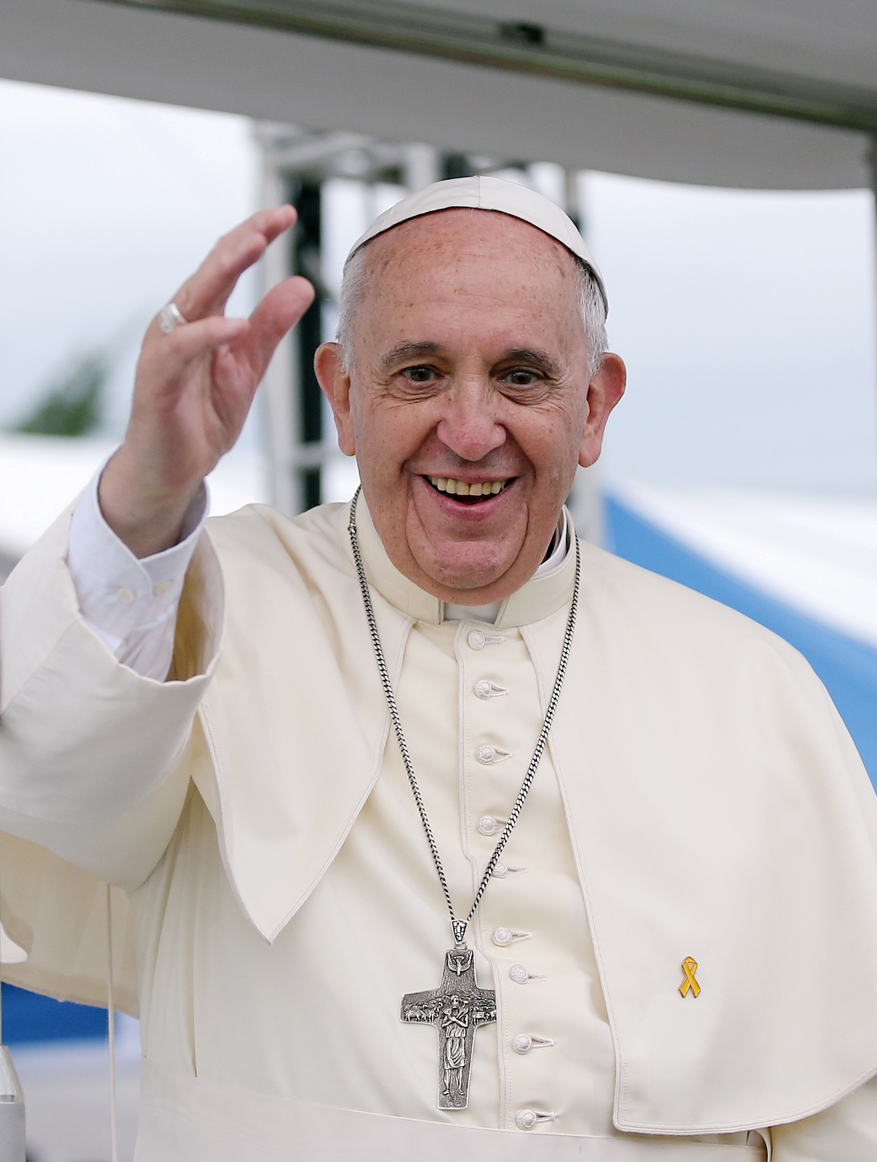
“Humanity needs justice, peace and love and we can have this only by returning with our hearts towards God who is the source of all this.”
Pope Francis
Notes:
What do you think Pope Francis meant by this?

Slide 16
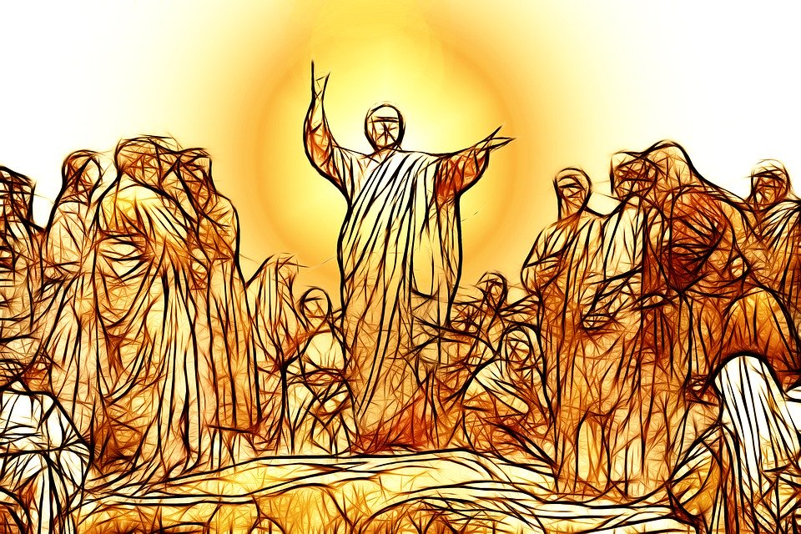

Slide 17
Respond: Hunger for Righteousness

Slide 18
How can we show that we are Righteous?

Slide 19
‘Blessed are the righteous’
Try to hunger and thirst for Righteousness by:
Doing the right thing in school and at home
Making good choices
Doing good deeds at home, school and in the community.
Showing kindness and compassion for those
that are lonely, sad or in need of a friend.

Slide 20
‘Blessed are the righteous’
Try to hunger and thirst for Righteousness by:
Showing compassion for our sisters and brothers around the world, who are in need of our help.
Taking care of God’s creation, at home and further afield.
Living more simply, not always wanting more.

Slide 21
“To all people of good will who are working for social justice: never tire of working for a more just world, marked by greater solidarity!”
Pope Francis
Notes:
What do you think Pope Francis means by this?
What does ‘liberation’ mean?
Why ‘must’ we ‘breathe’ it?

Slide 22
Respond - Prayer
Breathe in me, O Holy Spirit, that my thoughts may all be holy.
Act in me, O Holy Spirit, that my work too, may be holy.
Draw my heart, O Holy Spirit, that I love but what is holy.
Strengthen me, O Holy Spirit, to defend all that is holy.
Guard me, then, O Holy ‘Spirit, that I always may be holy.
Amen.
— St. Augustine

Slide 23
Mission: Hunger for Righteousness

Slide 24
Mission
How can you do the right thing today?
Create a list of acts of kindness that you can then turn into actions in school and at home.
Research different charities, locally, nationally and internationally that aim to help people – Then think about ways you can get involved to support their work.
Think about someone who is lonely and how you can bring a smile to them today.
Create ideas on ways you can look after God’s creation in your local area and beyond

Slide 25
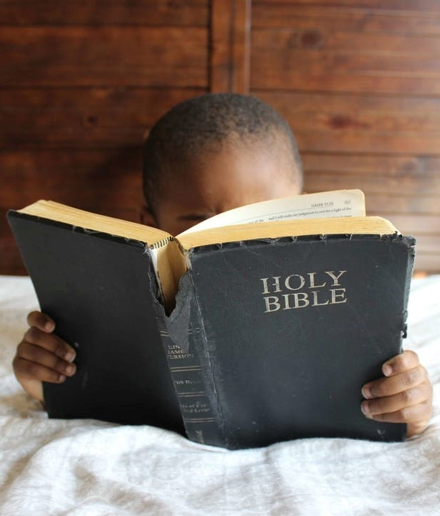
‘Blessed are those who hunger and thirst for righteousness’ Matthew 5:6

