Slide 1
Blessed are thE righteous FOR SECONDARY SCHOOLS
Notes:
Find a suitable place to pray where you can avoid distractions.
You may be alone or with others in your family. If you are with adults, you may wish to use a candle.
Breathe in and out 3 times quietly.
Ask God to be with you during this time of reflection.

Slide 2
GATHER
Father,
Thank you for your word.
Help us to listen
And show your love.
Amen
Notes:
Make the sign of the cross and say the prayer. You may also wish to pray for your own intentions.
We will be hearing the Word of God. Get your Bible and have it ready at Matthew 5:1-12

Slide 3
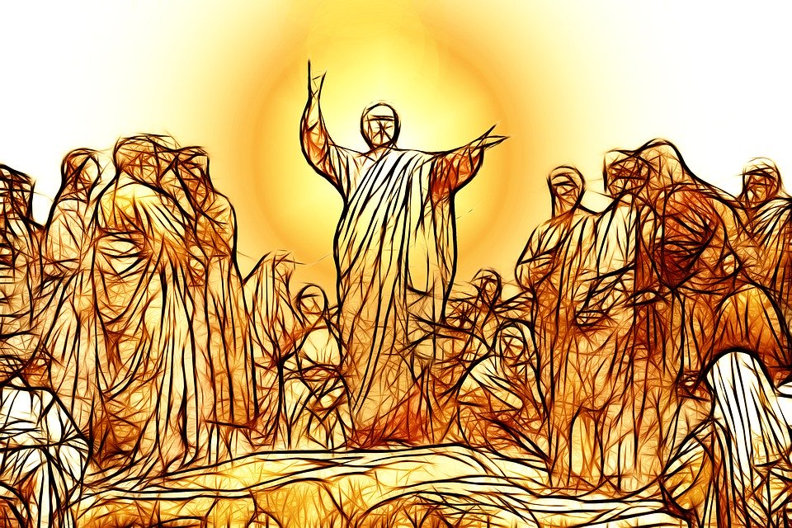
LISTEN
Jesus knew what brings real happiness so he taught us how to be truly happy or ‘blessed’.
He did this when he spoke to a large crowd on a mountain.
It is called ‘The Sermon on the Mount’.
He taught us about 8 attitudes which are called the Beatitudes.
Click here to watch the Sermon on the Mount
Or read Matthew 5:1-12 in your Bible or from the next slide.
Notes:
Be open to what God wants to say to you as you watch and/or read Matthew 5:1-12

Slide 4
LISTEN
Matthew 5:1-12 The Beatitudes
When Jesus saw the crowds, he went up the mountain; and after he sat down, his disciples came to him. Then he began to speak, and taught them, saying:
“Blessed are the poor in spirit, for theirs is the kingdom of heaven.
Blessed are those who mourn, for they will be comforted.
Blessed are the meek, for they will inherit the earth.
Blessed are those who hunger and thirst for righteousness, for they will be filled.
Blessed are the merciful, for they will receive mercy.
Blessed are the pure in heart, for they will see God.
Blessed are the peacemakers, for they will be called children of God.
Blessed are those who are persecuted for righteousness’ sake, for theirs is the kingdom of heaven.
Blessed are you when people revile you and persecute you and utter all kinds of evil against you falsely on my account. 12 Rejoice and be glad, for your reward is great in heaven, for in the same way they persecuted the prophets who were before you.”
Notes:
Can you remember who he said was ‘blessed’? Was it those who were content? Who live a quiet life?
What does it mean to hunger and thirst for something?
What will happen to those who hunger and thirst for righteousness?

Slide 5
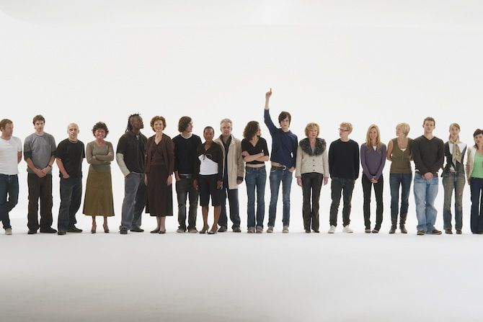
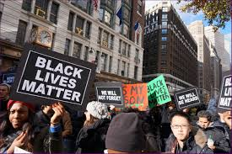
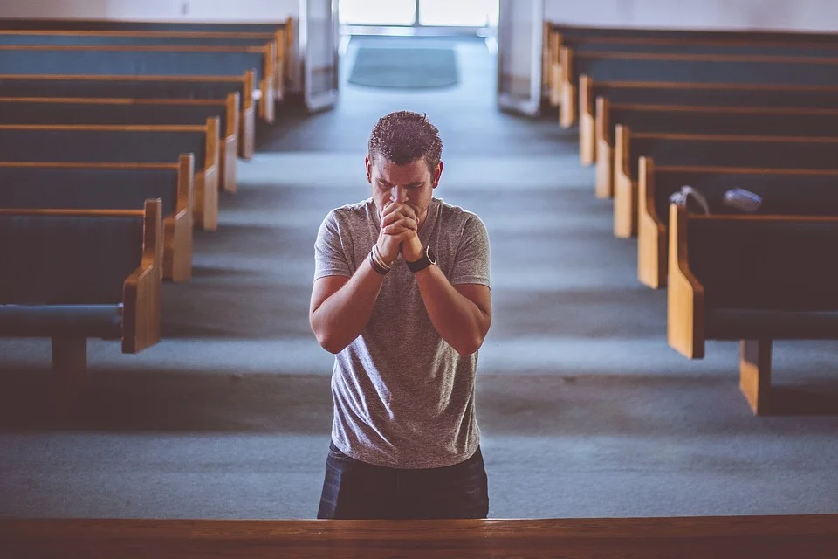
What is righteousness?
Notes:
What is righteousness?
Being right?
Doing things right?
Putting other people in their place?
Something else?
Spend time considering this question

Slide 6
What is righteousness?
Righteousness can be understood by Catholics in two ways -
Being morally right or justifiable
Being spiritually ‘right’ with God
Notes:
Read and think about these definitions of righteousness.

Slide 7
What does it mean to ‘hunger and thirst for righteousness?’
Some Catholics understand this to mean we should desire (like when we are hungry and thirsty) what is right for our world.
Therefore we should stand up against injustice and make things right.
Watch this video
Notes:
Watch the video and discuss what we it means to ‘hunger and thirst for righteousness’ in your community?

Slide 8
What does it mean to ‘hunger and thirst for righteousness?’
Some Catholics understand this to mean we should desire what is ‘right’ for God. Or put another way we should need God like when we are hungry or thirsty.
Watch this video
Notes:
How can we desire to be ‘right’ with God?
How would this change what we spend our time doing?
Link to video –
https://www.youtube.com/watch?v=dJp4DzxrlEo

Slide 9
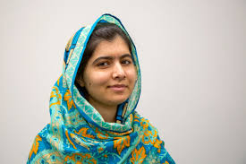
Other Biblical References to Righteousness
‘Light dawns in the darkness for the upright; they are gracious, merciful, and righteous. All is well with the person who deals generously and lends; who conducts their affairs with justice. For the righteous will never be moved; they will be remembered forever. They are not afraid of bad news; their hearts are firm, trusting in the Lord. Their heart is steady; they will not be afraid, until they look in triumph on their adversaries.’
Psalm 112:4-8
Watch this
Notes:
Malala – stood up for girls education in Pakistan and was shot as a result - https://www.bbc.co.uk/news/magazine-24379018
Discuss other people who the students might know who have acted righteously - this can be people they know or famous people.

Slide 10
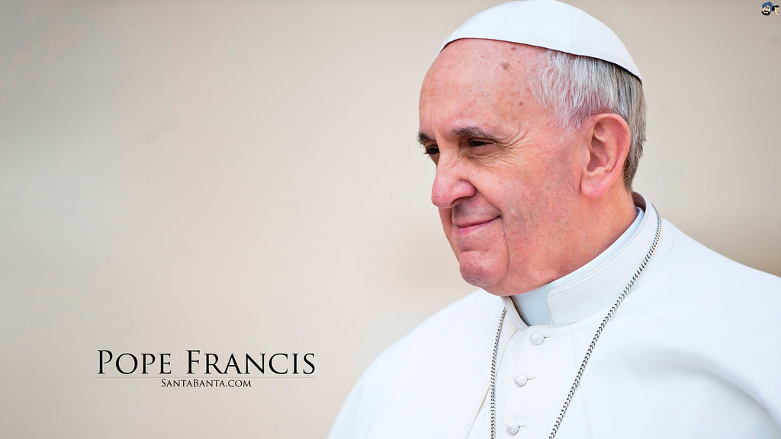
Why righteousness?
“… This Beatitude promises us that by promoting justice in this highest sense, we will find true satisfaction, for our thirsting for righteousness will be quenched by the love God pours out upon his children.”
What does the Pope mean?
Notes:
What does the Pope mean?
Spend time considering this.

Slide 11
RESPOND - ‘Blessed are the righteous’
What does this mean for you?
How can you hunger and thirst for righteousness?
Notes:
Spend some time praying about these questions

Slide 12
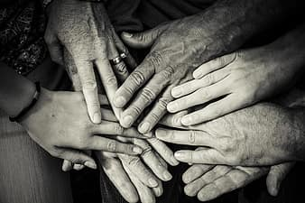
RESPOND - ‘Blessed are the righteous’
DO
Spent time seeking God through prayer or reading the Bible
Ask God to give you a hunger for Him and for others
Take time to consider what is not right in your community and our world
Find ways to overcome what
is not right
Notes:
Look at this list. Which ones can you do?
Ask God to help you to be righteous

Slide 13
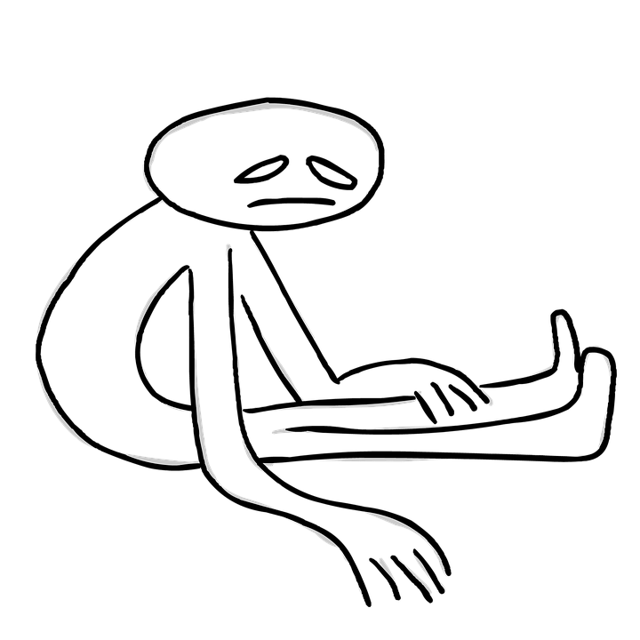
RESPOND - ‘Blessed are the merciful’
TRY NOT TO:
Be indifferent to God
Be apathetic to what is not right in the world
Be hard hearted
Notes:
Ask God to give you the patience, wisdom and grace to be merciful, especially with those who frustrate you the most!

Slide 14
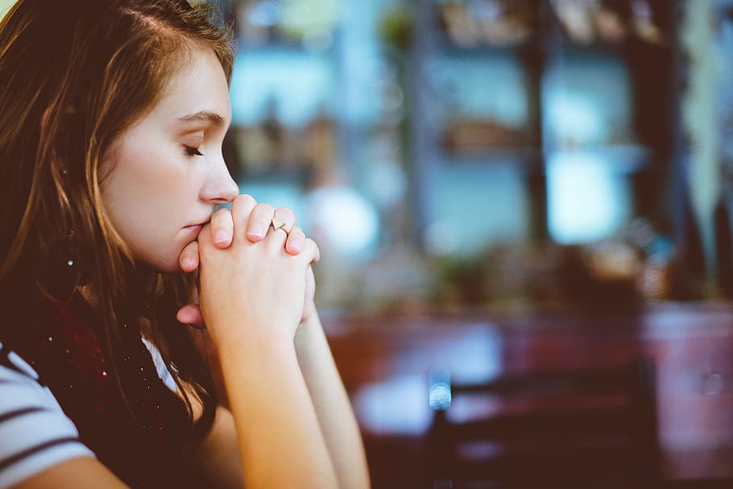
RESPOND - Prayer
Lord, make us hungry and thirsty for your righteousness.
Give us a desire for your will so we can then discern what is not right in our world.
Help us to then build Your Kingdom on earth.
Through Jesus Christ our Lord we pray.
Amen
Notes:
Say this prayer – or make up your own prayer – about following Jesus’ teaching and being righteous
In the name of the Father and of the Son and of the Holy Spirit. Amen.

Slide 15
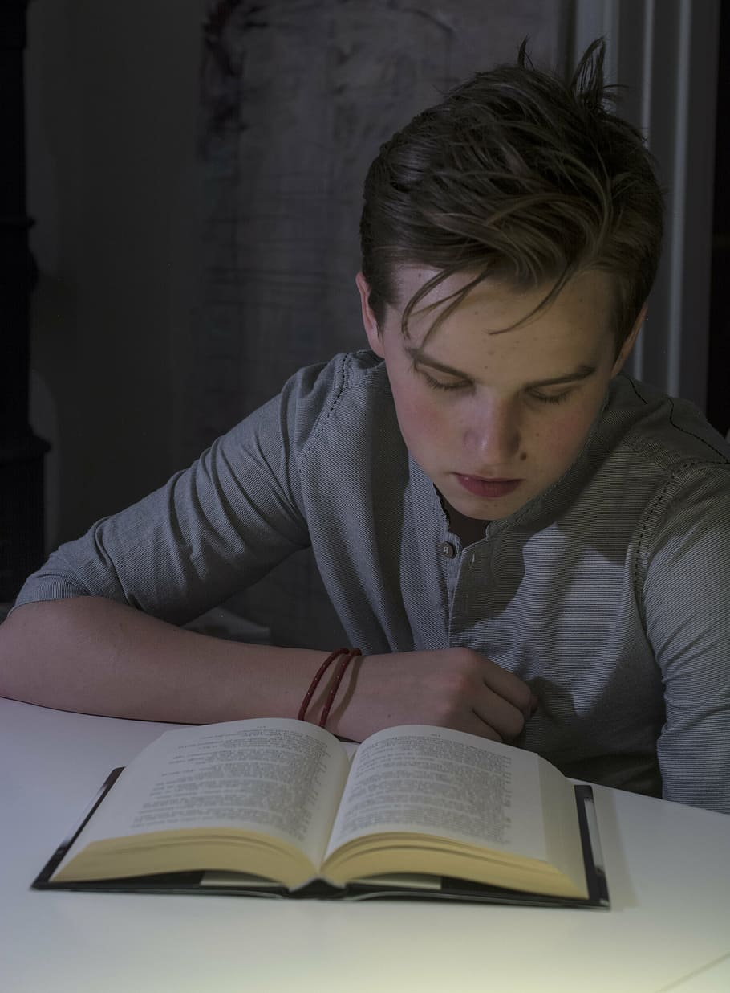
MISSION
Choose:
Write and decorate the words Jesus said about being righteous and learn them.
Find out about saints who were righteous. Say a prayer of/to your favourite one.
Research what Pope Francis said about righteousness and how we should treat others.
Find out what else the Bible tells us about righteousness.
Be righteous.
Find out about charities who work to do what is right.
Notes:
Choose one of these activities to help you consider further what is means to follow Jesus’ words – “Blessed by those who hunger and thirst for righteousness…”

Slide 16
Be righteous
Notes:
Other links:
- https://www.openbible.info/topics/righteousness
https://www.romereports.com/en/2020/03/11/pope-francis-explains-what-it-means-to-thirst-for-righteousness/
https://www.youtube.com/watch?v=q6fmzE3dk0s&list=PL0NrSPXV4RbOR90mJ6nZ_9TEB0a6uk_Rf&index=5

