Slide 1
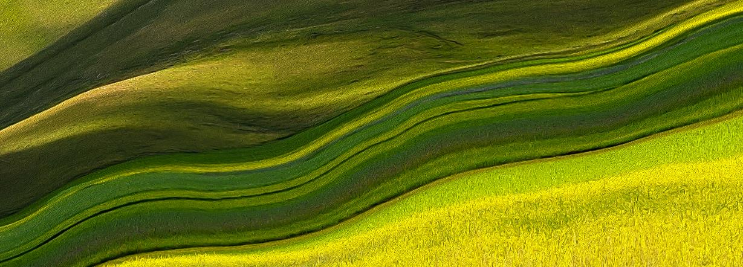
‘Blessed are those who are persecuted for righteousness’ sake, for theirs is the kingdom of heaven.’
Notes:
Find a suitable place to pray where you can avoid distractions.
You may be alone or with others in your family. If you are with adults, you may wish to use a candle.
Breathe in and out 3 times quietly.
Ask God to be with you during this time of reflection.

Slide 2
GATHER
Father,
Thank you for your word.
Help us to listen
And show your love.
Amen
Notes:
Make the sign of the cross and say the prayer. You may also wish to pray for your own intentions.
We will be hearing the Word of God. Get your Bible and have it ready at Matthew 5:1-12

Slide 3
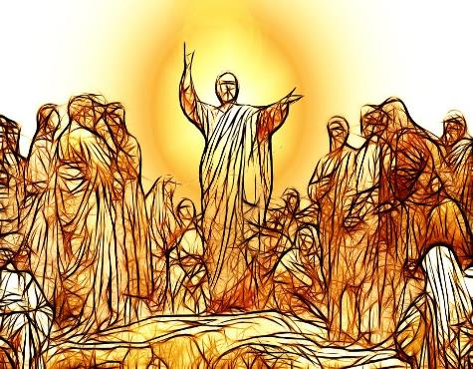
LISTEN
Jesus knew what brings real happiness so he taught us how to be truly happy or ‘blessed’.
He did this when he spoke to a large crowd on a mountain.
It is called ‘The Sermon on the Mount’.
He taught us about 8 attitudes which are called the Beatitudes.
Click here to watch the Sermon on the Mount
Or read Matthew 5:1-12 in your Bible or from the next slide.
Notes:
Be open to what God wants to say to you as you watch and/or read Matthew 5:1-12

Slide 4
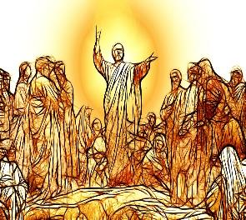
LISTEN
Matthew 5:1-12 The Beatitudes
When Jesus saw the crowds, he went up the mountain; and after he sat down, his disciples came to him. Then he began to speak, and taught them, saying:
“Blessed are the poor in spirit, for theirs is the kingdom of heaven.
Blessed are those who mourn, for they will be comforted.
Blessed are the meek, for they will inherit the earth.
Blessed are those who hunger and thirst for righteousness, for they will be filled.
Blessed are the merciful, for they will receive mercy.
Blessed are the pure in heart, for they will see God.
Blessed are the peacemakers, for they will be called children of God.
Blessed are those who are persecuted for righteousness’ sake, for theirs is the kingdom of heaven.
Blessed are you when people revile you and persecute you and utter all kinds of evil against you falsely on my account. Rejoice and be glad, for your reward is great in heaven, for in the same way they persecuted the prophets who were before you.”
Notes:
Can you remember who he said was ‘blessed’?
What does it mean to be persecuted?
What will happen to those who are persecuted for righteousness’ sake?
What does this mean?

Slide 5
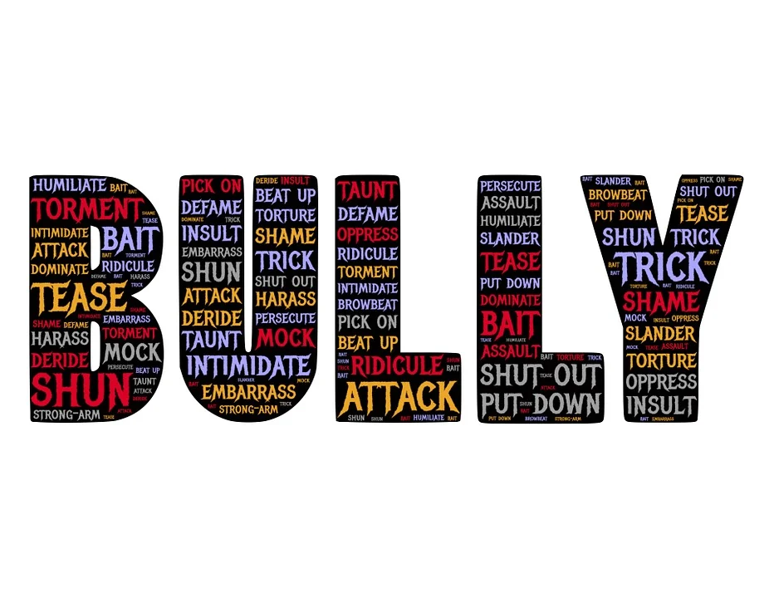
What does it mean to be ‘persecuted’?
Put simply, to be ‘persecuted’ means
to suffer because of your beliefs.
The early Christians were persecuted when they were put in prison, tortured or even killed because of their faith.
Some Christians still face these challenges but in England now it may mean people laughing at you or mocking you for being a Catholic and doing the right thing.
Notes:
Read and think about what it means.

Slide 6
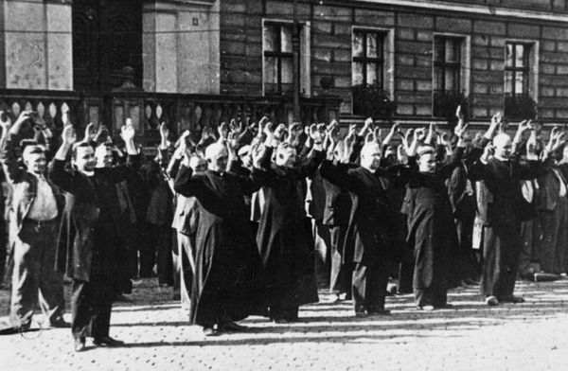
Polish priests and Catholic civilians in Bydgoszcz's Old Market Square, 9 September 1939. The Polish Church experienced brutal persecution under Nazi occupation.
Notes:
Read and discuss this image

Slide 7
What does it mean to be ‘righteous’?
The word ‘righteous’ means in Greek ‘dikaiosune.’ This is the character trait or quality of being ‘just’ or ‘right’.
It’s an attribute of God and used in the teachings of Jesus.
Also, it’s the sum of all the requirements of God.
Being righteous means you would live just like God would
want you to live, in our relationship with others
and with the rest of creation.
Notes:
Read and think about what this means

Slide 8
Can you think of any other words which would describe someone who is ‘righteous’?
Conscientious
Spiritual
Noble
Seek justice
Ethical
Pure
Honourable
Upright
Notes:
Check students understand all these words

Slide 9
So what does ‘persecuted for righteousness’ sake’ mean?
Notes:
Watch this video

Slide 10
Pope Francis’ reflection….
Notes:
Watch this video

Slide 11
RESPOND - ‘Blessed are those who are persecuted for righteousness’ sake’
DO:
Think about what God would want you to do in certain situations and then act in this way regardless of what other people say or do.
Put the needs of others before yourselves.
Recognise when something ‘isn’t right’ and do something to make it better, even if people mock you.
Notes:
Look at this list. Which ones can you do?
Ask God to help you to be persecuted for righteousness’ sake

Slide 12
RESPOND - ‘Blessed are those who are persecuted for righteousness’ sake’
TRY NOT TO:
Put your needs above the needs of others.
Accept things that we know are unfair, especially in the way that people treat each other.
Judge others and be critical of their behaviour or actions.
Make people feel inferior or inadequate for any reason.
Ignore situations where people are being treated unfairly or unkindly.

Slide 13
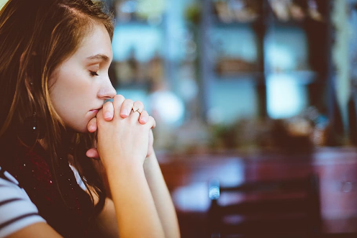
RESPOND - Prayer
Righteous God,
Help us to be more like you and actively pursue righteousness and love regardless of the consequences.
Help us not want to waste our time being like the world because the world can only offer temporary, unsatisfactory things.
Help us to remember that you offer life, love and honour and that we must help bring those to others.
Your Word says that the righteous will never be shaken and will be remembered forever.
Thank you for your righteousness.
Amen.
Notes:
Say this prayer – or make up your own prayer
In the name of the Father and of the Son and of the Holy Spirit. Amen.

Slide 14
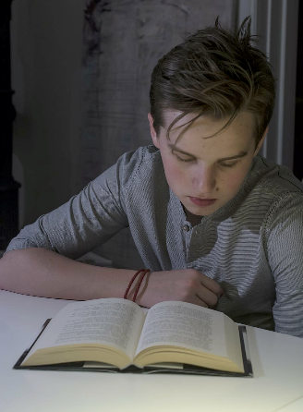
MISSION
Choose:
Design/Create a ‘Cool to be Catholic!’ poster/logo which demonstrates how we are called to stand up for what we believe in.
During the Sermon on the Mount, Jesus told the gathered crowds that they were the ‘light of the world’; how can we ‘shine’ for others, in home, at school and in the wider community?
Can you think of 3 – 4 ‘injustices’ that you have seen in your daily life; how could you help to correct these and make ‘your’ world a better place?
Which charities that are you involved in through school, or personally, support victims of injustice and try to make their lives better? How could you support them further?
Notes:
Choose one of these activities to help you consider further what is means to follow Jesus’ words.

Slide 15
‘To consider ourselves righteous is to leave God, the only righteous one, out in the cold.’
Pope Francis

