Slide 1
Praying the Rosary with the Diocese of Westminster
Agony in the Garden: Friday 18th September 2020

Slide 2
‘The Rosary is the prayer of the humble and of the saints. In its mysteries, they contemplate, along with Mary, the life of Jesus, the merciful face of the Father. O, how much we all need to be truly comforted, to be wrapped in loving presence!
Pope Francis (April 2020)

Slide 3
We offer this decade of the Rosary for all those affected by the coronavirus and we ask the help of Our Blessed Mother, Mary, to take our prayers to her beloved son, Jesus.
-

Slide 4
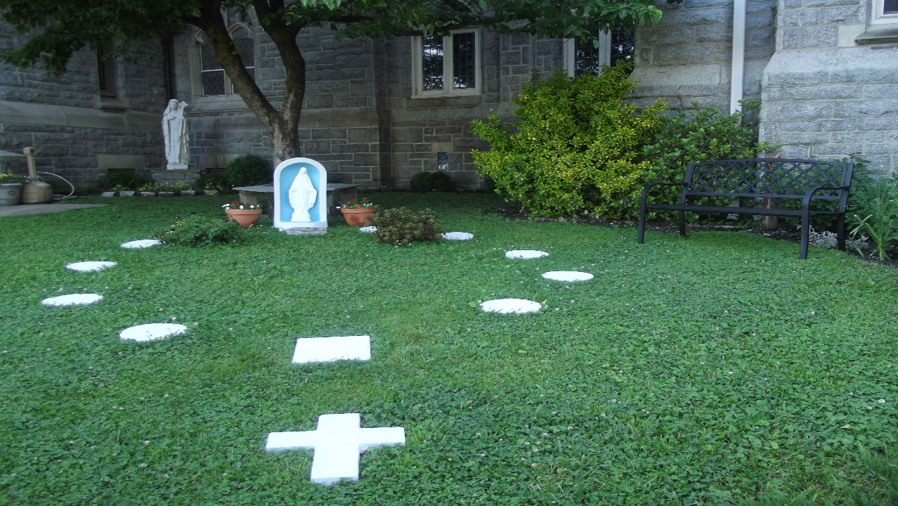
Our Father
Who art in heaven
Hallowed be thy name
Thy kingdom come
Thy will be done
On earth as it is in heaven
Give us this day our daily bread
And forgive us our trespasses
As we forgive those
who trespass against us
And lead us not into temptation
But deliver us from evil.
Amen.

Slide 5
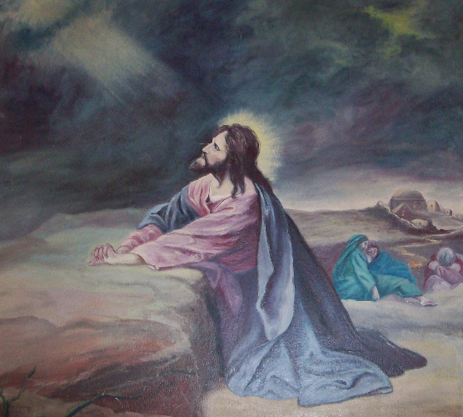
1
Jesus comes with his disciples to Gethsemane: “Stay here, while I go yonder and pray.”
Guide us to put Jesus at the centre of our lives every day. Help us to listen to what Jesus is telling us in the Gospel and keep it faithfully in our hearts.

Slide 6
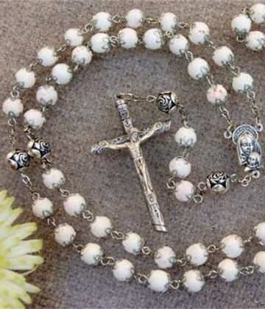
Hail Mary, Full of Grace
The Lord is with thee
Blessed art thou amongst women
And blessed is the fruit
of thy womb, Jesus,
Holy Mary, Mother of God,
Pray for us sinners
Now and at the hour
Of our death.
Amen.

Slide 7
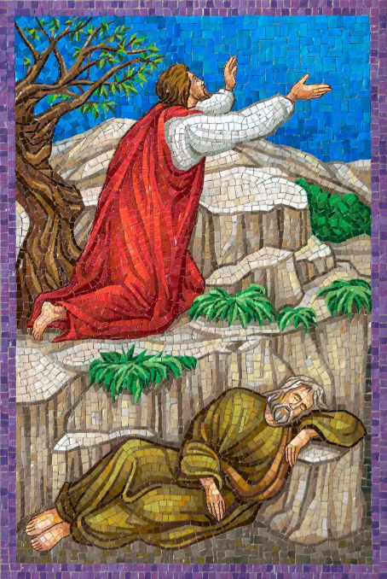
2
Entering the garden with Peter, James, and John, Jesus prays, “My soul is sorrowful unto death.”
Help us to be courageous and face the times that are difficult. Help us to be as brave as your son.

Slide 8
Hail Mary, Full of Grace
The Lord is with thee
Blessed art thou amongst women
And blessed is the fruit
of thy womb, Jesus,
Holy Mary, Mother of God,
Pray for us sinners
Now and at the hour
Of our death.
Amen.

Slide 9
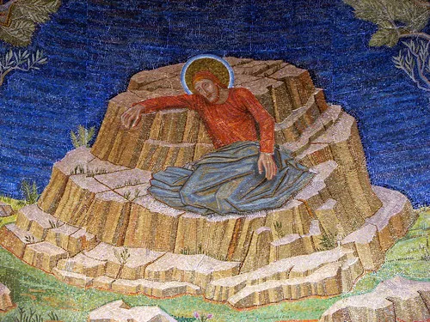
3
Jesus sees the sins of all mankind, whose guilt he has taken upon himself.
Help us to acknowledge and understand what we have done wrong. We pray for forgiveness for our sins and guidance to learn how to not sin again.

Slide 10
Hail Mary, Full of Grace
The Lord is with thee
Blessed art thou amongst women
And blessed is the fruit
of thy womb, Jesus,
Holy Mary, Mother of God,
Pray for us sinners
Now and at the hour
Of our death.
Amen.

Slide 11
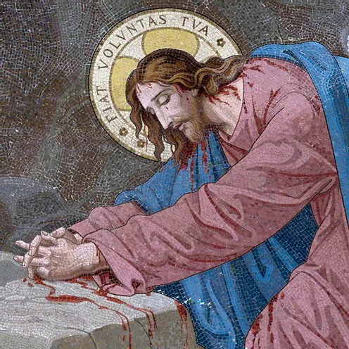
4
He sees the wrath of the Father which his sufferings must appease.
Help us to be truly humble and genuinely sorry for our sins against others and against the God who loves and made us.

Slide 12
Hail Mary, Full of Grace
The Lord is with thee
Blessed art thou amongst women
And blessed is the fruit
of thy womb, Jesus,
Holy Mary, Mother of God,
Pray for us sinners
Now and at the hour
Of our death.
Amen.

Slide 13
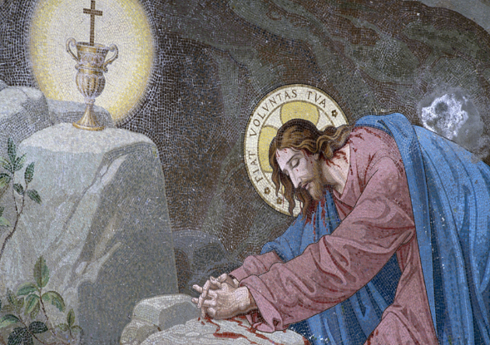
5
So great is his anguish that his sweat becomes as drops of blood falling to the ground.
Help us to have courage to defend God’s truth and strength to withstand the criticism and hatred of others.

Slide 14
Hail Mary, Full of Grace
The Lord is with thee
Blessed art thou amongst women
And blessed is the fruit
of thy womb, Jesus,
Holy Mary, Mother of God,
Pray for us sinners
Now and at the hour
Of our death.
Amen.

Slide 15
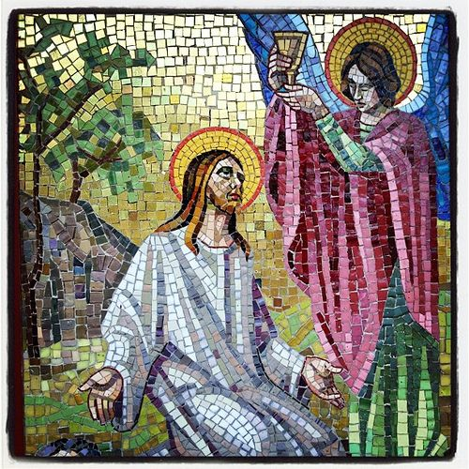
6
An angel appears to him from heaven to strengthen him.
Help us to have the courage to conform to your will especially when it may be difficult.

Slide 16
Hail Mary, Full of Grace
The Lord is with thee
Blessed art thou amongst women
And blessed is the fruit
of thy womb, Jesus,
Holy Mary, Mother of God,
Pray for us sinners
Now and at the hour
Of our death.
Amen.

Slide 17
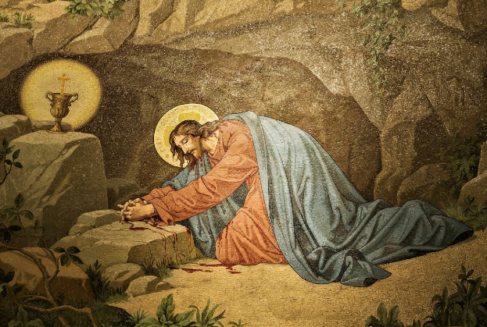
7
“Father, if it be possible, let this cup pass from Me; yet, not My will but Yours be done.”
Help us to be strengthened by God’s grace, inspired by the Holy Spirit, and encouraged by examples within our faith community.

Slide 18
Hail Mary, Full of Grace
The Lord is with thee
Blessed art thou amongst women
And blessed is the fruit
of thy womb, Jesus,
Holy Mary, Mother of God,
Pray for us sinners
Now and at the hour
Of our death.
Amen.

Slide 19
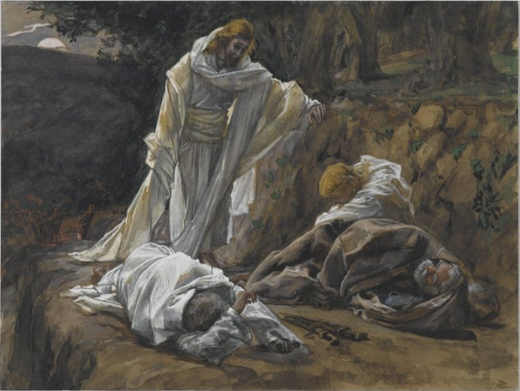
8
Finding the disciples asleep: “Could you not watch one hour with me?”
Help us to find the strength to protect our world and preserve the resources within it.

Slide 20
Hail Mary, Full of Grace
The Lord is with thee
Blessed art thou amongst women
And blessed is the fruit
of thy womb, Jesus,
Holy Mary, Mother of God,
Pray for us sinners
Now and at the hour
Of our death.
Amen.

Slide 21
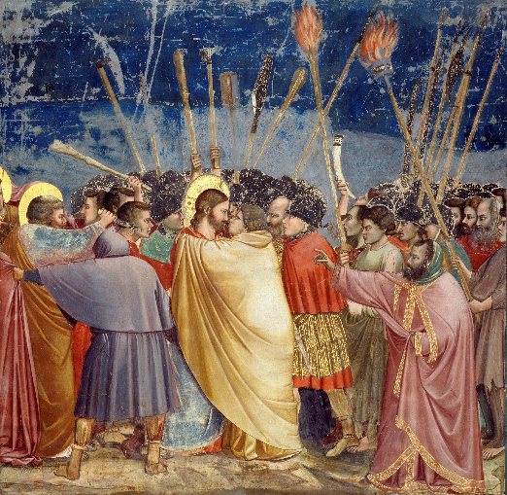
9
Jesus is betrayed by Judas, cruelly bound and led away.
Guide us to make individual and communal choices that protect life and honour all people and all creation.

Slide 22
Hail Mary, Full of Grace
The Lord is with thee
Blessed art thou amongst women
And blessed is the fruit
of thy womb, Jesus,
Holy Mary, Mother of God,
Pray for us sinners
Now and at the hour
Of our death.
Amen.

Slide 23
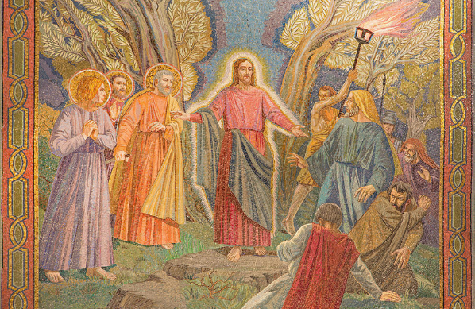
10
Father, by the merits of the agony of Jesus in the Garden, have mercy on us and on the whole world.
Help us as individuals and within our communities to always see the dignity of our fellow
human beings.

Slide 24
Hail Mary, Full of Grace
The Lord is with thee
Blessed art thou amongst women
And blessed is the fruit
of thy womb, Jesus,
Holy Mary, Mother of God,
Pray for us sinners
Now and at the hour
Of our death.
Amen.

Slide 25
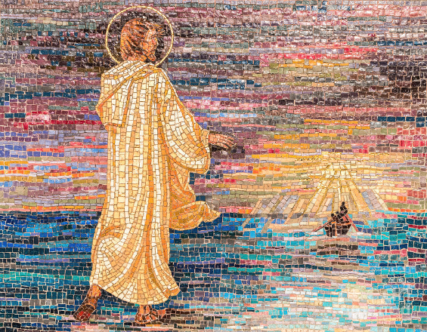
We trust that God who is all-knowing and compassionate will hear our prayers and send us his Holy Spirit so that we can offer ourselves completely to the will of God following the example of our Lord and Saviour, Jesus Christ.

Slide 26
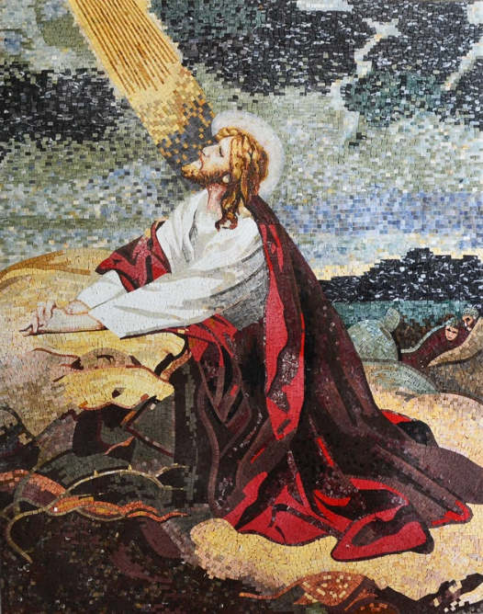
Glory be to the Father
And to the Son
And to the Holy Spirit
As it was in the beginning
Is now and ever shall be
World without end.
Amen.

Slide 27
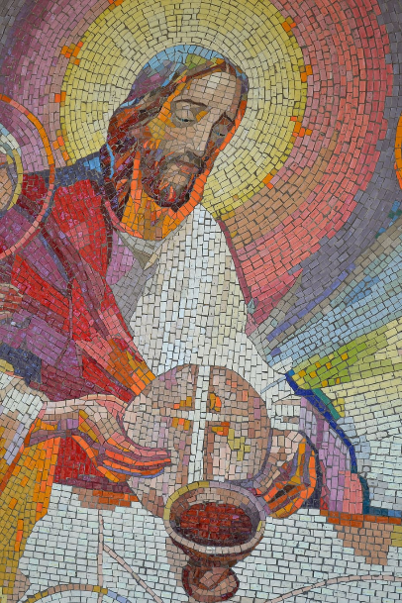
Thank you to
https://fineartamerica.com/art/royalty+free+images
https://pixabay.com/images/search/mosaics%20jesus/
https://www.rosarycenter.org/homepage-2/rosary/how-to-pray-the-rosary/sorrowful-without-distractions/

Slide 28
Thank you for joining us today…

