Slide 1
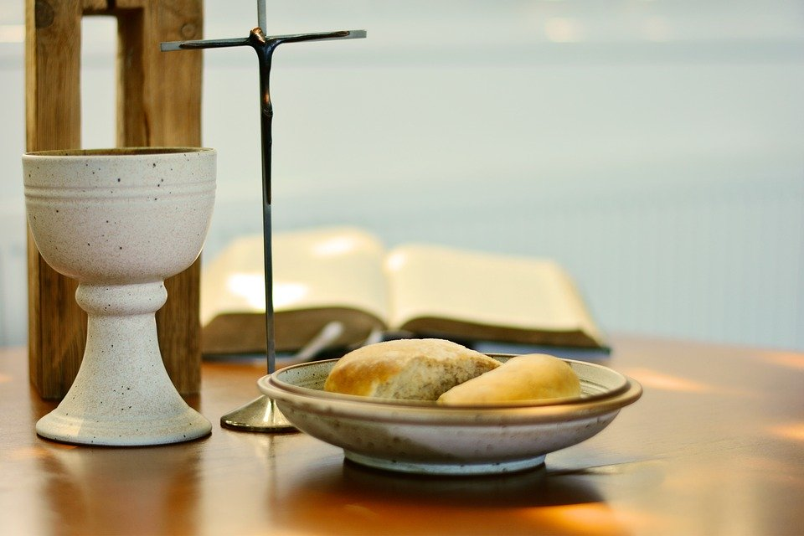
The Name of Jesus

Slide 2
The Name of Jesus

Slide 3
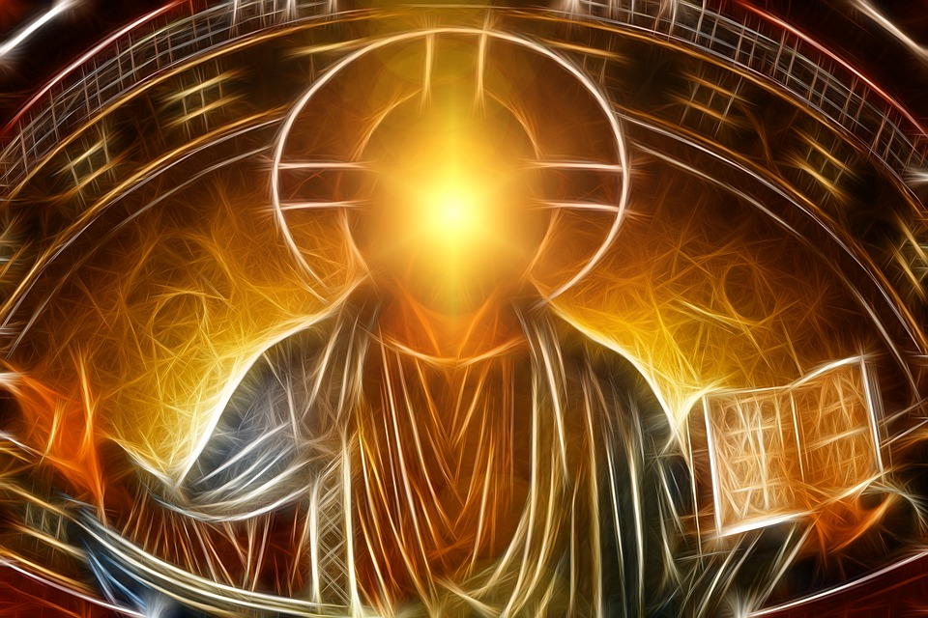
“Faith in Jesus and in the power of his Holy Name is the greatest spiritual force in the world today.”
Blessed Henry Suso (1290-1365
Gather

Slide 4
The name of Jesus is so special that it is celebrated on 3rd January every year and the whole month of January is dedicated to it.
Let us begin by saying the name of Jesus slowly and silently as a prayer.
Gather

Slide 5
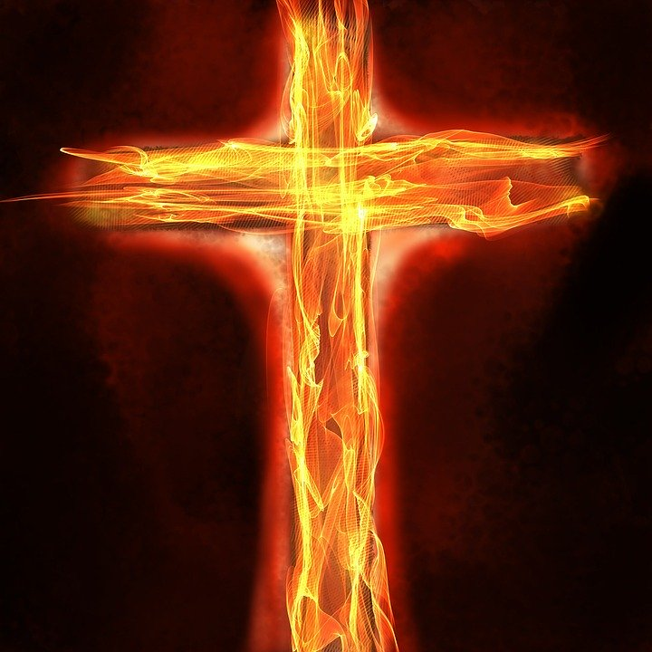
“So great is the Most Holy Name of Jesus that God highly exalted him and gave him the Name that is above every name, so that at the Name of Jesus every knee should bend; in heaven and on earth and under the earth, and every tongue confess that Jesus Christ is Lord, to the glory of God the Father.”
St Paul the Apostle (Phil 2:9-11)
What other names and titles are given to Jesus?
D Listen

Slide 6
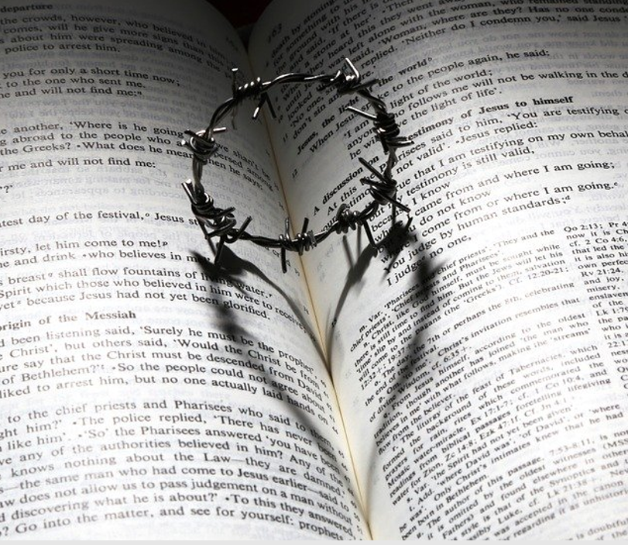
St Paul tells us that the Name of Jesus is so holy that we should go on bended knee when we hear it.
In the New Testament we hear that the apostles were able to heal and do great wonders in Jesus’ name:
“Lord, even the demons are subject to us in your name!” (Lk 10:17)
Jesus says “If you ask me anything in my name, I will do it.” (Jn 14:14)
What would you do/ask in the Name of Jesus?
D Respond

Slide 7
The second commandment tells us: ‘Do not take the name of the Lord your God in vain.’ (Ex 20:7)
Sadly, not everyone obeys this commandment and respects the name of Jesus. Instead, many use it disrespectfully and use bad language.
How do you think this makes God and others feel? How does it make you feel?

Slide 8
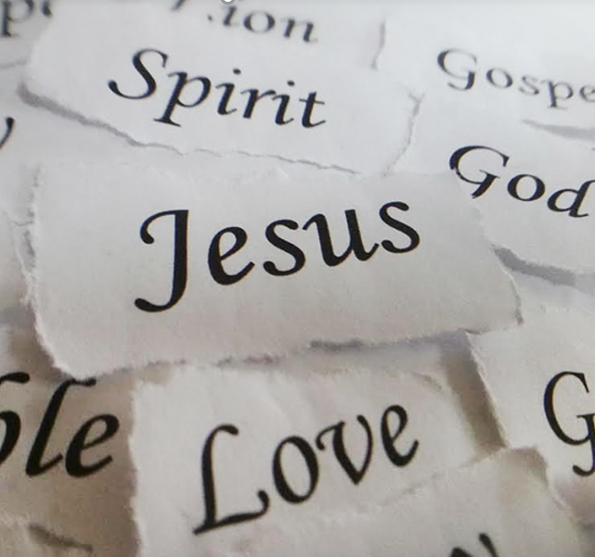
The Divine Praises were written by an Italian Jesuit priest in the 18th Century (Luigi Felici, 1797) as a way of reparation for taking the Lord’s name in vain and using blasphemy or bad language. Originally there were only eight praises and then six more were added (by a number of popes). St Teresa of Calcutta included another one: ‘Blessed be Jesus in the poorest of the poor’.

Slide 9
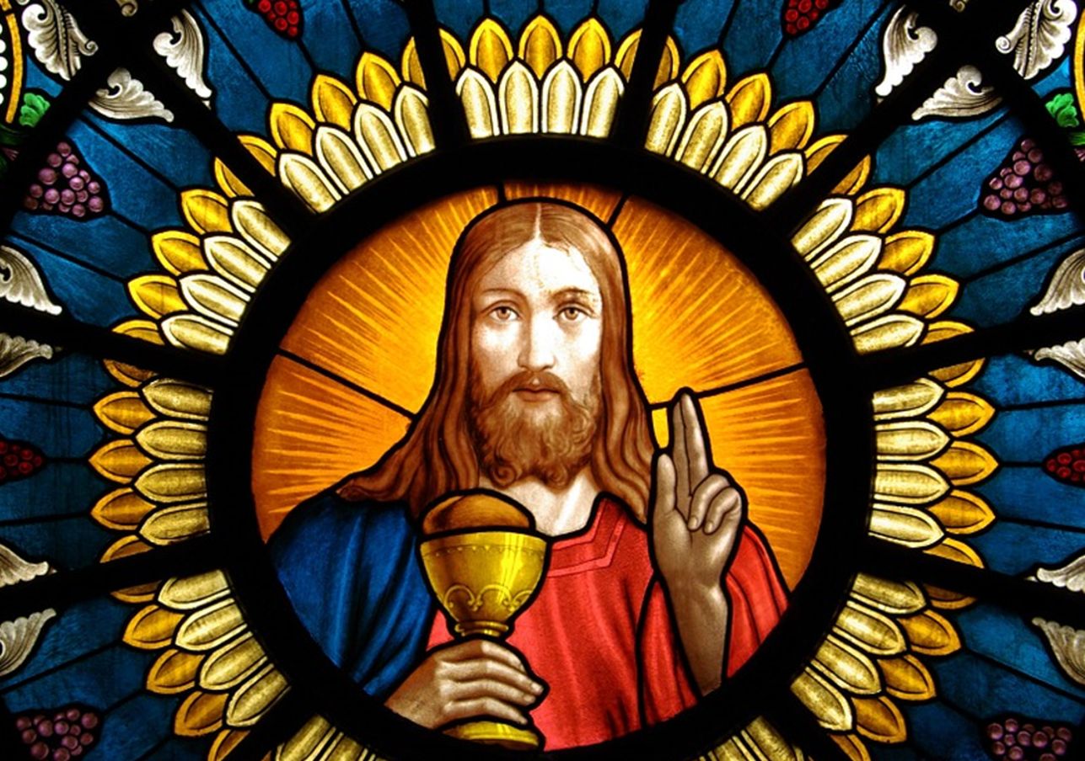
The Divine Praises are usually said during Benediction, although they can be said at any time. The prayer leader usually recites the praises one by one with the worshippers echoing each time.

Slide 10
Let us pray

Slide 11
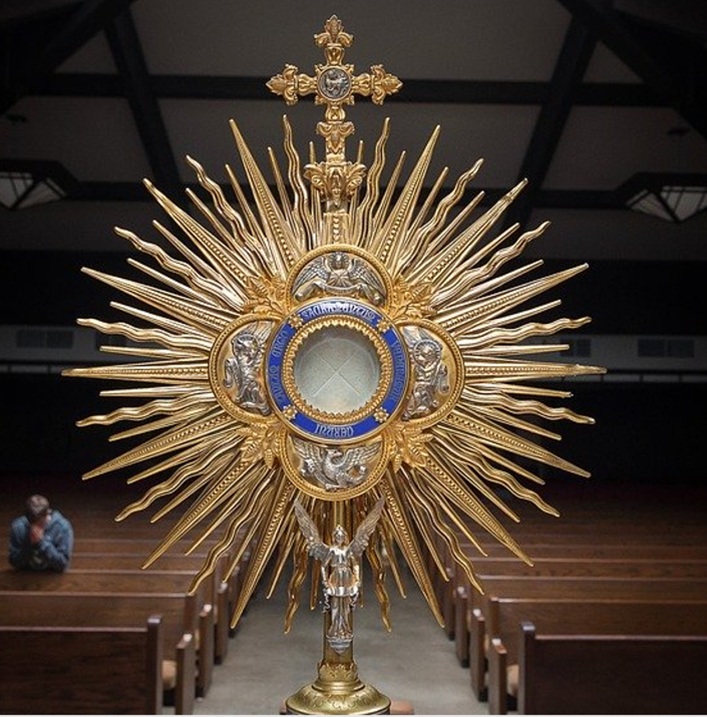
The Divine Praises
Blessed be God. Blessed be his holy Name. Blessed be Jesus Christ, true God and true Man. Blessed be the Name of Jesus. Blessed be his most Sacred Heart. Blessed be his most Precious Blood. Blessed be Jesus in the most Holy Sacrament of the Altar. Blessed be Jesus in the Poorest of the Poor. Blessed be the Holy Spirit, the Paraclete. Blessed be the great Mother of God, Mary most Holy. Blessed be her holy and Immaculate Conception. Blessed be her Glorious Assumption. Blessed be the Name of Mary, Virgin and Mother. Blessed be St. Joseph, her most chaste spouse. Blessed be God in his Angels and in his Saints.

Slide 12
Make a special effort during the month of January to use the name of Jesus respectfully.
Say Jesus’ name as a prayer during the day.
Choose your favourite Divine Praise and learn more about what it means. Memorise it.
Mission

Slide 13
The Name of Jesus

