Slide 1
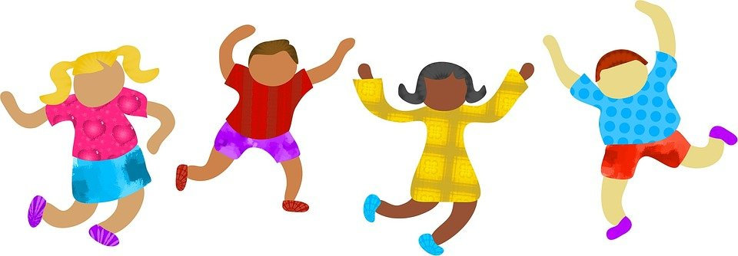
KS1 Prayer Cards

Slide 2
By Alexa, St John Fisher Primary, St Albans
Loving Father,
Just because we all look different,
Doesn’t mean we aren’t all special.
We have our own personality and we all love God.
Help us to be kind to one another and help us to grow strong and healthy.
In the name of Jesus Christ,
Amen

Slide 3
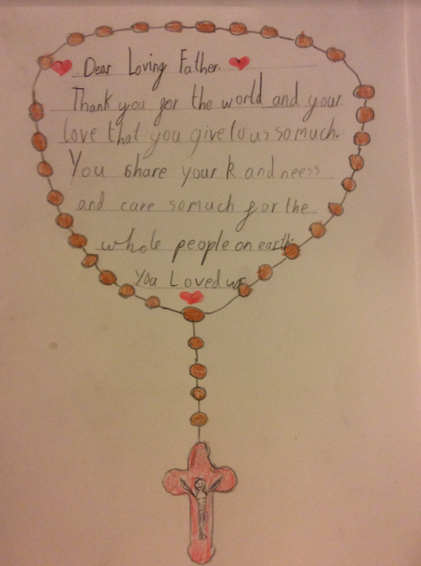
By Alice Saint Joseph’s Primary, K and C Deanery

Slide 4
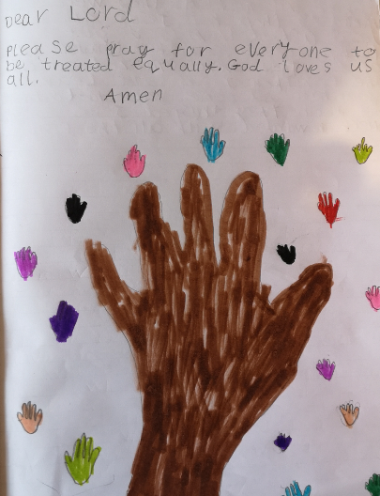
By Orlaith, St Teresa’s Primary, Herts

Slide 5
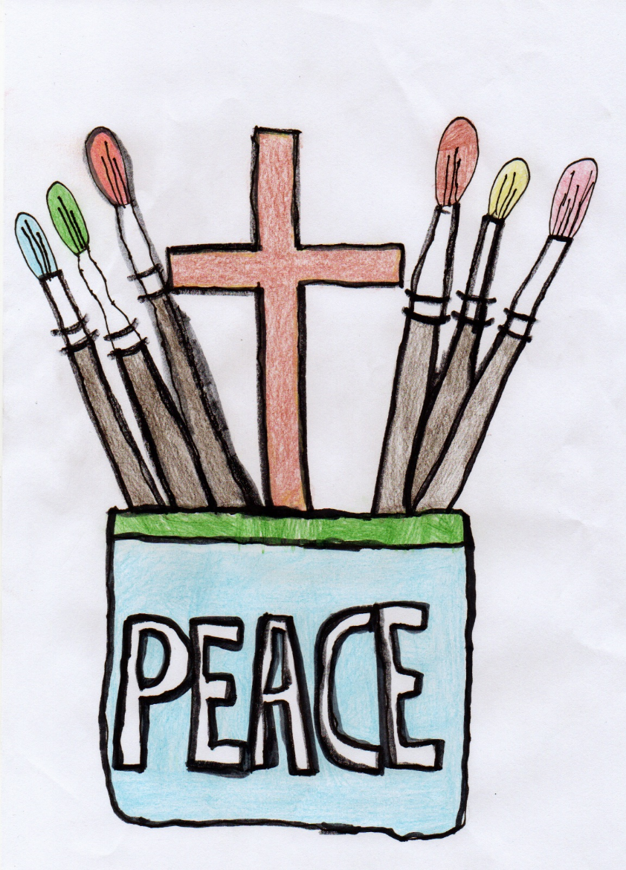
Lucia, Reception, St. Joseph’s Primary, K and C deanery
Dear Lord,
May people of all
Colours and religions
Live in peace and harmony.
Please help us with a
Safe and happy world.
Amen

Slide 6
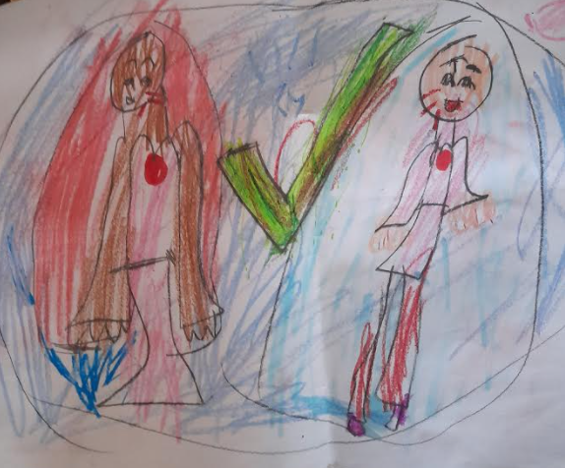
Purity and Megan, St Scholastica’s School, Hackney
Dear God
Please help us with our love and kindness for everyone.
We are all your creation. Help us not to hurt each other’s feelings.
Thank you for being there for us all. I like how you made us all different. But we are all your people.
Amen

Slide 7
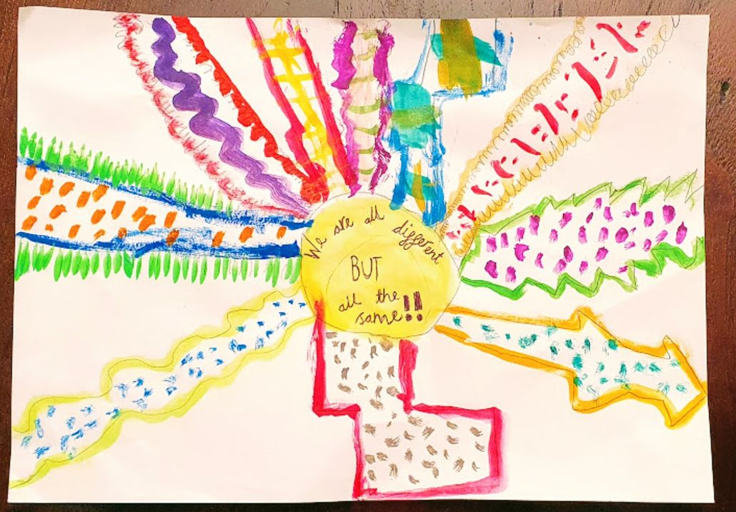
Francesco, St. Theresa’s School, Barnet

Slide 8
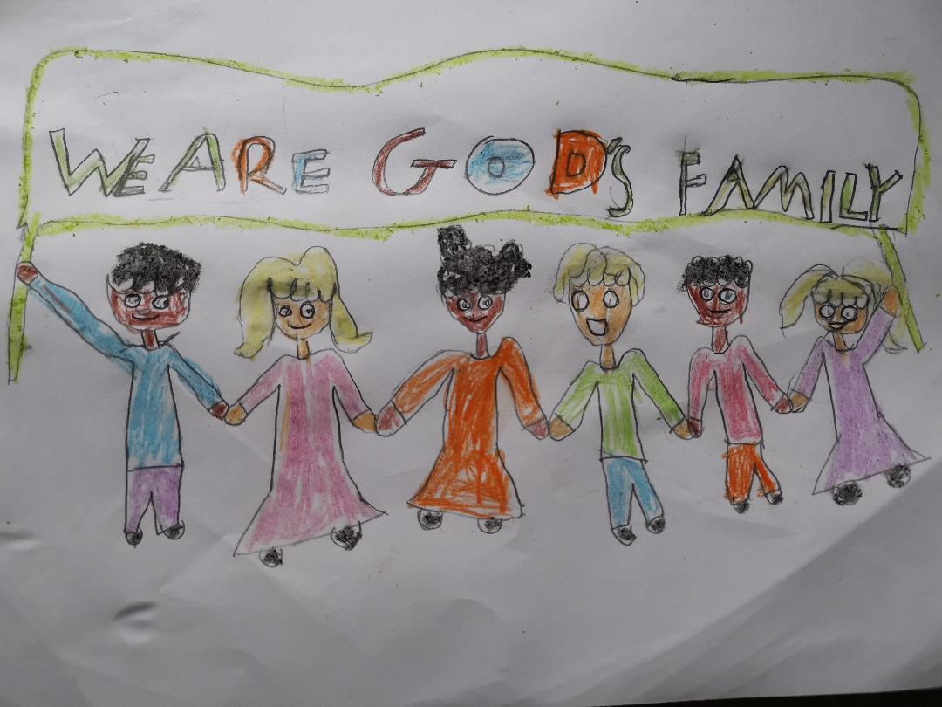
Daniel, English Martyrs Primary, Tower Hamlets
Thank you God, you are a true friend and a good father. Please help us to be kind to one another. Help us to understand that we are all special no matter our differences. Please protect every human in this world. We are all your children and we thank you for loving us all unconditionally. Please grant our prayers in Jesus name. Amen.

Slide 9
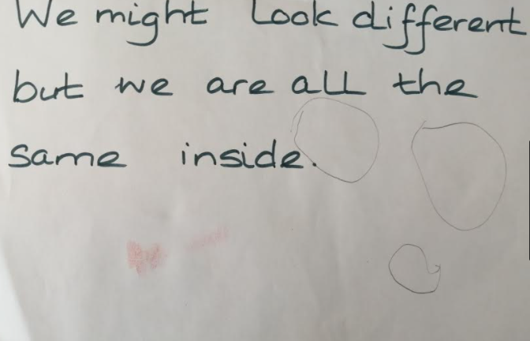
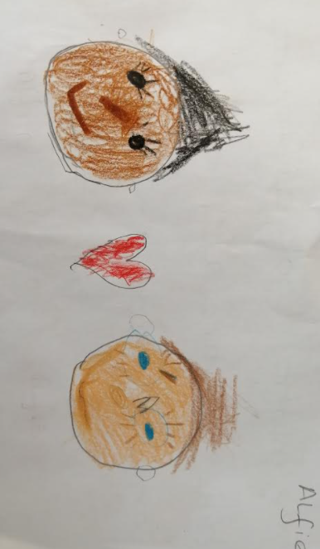
Alfie (EYFS), Holy Rood Primary, Watford

Slide 10
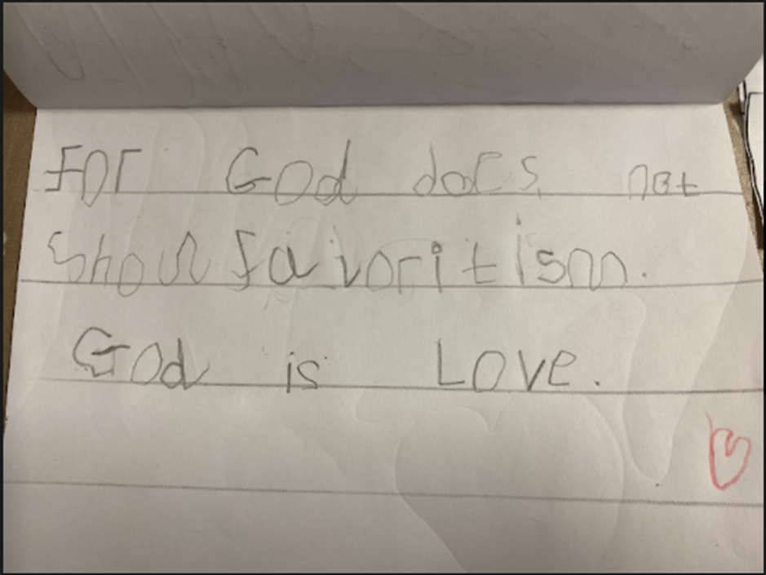
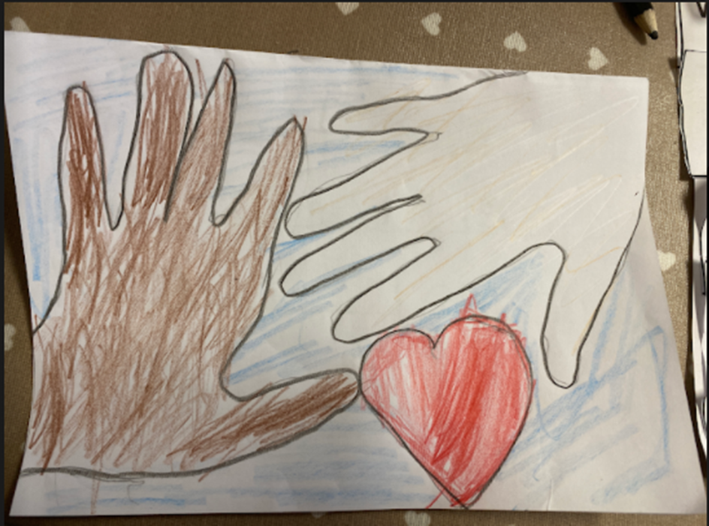
Rocco, Holy Rood Primary, Watford
Add image here – scan image
Artwork should be created by the child(ren) using art or ICT skills.
All images MUST be copyright-free as they will be used for the website.

Slide 11
Cillian,, Holy Rood Primary, Watford

Slide 12
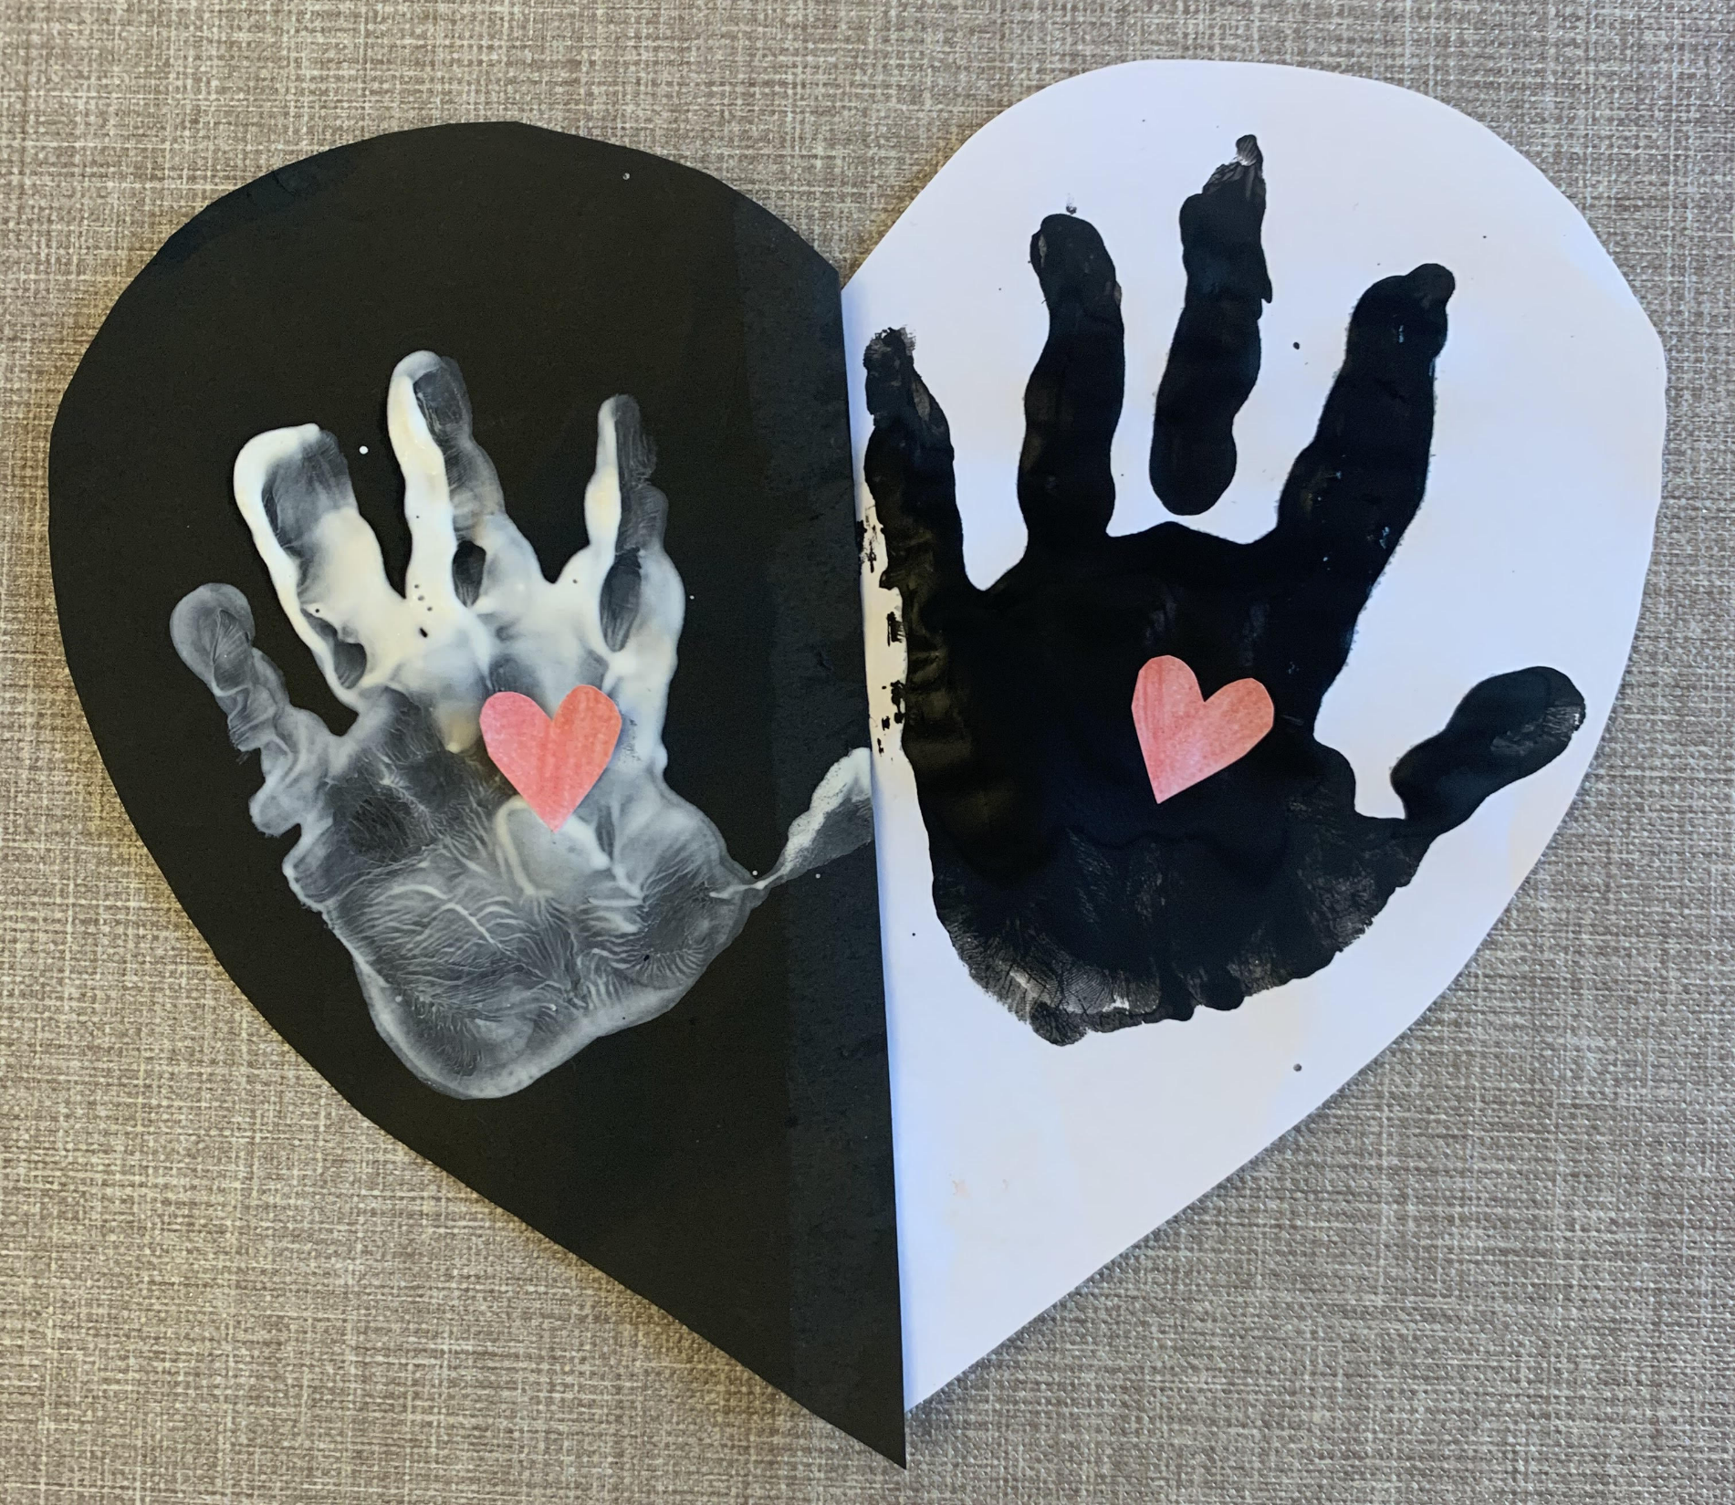
Darcy, Nursery- Holy Rood Primary, Watford
Add image here – scan image
Artwork should be created by the child(ren) using art or ICT skills.
All images MUST be copyright-free as they will be used for the website.

