Slide 1
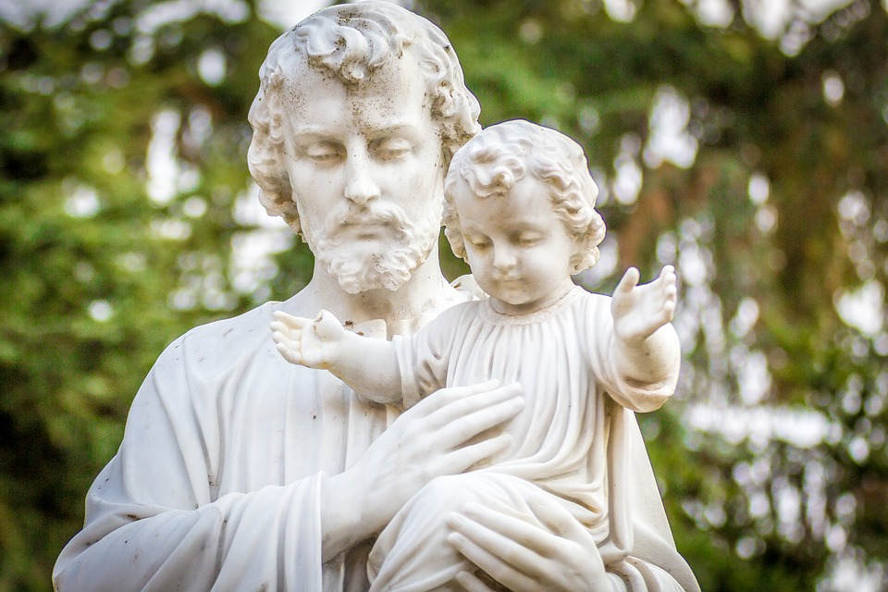
St Joseph – March: Father of Jesus

Slide 2
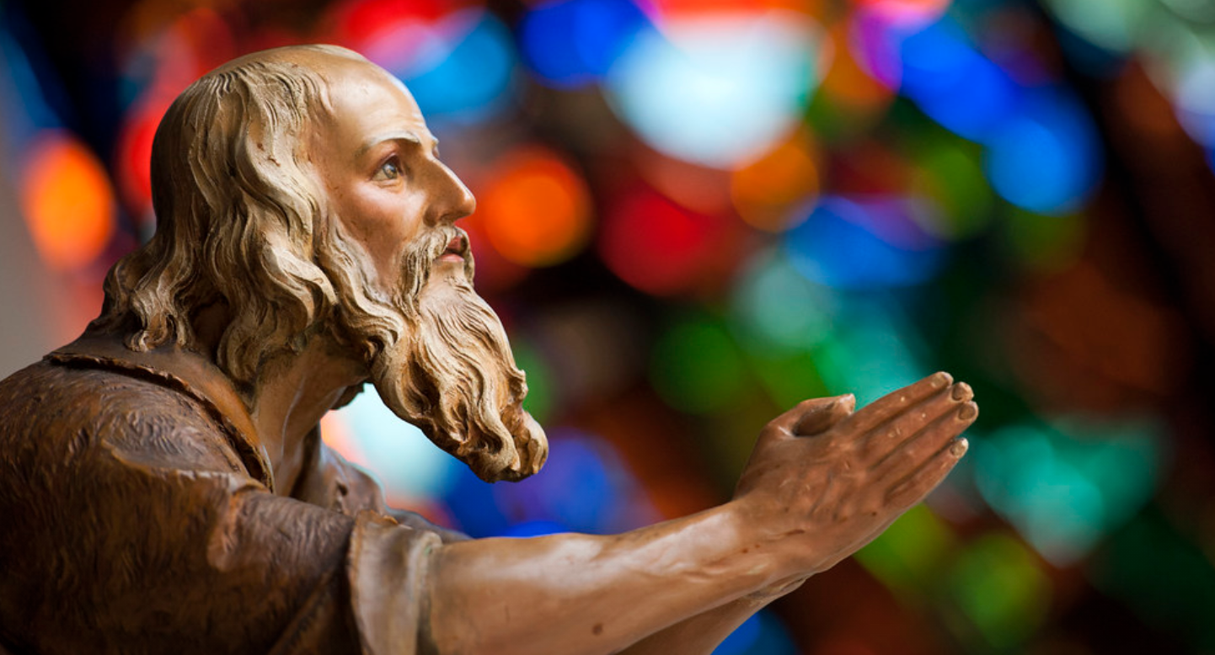
It has been 150 years since St Joseph was declared Patron Saint of the Universal Church
To mark the occasion, the Holy Father has proclaimed a ‘Year of St Joseph’ from 8 December 2020.
Before we begin…

Slide 3
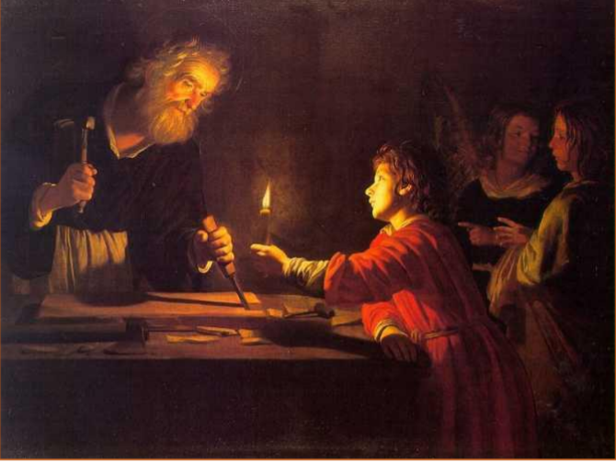
We don’t know much about St Joseph but we are going to reflect on what we can learn from what we do know about him. Today we will reflect on him as father.
Pope Francis said during the coronavirus pandemic so many people have made hidden sacrifices to protect others, just as St. Joseph quietly protected and cared for Mary and Jesus.
Before we begin…

Slide 4
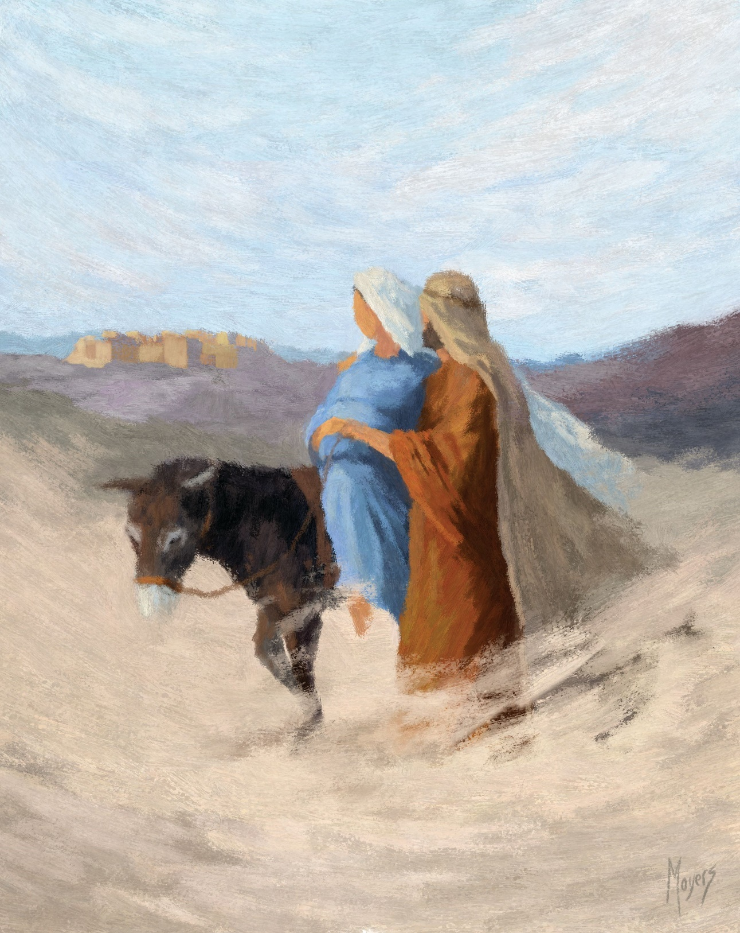
‘Each of us can discover in Joseph -- the man who goes unnoticed, a daily, discreet and hidden presence -- an intercessor, a support and a guide in times of trouble,’ the Pope wrote.
He also said he wanted to highlight St. Joseph’s role as a father who served his family with charity and humility, adding, ‘Our world today needs fathers.’
Before we begin…

Slide 5
Patris Corde by Pope Francis
WITH A FATHER’S HEART: that is how Joseph loved Jesus, whom all four Gospels refer to as “the son of Joseph”.
Before we begin…

Slide 6
O glorious St Joseph, called by God to be protector of Jesus his only Son, be our guide as we come to know our heavenly Father.
Amen
Gather

Slide 7
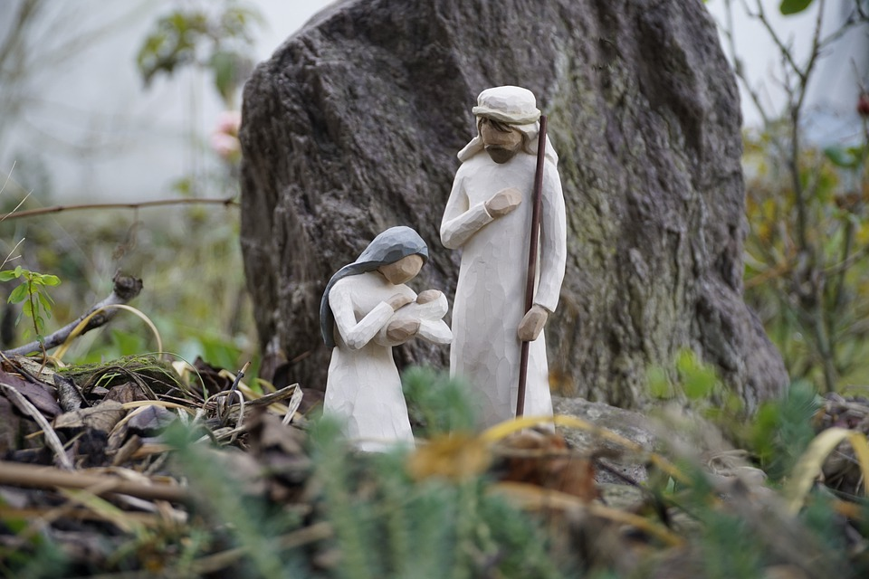
‘So they hurried away and found Mary and Joseph, and the baby lying in the manger. Everyone was astonished at what the shepherds had to say.’
Listen (Luke 2:15-20)

Slide 8
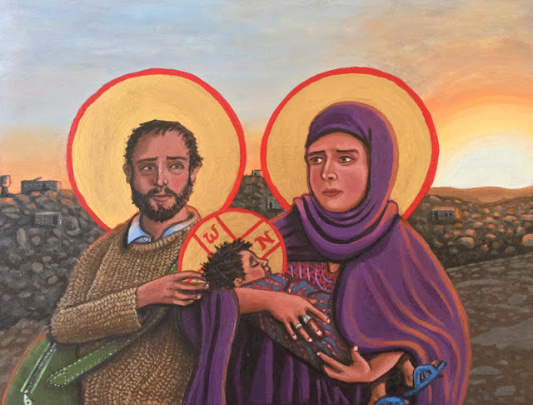
How wonderful those first hours as new parents; already full of challenge, and a life ahead of joy and tears, but always full of wonder.
Why is St Joseph special?
What can we learn from him?
Reflect

Slide 9
Let us pray

Slide 10
Lord Jesus Christ, Many families – and fathers – have struggled this past year: with distance from loved ones, or loss of income, uncertainty, ill health or many other stresses. We bring the fathers and grandfathers we know to you and St Joseph. We commend them to their care, and ask your blessing on them.
Amen
Prayer

Slide 11
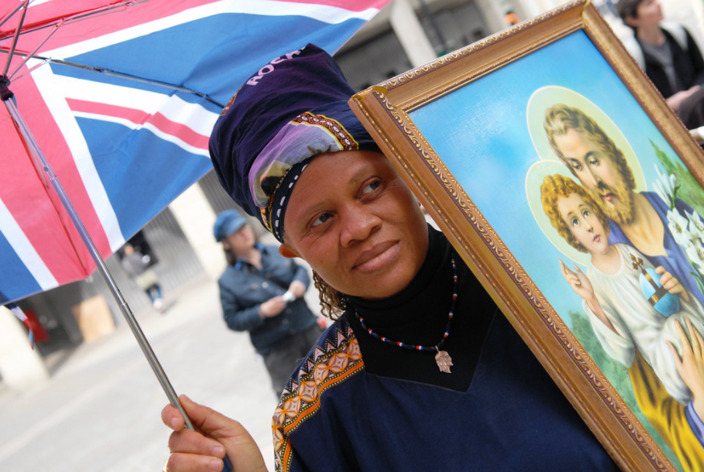
Joseph’s Lullaby
Click on this link for a video of the song ‘Joseph’s Lullaby’ by Mercy Me with images and lyrics.
Song prayer

Slide 12
Do you know a father or grandfather who would appreciate a phone call or a message?
Mission

Slide 13
More information on St Joseph for teachers
For more information and resources on St Joseph, please see our Catholicism Unpacked: St Joseph document that can be found here:
Catholicism Unpacked: St Joseph

