Slide 1
Praying the Rosary with the Diocese of Westminster
The Resurrection: Friday 17th April 2020

Slide 2
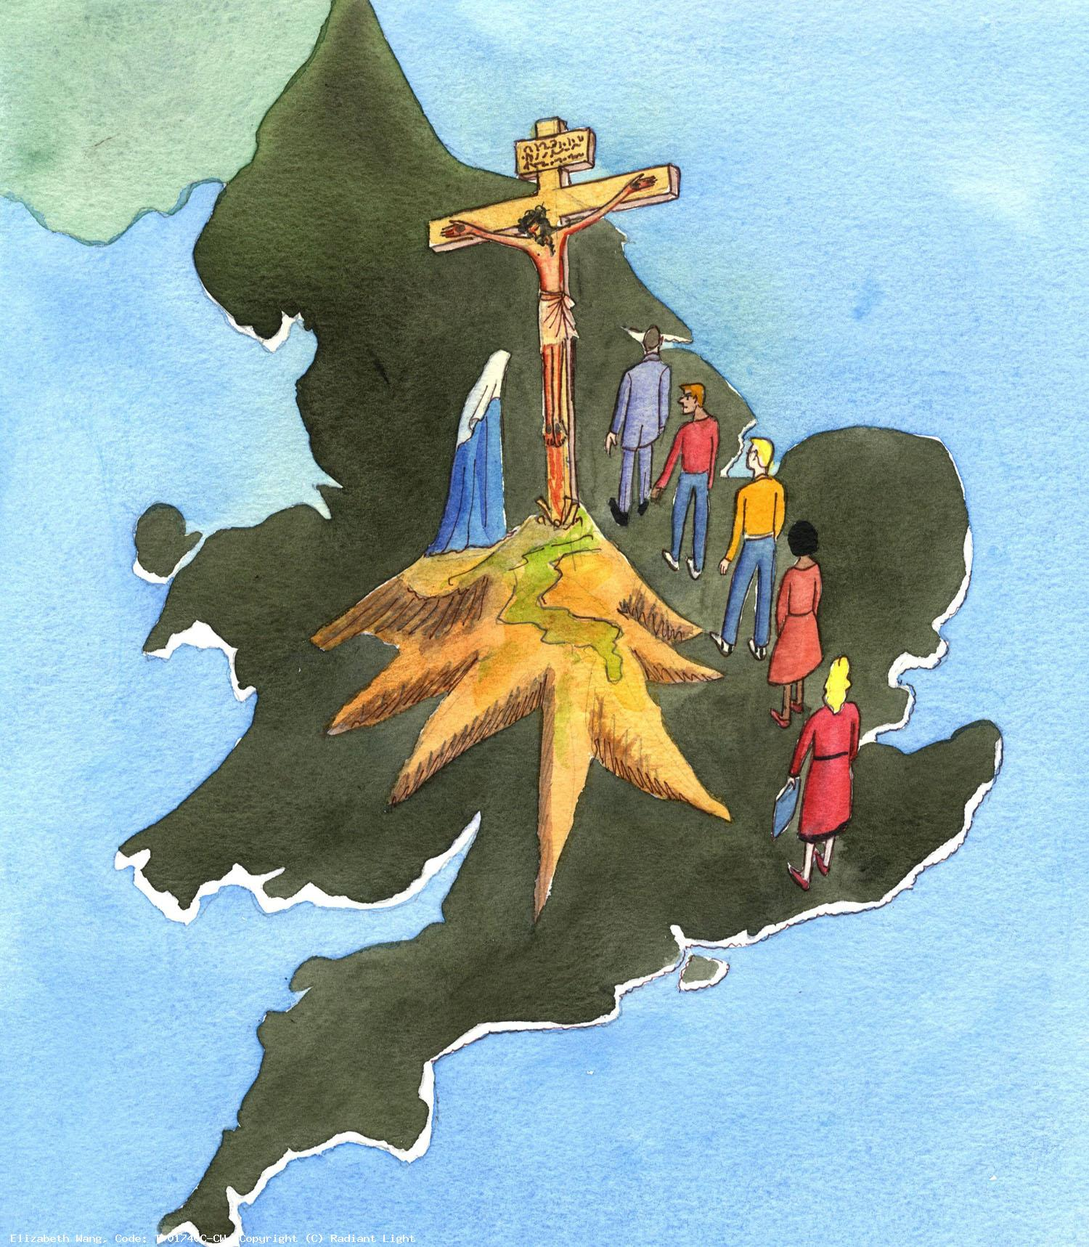
We offer this decade of the Rosary for all those affected by the coronavirus, that they will feel the joy and hope of the resurrection.
We ask the help of Our Blessed Mother, Mary, to take our prayers to her beloved son, Jesus.
-

Slide 3
Our Father
Who art in heaven
Hallowed be thy name
Thy kingdom come
Thy will be done
On earth as it is in heaven
Give us this day our daily bread
And forgive us our trespasses
As we forgive those
who trespass against us
And lead us not into temptation
But deliver us from evil.
Amen.

Slide 4
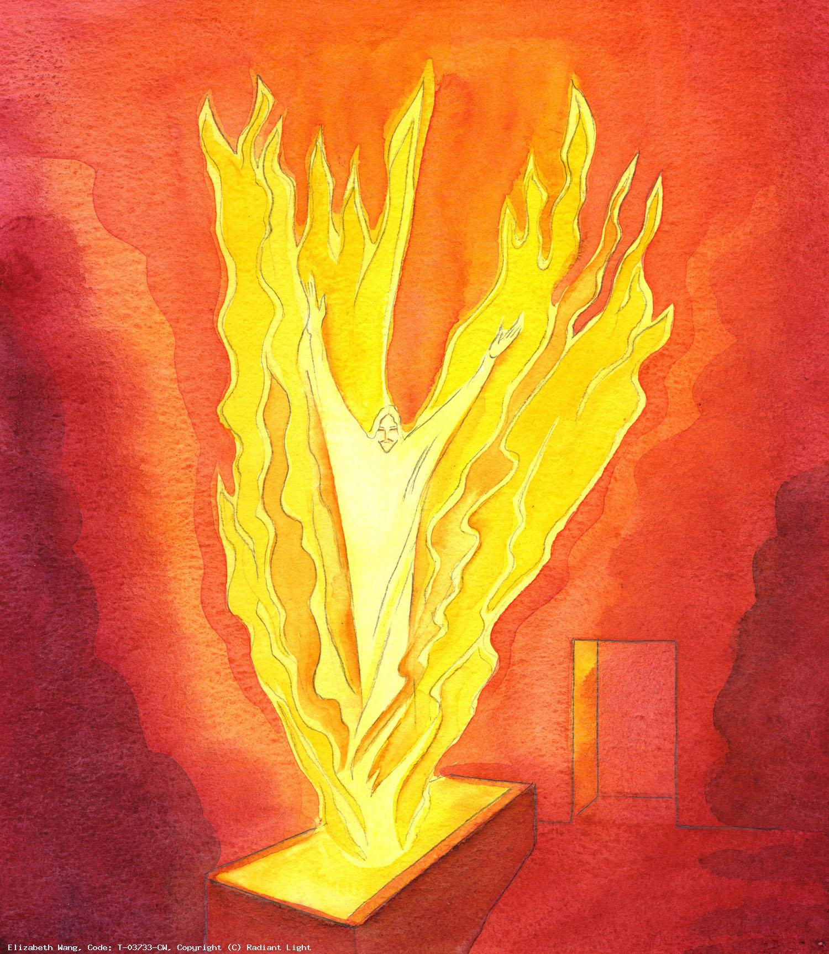
After the Sabbath, as the first day of the week was dawning, Mary and the other Mary came to see the tomb.
We pray for all those whose lives have changed immeasurably as a result of this virus, that they will face each dawn with strength and hope.

Slide 5
Hail Mary, Full of Grace
The Lord is with thee
Blessed art thou amongst women
And blessed is the fruit
of thy womb, Jesus,
Holy Mary, Mother of God,
Pray for us sinners
Now and at the hour
Of our death.
Amen.

Slide 6
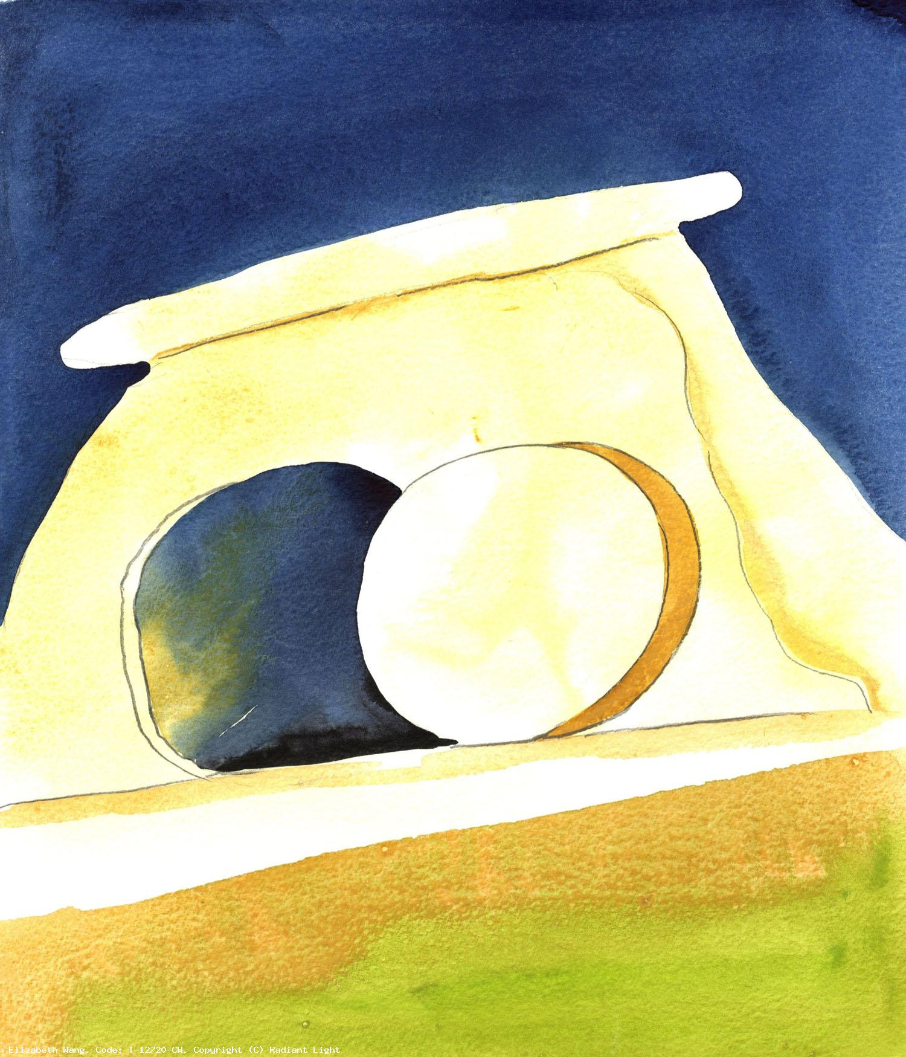
2. And behold, there was a great earthquake; for an angel of the Lord descended from heaven, approached, rolled back the stone and sat upon it.
We pray for those who feel their lives are shaking and shattering at this time, that they will trust the Lord’s goodness and wisdom will prevail.

Slide 7
Hail Mary, Full of Grace
The Lord is with thee
Blessed art thou amongst women
And blessed is the fruit
of thy womb, Jesus,
Holy Mary, Mother of God,
Pray for us sinners
Now and at the hour
Of our death.
Amen.

Slide 8
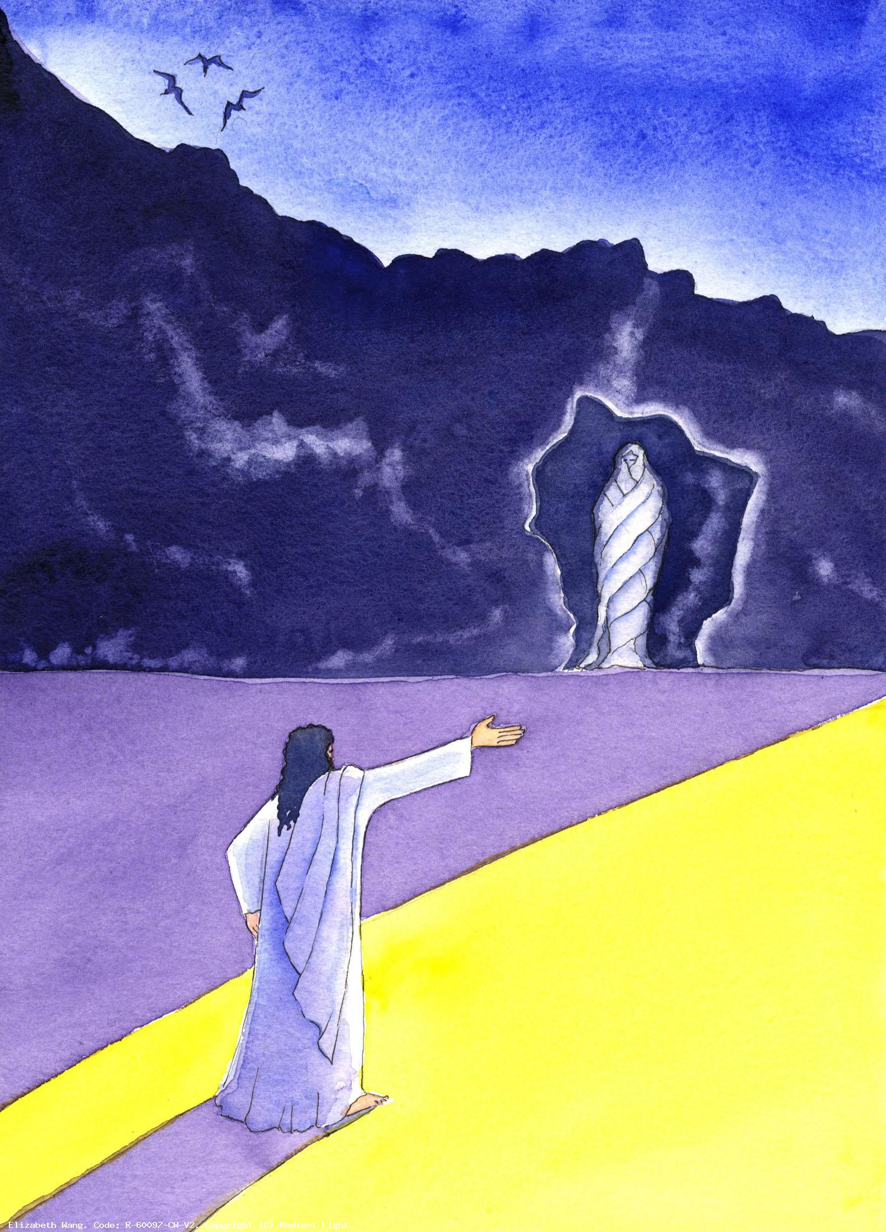
3. His appearance was like lightning and his clothing was white as snow.
We pray that during this time of self-isolation each person will emerge stronger in faith, love and mercy.

Slide 9
Hail Mary, Full of Grace
The Lord is with thee
Blessed art thou amongst women
And blessed is the fruit
of thy womb, Jesus,
Holy Mary, Mother of God,
Pray for us sinners
Now and at the hour
Of our death.
Amen.

Slide 10
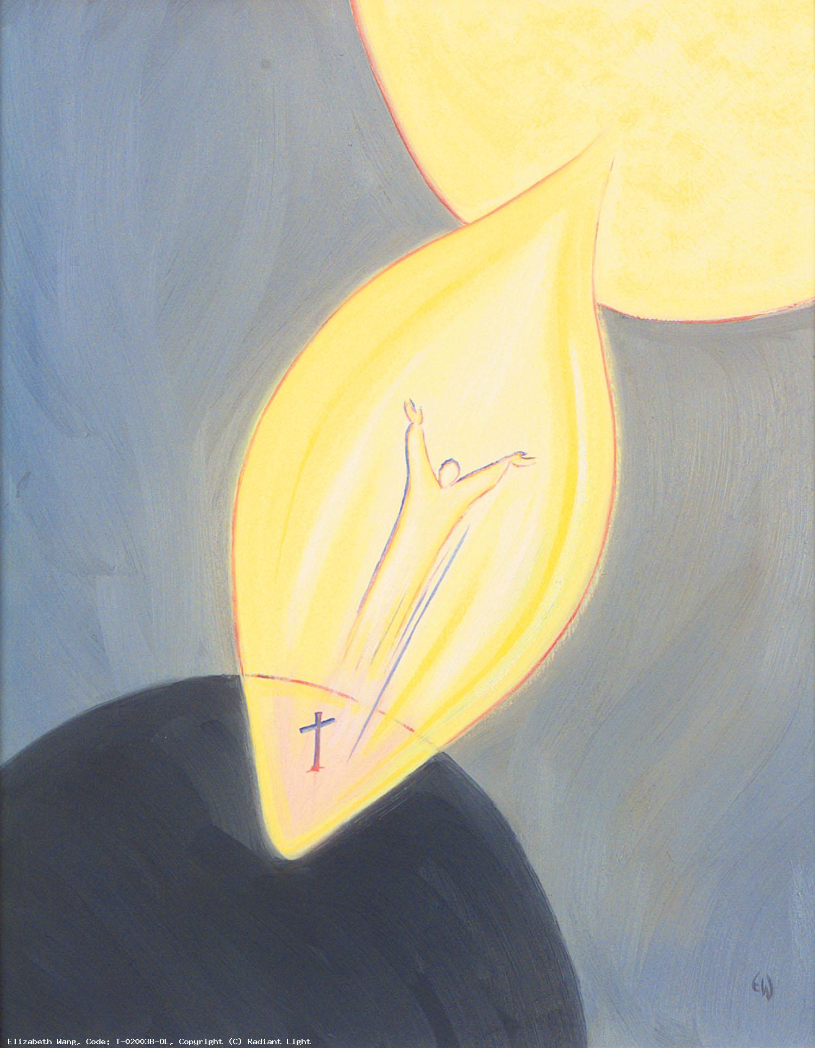
4. The guards were shaken with fear of him and became like dead men.
We pray for those who work hard to bring messages of kindness and joy to others, to help dispel the darkness in their hearts and minds, that they will be filled with the Spirit’s life-giving energy.

Slide 11
Hail Mary, Full of Grace
The Lord is with thee
Blessed art thou amongst women
And blessed is the fruit
of thy womb, Jesus,
Holy Mary, Mother of God,
Pray for us sinners
Now and at the hour
Of our death.
Amen.

Slide 12
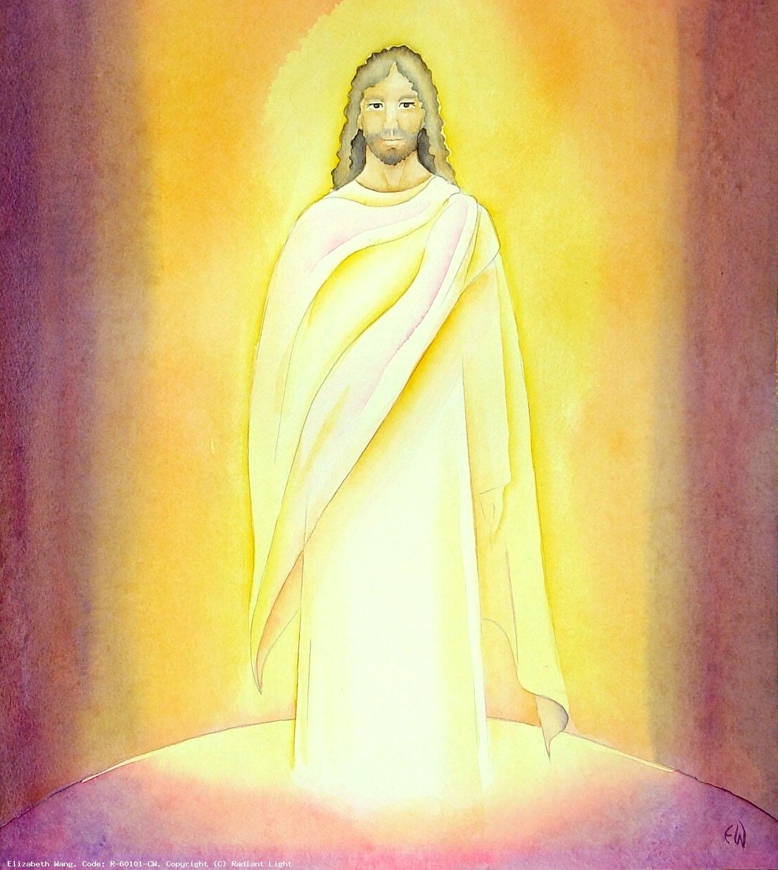
5. Then the angel said “Do not be afraid! I know that you are seeking Jesus, the crucified”.
We pray for all those who feel afraid of not seeing their loved ones again, that they will place them in God’s loving care.

Slide 13
Hail Mary, Full of Grace
The Lord is with thee
Blessed art thou amongst women
And blessed is the fruit
of thy womb, Jesus,
Holy Mary, Mother of God,
Pray for us sinners
Now and at the hour
Of our death.
Amen.

Slide 14
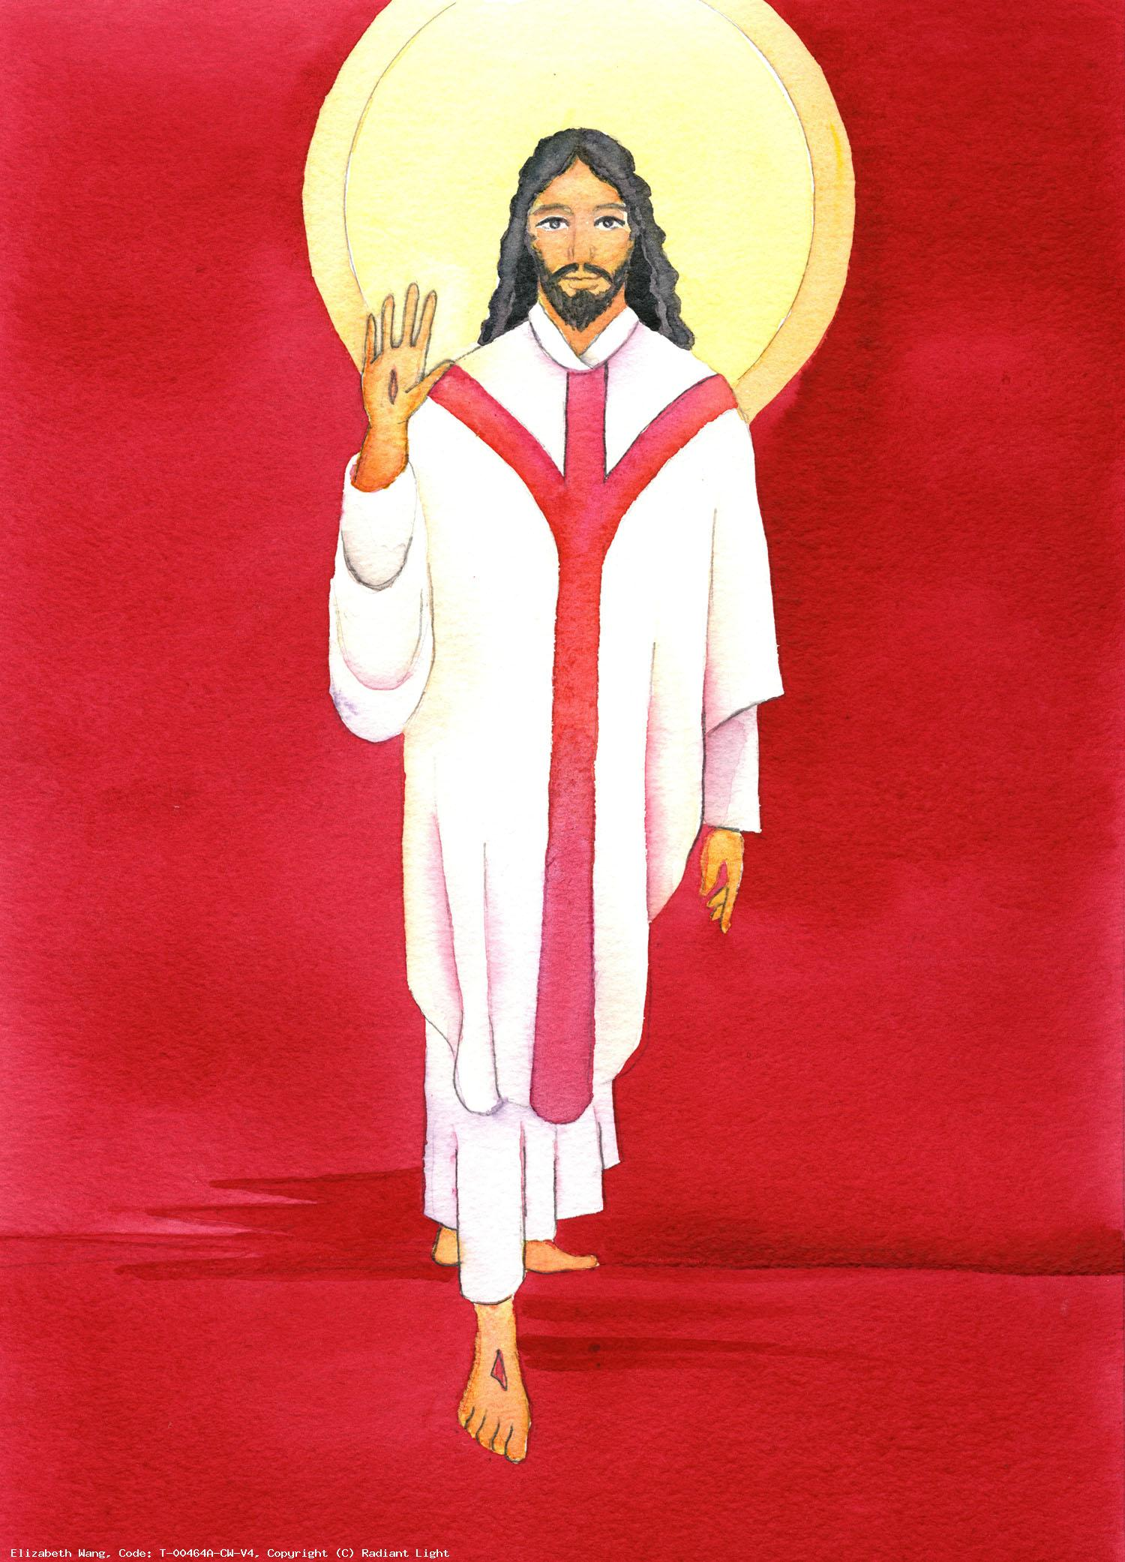
6. “He is not here, for he is raised, just as he said.”
We pray for all those who have given up their lives in the service of others, that they will always be remembered, and that their sacrifice and kindness will inspire us to love one another as Jesus loves us.

Slide 15
Hail Mary, Full of Grace
The Lord is with thee
Blessed art thou amongst women
And blessed is the fruit
of thy womb, Jesus,
Holy Mary, Mother of God,
Pray for us sinners
Now and at the hour
Of our death.
Amen.

Slide 16
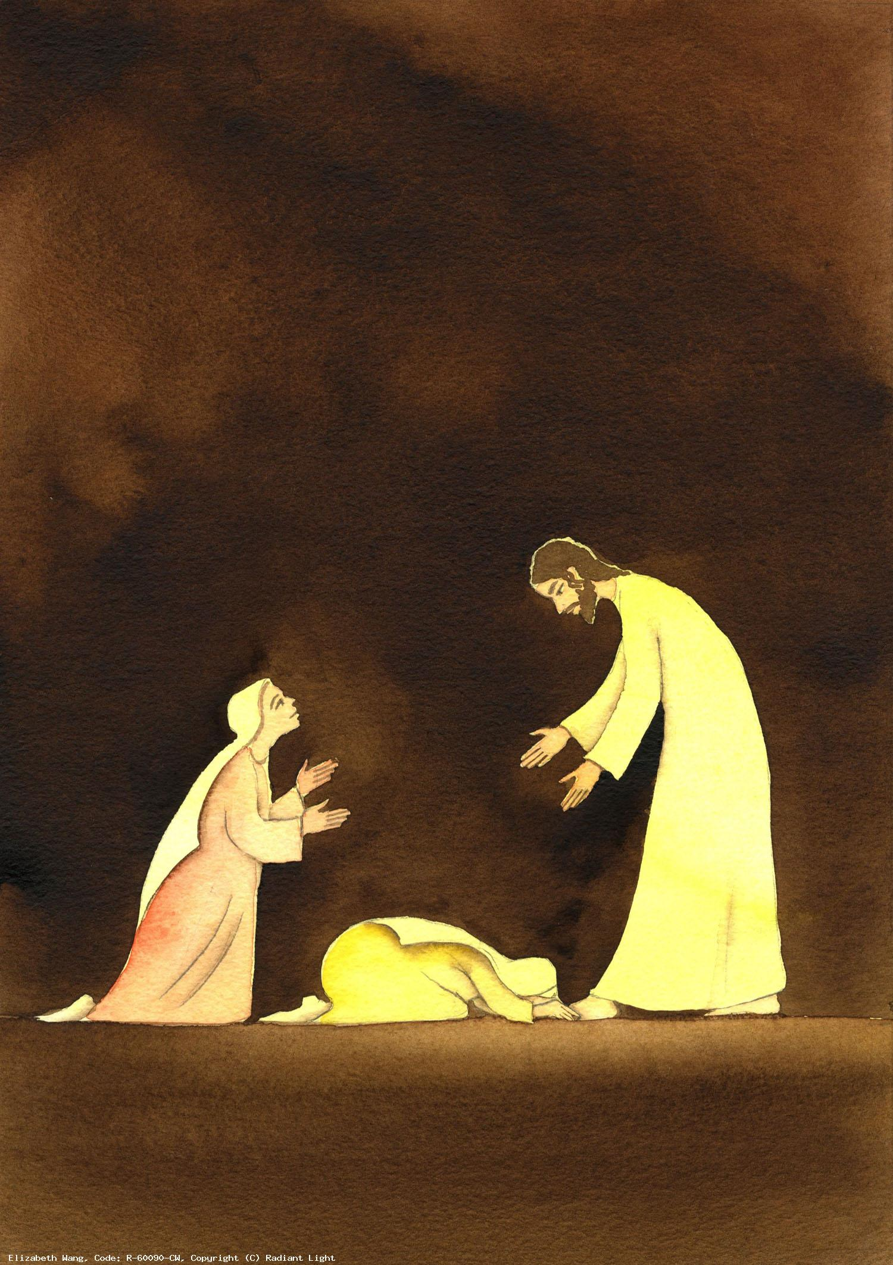
7. “Come and see the place where he lay.”
We pray for all those who have been healed and for all those who have contributed to this process, that we will remember to say thank you and have thankful and gracious hearts.

Slide 17
Hail Mary, Full of Grace
The Lord is with thee
Blessed art thou amongst women
And blessed is the fruit
of thy womb, Jesus,
Holy Mary, Mother of God,
Pray for us sinners
Now and at the hour
Of our death.
Amen.

Slide 18
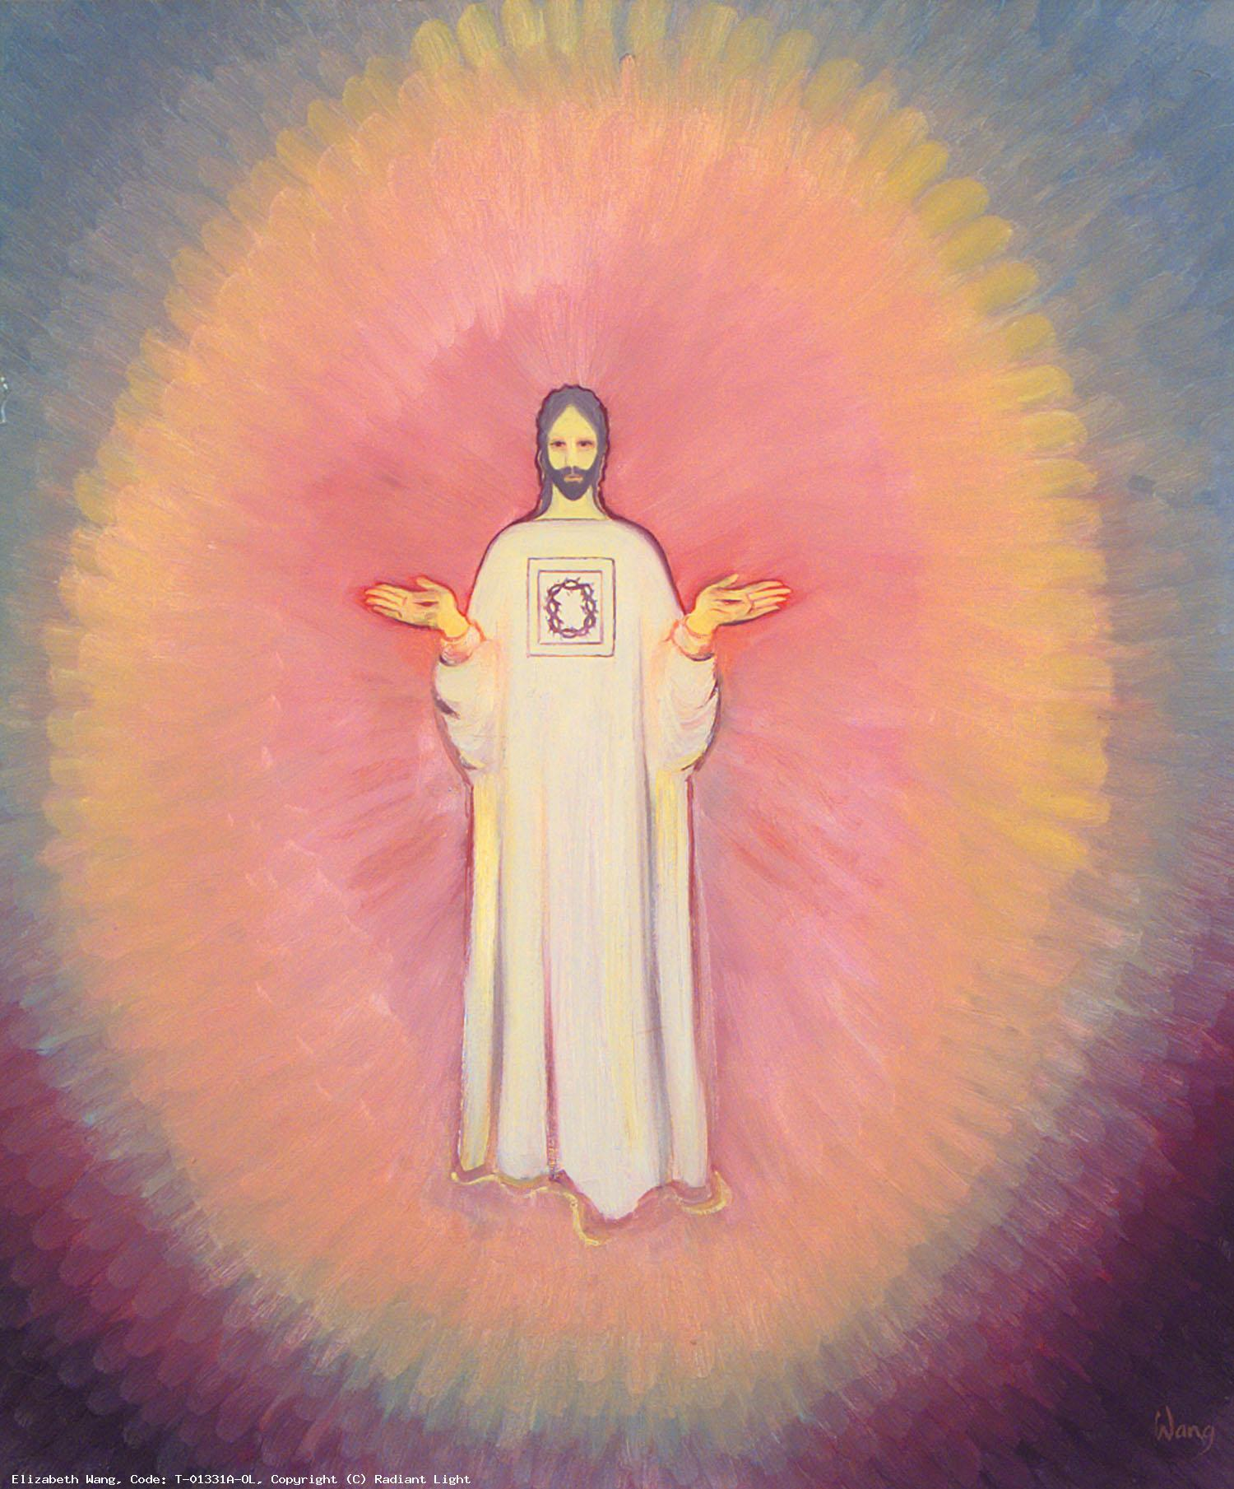
8. “Then go quickly and tell his disciples, ‘He has been raised from the dead’.”
We pray for all members of the clergy at this time as well as each member of the Church, that together we can find meaningful and innovative ways to hear and spread the good news.

Slide 19
Hail Mary, Full of Grace
The Lord is with thee
Blessed art thou amongst women
And blessed is the fruit
of thy womb, Jesus,
Holy Mary, Mother of God,
Pray for us sinners
Now and at the hour
Of our death.
Amen.

Slide 20
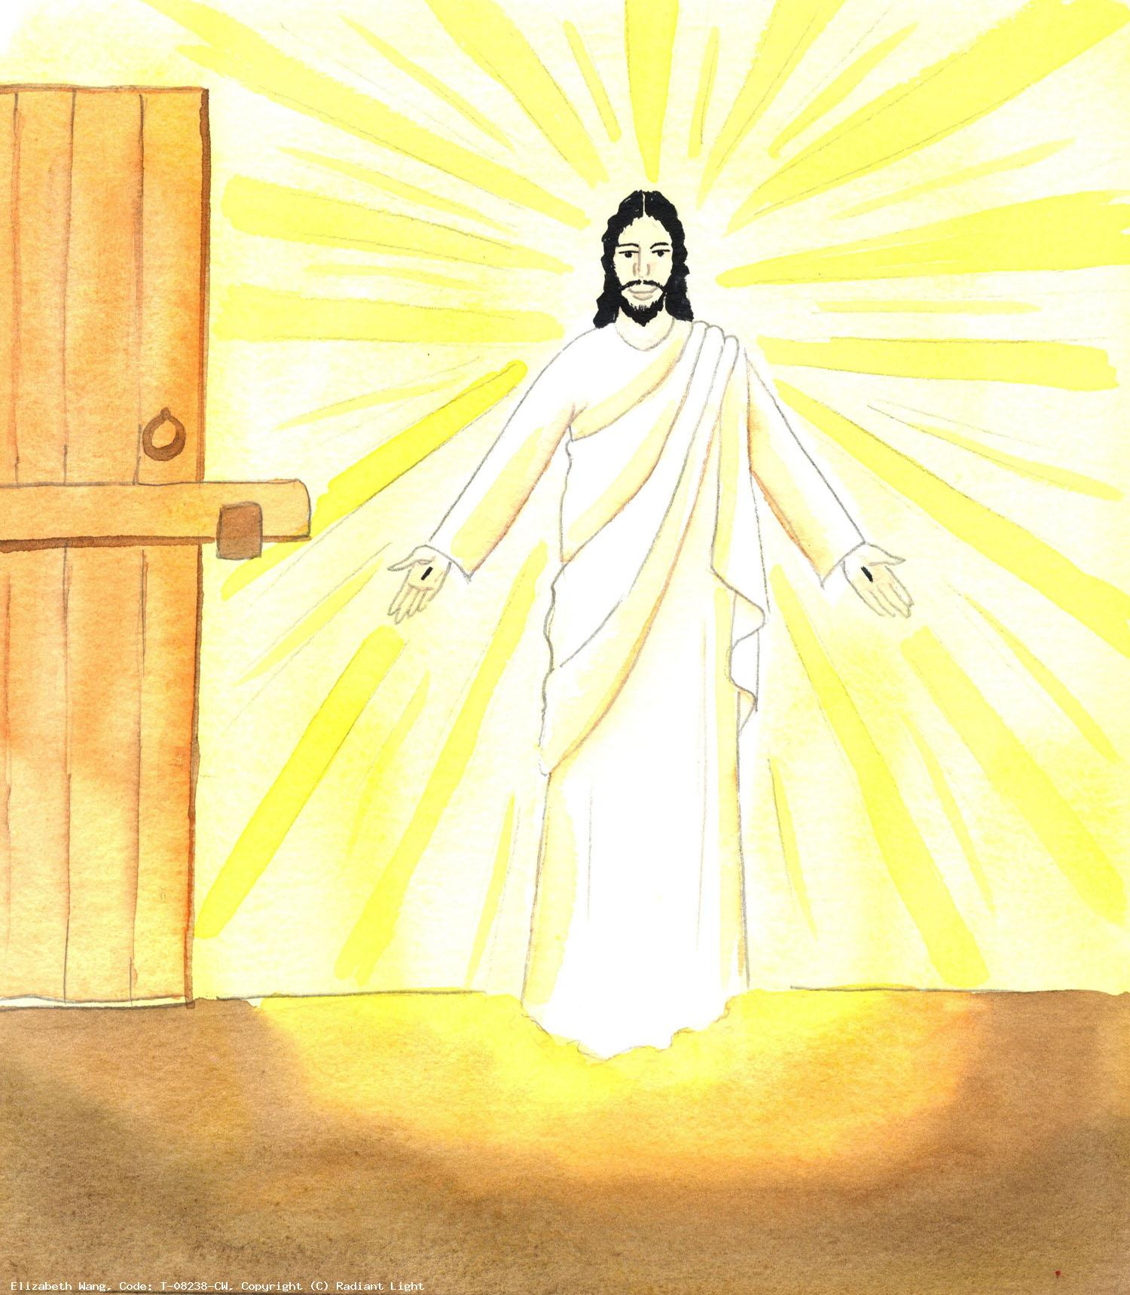
9. “He is going before you to Galilee; there you will see him.”
We pray that at this time of social distancing we will seek Jesus with all our hearts and in so doing we will truly find him and develop our relationship with him.

Slide 21
Hail Mary, Full of Grace
The Lord is with thee
Blessed art thou amongst women
And blessed is the fruit
of thy womb, Jesus,
Holy Mary, Mother of God,
Pray for us sinners
Now and at the hour
Of our death.
Amen.

Slide 22
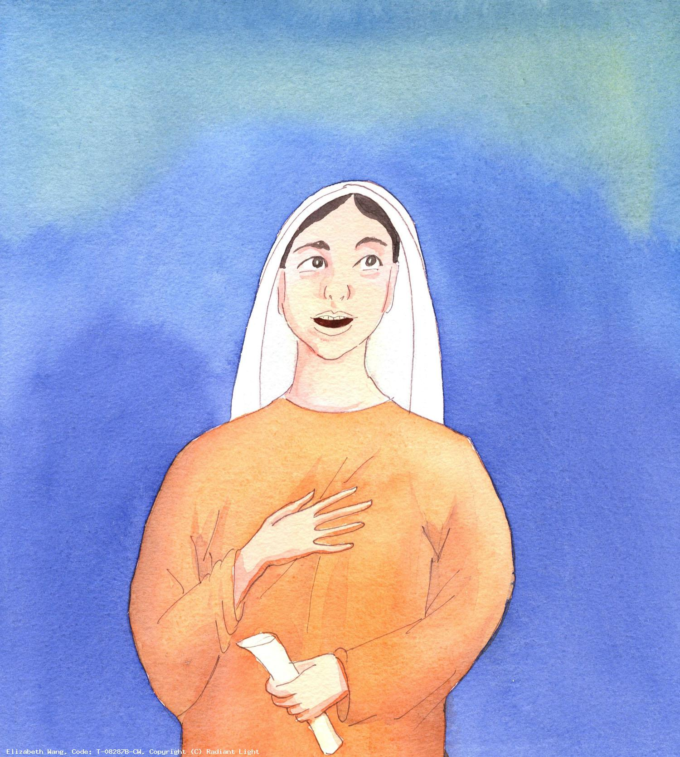
10. Then they went quickly from the tomb, fearful yet overjoyed, and ran to announce this to his apostles.
We pray for all God’s children at this time, especially those who are fearful and in need, that with the Lord’s help this can be a time of joy and renewal.

Slide 23
Hail Mary, Full of Grace
The Lord is with thee
Blessed art thou amongst women
And blessed is the fruit
of thy womb, Jesus,
Holy Mary, Mother of God,
Pray for us sinners
Now and at the hour
Of our death.
Amen.

Slide 24
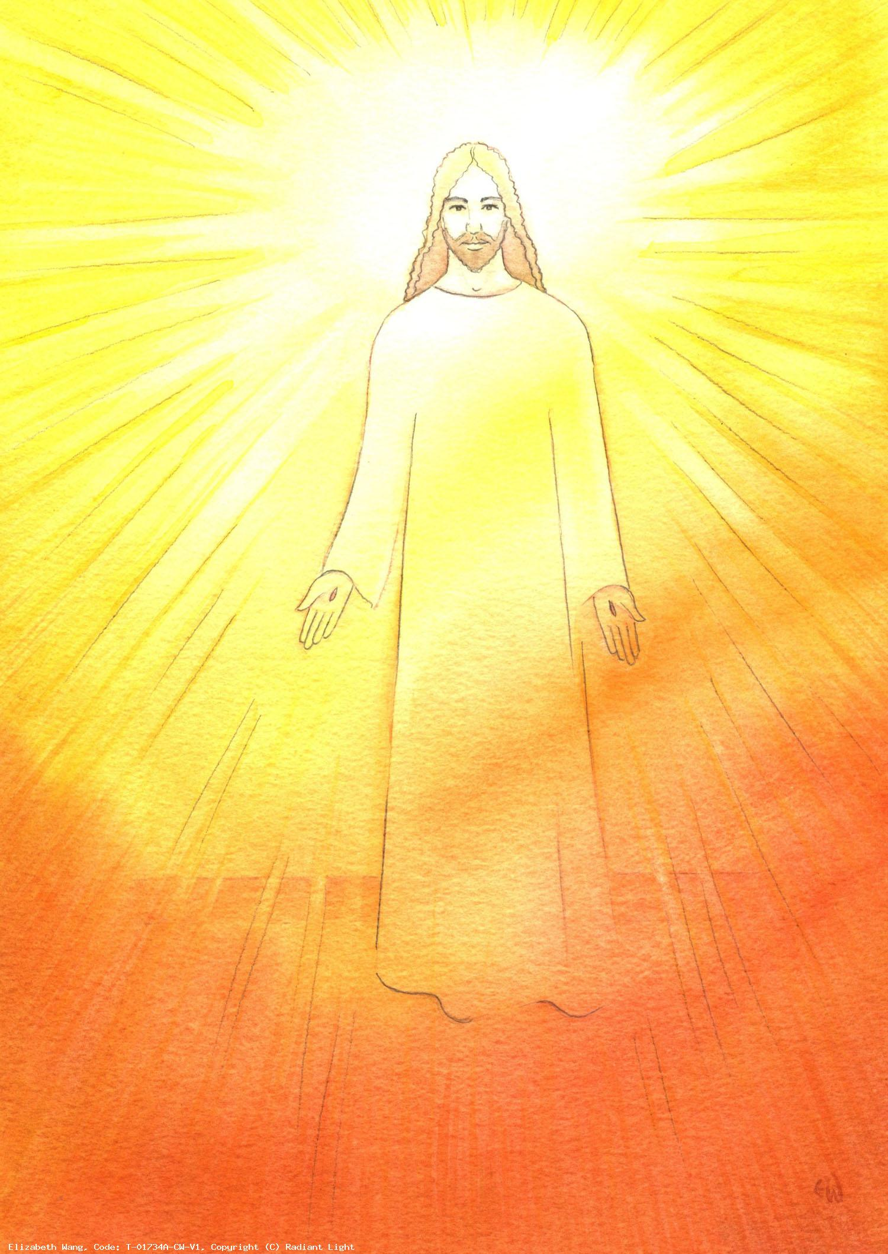
We trust that God who is all-knowing and compassionate will hear our prayers and send us his Holy Spirit, filling us with hope and joy so we, too, can be bearers of good news.

Slide 25
Glory be to the Father
And to the Son
And to the Holy Spirit
As it was in the beginning
Is now and ever shall be
World without end.
Amen.

Slide 26
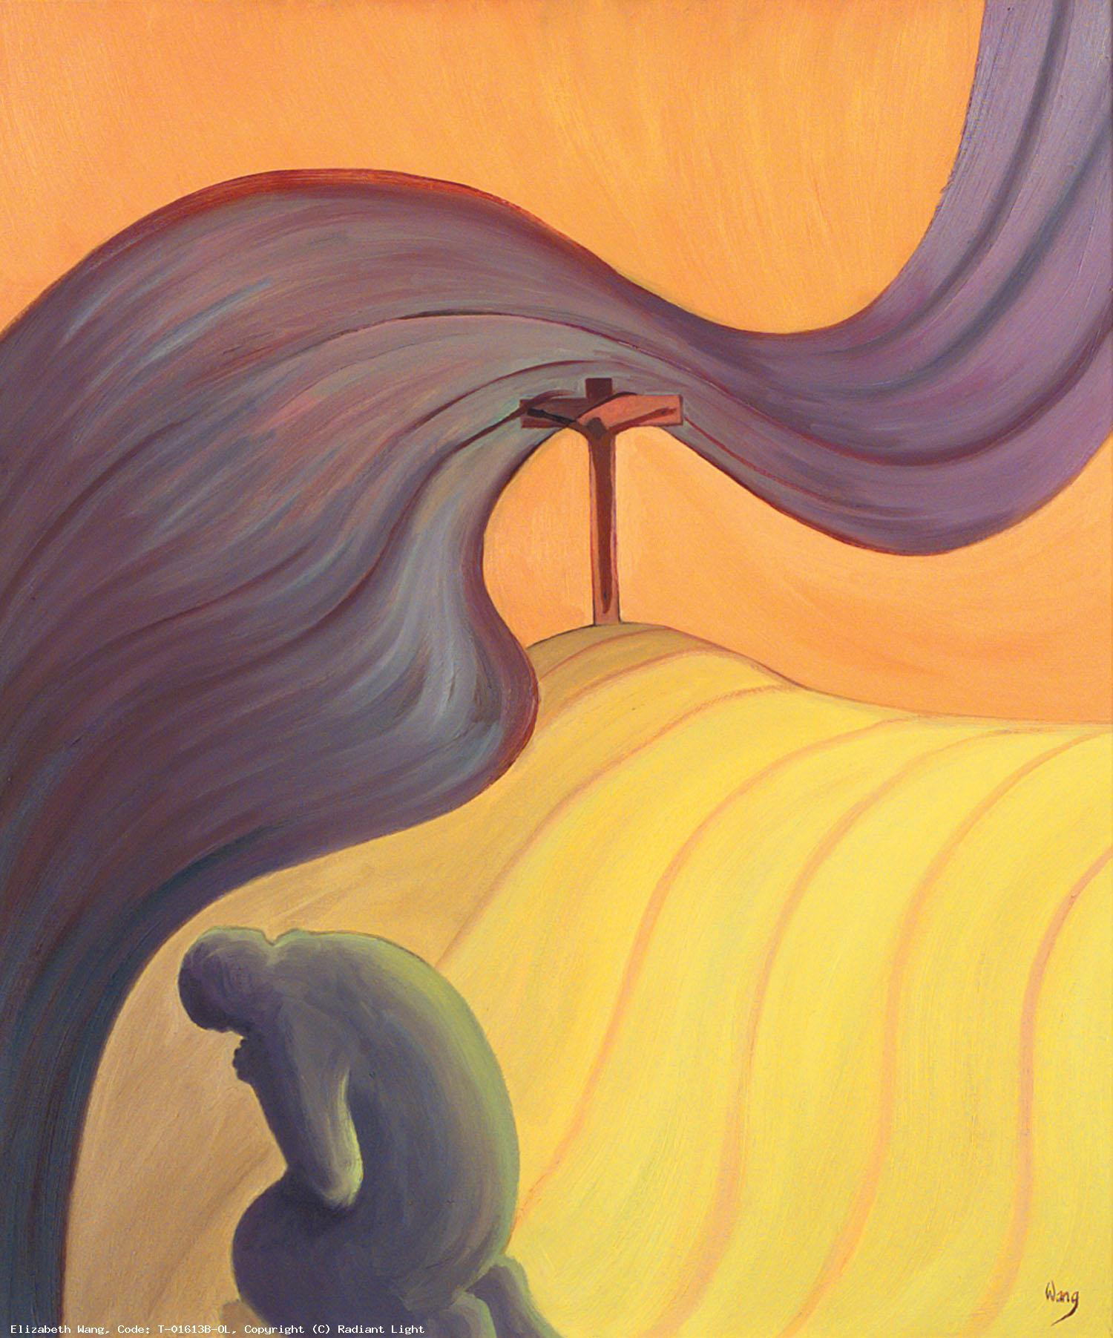
The Prayer of Fatima
Let us pray:
O my Jesus, forgive us our sins and save us from the fires of hell. Lead all souls to heaven, especially those who are in most need of your mercy.

Slide 27
Thank you for joining us today
May God bless you
and keep you
Now and forever
Images - Elizabeth Wang https://radiantlight.org.uk/

