Slide 1
Praying the Rosary with the Diocese of Westminster
The Assumption of Mary: Friday 8th May 2020

Slide 2
‘The Rosary is the prayer of the humble and of the saints. In its mysteries, they contemplate, along with Mary, the life of Jesus, the merciful face of the Father.
O, how much we all need to be truly comforted, to be wrapped in loving presence!’
Pope Francis (April 2020)

Slide 3
We offer this
decade of the Rosary for all those affected by the coronavirus and we ask the help of Our Blessed Mother, Mary, to take our prayers to her beloved son, Jesus.
-

Slide 4
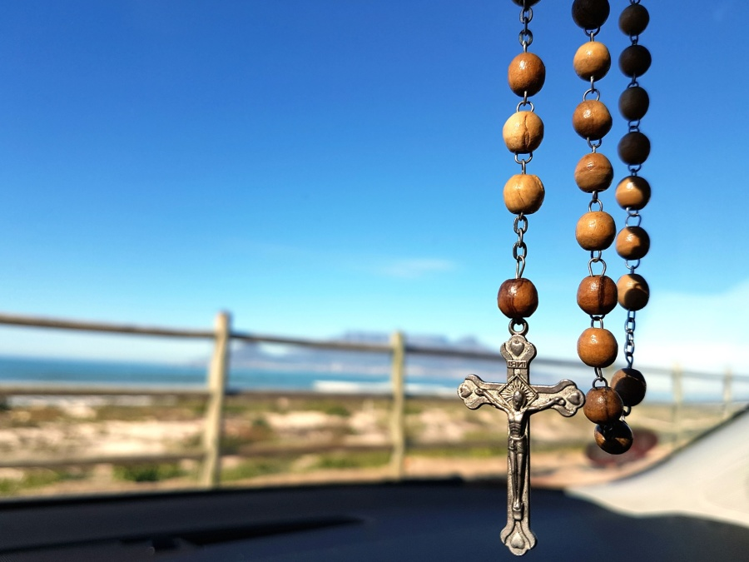
Our Father
Who art in heaven
Hallowed be thy name
Thy kingdom come
Thy will be done
On earth as it is in heaven
Give us this day our daily bread
And forgive us our trespasses
As we forgive those
who trespass against us
And lead us not into temptation
But deliver us from evil.
Amen.

Slide 5
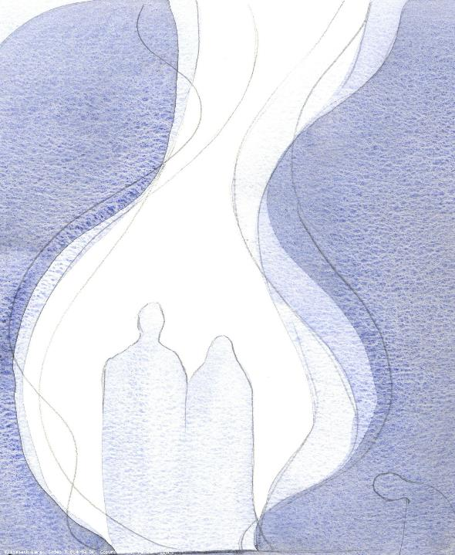
1. After the apostles have dispersed, the Blessed Mother goes to live with John, the beloved disciple.
We pray for people who find themselves living far away from their families and homes at this time. Help them to feel comfortable where they are and give them people who can become like family.

Slide 6
Hail Mary, Full of Grace
The Lord is with thee
Blessed art thou amongst women
And blessed is the fruit
of thy womb, Jesus,
Holy Mary, Mother of God,
Pray for us sinners
Now and at the hour
Of our death.
Amen.

Slide 7
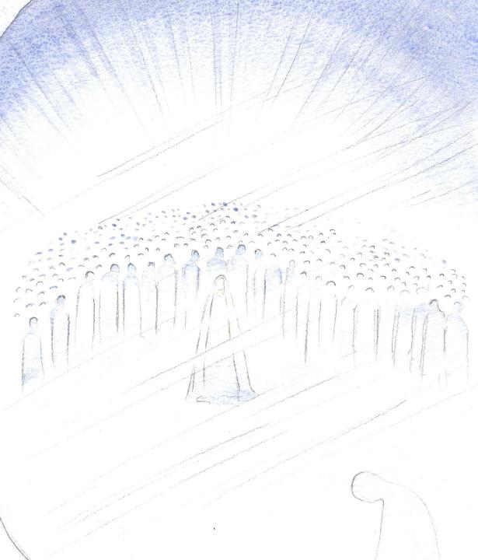
2. Mary continues to live on earth after the death of Christ.
We pray for all those who are bereaved and mourning. May you comfort them and be with them as they adjust to life without their loved ones.

Slide 8
Hail Mary, Full of Grace
The Lord is with thee
Blessed art thou amongst women
And blessed is the fruit
of thy womb, Jesus,
Holy Mary, Mother of God,
Pray for us sinners
Now and at the hour
Of our death.
Amen.

Slide 9
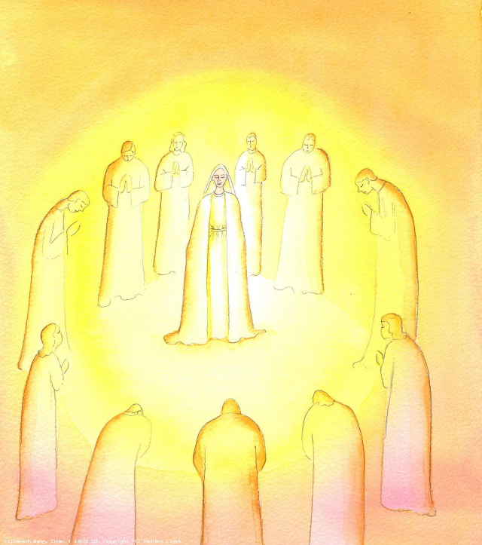
3. She is a source of comfort, wisdom and strength to the apostles.
We pray that we may be like Mary and offer comfort, wisdom and strength to those who are struggling mentally or physically during the pandemic.

Slide 10
Hail Mary, Full of Grace
The Lord is with thee
Blessed art thou amongst women
And blessed is the fruit
of thy womb, Jesus,
Holy Mary, Mother of God,
Pray for us sinners
Now and at the hour
Of our death.
Amen.

Slide 11
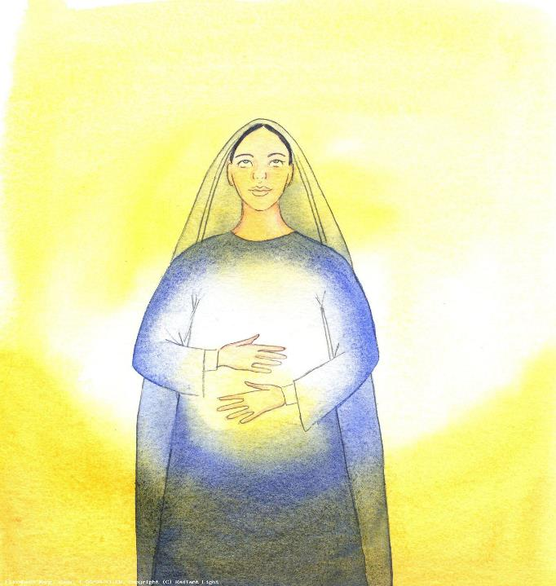
4. As she had nourished the infant Jesus, so she nourishes spiritually the infant Church.
We pray for the gifts of the Holy Spirit so we can nourish each other spiritually and support the Church as it looks to the future.

Slide 12
Hail Mary, Full of Grace
The Lord is with thee
Blessed art thou amongst women
And blessed is the fruit
of thy womb, Jesus,
Holy Mary, Mother of God,
Pray for us sinners
Now and at the hour
Of our death.
Amen.

Slide 13
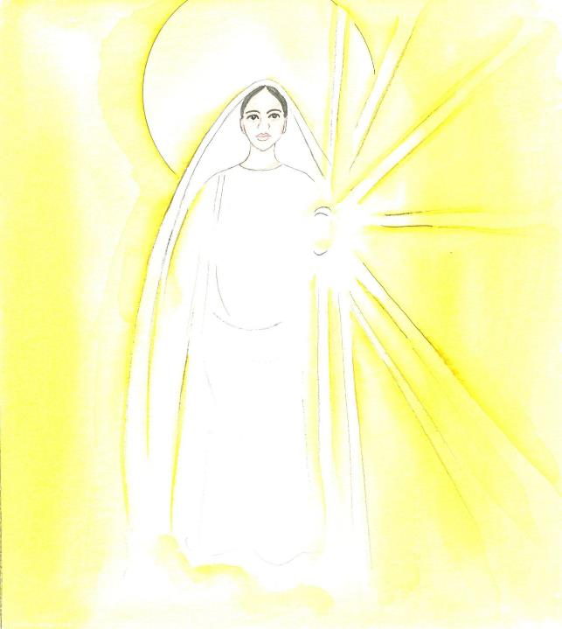
5. When the course of Mary's earthly life was finished, she was wholly overcome in a rapture of divine love.
We pray for all those who are dying. May your eternal and divine love give them peace and rest.

Slide 14
Hail Mary, Full of Grace
The Lord is with thee
Blessed art thou amongst women
And blessed is the fruit
of thy womb, Jesus,
Holy Mary, Mother of God,
Pray for us sinners
Now and at the hour
Of our death.
Amen.

Slide 15
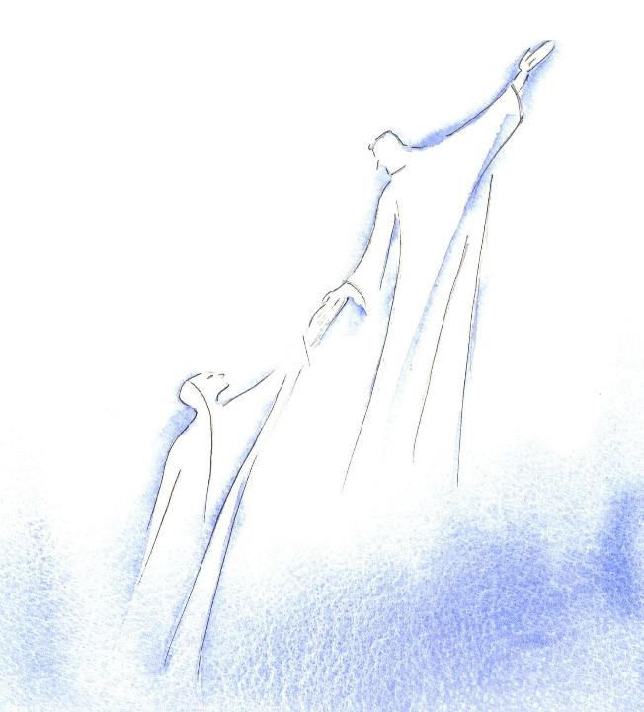
6. Her body as well as her soul is taken up into heaven.
We pray for all those who have died. May they be united with you in heaven.

Slide 16
Hail Mary, Full of Grace
The Lord is with thee
Blessed art thou amongst women
And blessed is the fruit
of thy womb, Jesus,
Holy Mary, Mother of God,
Pray for us sinners
Now and at the hour
Of our death.
Amen.

Slide 17
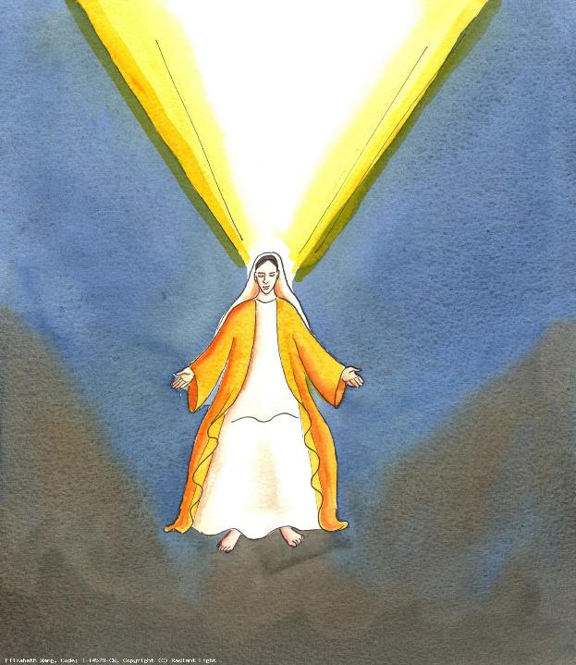
7. The Assumption of the Blessed Virgin is a singular participation in her Son's Resurrection and an anticipation of the resurrection of other Christians.
We pray for all those who care for the deceased. Help them to treat each person with dignity and compassion. Give priests words of wisdom as they comfort those who mourn.

Slide 18
Hail Mary, Full of Grace
The Lord is with thee
Blessed art thou amongst women
And blessed is the fruit
of thy womb, Jesus,
Holy Mary, Mother of God,
Pray for us sinners
Now and at the hour
Of our death.
Amen.

Slide 19
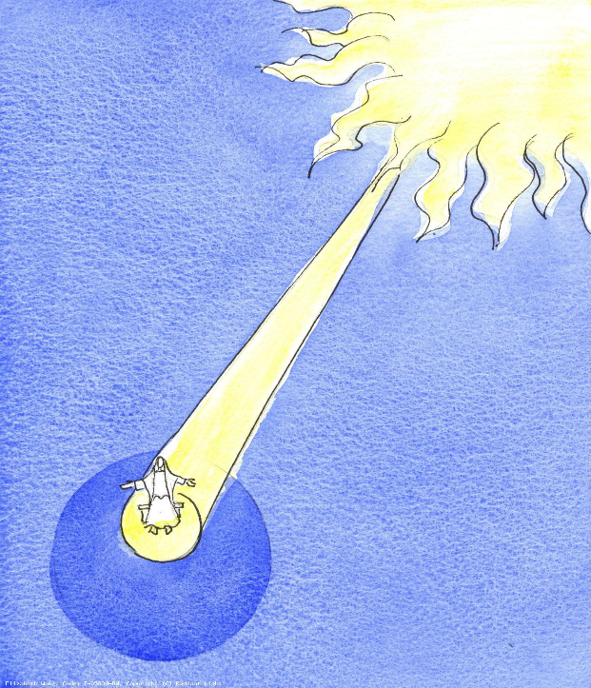
8. Jesus prepares a place for Mary in heaven, where she is among the angels and the saints praising God and interceding on our behalf.
We pray that Christ’s compassion and love will sustain us at this time and we will walk closely with Him, like Mary does in heaven.

Slide 20
Hail Mary, Full of Grace
The Lord is with thee
Blessed art thou amongst women
And blessed is the fruit
of thy womb, Jesus,
Holy Mary, Mother of God,
Pray for us sinners
Now and at the hour
Of our death.
Amen.

Slide 21
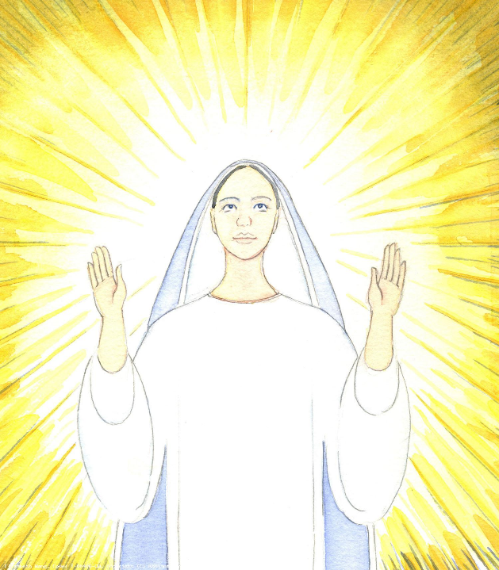
9. Mary was obedient throughout her earthly life. She said yes to God’s call.
We pray that we will listen to God’s call, just as Mary did, and will be willing to use our time, skills and talents to serve others at this time and be witnesses of Christ.

Slide 22
Hail Mary, Full of Grace
The Lord is with thee
Blessed art thou amongst women
And blessed is the fruit
of thy womb, Jesus,
Holy Mary, Mother of God,
Pray for us sinners
Now and at the hour
Of our death.
Amen.

Slide 23
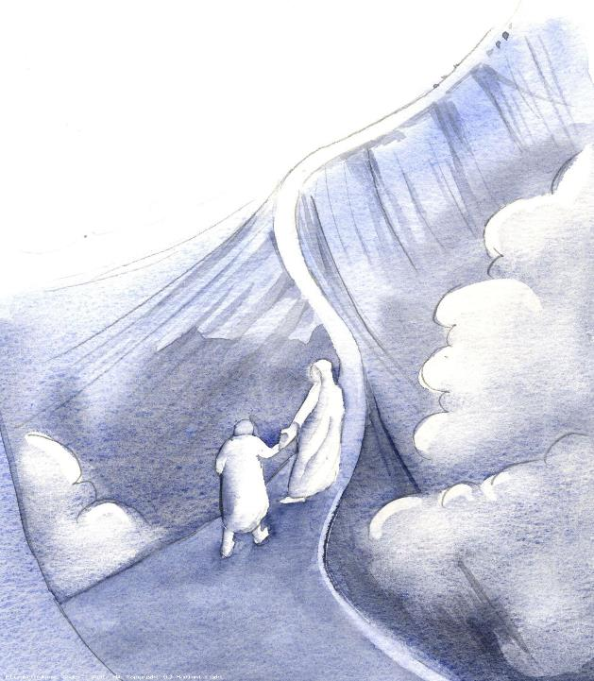
10. The bodies of all humanity, at the last judgment, will be brought back and united again to the soul.
We pray for all those facing your judgement and preparing to meet with God face to face. Have mercy on them.

Slide 24
Hail Mary, Full of Grace
The Lord is with thee
Blessed art thou amongst women
And blessed is the fruit
of thy womb, Jesus,
Holy Mary, Mother of God,
Pray for us sinners
Now and at the hour
Of our death.
Amen.

Slide 25
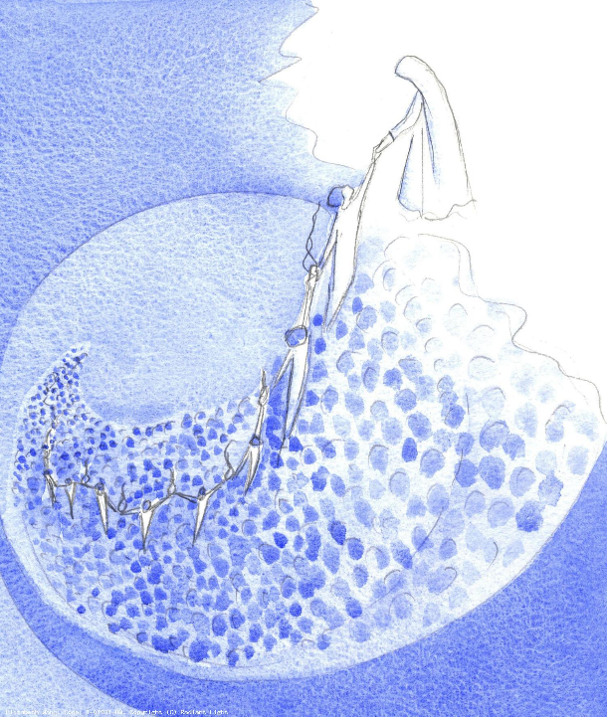
At the end of Mary’s life, God chose to bring her body and soul into eternal life. Mary prays for us at the hour of our death as we ask her so often in the Hail Mary. Let us now join our prayers with the Holy Trinity.

Slide 26
Glory be to the Father
And to the Son
And to the Holy Spirit
As it was in the beginning
Is now and ever shall be
World without end.
Amen.

Slide 27
Thank you for joining us today…

Slide 28
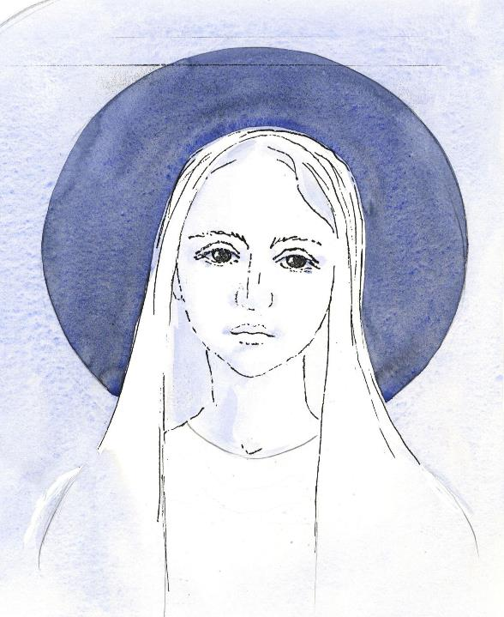
Painted images by Elizabeth Wang
To view and download images by Elizabeth Wang (and about Christian faith in general) please visit the Radiant Light website and use the search button to search by topic:
https://radiantlight.org.uk/
Thanks also to the following site:
https://www.rosarycenter.org/homepage-2/rosary/how-to-pray-the-rosary/glorious-without-distractions/

