Slide 1
Praying the Rosary with the Diocese of Westminster
The Coronation of Mary: Friday 15th May 2020

Slide 2
‘Mary, Consolation of the afflicted, embrace all your children in distress and pray that God will stretch out his all-powerful hand and free us from this terrible pandemic, so that life can serenely resume its normal course.
To you, who shine on our journey as a sign of salvation and hope, do we entrust ourselves, O Clement, O Loving, O Sweet Virgin Mary. Amen.
Pope Francis (April 2020)

Slide 3
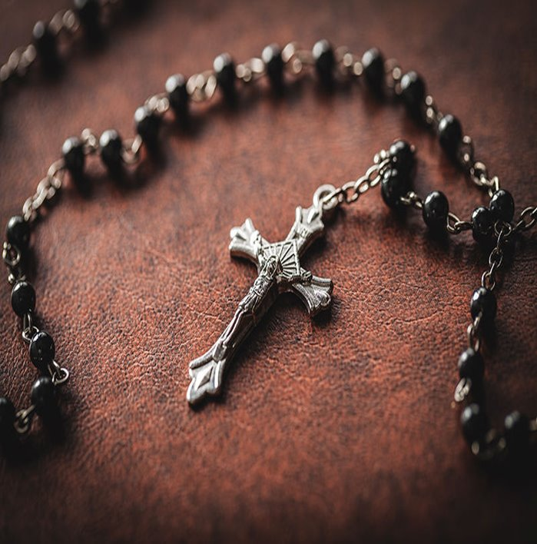
We offer this decade of the Rosary for all those affected by the coronavirus and we ask the help of Our Blessed Mother, Mary, to take our prayers to her beloved son, Jesus.​

Slide 4
Our Father,
Who art in Heaven, hallowed be Thy name; Thy Kingdom come, Thy will be done on earth as it is in Heaven.
Give us this day our daily bread; and forgive us our trespasses as we forgive those who trespass against us; and lead us not into temptation, but deliver us from evil.
Amen.

Slide 5
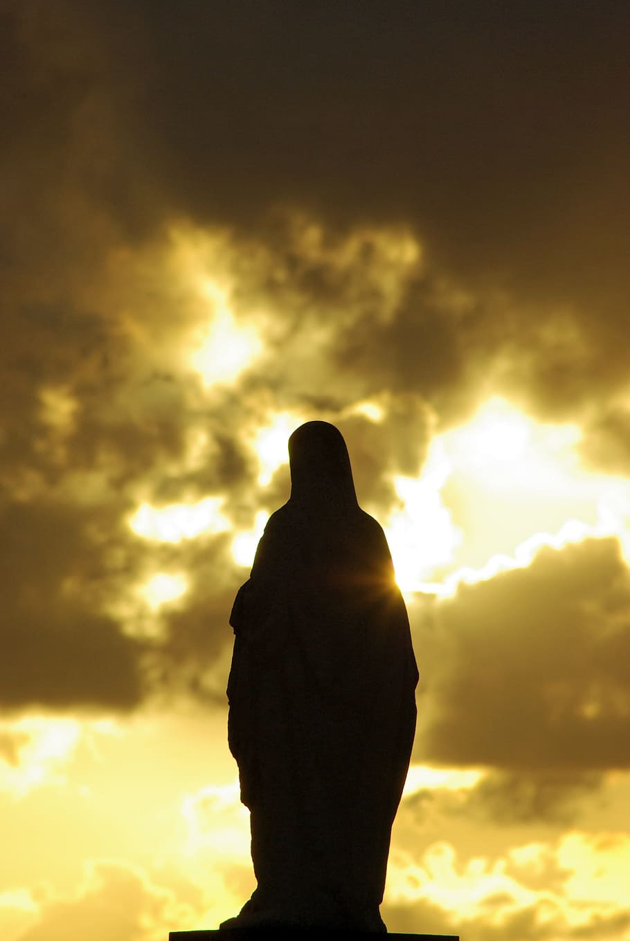
As Mary enters heaven, the entire court of heaven greets with joy this masterpiece of God’s creation.
O Mary, you shine continuously along our journey as a sign of salvation and hope.

Slide 6
Hail Mary full of Grace,
the Lord is with thee. Blessed are thou amongst women and blessed is the fruit of thy womb Jesus. Holy Mary Mother of God, pray for us sinners now and at the hour of our death Amen.

Slide 7
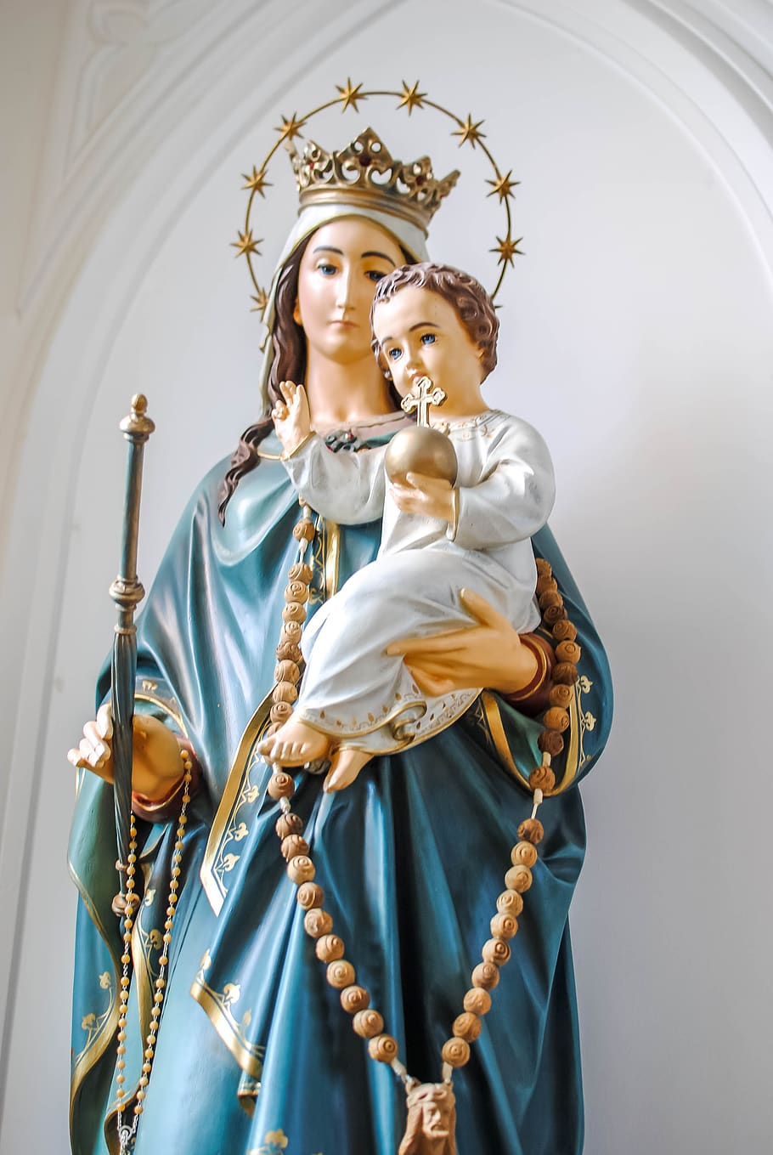
2. Mary is crowned by her divine Son as Queen of heaven and earth
Keep us, good Lord, under the shadow of your mercy in this time of uncertainty and distress.

Slide 8
Hail Mary full of Grace,
the Lord is with thee. Blessed are thou amongst women and blessed is the fruit of thy womb Jesus. Holy Mary Mother of God, pray for us sinners now and at the hour of our death Amen.

Slide 9
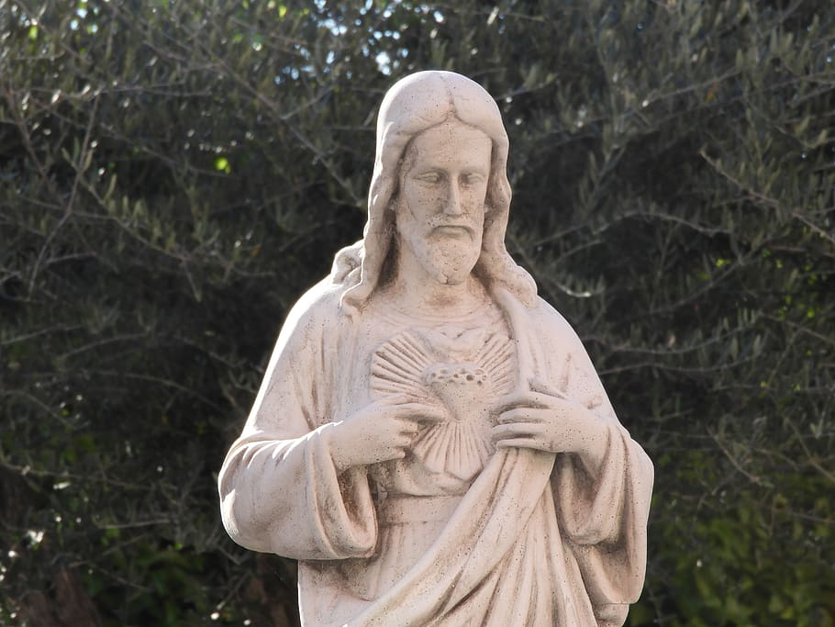
3. More than we can ever know the Hearts of Jesus and Mary overflow with joy at this reunion.
Be with us in our isolation,
Sustain and support the anxious and fearful until we can all be together.

Slide 10
Hail Mary full of Grace,
the Lord is with thee. Blessed are thou amongst women and blessed is the fruit of thy womb Jesus. Holy Mary Mother of God, pray for us sinners now and at the hour of our death Amen.

Slide 11
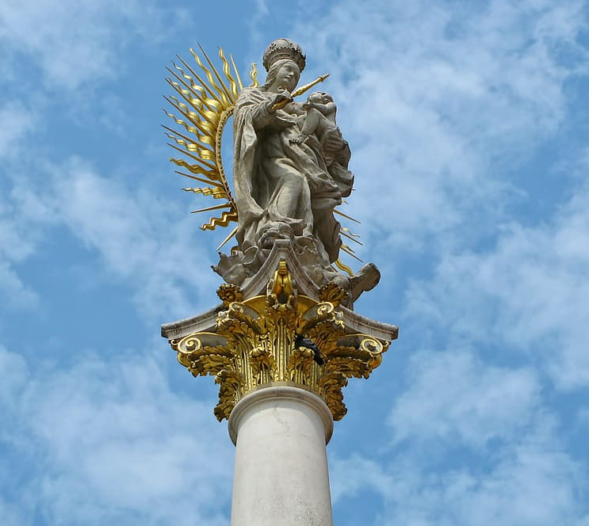
4. Only in heaven will we know the great majesty of that coronation, and the joy it gave to the angels and saints
Continue to teach us to love our neighbour, and to care for those in need as if we were caring for you.

Slide 12
Hail Mary full of Grace,
the Lord is with thee. Blessed are thou amongst women and blessed is the fruit of thy womb Jesus. Holy Mary Mother of God, pray for us sinners now and at the hour of our death Amen.

Slide 13
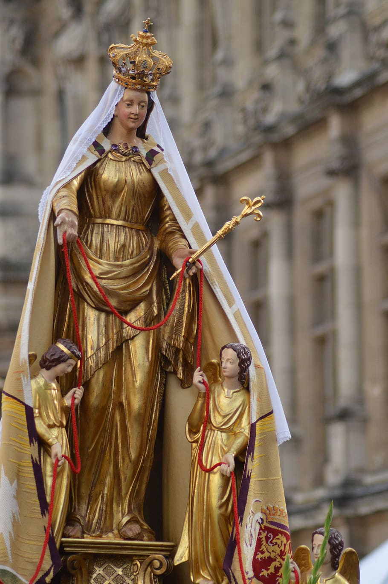
5. Even the angels, who by nature are greater than humans, hail Mary as their Queen.
During these anxious times, give us strength to comfort the fearful, to tend the sick and support one another.

Slide 14
Hail Mary full of Grace,
the Lord is with thee. Blessed are thou amongst women and blessed is the fruit of thy womb Jesus. Holy Mary Mother of God, pray for us sinners now and at the hour of our death Amen.

Slide 15
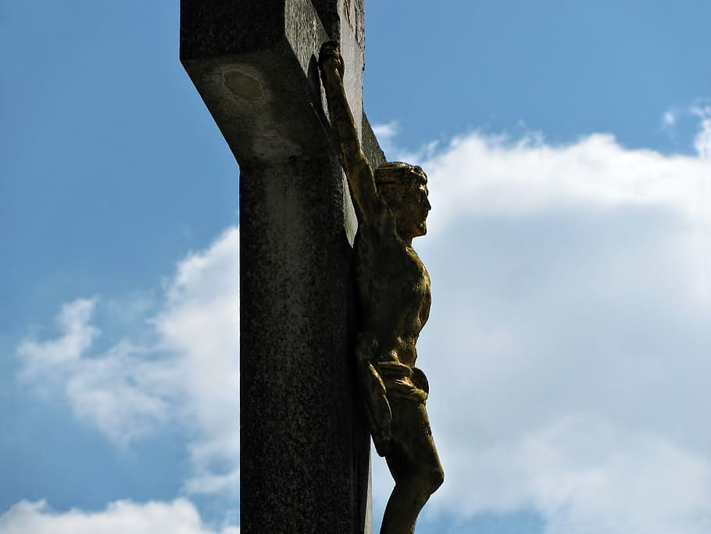
6. Mary shares so fully in the glory of Christ because she shared so fully in His suffering.
Be close to us In our loneliness, be our consolation; in our distress, be our hope; in our darkness, be our light.

Slide 16
Hail Mary full of Grace,
the Lord is with thee. Blessed are thou amongst women and blessed is the fruit of thy womb Jesus. Holy Mary Mother of God, pray for us sinners now and at the hour of our death Amen.

Slide 17
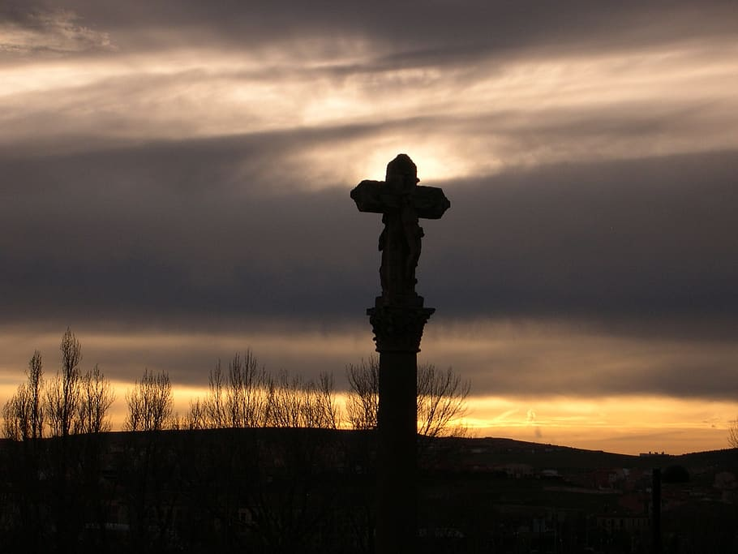
7. Only in heaven will we see how central is the role of Mary in the divine plan of redemption.
Gracious God, give skill, sympathy and resilience to all who are caring for the sick and to all who are looking for answers.

Slide 18
Hail Mary full of Grace,
the Lord is with thee. Blessed are thou amongst women and blessed is the fruit of thy womb Jesus. Holy Mary Mother of God, pray for us sinners now and at the hour of our death Amen.

Slide 19
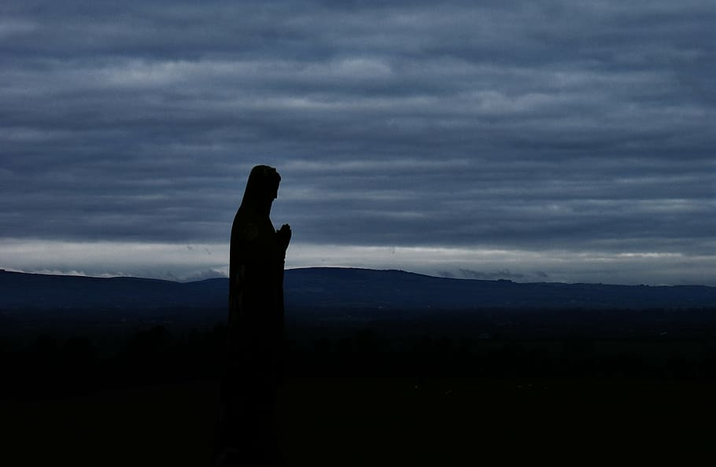
8. The angels and saints longed for the coming of her whose heel crushes the head of the serpent.
Be with the leaders of all nations. Give them the foresight to act with charity and true concern for the well-being of the people they are meant to serve.

Slide 20
Hail Mary full of Grace,
the Lord is with thee. Blessed are thou amongst women and blessed is the fruit of thy womb Jesus. Holy Mary Mother of God, pray for us sinners now and at the hour of our death Amen.

Slide 21
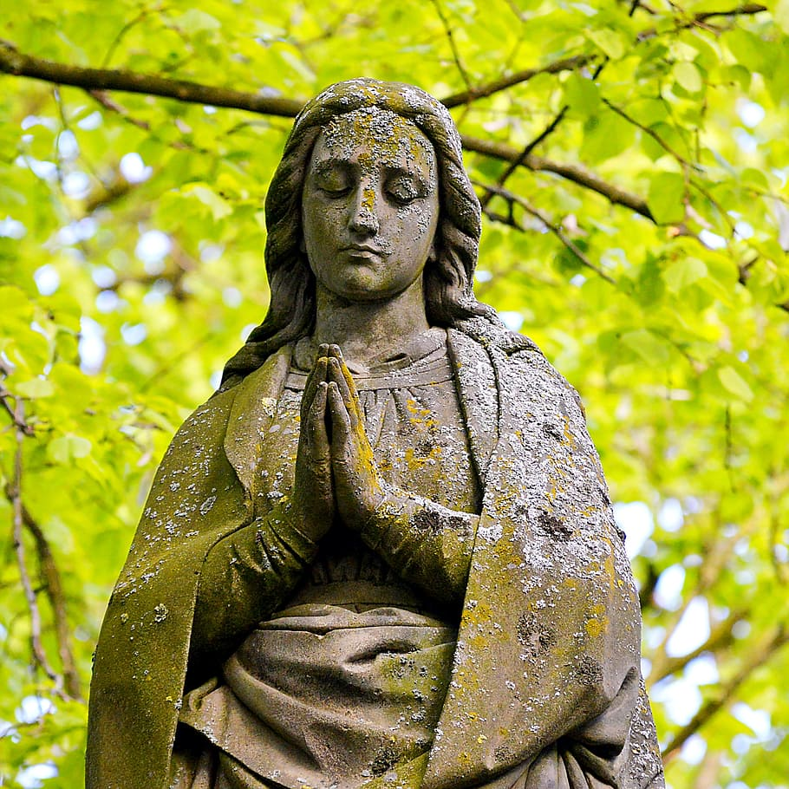
9. Mary pleads our cause as a most powerful Queen and a most merciful and loving Mother.
Guide all within school communities as they discover new ways to learn and explore the world you have granted us.

Slide 22
Hail Mary full of Grace,
the Lord is with thee. Blessed are thou amongst women and blessed is the fruit of thy womb Jesus. Holy Mary Mother of God, pray for us sinners now and at the hour of our death Amen.

Slide 23
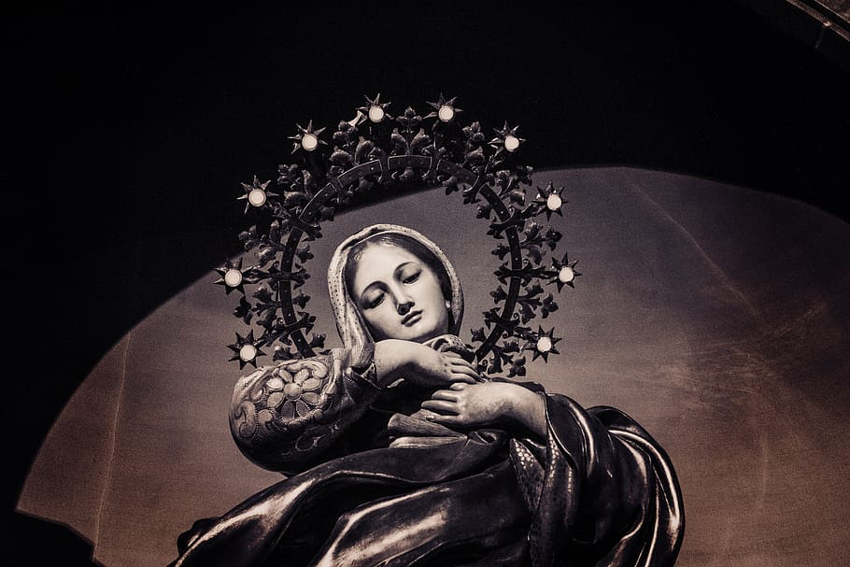
10. A great sign appeared in heaven; a woman clothed with the sun, the moon under her feet, and on her head a crown of twelve stars.
Even in these anxious times, you are with us. Help us to put our trust in you and keep us safe.

Slide 24
Hail Mary full of Grace,
the Lord is with thee. Blessed are thou amongst women and blessed is the fruit of thy womb Jesus. Holy Mary Mother of God, pray for us sinners now and at the hour of our death Amen.

Slide 25
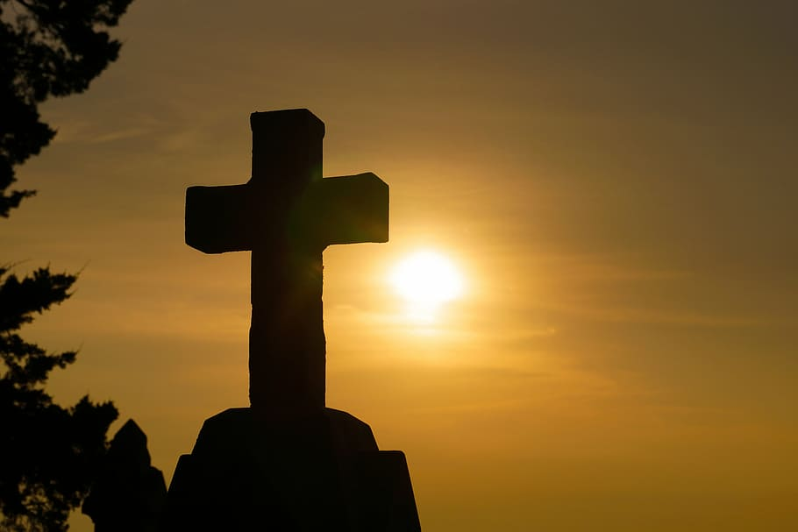
We trust that God who is all-knowing and compassionate will hear our prayers and send us his Holy Spirit so that we can offer ourselves completely to the will of God following the example of our Lord and Saviour, Jesus Christ.

Slide 26
Diana Roberts
Adviser for Catholic Education
Diocese of Westminster
Education Service
Vaughan House
46 Francis Street
Westminster
SW1P 1QN
Glory be to the Father
and to the Son
and to the Holy Spirit;
as it was in the beginning
is now and ever shall be
world without end.
Amen.

Slide 27
Thank you for joining us today…

Slide 28
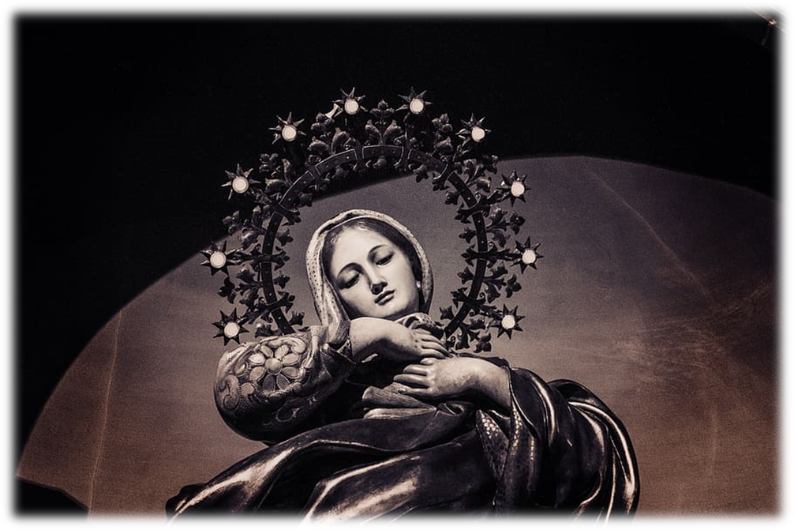
Images from
https://www.pxfuel.com/en/search?q=images+of+mary
Thanks also to the following site:
https://www.rosarycenter.org/homepage-2/rosary/how-to-pray-the-rosary/glorious-without-distractions/

