Slide 1
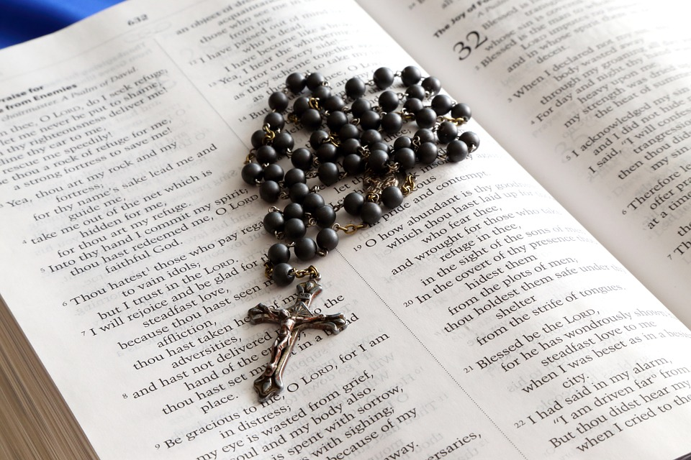
Praying the Rosary with the Diocese of Westminster
The Wedding at Cana: Friday 29th May 2020

Slide 2
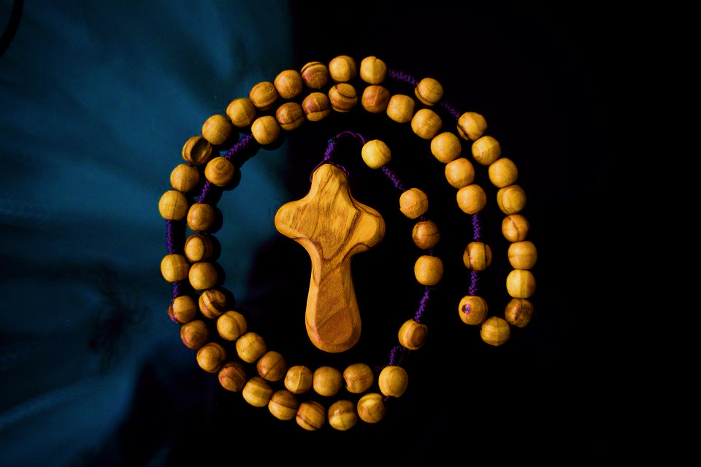
John 2: 1-12
‘As Mary bids us, let us “do what the Lord tells us”. Do what he tells you. And let us be thankful that in this, our time and our hour, the new wine, the finest wine, will make us recover the joy of families, the joy of living in a family. Let it be so.’
Pope Francis, Holy Mass for Families, Samanes Park, Guayaquil (Ecuador), Monday, 6 July 2015

Slide 3
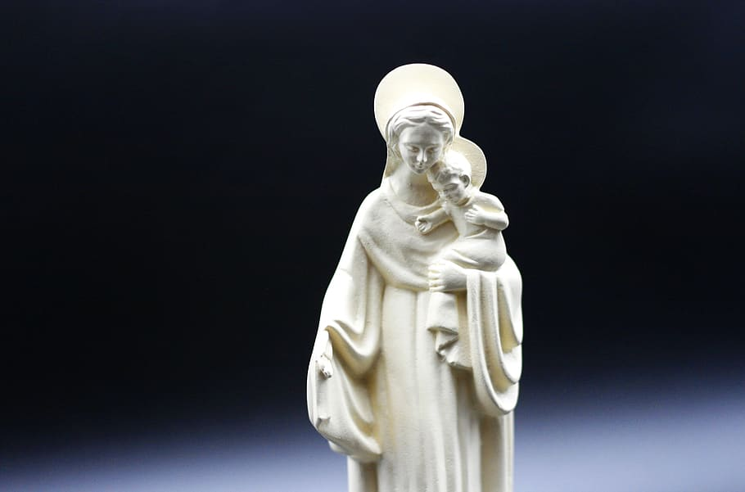
We offer this decade of the Rosary for all those affected by the coronavirus and we ask the help of Our Blessed Mother, Mary, to take our prayers to her beloved son, Jesus.​

Slide 4
Our Father,
Who art in Heaven, hallowed be Thy name; Thy Kingdom come, Thy will be done on earth as it is in Heaven.
Give us this day our daily bread; and forgive us our trespasses as we forgive those who trespass against us; and lead us not into temptation, but deliver us from evil.
Amen.

Slide 5
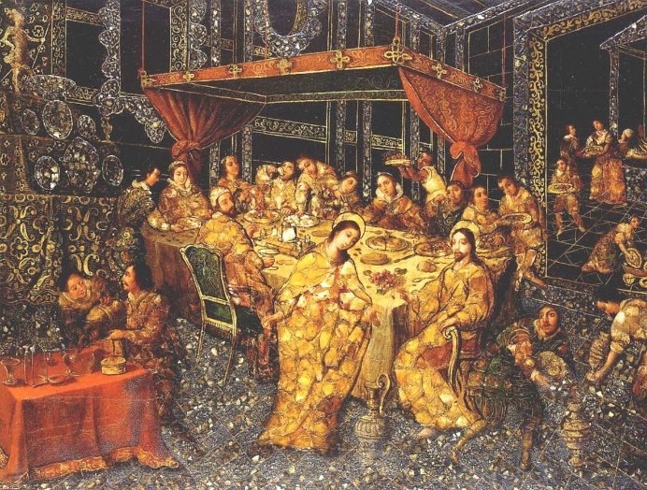
1
On the third day there was a wedding at Cana in Galilee.
Many weddings and other celebrations have been cancelled due to the current situation.
We pray that soon they will have the opportunity to celebrate with their communities.

Slide 6
Hail Mary full of Grace,
the Lord is with thee. Blessed are thou amongst women and blessed is the fruit of thy womb Jesus. Holy Mary Mother of God, pray for us sinners now and at the hour of our death Amen.

Slide 7
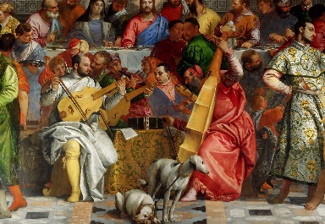
2
The mother of Jesus was there and Jesus and his disciples had also been invited.
It is essential for us to live in community, to feel connected and invited.
We pray for those who feel isolated and unhappy at this time.

Slide 8
Hail Mary full of Grace,
the Lord is with thee. Blessed are thou amongst women and blessed is the fruit of thy womb Jesus. Holy Mary Mother of God, pray for us sinners now and at the hour of our death Amen.

Slide 9
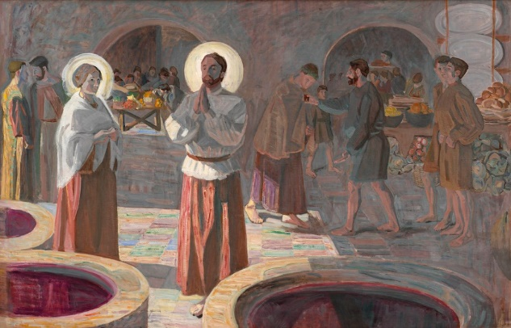
3
And they ran out of wine, since the wine provided for the feast had all been used, and the mother of Jesus said to him, 'They have no wine.’
Everyone needs food and drink to stay healthy.
We pray for those who have run out of basic supplies and those who are struggling financially.

Slide 10
Hail Mary full of Grace,
the Lord is with thee. Blessed are thou amongst women and blessed is the fruit of thy womb Jesus. Holy Mary Mother of God, pray for us sinners now and at the hour of our death Amen.

Slide 11
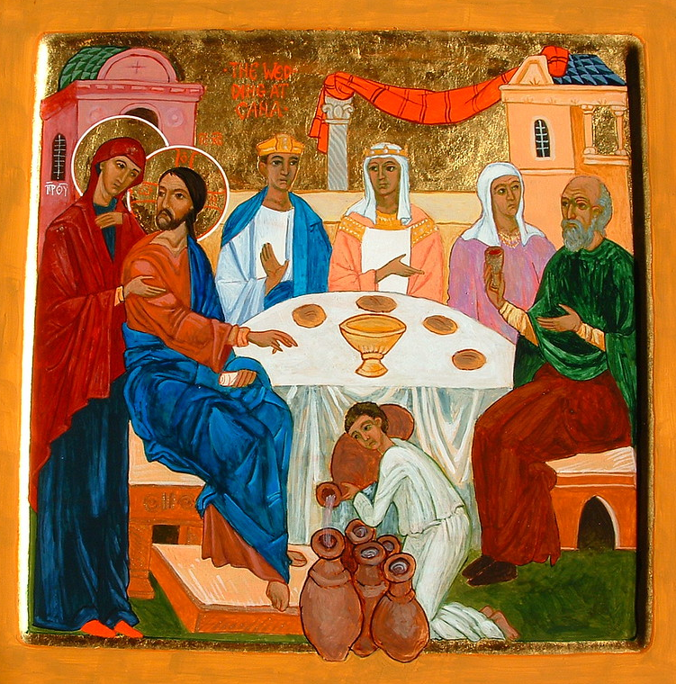
4
Jesus said, 'Woman, what do you want from me? My hour has not come yet.'
​Mary sees other people’s needs and, out of compassion and faith, asks Jesus for help.
We pray that we, too, will be filled with compassion and faith, especially when times are most difficult.

Slide 12
Hail Mary full of Grace,
the Lord is with thee. Blessed are thou amongst women and blessed is the fruit of thy womb Jesus. Holy Mary Mother of God, pray for us sinners now and at the hour of our death Amen.

Slide 13
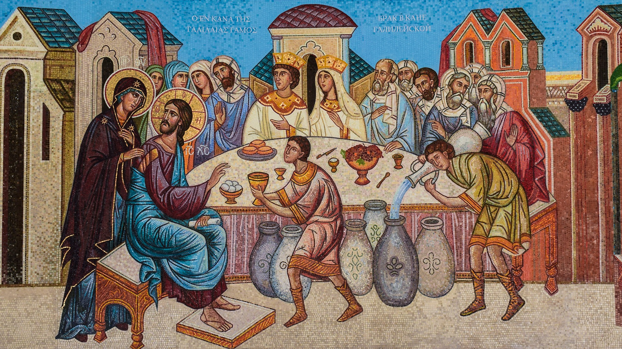
5
His mother said to the servants, 'Do whatever he tells you.'
Jesus was always obedient and respectful to his mother.
We pray for all families working and learning at home together, that they will be tolerant and respectful of each other during this challenging time.

Slide 14
Hail Mary full of Grace,
the Lord is with thee. Blessed are thou amongst women and blessed is the fruit of thy womb Jesus. Holy Mary Mother of God, pray for us sinners now and at the hour of our death Amen.

Slide 15
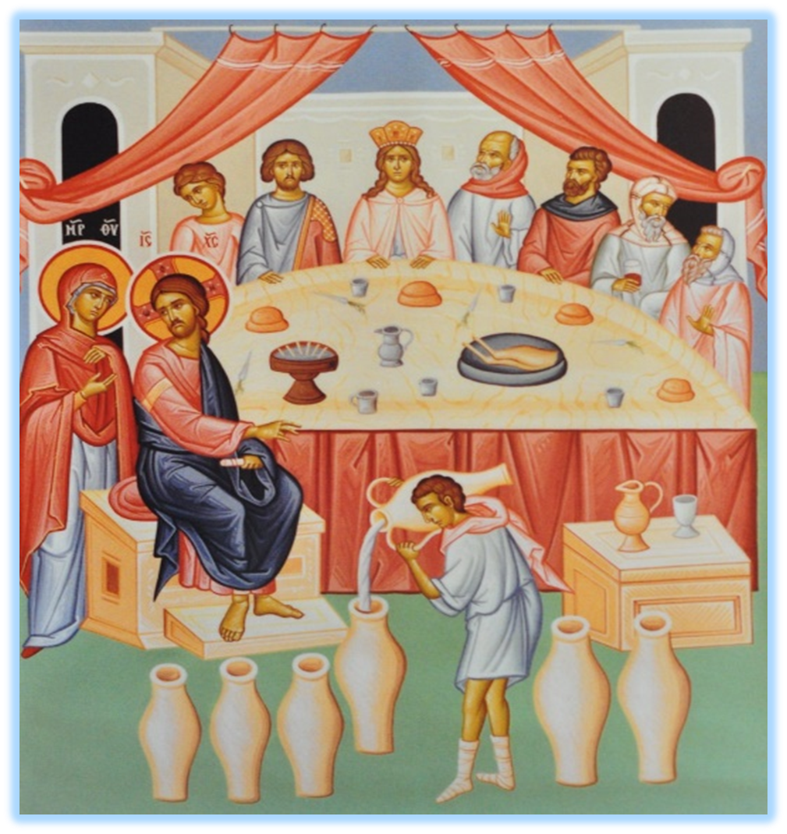
6
Jesus said to the servants, 'Fill the jars with water,' and they filled them to the brim’.
Many key workers help with our food, drink, health, communication and other services.
We pray for all those in our society who help others, especially all those who work in schools.

Slide 16
Hail Mary full of Grace,
the Lord is with thee. Blessed are thou amongst women and blessed is the fruit of thy womb Jesus. Holy Mary Mother of God, pray for us sinners now and at the hour of our death Amen.

Slide 17
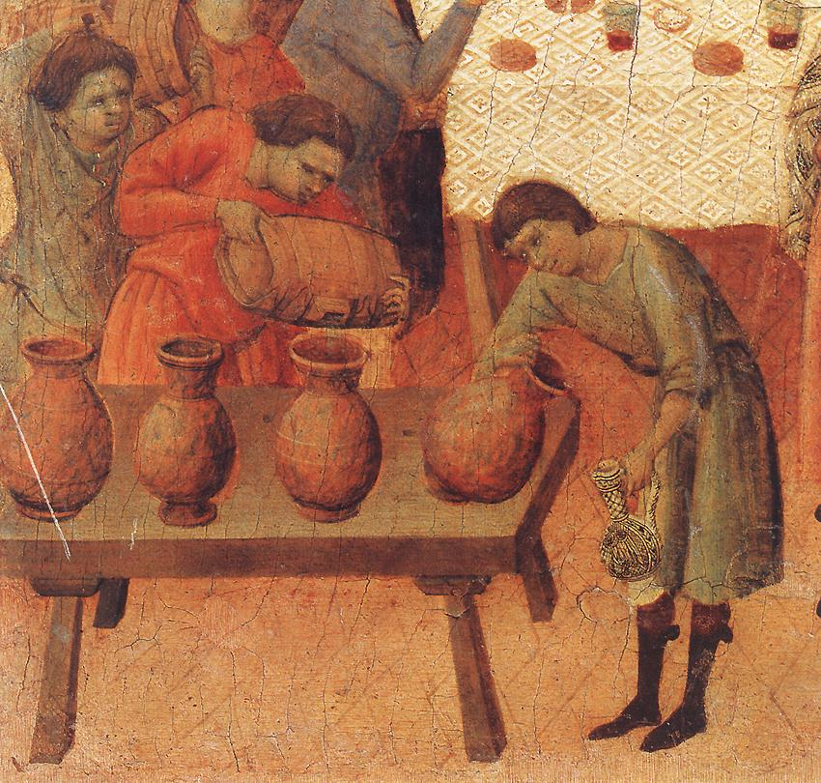
7
Then he said to them, 'Draw some out now and take it to the president of the feast’.
Jesus knew that he could bring about change and that good things were still to come.
We pray for those who are striving to bring about positive change in our world today, especially our leaders, scientists and all those involved in education.

Slide 18
Hail Mary full of Grace,
the Lord is with thee. Blessed are thou amongst women and blessed is the fruit of thy womb Jesus. Holy Mary Mother of God, pray for us sinners now and at the hour of our death Amen.

Slide 19
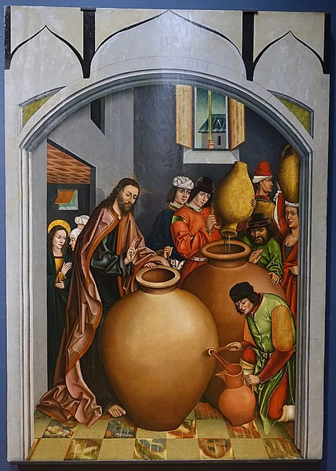
8
They did this; the president tasted the water, and it had turned into wine. Having no idea where it came from -- though the servants who had drawn the water knew.
God has given us many blessings – our families and friends, our homes, our food and our health.
We pray that we will grow in gratitude with thankful and prayerful hearts.

Slide 20
Hail Mary full of Grace,
the Lord is with thee. Blessed are thou amongst women and blessed is the fruit of thy womb Jesus. Holy Mary Mother of God, pray for us sinners now and at the hour of our death Amen.

Slide 21
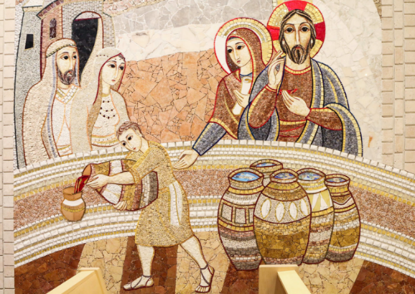
9
The president of the feast called the bridegroom and said, 'Everyone serves good wine first and the worse wine when the guests are well wined; but you have kept the best wine till now.’
Jesus is sufficient in fulfilling all our spiritual needs, he knows what is best.
We pray for his guidance and peace during this challenging time and for a new and better world for us and for our children.

Slide 22
Hail Mary full of Grace,
the Lord is with thee. Blessed are thou amongst women and blessed is the fruit of thy womb Jesus. Holy Mary Mother of God, pray for us sinners now and at the hour of our death Amen.

Slide 23
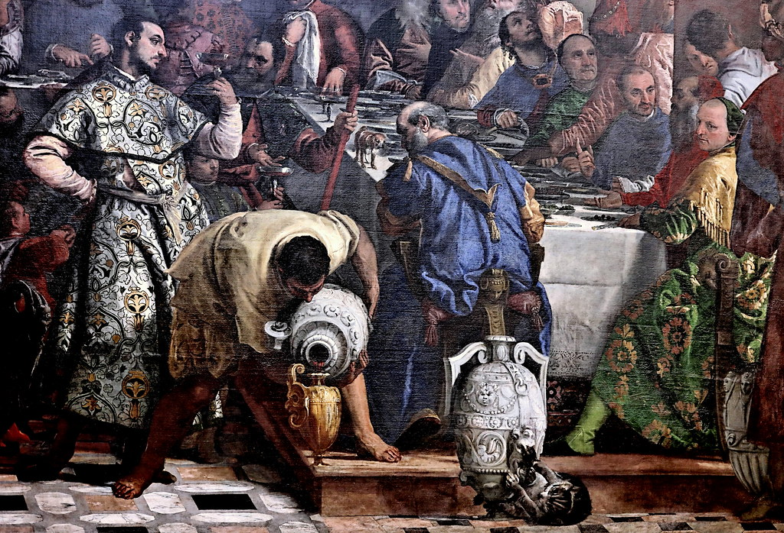
10
This was the first of Jesus' signs: it was at Cana in Galilee. He revealed his glory, and his disciples believed in him.
God gave us many signs through his son, Jesus.
We pray for an increase of faith and hope during this time of social distancing, that we will grow ever close to our loving saviour, Jesus.

Slide 24
Hail Mary full of Grace,
the Lord is with thee. Blessed are thou amongst women and blessed is the fruit of thy womb Jesus. Holy Mary Mother of God, pray for us sinners now and at the hour of our death Amen.

Slide 25
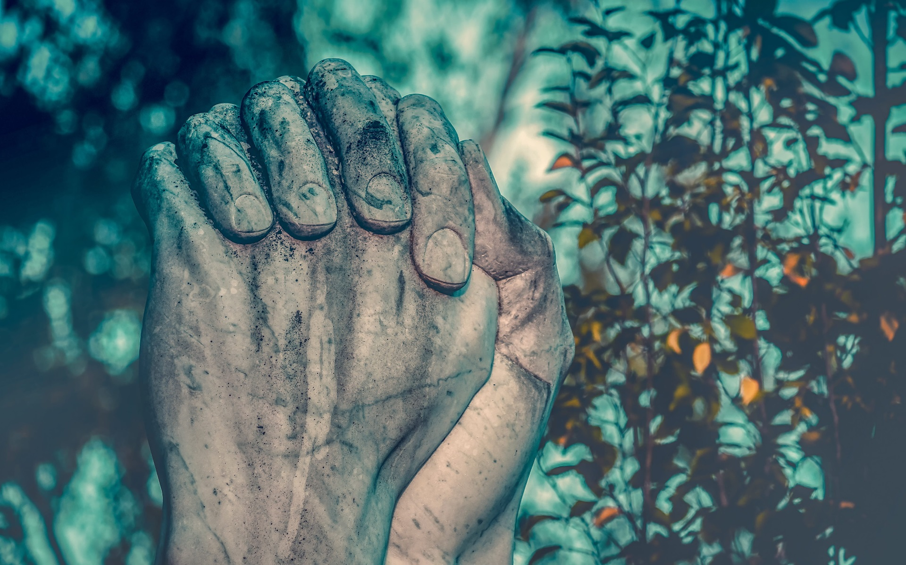
We trust that God who is all-knowing and compassionate will hear our prayers and send us his Holy Spirit so that we can offer ourselves completely to the will of God following the example of our Lord and Saviour, Jesus Christ.

Slide 26
Glory be to the Father
and to the Son
and to the Holy Spirit;
as it was in the beginning
is now and ever shall be
world without end.
Amen.

Slide 27
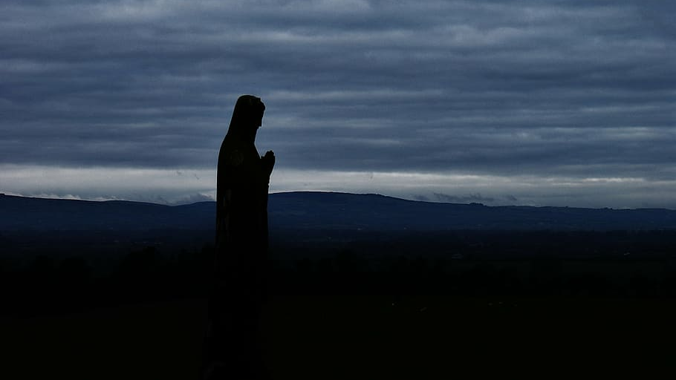
O my Jesus
Forgive us our sins
And save us from the fires of hell.
Lead all souls to heaven,
Especially those in most need of your mercy.

Slide 28
Thank you for joining us today…

Slide 29
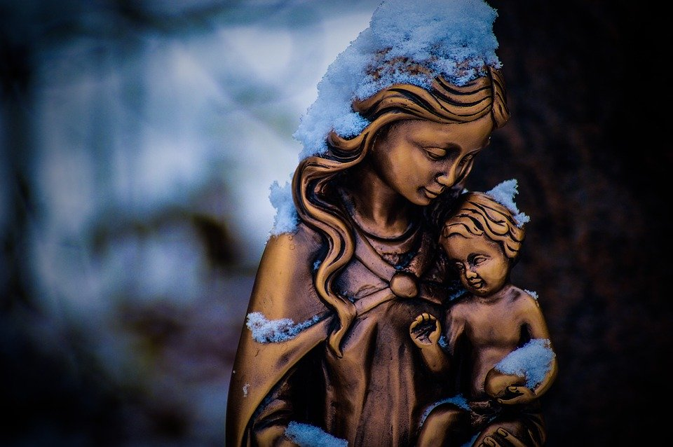
Artwork
Slide 5
'The Wedding at Cana' by Nicolás Correa
Slide 7
The Marriage at Cana by Paolo Veronese
Slide 9
Niels Larsen Stevns - Wedding at Cana
Slide 11
Icon of the Wedding at Cana, Acrylic gouache and gold leaf - Flickr
Slide 13
Image by Dimitris Vetsikas from Pixabay
Slide 15
Wedding at Cana - Flickr
Slide 17
Wedding at Cana by Duccio di Buoninsegna
Slide 19
Changing the Water into Wine by Fernando Gallego
Slide 21
Mosaic by Fr Marko Rupnik SJ from the National Shrine of St John Paul II
Slide 23
Les Noces de Cana by Paolo Caliari
Images from
www.pixabay.com
www.pxfuel.com
www.liturgytools.net
www.Wikimedia.com

