Slide 1
Praying the Rosary with the Diocese of Westminster
Proclamation of the Kingdom Friday 5th June

Slide 2
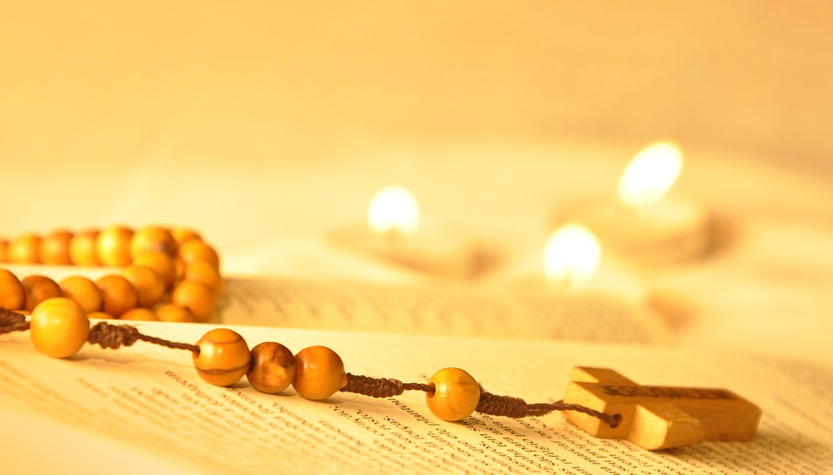
‘The Rosary is the prayer of the humble and of the saints. In its mysteries, they contemplate, along with Mary, the life of Jesus, the merciful face of the Father. O, how much we all need to be truly comforted, to be wrapped in loving presence!
Pope Francis (April 2020)

Slide 3
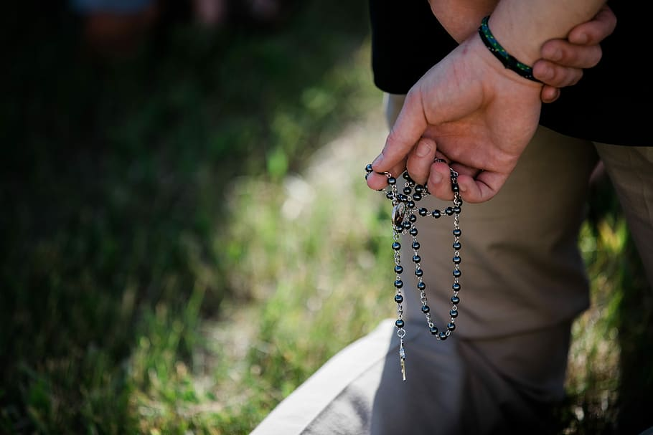
We offer this decade of the Rosary for all those affected by the coronavirus and we ask the help of Our Blessed Mother, Mary, to take our prayers to her beloved son, Jesus.
-

Slide 4
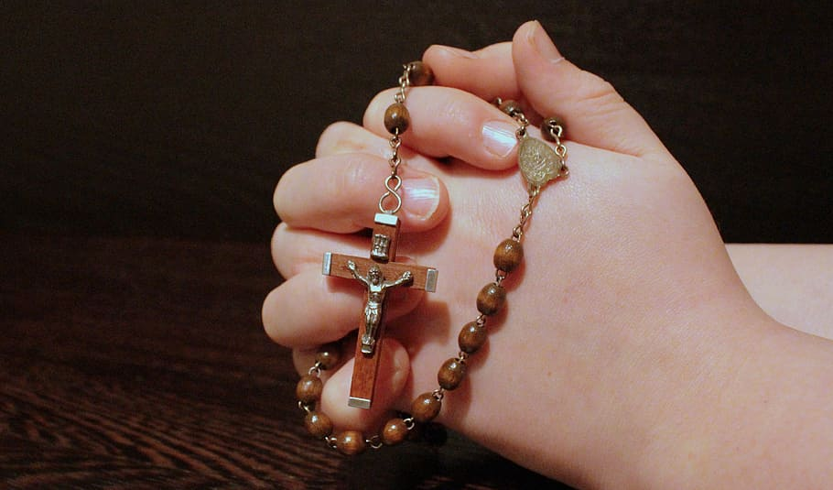
Our Father
Who art in heaven
Hallowed be thy name
Thy kingdom come
Thy will be done
On earth as it is in heaven
Give us this day our daily bread
And forgive us our trespasses
As we forgive those
who trespass against us
And lead us not into temptation
But deliver us from evil.
Amen.

Slide 5
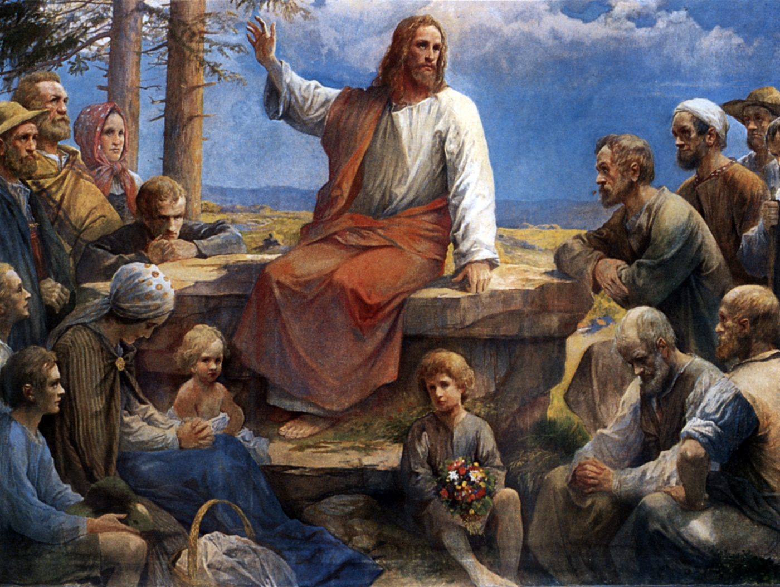
1. “Repent, for the kingdom of God is at hand.”
Whether we are home or abroad, surrounded by many people suffering from this illness or only a few, Jesus Christ, be with us as we endure and mourn, persist and prepare, and look towards the future.
(Image: Rudolf Yelin)

Slide 6
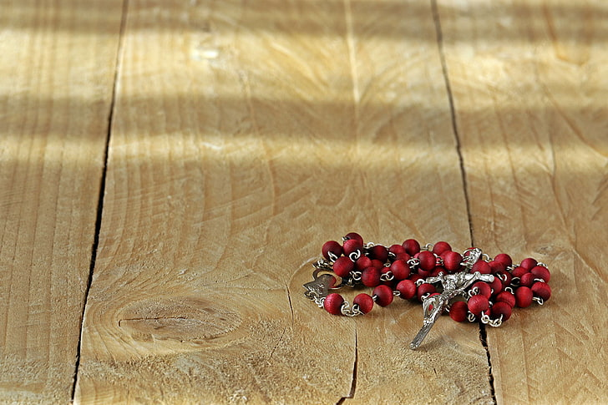
Hail Mary, Full of Grace
The Lord is with thee
Blessed art thou amongst women
And blessed is the fruit
of thy womb, Jesus,
Holy Mary, Mother of God,
Pray for us sinners
Now and at the hour
Of our death.
Amen.

Slide 7
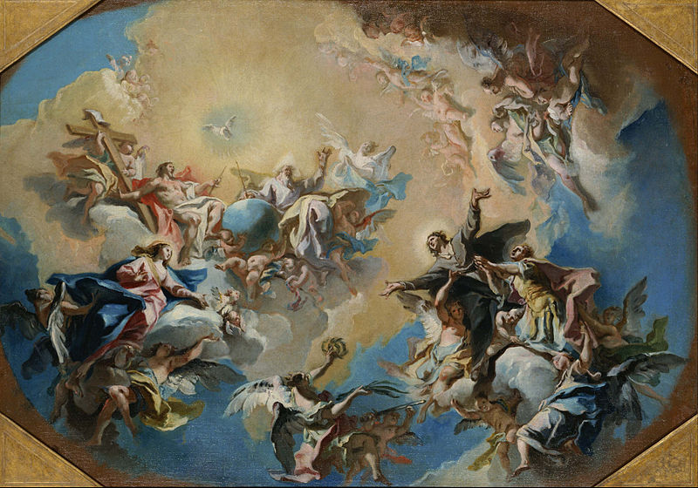
2. “My kingdom is not of this world.”
Be with those who have died from the virus. May they be at rest with you in your eternal peace.
(Image: Carlo Innocenzo Carlone)

Slide 8
Hail Mary, Full of Grace
The Lord is with thee
Blessed art thou amongst women
And blessed is the fruit
of thy womb, Jesus,
Holy Mary, Mother of God,
Pray for us sinners
Now and at the hour
Of our death.
Amen.

Slide 9
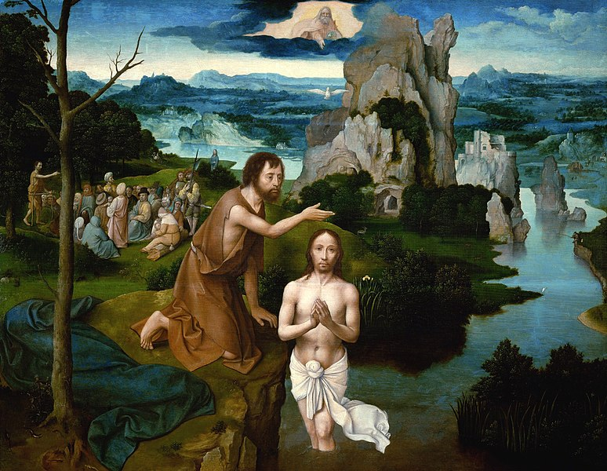
3. “Unless a man be born again of water and the Spirit, he cannot enter the kingdom of heaven.”
Heal those who are sick with the virus. May they regain their strength and health through quality medical care.
(Image: Joachim Patenier)

Slide 10
Hail Mary, Full of Grace
The Lord is with thee
Blessed art thou amongst women
And blessed is the fruit
of thy womb, Jesus,
Holy Mary, Mother of God,
Pray for us sinners
Now and at the hour
Of our death.
Amen.

Slide 11
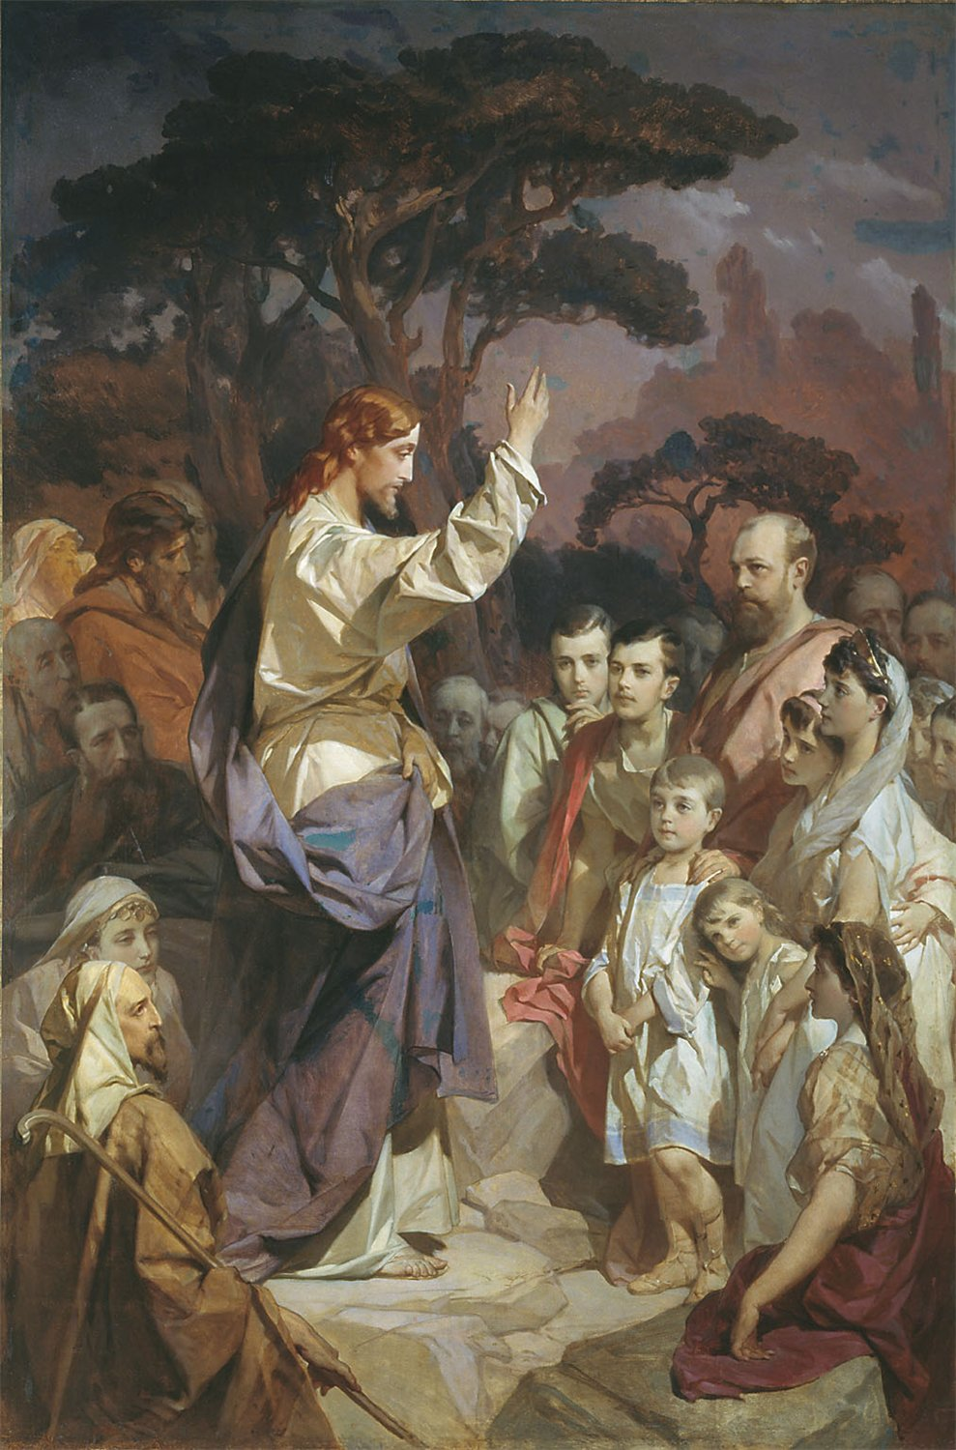
4. “Whoever does not accept the kingdom of God as a little child will not enter into it.”
Be with all children and young people, especially those of the Diocese of Westminster.
Be with them with comfort and guidance; in their own fear and anxiety at this time. Let them know and feel your eternal presence.
(Image: I.Makarov)

Slide 12
Hail Mary, Full of Grace
The Lord is with thee
Blessed art thou amongst women
And blessed is the fruit
of thy womb, Jesus,
Holy Mary, Mother of God,
Pray for us sinners
Now and at the hour
Of our death.
Amen.

Slide 13
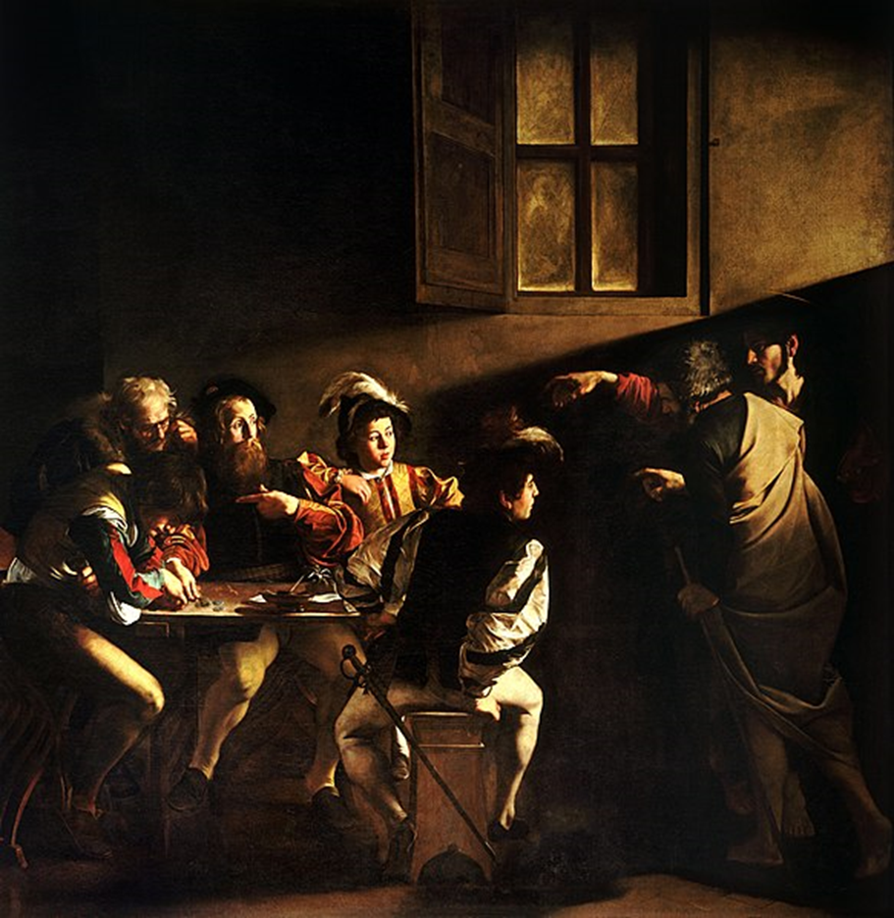
5. “I have come to call sinners, not the just.”
Good Lord, healer of all, Be at the side of those who feel isolated and alone during these uncertain times. Let them feel your strength and love.
(Image: Michelangelo Merisi da Caravaggio)

Slide 14
Hail Mary, Full of Grace
The Lord is with thee
Blessed art thou amongst women
And blessed is the fruit
of thy womb, Jesus,
Holy Mary, Mother of God,
Pray for us sinners
Now and at the hour
Of our death.
Amen.

Slide 15
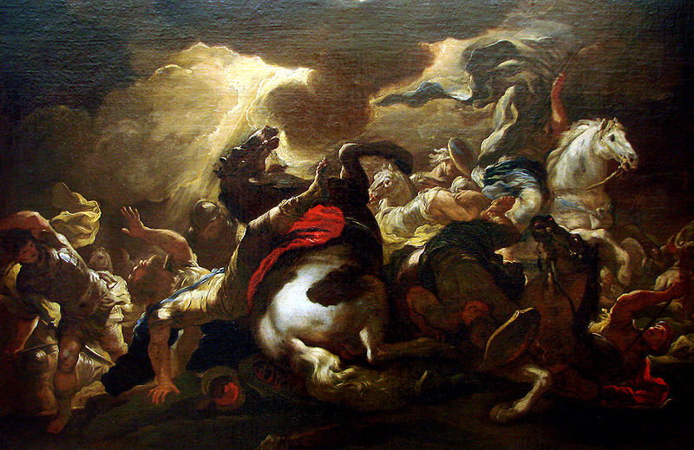
6. “Love your enemies, pray for those who persecute you.”
Be with the leaders of all nations. Give them the foresight to act with charity and true concern for the well-being of the people they are meant to serve. May they know your peace, as they work together to achieve it on earth.
(Image: Luca Giordano)

Slide 16
Hail Mary, Full of Grace
The Lord is with thee
Blessed art thou amongst women
And blessed is the fruit
of thy womb, Jesus,
Holy Mary, Mother of God,
Pray for us sinners
Now and at the hour
Of our death.
Amen.

Slide 17
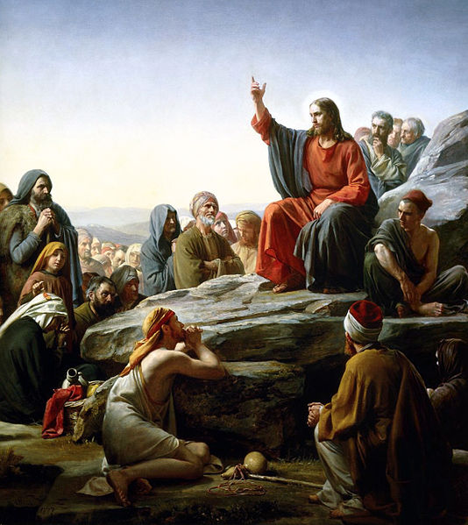
7. “Blessed are the poor in spirit, for theirs is the kingdom of heaven.”
Be with those who face hardships such as poverty and homelessness. Strengthen them with courage and the knowledge that they are loved.
(Image: Carl Bloch)

Slide 18
Hail Mary, Full of Grace
The Lord is with thee
Blessed art thou amongst women
And blessed is the fruit
of thy womb, Jesus,
Holy Mary, Mother of God,
Pray for us sinners
Now and at the hour
Of our death.
Amen.

Slide 19
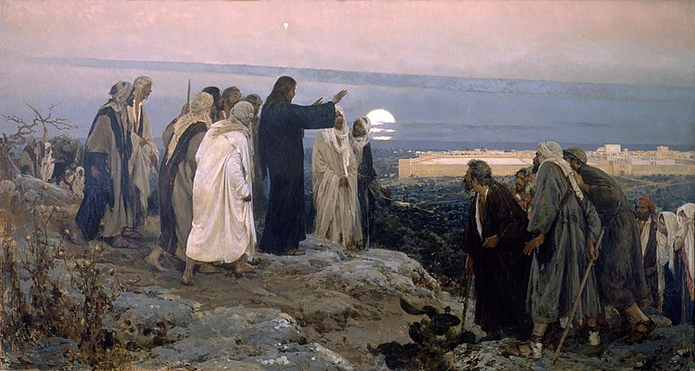
8. “Blessed are they who hunger and thirst for justice, for they shall be satisfied.”
Be with those who are searching for a vaccine for the Coronavirus. Give them your wisdom and insight. May they know your peace as they strive to help to protect millions of people across the world.
(Image: Enrique Simonet Lombardo)

Slide 20
Hail Mary, Full of Grace
The Lord is with thee
Blessed art thou amongst women
And blessed is the fruit
of thy womb, Jesus,
Holy Mary, Mother of God,
Pray for us sinners
Now and at the hour
Of our death.
Amen.

Slide 21
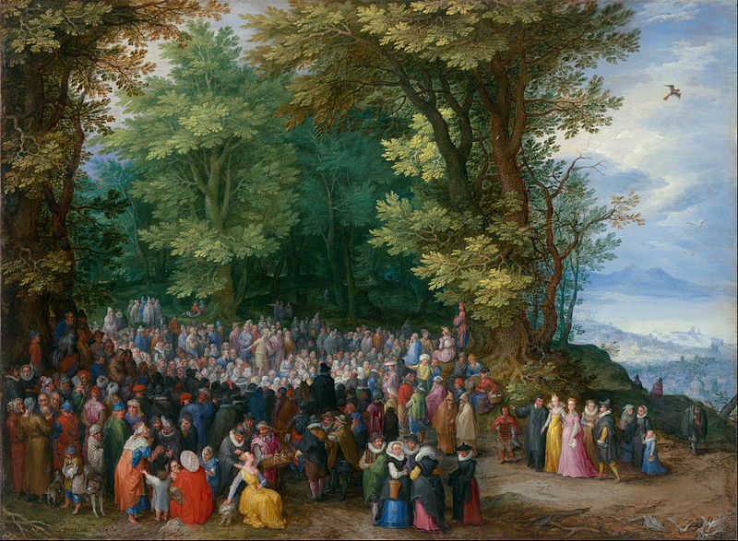
9. “Blessed are they who suffer persecution for justice’ sake, for theirs is the kingdom of heaven.”
Be with the doctors, nurses, researchers and all medical professionals who seek to heal and help those affected and who put themselves at risk in the process. May they know your protection and peace.
(Image: Jan Brueghel the Elder)

Slide 22
Hail Mary, Full of Grace
The Lord is with thee
Blessed art thou amongst women
And blessed is the fruit
of thy womb, Jesus,
Holy Mary, Mother of God,
Pray for us sinners
Now and at the hour
Of our death.
Amen.

Slide 23
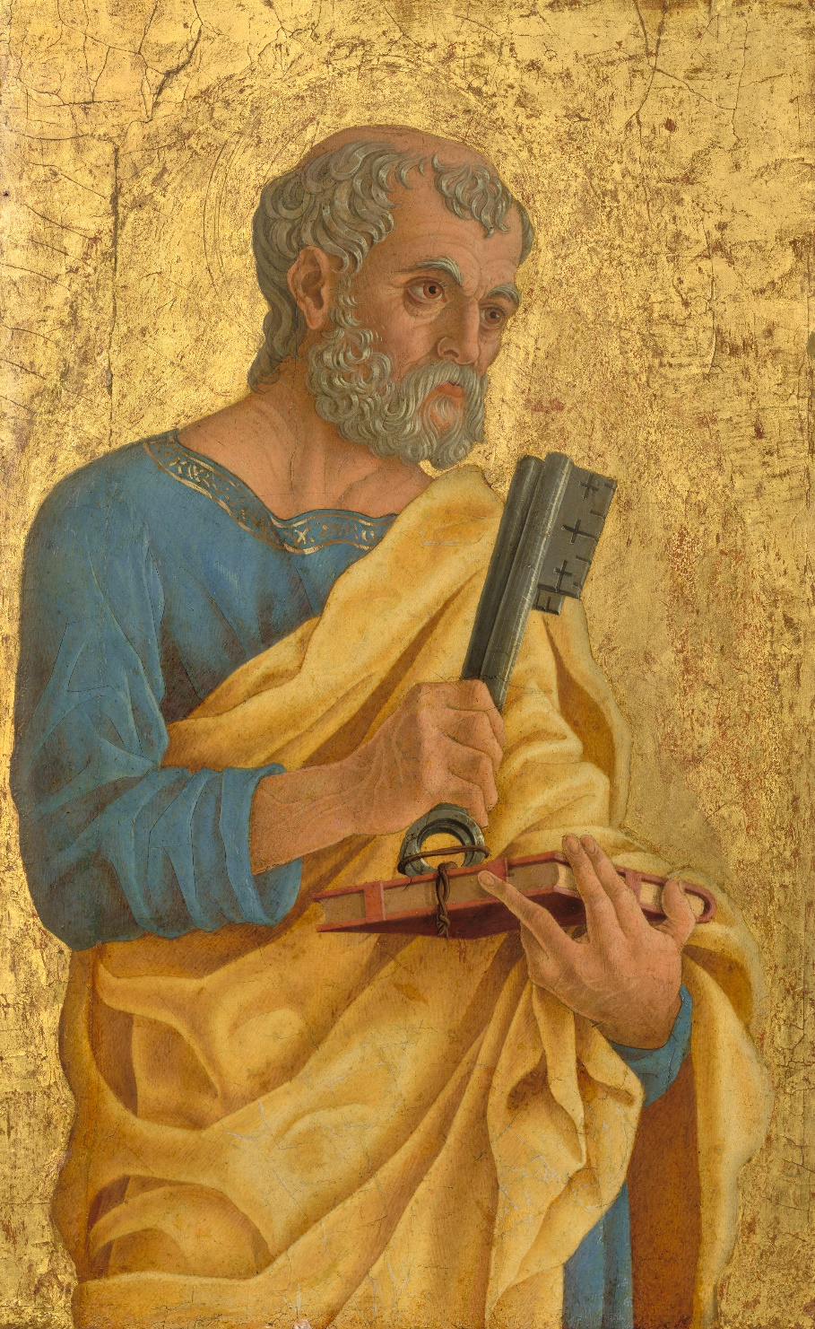
10. “You are Peter, and upon this rock I will build My church… I will give you the keys of the kingdom of heaven.”
Be with Pope Francis and all the clergy. May they know your protection and peace on earth as they continue to selflessly devote themselves to Your work.
(Image: Marco Zoppo)

Slide 24
Hail Mary, Full of Grace
The Lord is with thee
Blessed art thou amongst women
And blessed is the fruit
of thy womb, Jesus,
Holy Mary, Mother of God,
Pray for us sinners
Now and at the hour
Of our death.
Amen.

Slide 25
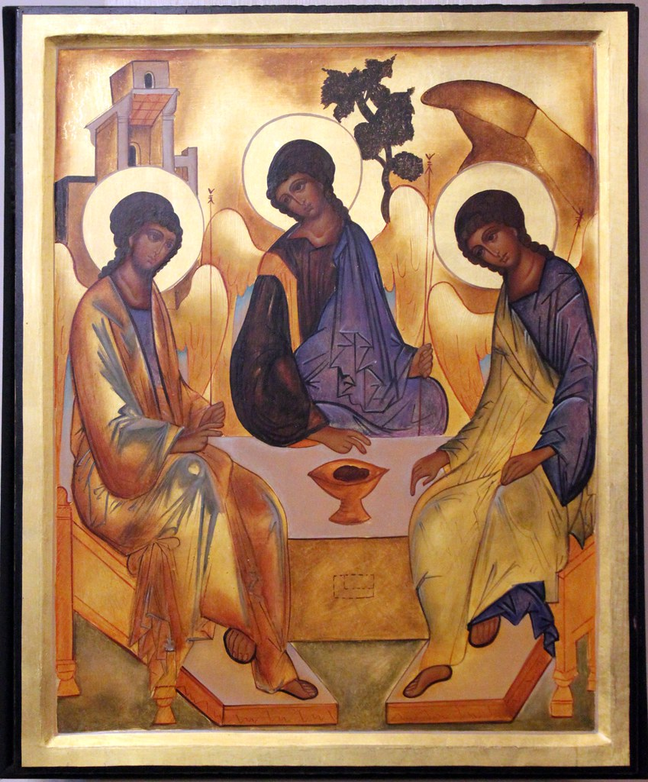
We trust that God who is all-knowing and compassionate will hear our prayers and send us his Holy Spirit so that we can offer ourselves completely to the will of God following the example of our Lord and Saviour, Jesus Christ.
Fr Bradley, Holy Trinity, Winchester)

Slide 26
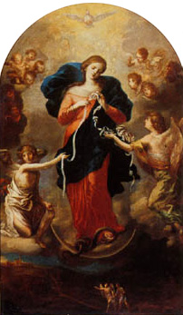
(Optional: The Prayer of Fatima)
Let us pray:
O my Jesus, forgive us our sins and save us from the fires of hell. Lead all souls to heaven, especially those who are in most need of your mercy.
(Image: Johann George Melchior Schmidtner )

Slide 27
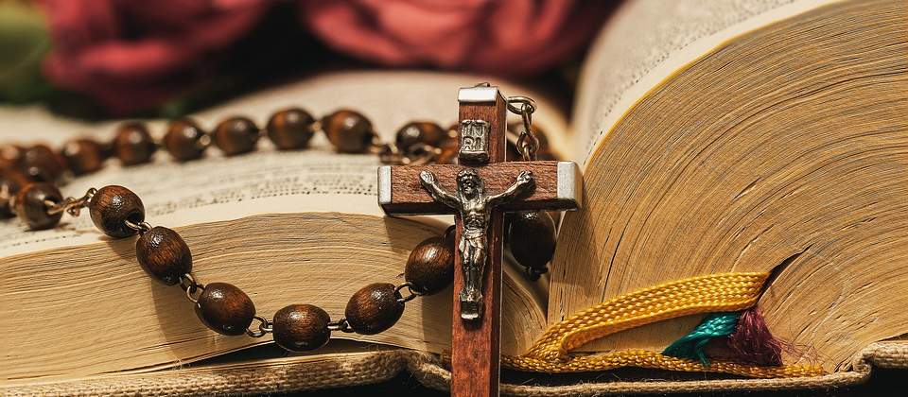
Thank you for joining us today…

