Slide 1
Diocese of Westminster
Education Service
Our Live Event
Praying the Rosary – The Crucifixion
Good Friday - 2020
will begin shortly

Slide 2
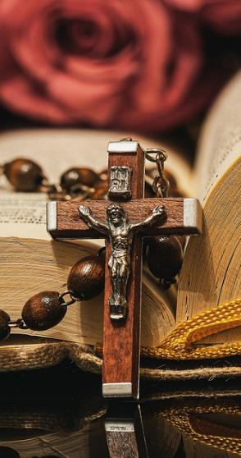
Praying the Rosary with the Diocese of Westminster
The Crucifixion: Friday 10th April 2020

Slide 3
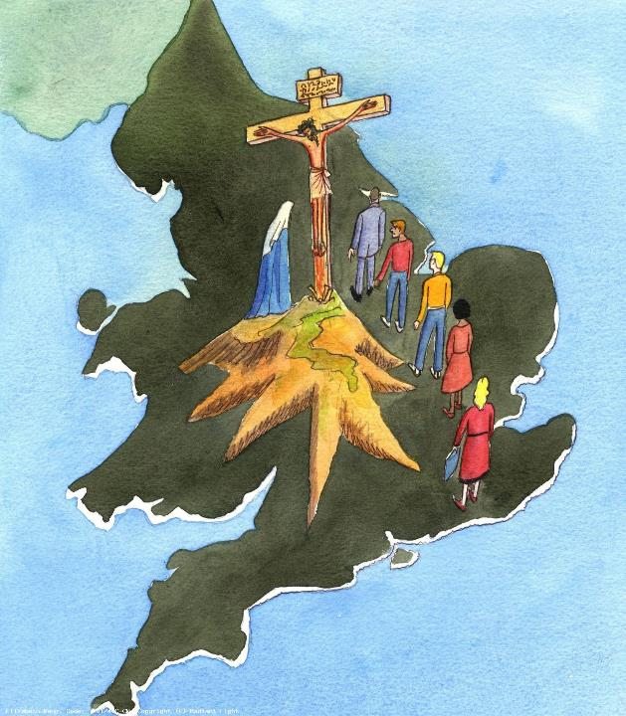
We offer this decade of the Rosary for all those affected by the coronavirus and we ask the help of Our Blessed Mother, Mary, to take our prayers to her beloved son, Jesus.
-

Slide 4
Our Father
Who art in heaven
Hallowed be thy name
Thy kingdom come
Thy will be done
On earth as it is in heaven
Give us this day our daily bread
And forgive us our trespasses
As we forgive those
who trespass against us
And lead us not into temptation
But deliver us from evil.
Amen.

Slide 5
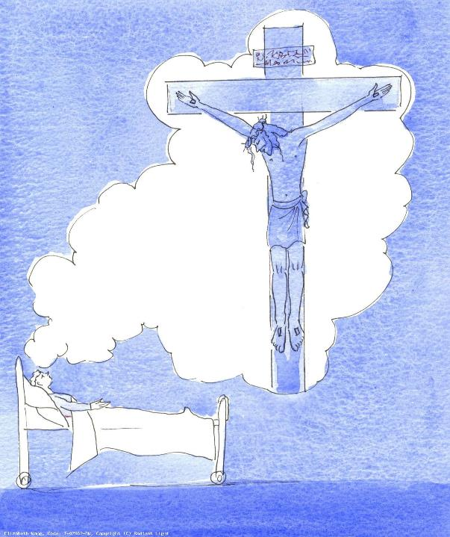
1.They came to a place called Golgotha (which means ‘the place of the skull’). There they offered Jesus wine to drink mixed with gall…
We pray for the NHS and all those who are working hard to provide medication, equipment and relief to cope with the virus, that they will be filled with knowledge and compassion.

Slide 6
Hail Mary, Full of Grace
The Lord is with thee
Blessed art thou amongst women
And blessed is the fruit of thy womb, Jesus,
Holy Mary, Mother of God, pray for us sinners now and at the hour of our death.
Amen.

Slide 7
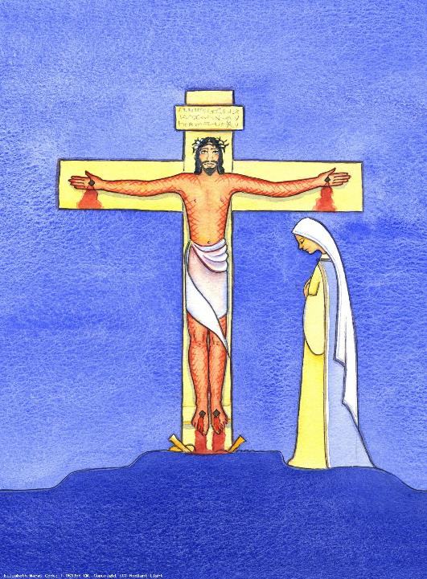
2. The hands and feet of Jesus were nailed to the cross in the presence of his loving mother.
We pray for the mothers of those who are suffering due to the virus, especially those who are pregnant, that they will find courage and comfort.

Slide 8
Hail Mary, Full of Grace
The Lord is with thee
Blessed art thou amongst women
And blessed is the fruit of thy womb, Jesus,
Holy Mary, Mother of God, pray for us sinners now and at the hour of our death.
Amen.

Slide 9
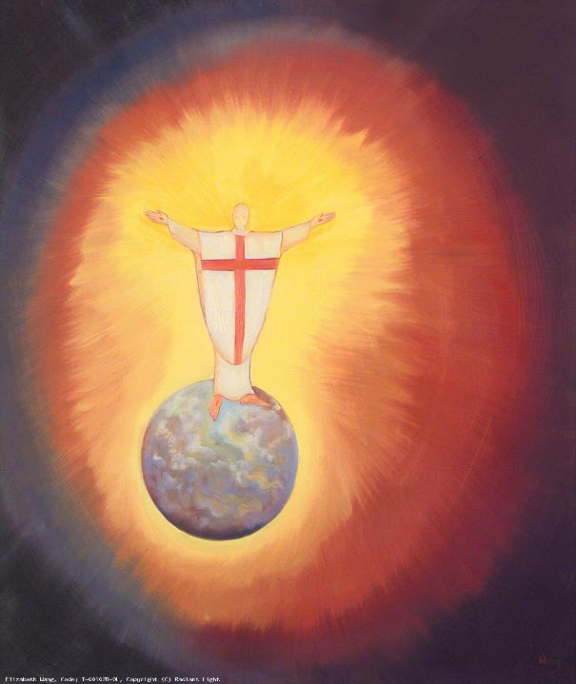
3. Above his head they placed the written charge against him: This is Jesus, the king of the Jews.
We pray for the royal, political and medical leaders of our country, that they will lead with wisdom and humility.

Slide 10
Hail Mary, Full of Grace
The Lord is with thee
Blessed art thou amongst women
And blessed is the fruit of thy womb, Jesus,
Holy Mary, Mother of God, pray for us sinners now and at the hour of our death.
Amen.

Slide 11
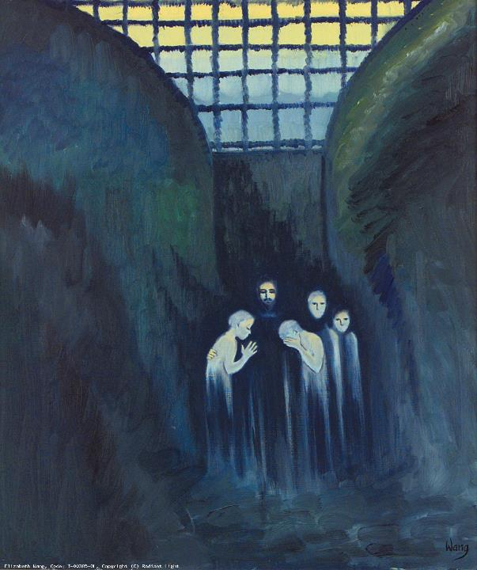
4. Jesus was crucified between two criminals, one on his right and one on his left. He said ‘Father, forgive them’.
We pray for those in need of forgiveness: those in prisons, those who are dying and for each one of us, that we will be truly penitent and willing to change for the better.

Slide 12
Hail Mary, Full of Grace
The Lord is with thee
Blessed art thou amongst women
And blessed is the fruit of thy womb, Jesus,
Holy Mary, Mother of God, pray for us sinners now and at the hour of our death.
Amen.

Slide 13
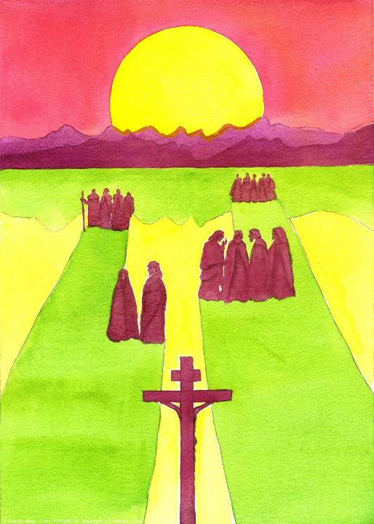
5. The people stood watching, and the rulers even sneered at him.
We pray for all of those who don’t just stand watching but who help in any way they can: emergency services, transport workers, retail staff and volunteers, that they will be sustained in terms of energy, health and faith.

Slide 14
Hail Mary, Full of Grace
The Lord is with thee
Blessed art thou amongst women
And blessed is the fruit of thy womb, Jesus,
Holy Mary, Mother of God, pray for us sinners now and at the hour of our death.
Amen.

Slide 15
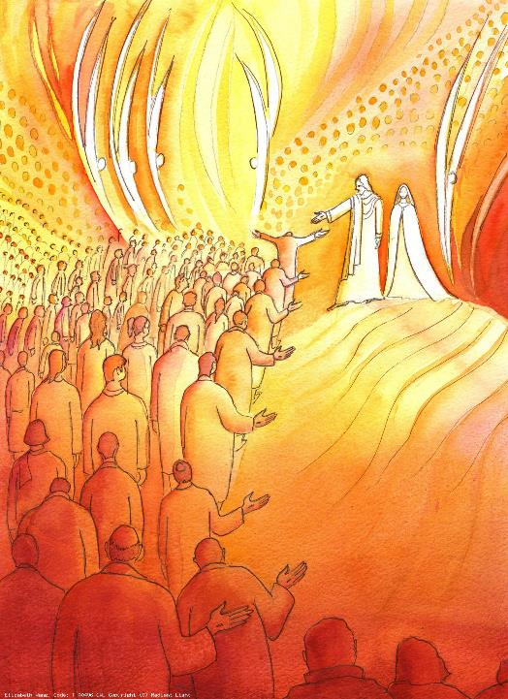
6. One of the criminals said ‘Jesus, remember me when you come into your kingdom’ and Jesus answered him ‘Truly I tell you, today you will be with me in paradise’.
We pray for all those who have died or who have lost their loved ones, that they will take comfort knowing that Jesus is with them and that there are better things to come.

Slide 16
Hail Mary, Full of Grace
The Lord is with thee
Blessed art thou amongst women
And blessed is the fruit of thy womb, Jesus,
Holy Mary, Mother of God, pray for us sinners now and at the hour of our death.
Amen.

Slide 17
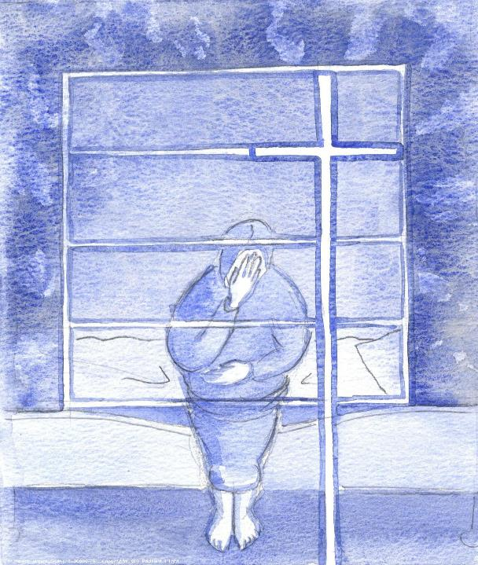
7. From noon until three in the afternoon darkness came over the land.
We pray for all of those who are experiencing darkness at this time – in body, mind or spirit – that they will find comfort in the Lord and in those around them who have reached out in some way.

Slide 18
Hail Mary, Full of Grace
The Lord is with thee
Blessed art thou amongst women
And blessed is the fruit of thy womb, Jesus,
Holy Mary, Mother of God, pray for us sinners now and at the hour of our death.
Amen.

Slide 19
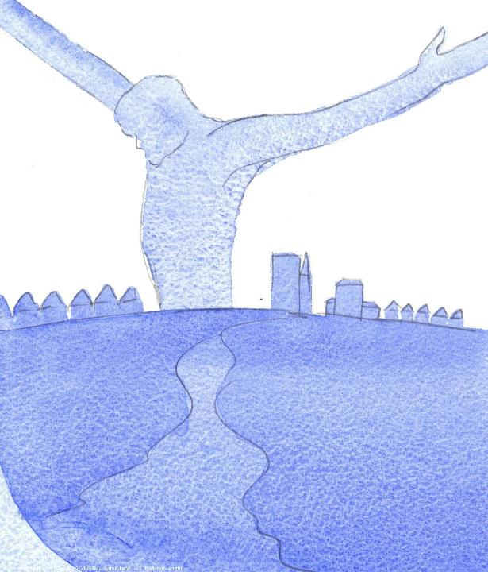
8. About three in the afternoon Jesus cried out in a loud voice, ‘My God, my God, why have you forsaken me’.
We pray for those who feel forsaken, isolated and desperate as a result of this virus, that each family can reach out so that every person in our community feels connected and valued.

Slide 20
Hail Mary, Full of Grace
The Lord is with thee
Blessed art thou amongst women
And blessed is the fruit of thy womb, Jesus,
Holy Mary, Mother of God, pray for us sinners now and at the hour of our death.
Amen.

Slide 21
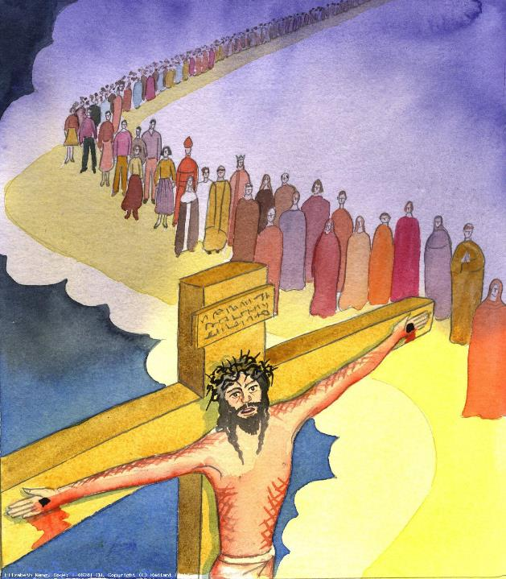
9. Knowing that all was complete, and so that the Scripture was fulfilled, Jesus said ‘I am thirsty’ so they soaked a sponge in vinegar and put it to his lips.
We pray for all those who thirst for God and for our chaplains, clergy and religious leaders who nurture them, that they will be filled with God’s spirit and strength.

Slide 22
Hail Mary, Full of Grace
The Lord is with thee
Blessed art thou amongst women
And blessed is the fruit of thy womb, Jesus,
Holy Mary, Mother of God, pray for us sinners now and at the hour of our death.
Amen.

Slide 23
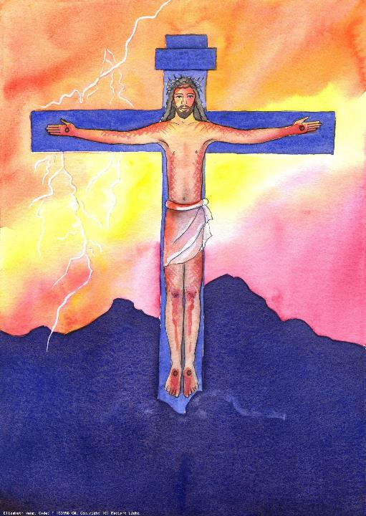
10. When Jesus had cried out again in a loud voice, he gave up his spirit.
We pray for all of those who serve in the schools in our Diocese and for the Education Service, that we can continue to work together to give all that we can for each and every one of our pupils and their families, for the glory of God our Father.

Slide 24
Hail Mary, Full of Grace
The Lord is with thee
Blessed art thou amongst women
And blessed is the fruit of thy womb, Jesus,
Holy Mary, Mother of God, pray for us sinners now and at the hour of our death.
Amen.

Slide 25
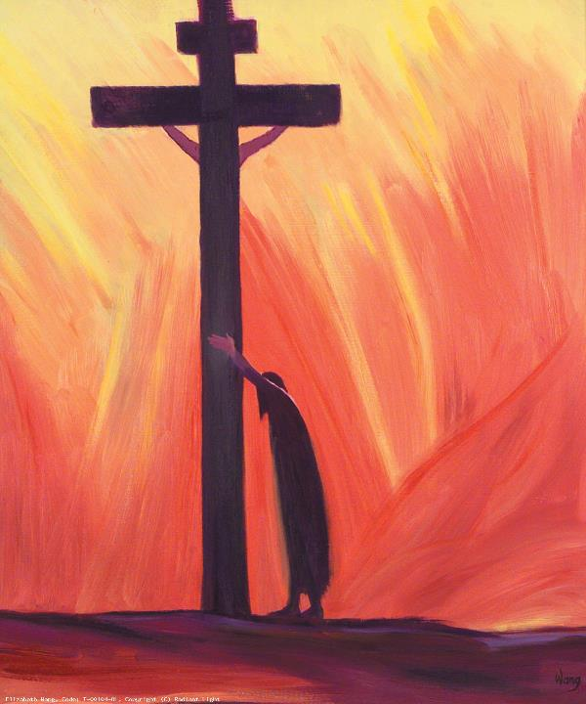
We trust that God who is all-knowing and compassionate will hear our prayers and send us his Holy Spirit so that we can offer ourselves completely to the will of God following the example of our Lord and Saviour, Jesus Christ.

Slide 26
Glory be to the Father
And to the Son
And to the Holy Spirit
As it was in the beginning
Is now and ever shall be
World without end.
Amen.

Slide 27
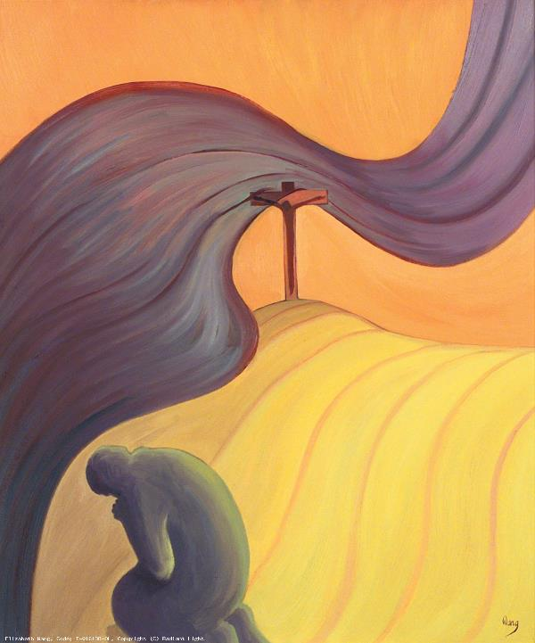
(Optional: The Prayer of Fatima)
Let us pray:
O my Jesus, forgive us our sins and save us from the fires of hell. Lead all souls to heaven, especially those who are in most need of your mercy.

Slide 28
Thank you for joining us today
May God bless you
and keep you
Now and forever
Credits:
Images - Elizabeth Wang https://radiantlight.org.uk/
Music - https://archive.org/

