Slide 1


DOW Six Step Plan for Heat Decarbonisation & Net Zero

Slide 2

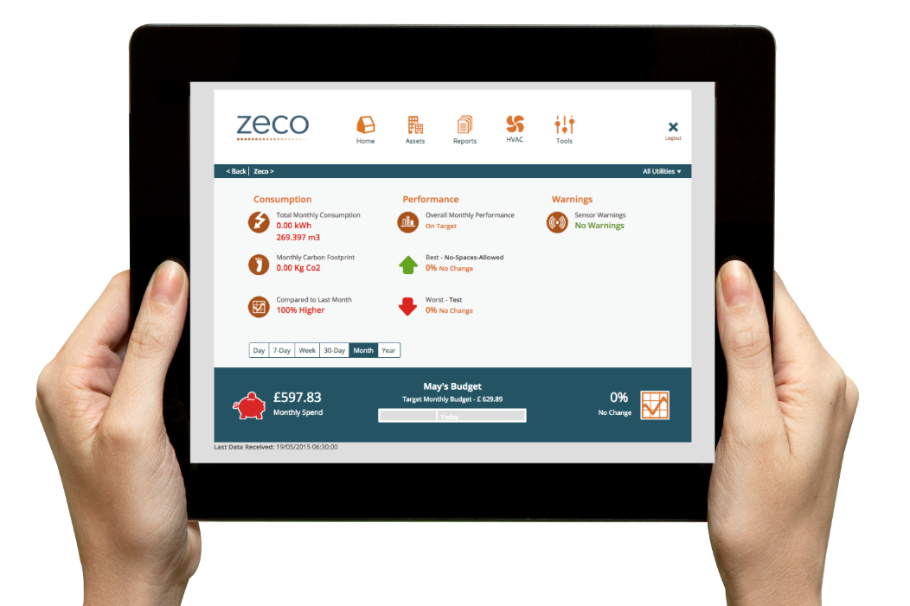
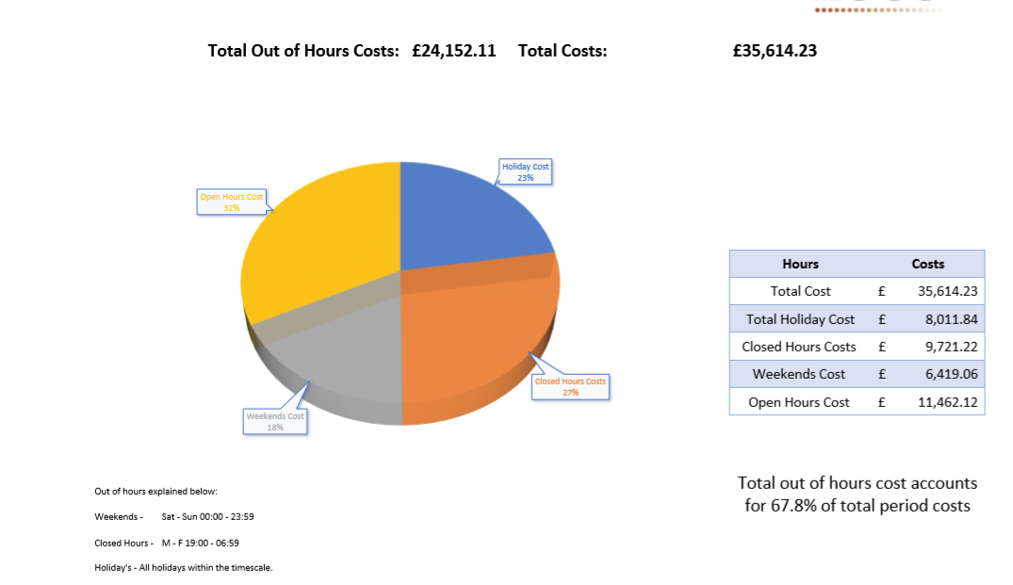
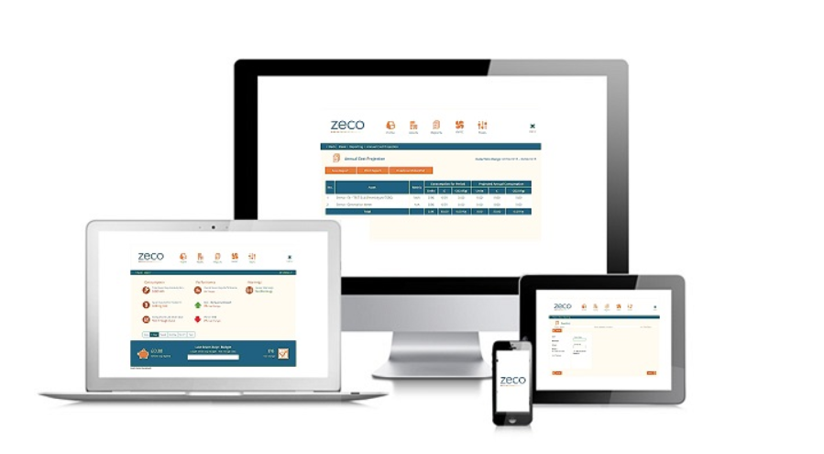
DOW Six Step Plan for Heat Decarbonisation & Net Zero
Monitor & Measure - Identify areas of excess energy use/waste
Control - Control your building correctly
Optimise - Use your systems & equipment efficiently to reduce costs
Comply - Ensure you adhere to legislation
Maintain - Manage your assets properly
Decarbonise & Fund - Introduce low/zero carbon heating, renewable & energy efficient technologies into your estate

Slide 3

DfE Guidance December 2022
Understand Your energy Use, Metering & Bills – (Step 1) – reduce out of hours usage by 10%
Identify Areas for Improvement (Steps 2-5) – you need to know age, performance and condition of building, technology & equipment
Implement Behavioural Change (Step 1 & Shutdown List) – make the energy data accessible run campaigns encourage wider occupants to assist
Heating (Steps 2 & 3) – reducing heat 1ºC will save 5% - 10% of your heating bill, turn heating off earlier latent het will keep it warm, temp, CO₂ sensors
Lighting (Steps 2 & 3) – invest in sensors, absence/occupancy monitoring, do not do point for point swap out, use daylight where possible
Ventilation (Steps 2-5) – link units together, implement controls strategy, educate room occupants, turn off when room not in use
Improve building, technology & equipment (Steps 2-6) – minimise heat loss (fabric), implement preventive maintenance, replace aging equipment
Renewable Generation (Step 6) – Decarbonise and generate on site with low/zero carbon technology, generate onsite and store using batteries
https://www.gov.uk/government/publications/energy-efficiency-guidance-for-the-school-and-fe-college-estate/energy-efficiency-guidance-for-the-school-and-further-education-college-estate

Slide 4
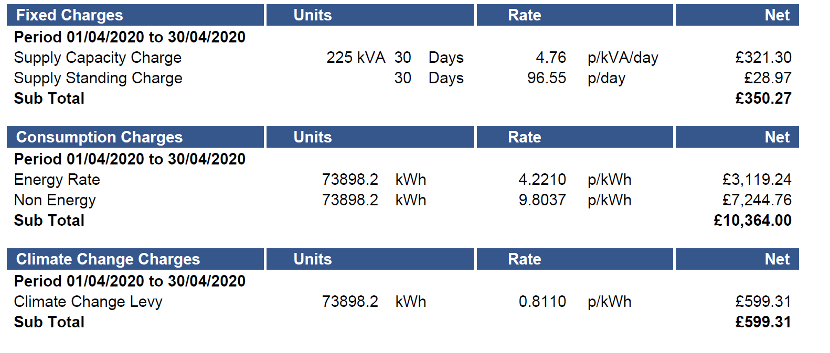
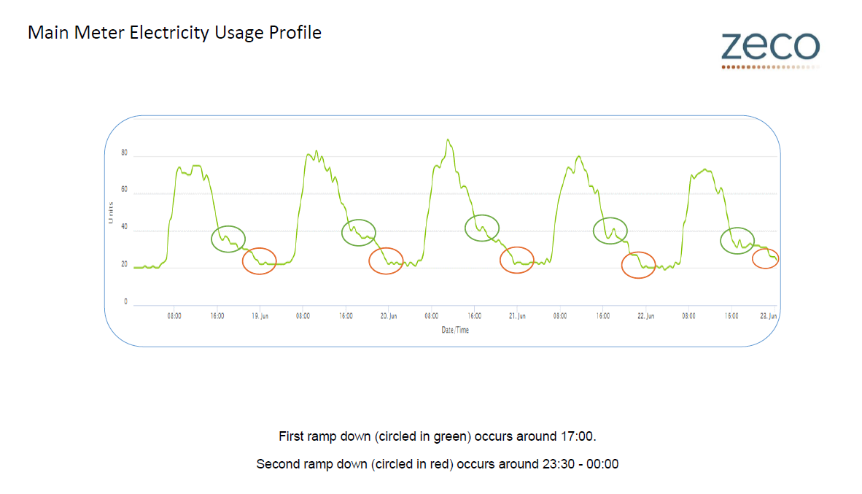
1) Monitor & Measure
Monitor your bills, stop overpayments from occurring, out of 35 schools surveyed we have identified £326k in overpayments so fa.
We can collect data directly from your main utility meters in order to understand when energy is being used/wasted.
A bill tells you how much you have used.
The data shows you when you are wasting energy/costs
We can prevent overbilling – see example across.
Using IoT & DTECM we monitor multiple types of usage, equipment & conditions, costs can be covered under latest funding:
usage
cost
Co2
Heat, humidity, etc.
IoT – Internet of Things
DTECM – Digital technologies for Energy & Carbon Management

Slide 5
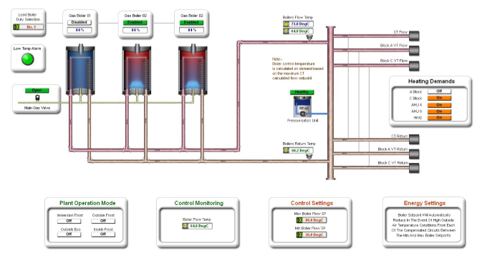
2) Control
From recent surveys across the DOW estate we have found that a great deal of equipment is not being controlled effectively and is running 24x7 wasting energy/costs unnecessarily
Costs to complete BMS surveys and metering improvements covered under new funding
Using energy data we can start to control your schools heating, cooling etc. properly to reduce energy/costs
Improve the existing control by introducing a Building Energy Management System

Slide 6
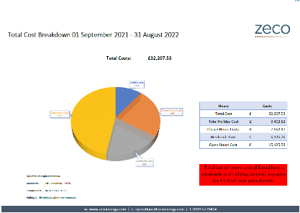
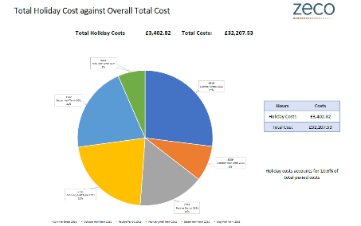
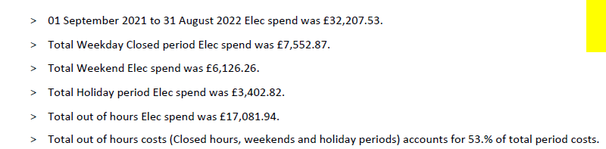
Out of Hours Usage

Slide 7
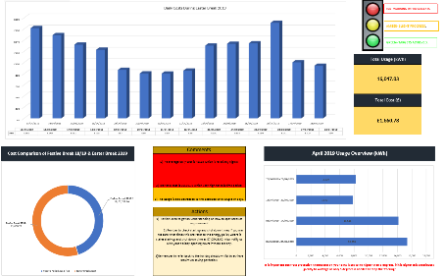
3) Optimise
Once the building, plant & equipment are working effectively, the BEMS will automatically adjust via optimisation for maximum efficiencies and cost savings based on performance
Improve, enhance & reduce unnecessary usage, costs & carbon
We provide you with monthly reports, recommendations & guidance on how to reduce usage/costs

Slide 8
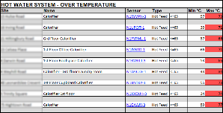
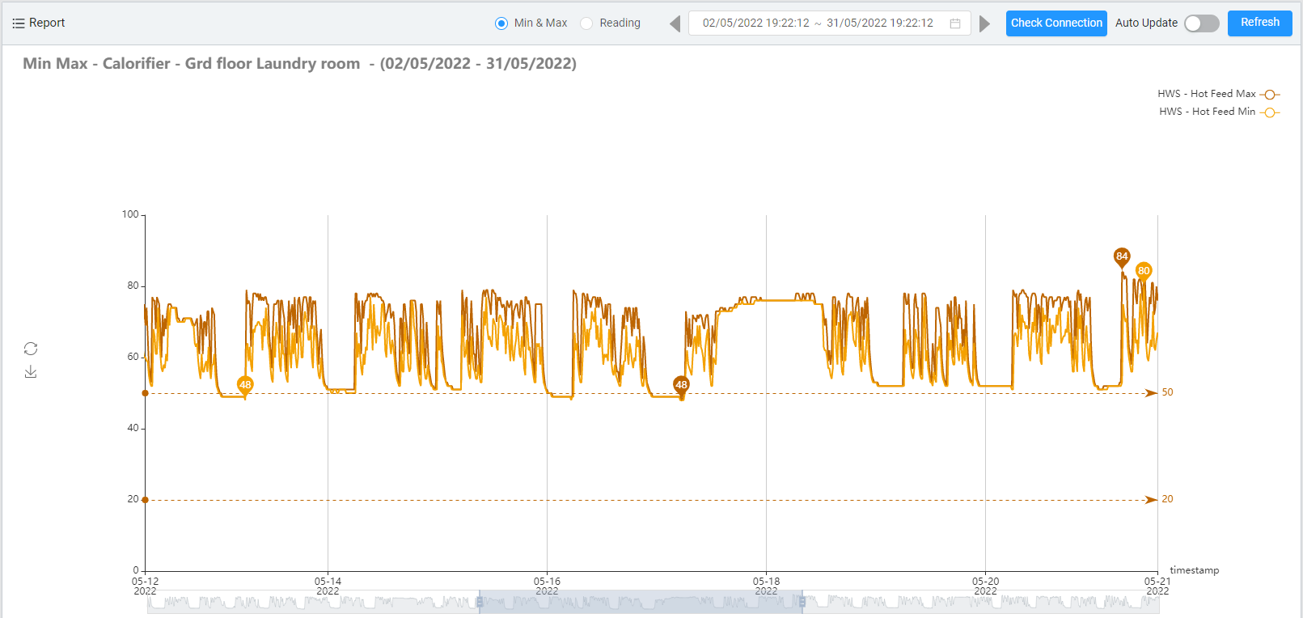
4) Comply (with data)
Compliance data will assist your staff to ensure your buildings, plant, equipment & systems are operating effectively, an added benefit is that it also enables preventive maintenance to be used
We ensure all applicable policies, regulations, compliance, laws & legislations are in 1 place accessed via the web & are managed correctly – our compliance services team can assist with this
Using IoT to assist in compliance will also identify cost savings
If systems are incorrectly setup, they will waste energy, costs & carbon
Unnecessary Energy/Heat & Costs!!!
Adjusting system temperatures in the example opposite saved this client £22k per annum
Additional savings from a reduction in equipment failure and maintenance are also achieved

Slide 9
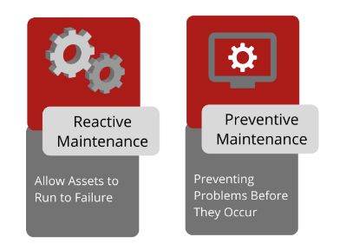
5) Maintain
We can assist you in maintaining your buildings and equipment effectively using data for condition monitoring & preventive maintenance
Preventive is cheaper than reactive and will ensure operational costs are minimised, badly maintained equipment will cost more to run
Ensure that there is no over or under maintenance occurring – helping you to reduce costs further.

Slide 10
6) Heat Decarbonisation Plans, Net Zero & Funding
You need to understand your building, what’s in it, and how it is operating
in order to commence your journey to Heat Decarbonisation & Net Zero
Whole Building Approach - Heat Decarbonisation Plans:
Building Fabric
Mechanical
Electrical
Controls
Energy Policy, Heat Decarbonisation & Net Zero Strategy
Zeco has secured the following grant funding for clients in the last year:
Low Carbon Skills Fund (LCSF 1 & 2) - Grants to produce Heat Decarbonisation Plans - £3m
Public Sector Decarbonisation Scheme (PSDS 1 & 3) - Grants for Low carbon heating/energy efficiency schemes £5m 2022 – Applications for DOW 2023 - £8m
Towns Fund - Grants for New Build to deliver T-Levels £3m
ERDF - Grants for a Renewable energy centre - £2m
Partnerships for Green Bonds, Power Purchase Agreements etc. – Access to £200m to fund
sustainability projects, capital replacements etc.

Slide 11
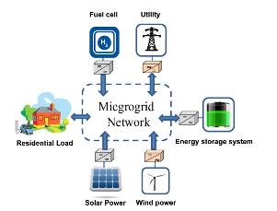
Microgrids – Hybrid Renewable Energy Systems
Hybrid renewable energy systems (HRES), or more commonly referred to as Microgrids, are becoming popular as stand-alone power systems for providing electricity to main grid supplies, especially in remote areas. This is due to advances in renewable energy technologies and subsequent rise in prices for fossil fuel generation. A Microgrid, usually consists of two or more renewable energy sources used together to provide increased system efficiency as well as greater balance in energy supply.
A Microgrid is defined as a small-scale power grid that can operate independently or collaboratively with other power grids. It can be a small-scale, localised power-station that has its own generation and storage
resources. Pairing geothermal, biomass, solar, wind, and waste to energy systems, or another
combination of renewable energy systems such as Hydrogen with batteries, will lead to a more
efficient and balanced output for electricity networks.

Slide 12
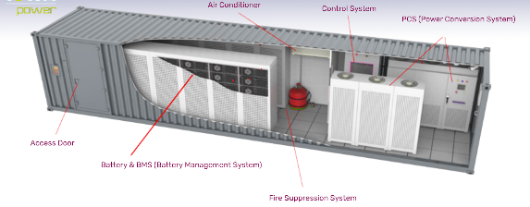
Large Scale Battery Energy Storage Systems (BESS)
A Large Grid Scale Battery System is composed of a group of containerised battery cells that are connected to the National Grid at a major substation via a high voltage cable. This cable can export power from the battery system to the Grid at a few milliseconds notice when required to do so. Conversely, when the Grid has excess energy within the network, the connection allows the battery to import power and store it.
Inverters, transformers, switchgear & battery management systems all work to allow highly controlled bursts of power to be imported or exported in order to provide frequency balancing and power reinforcement services to the National Grid; they make payments for both storing and exporting.

Slide 13
Contact: Zeco Energy Operations
Telephone: 0333 5779414
Email: jon.kent@zecoenergy.com
Web: https://zecoenergy.com

