Slide 1
Week of Christian Unity

Slide 2
Background for teachers
The Week of Prayer for Christian Unity in 2021 has been prepared by the Monastic Community of Grandchamp in Switzerland. The theme that was chosen, “Abide in my love and you shall bear much fruit”, is based on John 15:1-17 and expresses Grandchamp Community’s vocation to prayer, reconciliation and unity in the Church and the human family.
Today the community has fifty sisters, all women from different generations, Church traditions, countries and continents. In their diversity the sisters are a living parable of communion. They remain faithful to a life of prayer, life in community and the welcoming of guests. The sisters share the grace of their monastic life with visitors and volunteers who go to Grandchamp for a time of retreat, silence, healing or in search of meaning.
For 2021, the sisters are inviting churches across the world to enter into their tradition of prayer and silence that is rooted in the ancient traditions of the Church catholic.

Slide 3
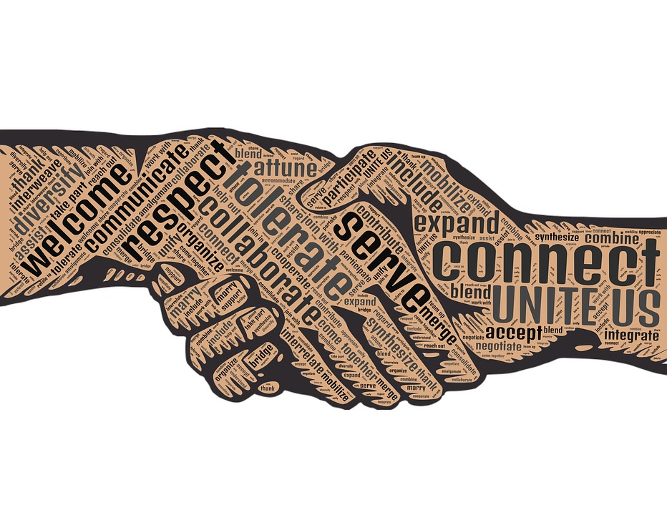
What is a Christian? What does unity mean?
Before we begin…

Slide 4
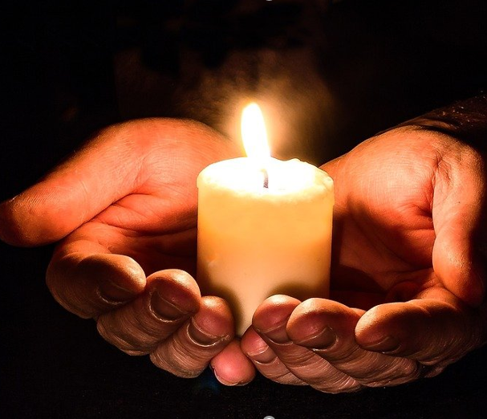
Loving Father,
We pray for unity
In our homes
In our schools
In our parishes
In our country
In our world
And in our own hearts.
Make us channels of your peace.
Glory be…
Gather: Day 1

Slide 5
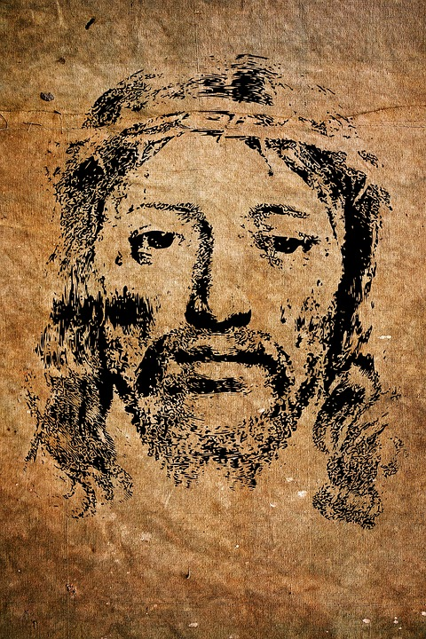
“You did not choose, me, I chose you”. (John 15:16)
The next day John again was standing with two of his disciples, and as he watched Jesus walk by, he exclaimed, “Look, here is the Lamb of God!” The two disciples heard him say this, and they followed Jesus.
When Jesus turned and saw them following, he said to them, “What are you looking for?” They said to him, “Rabbi” (which translated means Teacher), “where are you staying?” He said to them, “Come and see.”
Listen (John 1:35-51)

Slide 6
Watch this video on the Gospel. How did the disciples react when Jesus called them?
How might you respond to Jesus’ call to you today to follow him?
Watch

Slide 7
The start of the journey is an encounter between a human being and God, between the created and the Creator, between time and eternity.
Abraham heard the call: “Go to the land I will show you”.
Reflect

Slide 8
Like Abraham we are called to leave that which is familiar and go to the place that God has prepared in the depths of our hearts.
Along the way, we become more and more ourselves, the people God has wanted us to be from the beginning.
And by following the call that is addressed to us, we become a blessing for our loved ones, our neighbours, and the world.
Reflect

Slide 9
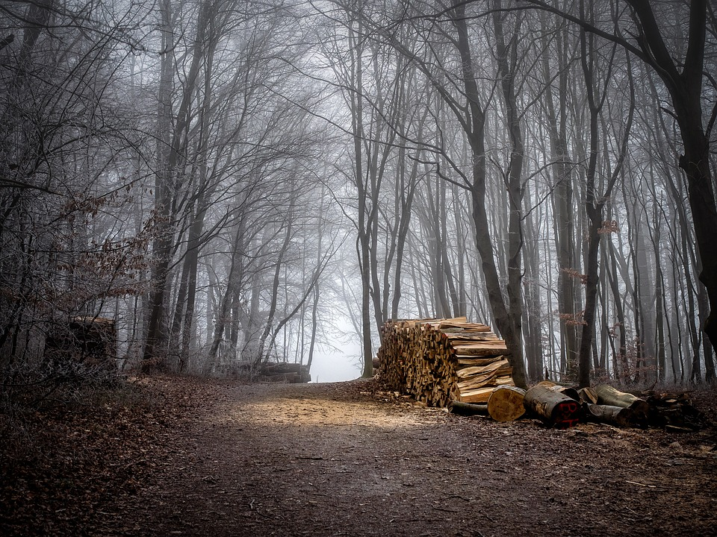
The love of God seeks us. God became human in Jesus, in whom we encounter the gaze of God.
In DAY 1 of our lives, as in the Gospel of John, God’s call is heard in different ways. Touched by his love, we set out.
In this encounter, we walk a path of transformation - the bright beginning of a relationship of love that is always started anew.
Reflect

Slide 10
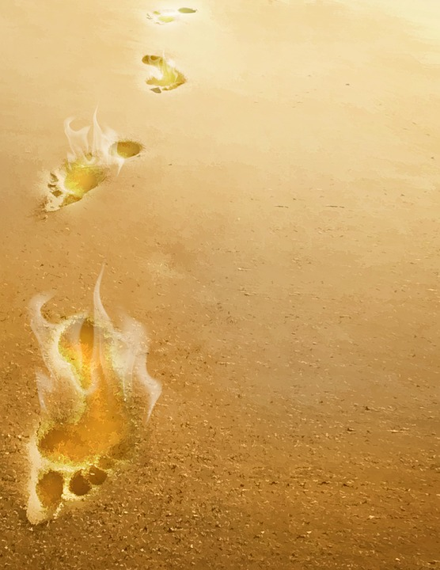
“One day you understood that, without your being aware of it, a yes had already been inscribed in your innermost depths.
And so you chose to go forward in the footsteps of Christ….
In silence in the presence of Christ, you heard him say, ‘Come, follow me; I will give you a place to rest your heart.’”
Reflect

Slide 11
Have you ever been aware that God was asking you or someone you know to begin a new journey in life – whether literally moving to somewhere else, or ‘changing direction’ in some other way?
How did you respond?
Reflect

Slide 12
Let us pray

Slide 13
Jesus Christ, you seek us, you wish to offer us your friendship and lead us to a life that is ever more complete. Grant us the confidence to answer your call so that we may be transformed and become witnesses of your tenderness for the world.
Let us pray

Slide 14
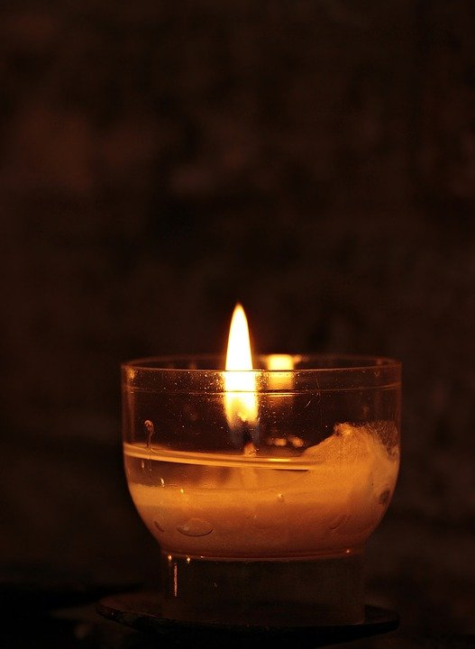
Go and do (see www.ctbi.org.uk/goanddo)
Global: Get informed about and take action on global refugee and asylum issues and campaigns.
Local: Participate in any hospitality being offered locally to those who have had no choice but to go on a long journey to find safety in an unfamiliar place across the world.
Personal: Spend time exploring what is unfamiliar to you in another Christian tradition and which might help lead you to greater understanding and unity.
Mission

Slide 15
Loving Father,
We pray for unity
In our homes
In our schools
In our parishes
In our country
In our world
And in our own hearts.
Make us channels of your peace.
Glory be…
Gather: Day 2

Slide 16
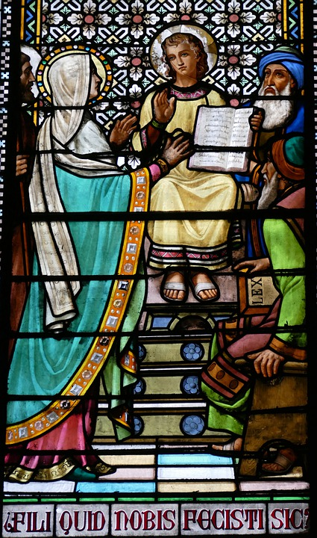
“Abide in me as I abide in you” (John 15:4) Now every year his parents went to Jerusalem for the festival of the Passover. And when he was twelve years old, they went up as usual for the festival. When the festival was ended and they started to return, the boy Jesus stayed behind in Jerusalem, but his parents did not know it.
Assuming that he was in the group of travellers, they went a day’s journey. Then they started to look for him among their relatives and friends. When they did not find him, they returned to Jerusalem to search for him.
Listen (Luke 2:41-52)

Slide 17
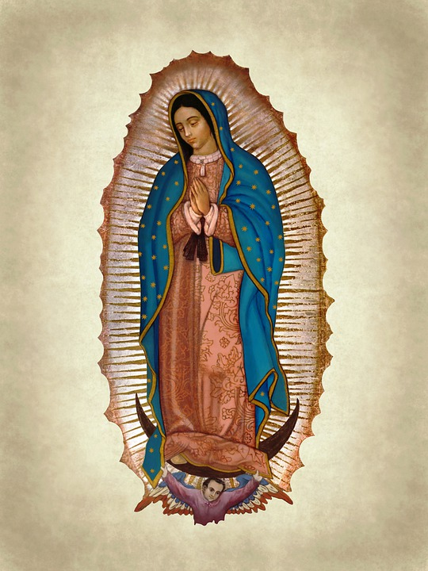
“Abide in me as I abide in you” (John 15:4)
After three days they found him in the temple, sitting among the teachers, listening to them and asking them questions. And all who heard him were amazed at his understanding and his answers. When his parents saw him they were astonished; and his mother said to him, “Child, why have you treated us like this? Look, your father and I have been searching for you in great anxiety.”
He said to them, “Why were you searching for me? Did you not know that I must be in my Father’s house?” But they did not understand what he said to them. Then he went down with them and came to Nazareth, and was obedient to them.
His mother treasured all these things in her heart.
Listen (Luke 2:41-52)

Slide 18
Watch this video on the Gospel. How did Jesus do the work of his Father? How can you do God’s work in your life?
Watch

Slide 19
The encounter with Jesus gives rise to the desire to stay with him and to abide in him: a time in which fruit matures.
Being fully human, like us Jesus grew and matured. He lived a simple life, rooted in the practices of his Jewish faith.
In this hidden life in Nazareth, where apparently nothing extraordinary happened, the presence of the Father nourished him.
Reflect

Slide 20
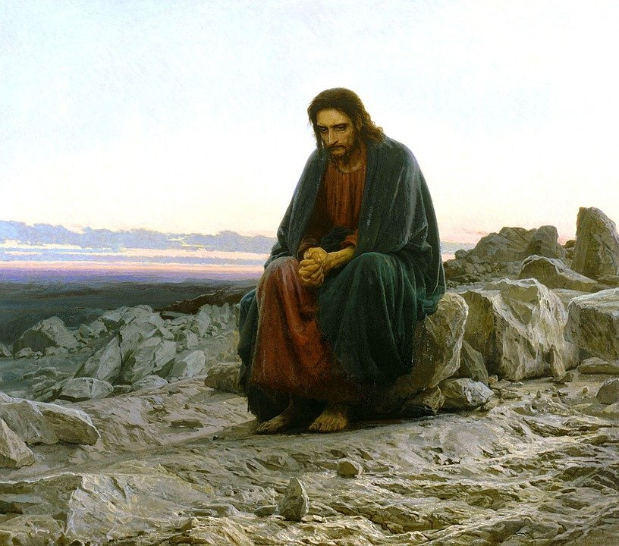
Mary contemplated the actions of God in her life and in that of her son. She treasured all these things in her heart.
Thus, little by little, she embraced the mystery of Jesus. We too need a long period of maturation, an entire lifetime, in order to plumb the depths of Christ’s love, to let him abide in us and for us to abide in him.
Reflect

Slide 21
Without our knowing how, the Spirit makes Christ dwell in our hearts. And it is through prayer, by listening to the word, in sharing with others, by putting into practice what we have understood, that the inner being is strengthened.
“Letting Christ descend into the depths of our being … He will penetrate the regions of the mind and the heart, he will reach our flesh unto our innermost being, so that we too will one day experience the depths of mercy.”
Reflect

Slide 22
The Bible tells us very little about Jesus’ youth and early adulthood, when he seems to have lived an ordinary life in Nazareth.
How are you conscious of God’s presence with you in the everyday things of life?
Reflect

Slide 23
Let us pray

Slide 24
Holy Spirit, May we receive in our hearts the presence of Christ, and cherish it as a secret of love. Nourish our prayer, enlighten our reading of Scripture, act through us, so that the fruits of your gifts can patiently grow in us.
Let us pray

Slide 25
Go and do (see www.ctbi.org.uk/goanddo)
Global: As people of faith think about how you can work together for the day when all can know a full and abundant human life.
Local: Consider how the churches in your area can be more child friendly spaces.
Personal: Give thanks and pray for the children you know.
Mission

Slide 26
Loving Father,
We pray for unity
In our homes
In our schools
In our parishes
In our country
In our world
And in our own hearts.
Make us channels of your peace.
Glory be…
Gather: Day 3

Slide 27
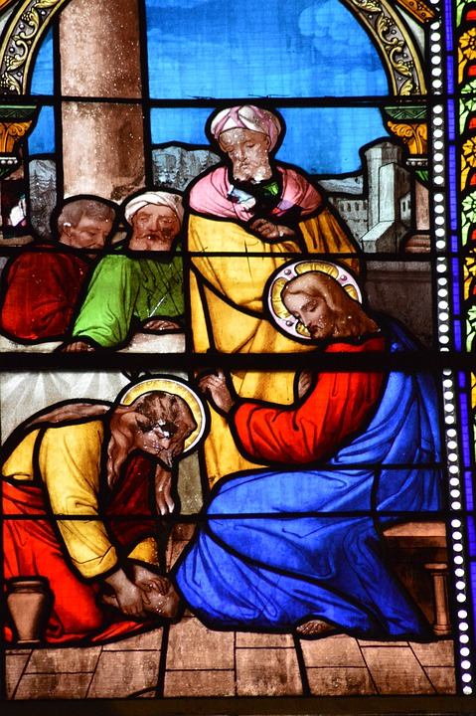
“Love one another as I have loved you”
(John 15:12)
Now before the festival of the Passover, Jesus knew that his hour had come to depart from this world and go to the Father. Having loved his own who were in the world, he loved them to the end. The devil had already put it into the heart of Judas son of Simon Iscariot to betray him. And during supper Jesus, knowing that the Father had given all things into his hands, and that he had come from God and was going to God, got up from the table, took off his outer robe, and tied a towel around himself. Then he poured water into a basin and began to wash the disciples’ feet and to wipe them with the towel that was tied around him.
Listen (John 13:1-15)

Slide 28
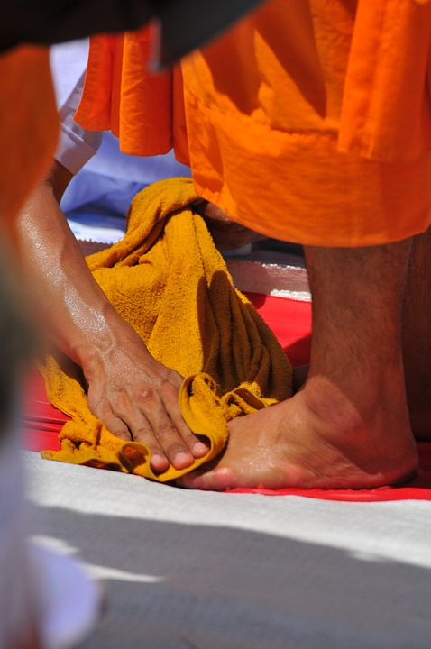
“Love one another as I have loved you”
(John 15:12)
He came to Simon Peter, who said to him, “Lord, are you going to wash my feet?” Jesus answered, “You do not know now what I am doing, but later you will understand.” ⁸ Peter said to him, “You will never wash my feet.” Jesus answered, “Unless I wash you, you have no share with me.” Simon Peter said to him, “Lord, not my feet only but also my hands and my head!”
Jesus said to him, “One who has bathed does not need to wash, except for the feet, but is entirely clean. And you are clean, though not all of you.” For he knew who was to betray him; for this reason he said, “Not all of you are clean.”
Listen (John 13:1-15)

Slide 29
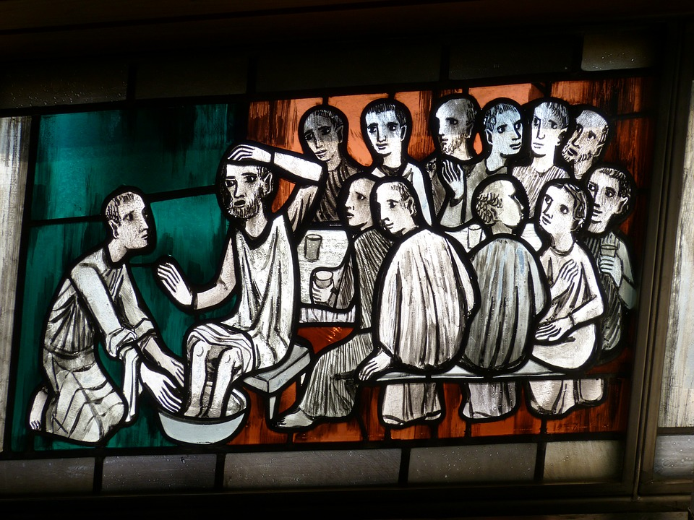
“Love one another as I have loved you”(John 15:12)
After he had washed their feet, had put on his robe, and had returned to the table, he said to them, “Do you know what I have done to you? You call me Teacher and Lord—and you are right, for that is what I am. So if I, your Lord and Teacher, have washed your feet, you also ought to wash one another’s feet.
For I have set you an example, that you also should do as I have done to you.
Listen (John 13:1-15)

Slide 30
Watch this video on the Gospel. What example did Jesus give us? What does compassion mean? How might you be compassionate?
Watch

Slide 31
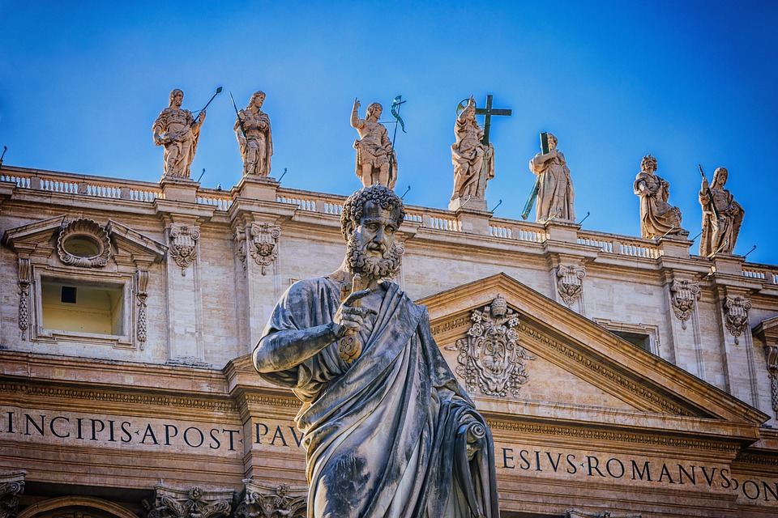
On the eve of his death, Jesus knelt to wash the feet of his disciples. He knew the difficulty of living together and the importance of forgiveness and mutual service. “Unless I wash you,” he said to Peter, “you have no share with me.”
Peter received Jesus at his feet; he was washed and was touched by the humility and gentleness of Christ. Later he would follow Jesus’ example and serve the fellowship of the faithful in the early Church.
Reflect

Slide 32
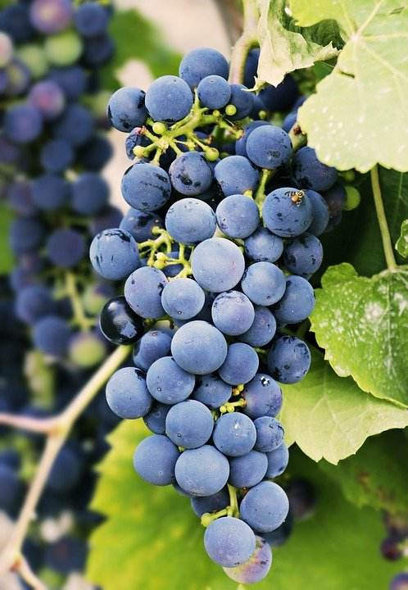
Jesus wishes that life and love circulate through us as the sap through the vine, so that Christian communities be one body. But today as in the past, it is not easy to live together. We are often faced with our own limitations.
At times we fail to love those who are close to us in a community, parish or family. There are times when our relationships break down completely.
In Christ we are invited to be clothed in compassion, through countless new beginnings. The recognition that we are loved by God moves us to welcome each other with our strengths and weaknesses. It is then that Christ is in our midst.
Reflect

Slide 33
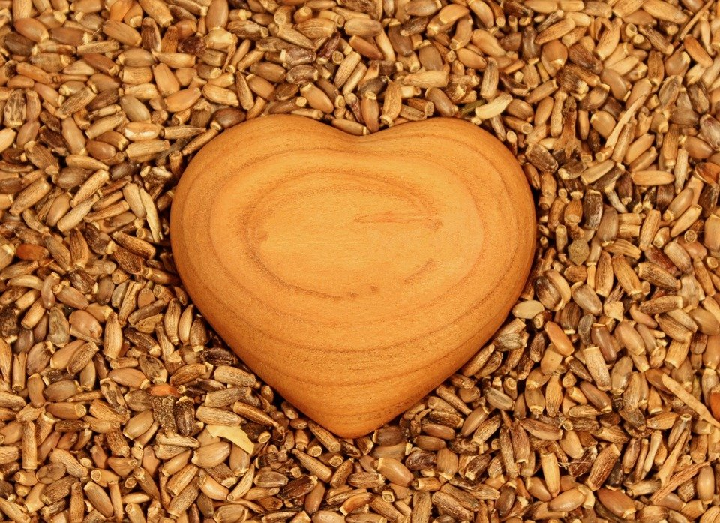
Can you think of a person in your life who you would identify as being “clothed in compassion”?
Can you recall a time when you have been the recipient of compassion?
Reflect

Slide 34
Let us pray

Slide 35
God our Father, you reveal to us your love through Christ and through our brothers and sisters. Open our hearts so that we can welcome each other with our differences and live in forgiveness. Grant us to live united in one body, so that the gift that is each person comes to light. May all of us together be a reflection of the living Christ.
Let us pray

Slide 36
Go and do (see www.ctbi.org.uk/goanddo)
Global: What action can we take in response to the compassion needed in the world?
Local: Consider making a banner or quilt together as churches and the wider community to demonstrate the things that thread and weave you together.
Personal: Consider the clothing in your wardrobe and the lives and hands that have touched them. Have these clothes been made with fair pay and good working conditions?
Mission

Slide 37
Loving Father,
We pray for unity
In our homes
In our schools
In our parishes
In our country
In our world
And in our own hearts.
Make us channels of your peace.
Glory be…
Gather: Day 4

Slide 38
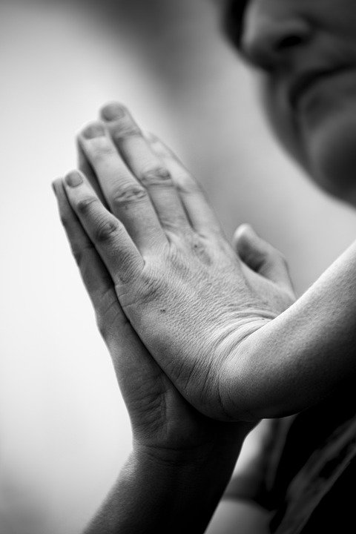
“I do not call you servants any longer… but I have called you friends” (John 15:15)
He was praying in a certain place, and after he had finished, one of his disciples said to him, ‘Lord, teach us to pray, as John taught his disciples.’ He said to them, ‘When you pray, say:
Father, hallowed be your name. Your kingdom come. Give us each day our daily bread. And forgive us our sins, for we ourselves forgive everyone indebted to us. And do not bring us to the time of trial.
Listen (Luke 11:1-4)

Slide 39
Watch this video on the Gospel. What does Jesus teach us about prayer? What does he say about how we should treat others?
Watch

Slide 40
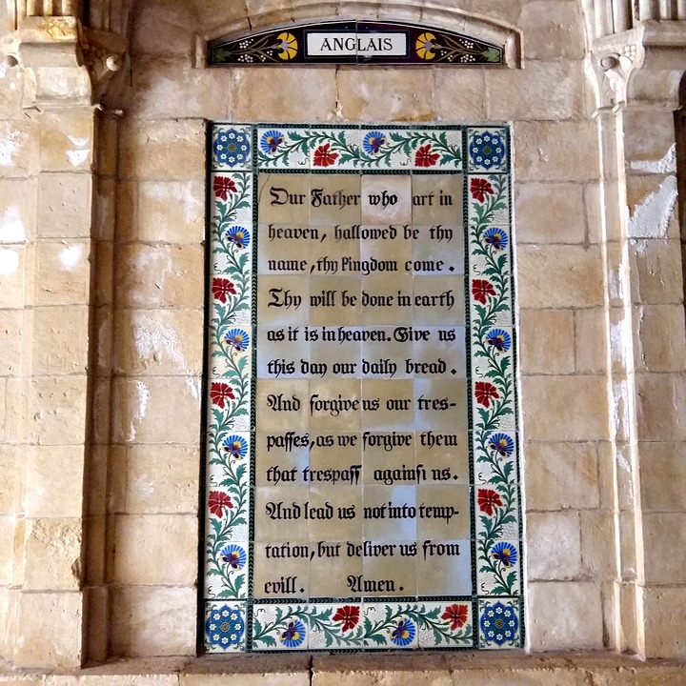
God thirsts for relationship with us. He searches for us as he searched for Adam, calling to him in the garden: “Where are you?” (Gen 3:9)
In Christ, God came to meet us. Jesus lived in prayer, intimately united to his Father, while creating friendships with his disciples and all those he met. He introduced them to that which was most precious to him: the relationship of love with his Father, who is our Father.
Jesus and the disciples sang psalms together, rooted in the richness of their Jewish tradition. At other times, Jesus retired to pray alone.
Reflect

Slide 41
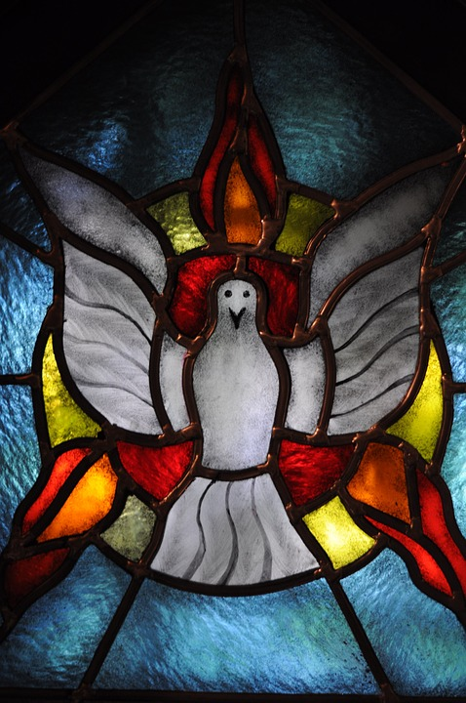
Prayer can be solitary or shared with others. It can express wonder, complaint, intercession, thanksgiving or simple silence. Sometimes the desire to pray is there, but one has the feeling of not being able to do so.
Turning to Jesus and saying to him, “teach me”, can pave the way. Our desire itself is already prayer. Getting together in a group offers us support.
Through hymns, words and silence, communion is created. If we pray with Christians of other traditions, we may be surprised to feel united by a bond of friendship that comes from the One who is beyond all division. The forms may vary, but it is the same Spirit that brings us together.
Reflect

Slide 42
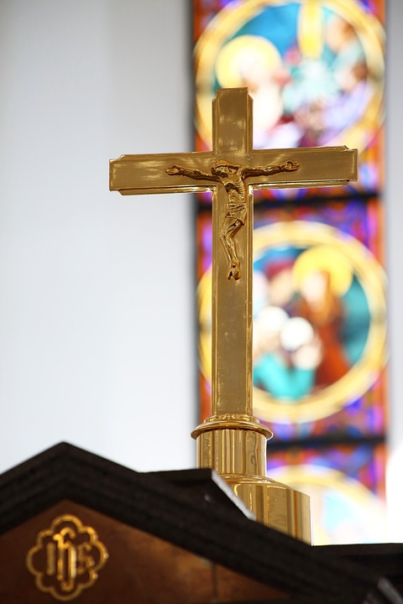
Jesus lived as an example of what it means to “live in prayer”.
If prayer is the foundation of our relationship with God how much time and attention could you give to your personal prayer life?
Reflect

Slide 43
Let us pray

Slide 44
Lord Jesus, your entire life was prayer, perfect harmony with the Father. Through your Spirit, teach us to pray according to your will of love. May the faithful of the whole world unite in intercession and praise, and may your kingdom of love come.
Let us pray

Slide 45
Go and do (see www.ctbi.org.uk/goanddo)
Global: Commit to praying through the WCC Ecumenical Prayer Cycle this year.
Local: Unite with others in your community to pray together this week, in person, online via Zoom or similar platform, or at a set time when you know others will be joining in prayer.
Personal: Consider how your prayer practices inform and influence your action in the world.
Mission

Slide 46
Loving Father,
We pray for unity
In our homes
In our schools
In our parishes
In our country
In our world
And in our own hearts.
Make us channels of your peace.
Glory be…
Gather: Day 5

Slide 47
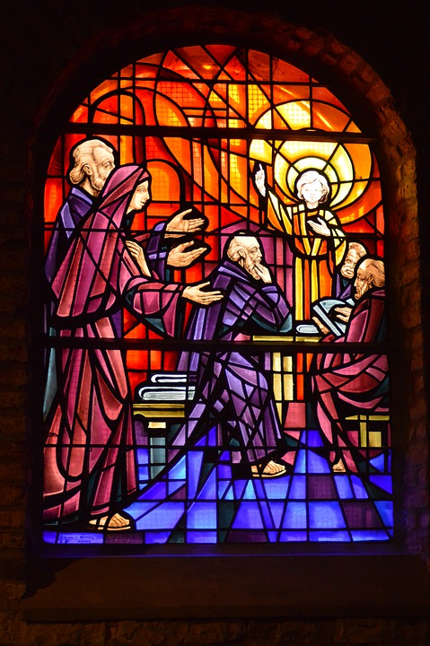
“You have already been pruned by the word…” (John 15:3)
When Jesus saw the crowds, he went up the mountain; and after he sat down, his disciples came to him. Then he began to speak, and taught them, saying:
‘Blessed are the poor in spirit, for theirs is the kingdom of heaven.
‘Blessed are those who mourn, for they will be comforted.
‘Blessed are the meek, for they will inherit the earth.
‘Blessed are those who hunger and thirst for righteousness, for they will be filled.
Listen (Matthew 5:1-12)

Slide 48
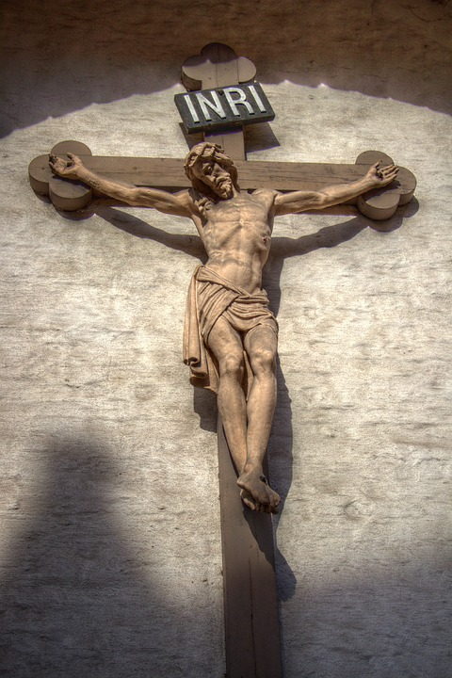
“You have already been pruned by the word…” (John 15:3)
‘Blessed are the merciful, for they will receive mercy.
‘Blessed are the pure in heart, for they will see God.
‘Blessed are the peacemakers, for they will be called children of God.
‘Blessed are those who are persecuted for righteousness’ sake, for theirs is the kingdom of heaven.
‘Blessed are you when people revile you and persecute you and utter all kinds of evil against you falsely on my account. Rejoice and be glad, for your reward is great in heaven, for in the same way they persecuted the prophets who were before you.
Listen (Matthew 5:1-12)

Slide 49
Watch this video on the Gospel.
Watch

Slide 50
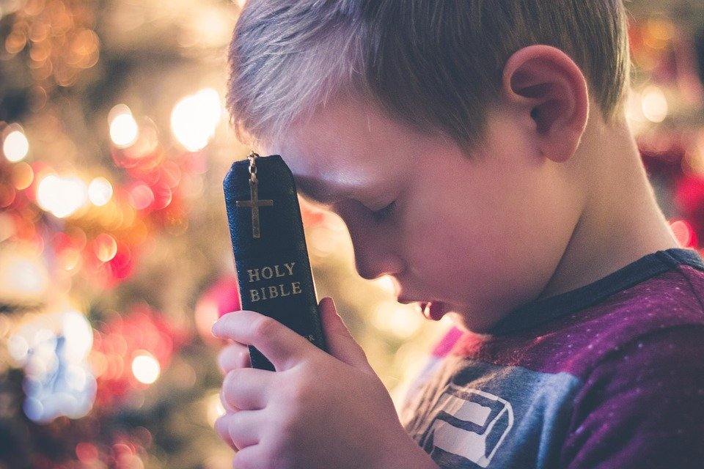
The Word of God is very close to us. It is a blessing and a promise of happiness. If we open our hearts, God speaks to us and patiently transforms that which is dying in us.
He removes that which prevents the growth of real life, just as the vine grower prunes the vine.
Reflect

Slide 51
Regularly meditating on a biblical text, alone or in a group, changes our outlook. Many Christians pray the Beatitudes every day.
The Beatitudes reveal to us a happiness that is hidden in that which is unfulfilled, a happiness that lies beyond suffering: blessed are those who, touched by the Spirit, no longer hold back their tears but let them flow and thus receive consolation.
As they discover the wellspring hidden within their inner landscape, the hunger for justice, and the thirst to engage with others for a world of peace, grows in them.
Reflect

Slide 52
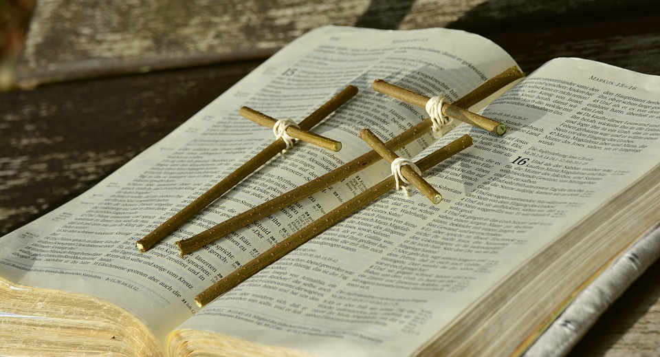
We are constantly called to renew our commitment to life, through our thoughts and actions. There are times when we already taste, here and now, the blessing that will be fulfilled at the end of time.
“Pray and work that God may reign. Throughout your day Let the Word of God breathe life into work and rest.
Maintain inner silence in all things so as to dwell in Christ. Be filled with the spirit of the Beatitudes, joy, simplicity, mercy.”
Reflect

Slide 53
What does it mean in our world today to be blessed by God?
Reflect

Slide 54
Let us pray

Slide 55
Blessed are you, God our Father, for the gift of your word in Holy Scripture. Blessed are you for its transforming power. Help us choose life and guide us by your Spirit, so that we can experience the happiness which you want so much to share with us
Let us pray

Slide 56
Go and do (see www.ctbi.org.uk/goanddo)
Global: Find out more about the Just Scripture initiative and help organise a session connecting the churches in your area with a community across the world.
Local: What one act of kindness could the churches in your area take together to be a unified blessing in your wider community?
Personal: Read the Beatitudes through slowly (Matthew 5: 3-11). Which of the actions described in the passage are you encouraged to take today?
Mission

Slide 57
All images used here from Pixabay
All content from Christians Together in Britain and Ireland (CBTI): https://ctbi.org.uk/week-of-prayer-for-christian-unity-2021/
For the full PDF document see https://ctbi.org.uk/wp-content/uploads/2020/10/WPCU-2021-English-pamphlet-Final.pdf.pagespeed.ce.SnR5lgw9dp.pdf
With thanks

