Slide 1
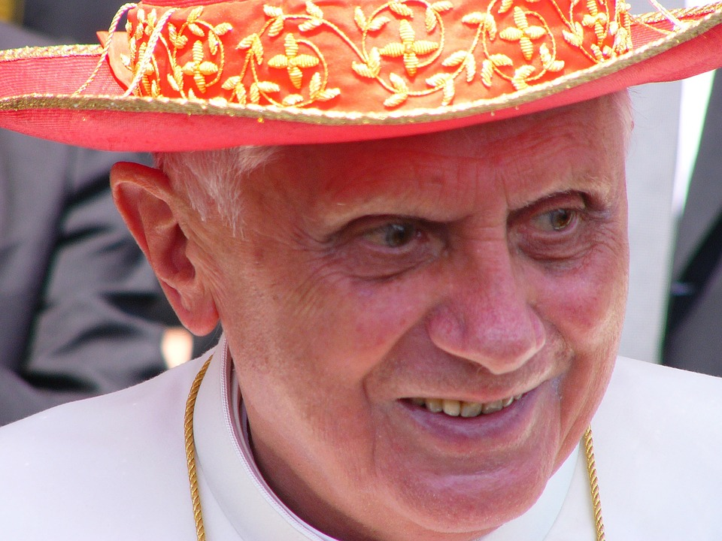
‘Benedict spent his life seeking the face of Jesus’.
(Fr. Lombardi, SJ)
Pope Emeritus Benedict XVI (1927-2022)

Slide 2
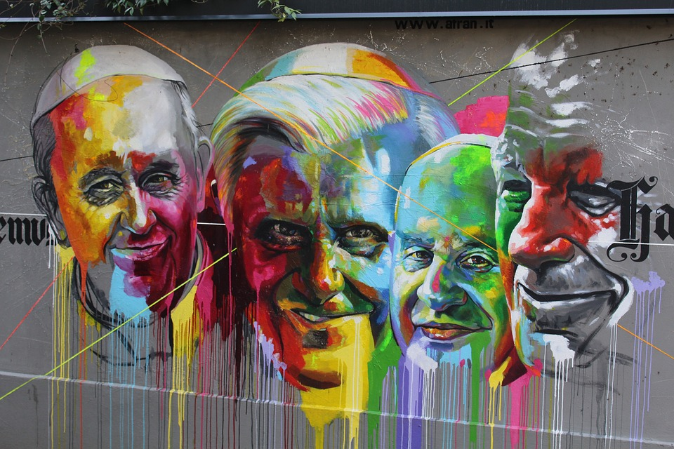
A major figure
Notes:
Pope Benedict was considered "a major figure on the Vatican stage for a quarter of a century“. He worked very closely with Pope John Paul and Pope Francis.
You may wish to ask the pupils some of the following questions depending on their age and ability:
Do you recognise anyone here?
What do you know about them/any of the popes?
What does a pope do?
Who was the first pope?
Other information
From 2002 until he was elected pope, he was also Dean of the College of Cardinals. Before becoming pope, he was "a major figure on the Vatican stage for a quarter of a century"; he had an influence "second to none when it came to setting church priorities and directions" as one of John Paul II's closest confidants.

Slide 3
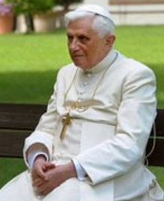
Key points about Pope Benedict:
Born Joseph Ratzinger on 16th April 1927 in Bavaria, Germany
Ordained as a priest in 1951 and created a cardinal in 1977
Was a professor of theology and wrote extensively about the Catholic faith and tradition
Was elected pope in 2005 and chose the name Benedict after Pope Benedict XV (Pope during WW1) and St Benedict of Nursia (founder of the Benedictine monasteries)
Pope Benedict Emeritus (1927-2022)
Notes:
Ratzinger chose the papal name Benedict, which comes from the Latin word meaning "the blessed", in honour of both Benedict XV and Benedict of Nursia.^{[78]} Benedict XV was pope during the First World War, during which time he passionately pursued peace between the warring nations. St. Benedict of Nursia was the founder of the Benedictine monasteries (most monasteries of the Middle Ages were of the Benedictine order) and the author of the Rule of Saint Benedict, which is still the most influential writing regarding the monastic life of Western Christianity. The Pope explained his choice of name during his first general audience in St. Peter's Square, on 27 April 2005:
Filled with sentiments of awe and thanksgiving, I wish to speak of why I chose the name Benedict. Firstly, I remember Pope Benedict XV, that courageous prophet of peace, who guided the Church through turbulent times of war. In his footsteps, I place my ministry in the service of reconciliation and harmony between peoples. Additionally, I recall Saint Benedict of Nursia, co-patron of Europe, whose life evokes the Christian roots of Europe. I ask him to help us all to hold firm to the centrality of Christ in our Christian life: May Christ always take first place in our thoughts and actions!^{[79]}

Slide 4
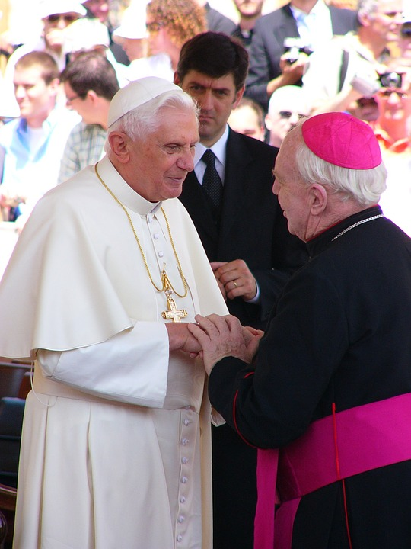
Key points about Pope Benedict:
Resigned on 11 February 2013, due to a ‘lack of strength of mind and body’
Dedicated the rest of his life to prayer and supporting Pope Francis and the Church
Was known as Pope Benedict Emeritus when he abdicated
He loved books, writing, languages and playing the piano
Died on 31st December 2022 and will be buried on 5th January 2023
Pope Benedict Emeritus (1927-2022)

Slide 5
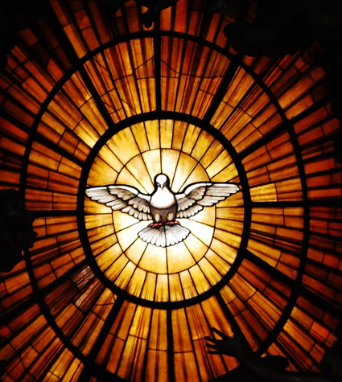
Bear with each other and forgive whatever grievances you may have against one another. Forgive as the Lord forgave you. And over all these virtues put on love, which binds them all together in perfect unity. Let the peace of Christ rule in your hearts, since as members of one body you were called to peace.
Col 3: 14-15
Reflect
Notes:
This image is from the Vatican where Pope Benedict lived.
Reflect on this reading and what it means.
Pope Benedict had many virtues but we will concentrate on 4 of these

Slide 6
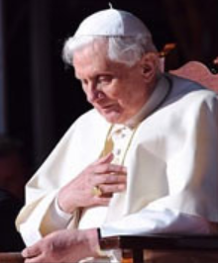
Faith – ‘His strength was clearly how to express the Christian faith in a way understandable to modern human beings. That's his message. That's what he leaves us.’ (Professor Koerner)
Fortitude - He was given the nickname "God's Rottweiler" for his uncompromising conservative views.
Reflect: A virtuous life
Notes:
Faith - As Pope, he was respected for his deep faith and his work as a theologian, producing 60 books between 1963 and 2013. "His strength was clearly how to express the Christian faith in a way understandable to modern human beings. That's his message. That's what he leaves us," said Professor Koerner
Fortitude – he stood for his convictions and values eg Pope Benedict gently but firmly spoke for ethics in the field of science and defended the sanctity of life and marriage when it wasn’t politically correct to do so. He was unashamedly moral. As a cardinal charged with enforcing doctrinal purity, Benedict was given the nickname "God's Rottweiler" for his uncompromising conservative views.

Slide 7
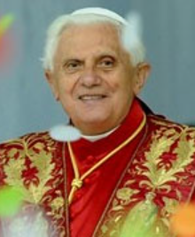
Prudence – ‘Gratitude to him, for all the good he did, and above all for his witness of faith and of prayer, especially in these last years of withdrawn life.’ (Pope Francis)
Love - 'He was a very different man from the media image of him. he was a very spiritual, very kind, very insightful, immensely intelligent and sensitive man.’ (Cardinal Nichols)
Reflect: A virtuous life
Notes:
Prudence – With great humility, he stepped down when he felt he wasn’t fit for the job.
For centuries every other pope served until their death, whether they were able to lead well or not. Pope Benedict made a modernizing choice in resigning. He was able to discern God’s will and was humble enough to step down and let Francis be pope, serving the Church for the rest of his life through his prayer. “With deep feeling, we recall his person, so noble, so gentle,'' Francis said. “And we feel in the heart so much gratitude: gratitude to God for having given him to the Church and to the world,” the pope said. "Gratitude to him, for all the good he did, and above all for his witness of faith and of prayer, especially in these last years of withdrawn life.
Charity/love - Pope Benedict is known for three encyclicals or letters. The first encyclical, Deus Caritas Est, or “God is Love,” defends “charity” as love that is freely given. Charity is not simply a good deed but an act that changes both the giver and the recipient. He writes in Deus Caritas Est that the service of charity is an “indispensable expression of her very being”. He says that all the faithful have the duty to devote themselves to a charitable life. Pope Benedict XVI wrote Caritas in Veritate (Love or Charity in Truth) in the midst of the global financial crisis of 2009. Which is why the Encyclical covers such a wide variety of issues: from globalization to the environment – even anticipating Pope Francis', Encyclical Laudato sì. In his second year in the office of the pope, Benedict announced the Vatican would become the first carbon-neutral country by planting trees to offset its carbon footprint. In addition, he had solar-panels installed in Paul VI hall. Ecology was key.

Slide 8
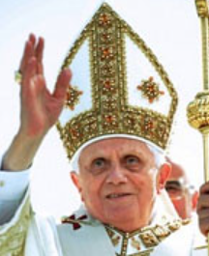
A prayer for the soul of Pope Emeritus Benedict XVI
Father, eternal shepherd, hear the prayers of your people for your servant Benedict, who governed your Church with love.
In your mercy, bring him with the flock once entrusted to his care to the reward you have promised your faithful servants.
May he who faithfully administered the mysteries of your forgiveness and love on earth, rejoice with you for ever in heaven
In your wise and loving care, you made your servant teacher of all your Church.
Respond: Let us pray

Slide 9
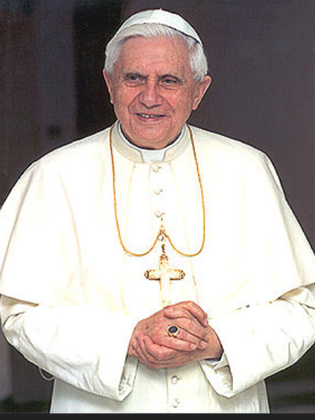
He did the work of Christ on earth.
May your Son welcome him into eternal glory.
May your servant whom you appointed high priest of your flock be counted now among the priests in the life of your kingdom.
Give your servant the reward of eternal happiness and let your mercy win for us the gift of your life and love.
We entrust your servant to your mercy with faith and confidence. In the human family he was an instrument of your peace and love.
We entrust your servant to your mercy with faith and confidence. In the human family he was an instrument of your peace and love.
May he rejoice in those gifts for ever with your saints.
Through Christ our Lord, Amen
Respond: Let us pray

Slide 10
References:
https://rcdow.org.uk/news/pope-emeritus-benedict-requiescat-in-pace/
https://www.vaticannews.va/en/vatican-city/news/2022-12/pope-emeritus-benedict-xvi-lombardi-papal-spokesman.html
https://www.vaticannews.va/en/pope/news/2022-12/pope-pays-tribute-benedict-xvi-s-witness-faith-prayer-kindness.html
https://en.wikipedia.org/wiki/Pope_Benedict_XVI
https://growingleaders.com/five-leadership-lessons-from-pope-benedict-xvi/
https://news.sky.com/story/pope-benedict-xvi-dies-resignation-of-gods-rottweiler-shocked-the-world-and-he-continued-to-be-controversial-12776084

