Slide 1
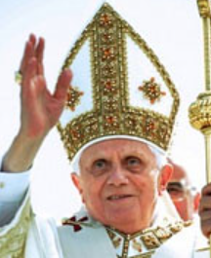
‘Benedict spent his life seeking the face of Jesus’.
(Fr. Lombardi, SJ)
Pope Benedict

Slide 2
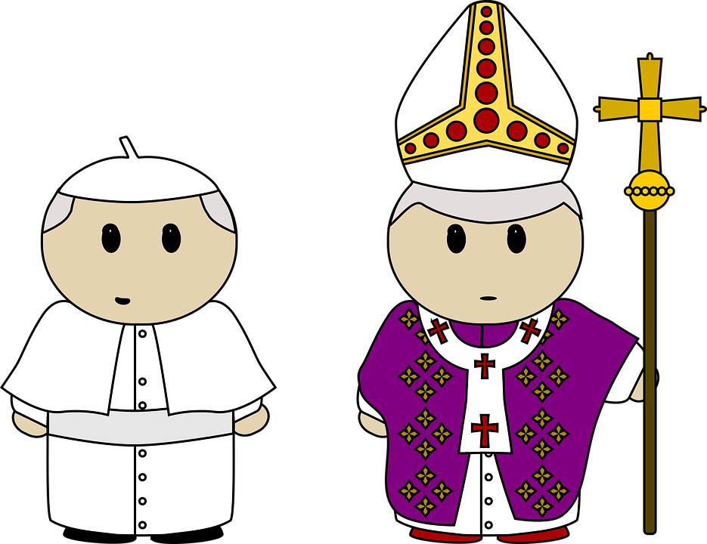
What is a pope?
What does it mean to be holy?
A holy man
Notes:
Look at the picture. Which one is pope? How do you know? (wearing white). Explain that Benedict was a pope meaning he was the leader of the Church. But because he was old and sick, he abdicated, which is like being retired.
He was a holy man – he believed in God, prayed, read the Bible, was kind and lived as God asked him to.

Slide 3
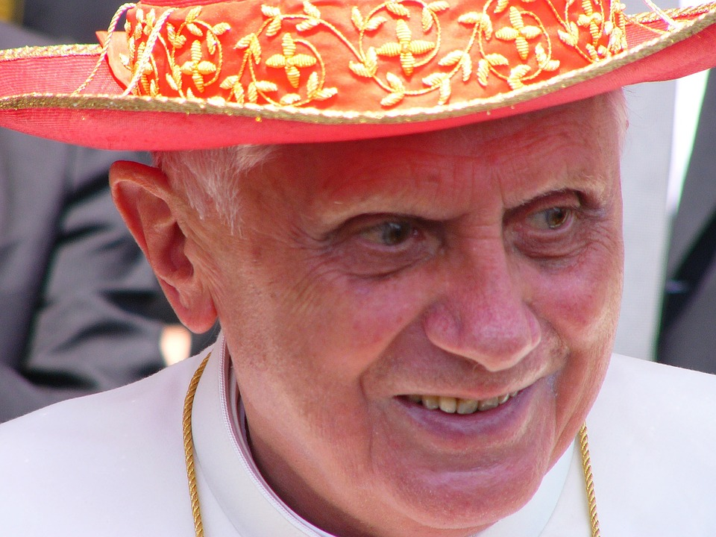
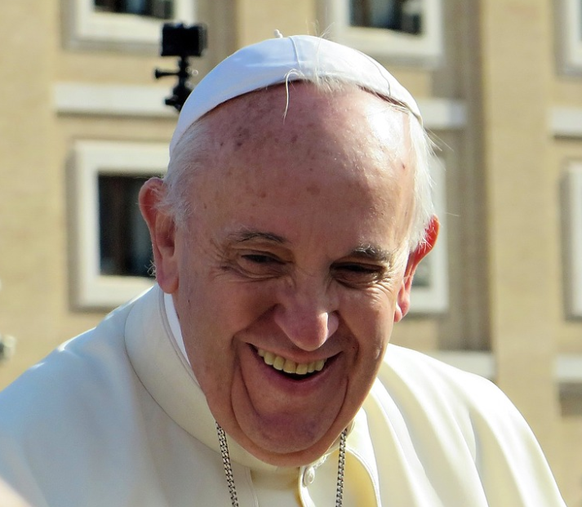
Pope Benedict
Pope Francis
Popes
Notes:
Explain that Pope Benedict was pope before Francis. When Francis was pope he helped him in lots of ways including through his prayer. During the holidays Pope Emeritus Benedict XVI died and his funeral will be this week.
Explain that before he was a pope he was priest for many years and then a cardinal. Discuss what a priest does.

Slide 4
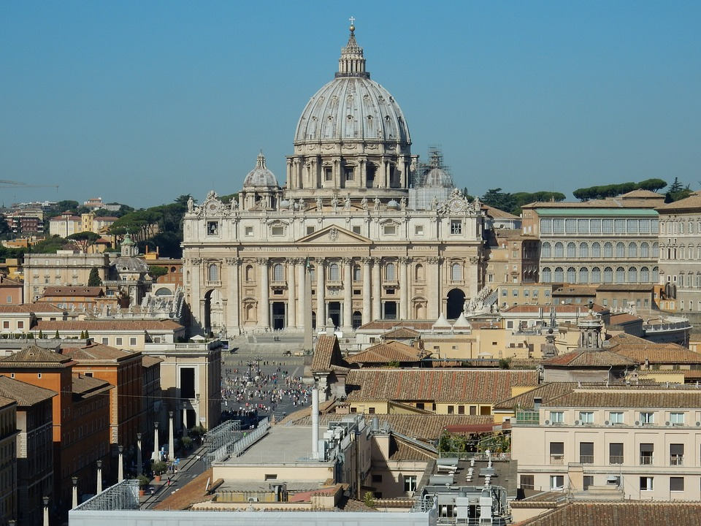
Where is the Vatican?
Vatican
Notes:
Explain that the Vatican city is in Rome and that it is a very special place as it is where the leaders of the Church live. It is where the first pope, St Peter, died. Lots of Church objects, artwork and documents are there.

Slide 5
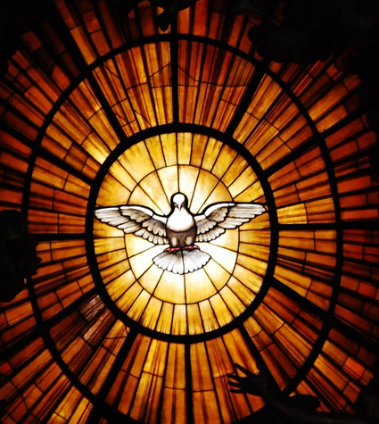
“And now, Israel, what does the Lord your God require of you, but to fear the Lord your God, to walk in all his ways, to love him, to serve the Lord your God with all your heart and with all your soul, and to keep the commandments of the Lord, which I am commanding you today for your good?
(Deut 10:12-13)
Listen
Notes:
This image is one from the Vatican. Reflect on this reading and what it means.

Slide 6
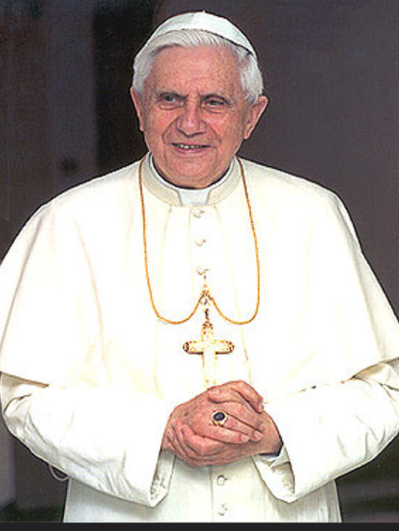
Lord, we thank you for Pope Benedict who loved you with all of his heart and soul.
Help us to follow his example by keeping your commandments and loving you and others.
Help us to serve you in all that we do, just as Benedict did.
May he rest with you in heaven forever. Amen
Reflect: Let us pray

Slide 7
References:
https://rcdow.org.uk/news/pope-emeritus-benedict-requiescat-in-pace/
https://www.vaticannews.va/en/vatican-city/news/2022-12/pope-emeritus-benedict-xvi-lombardi-papal-spokesman.html
https://www.vaticannews.va/en/pope/news/2022-12/pope-pays-tribute-benedict-xvi-s-witness-faith-prayer-kindness.html
https://en.wikipedia.org/wiki/Pope_Benedict_XVI
https://growingleaders.com/five-leadership-lessons-from-pope-benedict-xvi/
https://news.sky.com/story/pope-benedict-xvi-dies-resignation-of-gods-rottweiler-shocked-the-world-and-he-continued-to-be-controversial-12776084

