Slide 1
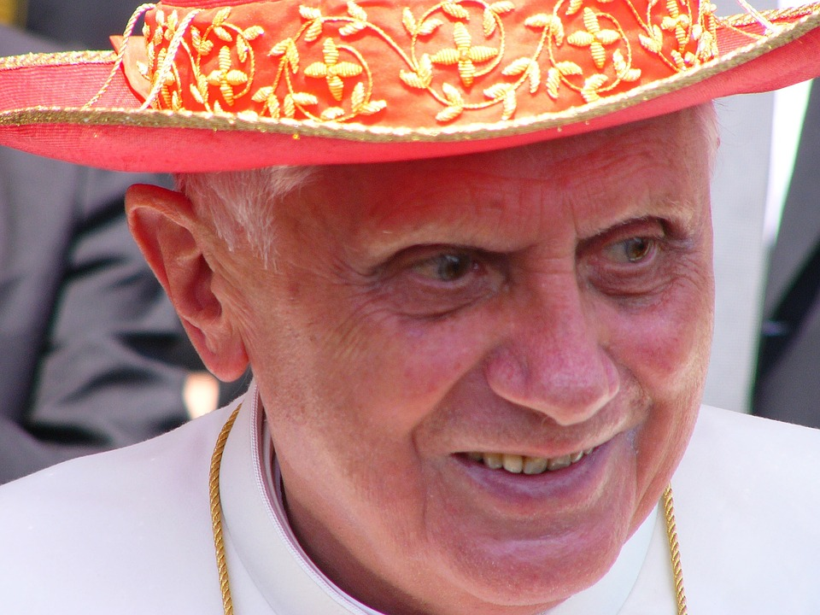
‘Benedict spent his life seeking the face of Jesus’.
(Fr. Lombardi, SJ)
Pope Benedict Emeritus (1927-2022)

Slide 2
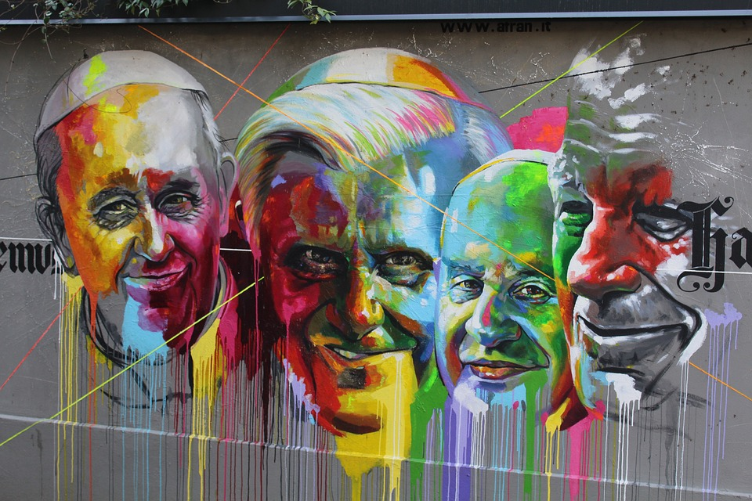
A major figure
Notes:
Pope Benedict was considered "a major figure on the Vatican stage for a quarter of a century“. He worked very closely with Pope John Paul and Pope Francis.
You may wish to ask the pupils some of the following questions depending on their age and ability:
Do you recognise anyone here?
What do you know about them/any of the popes?
What does a pope do?
Who was the first pope?
Other information
From 2002 until he was elected pope, he was also Dean of the College of Cardinals. Before becoming pope, he was "a major figure on the Vatican stage for a quarter of a century"; he had an influence "second to none when it came to setting church priorities and directions" as one of John Paul II's closest confidants.

Slide 3
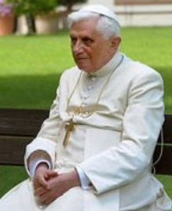
Key points about Pope Benedict:
Born Joseph Ratzinger in 1927 in Germany
Ordained as a priest in 1951 and created a cardinal in 1977
Was elected the 265th pope in 2005 and chose the name Benedict after Pope Benedict XV and St Benedict of Nursia
Pope Benedict Emeritus (1927-2022)
Notes:
Ratzinger chose the papal name Benedict, which comes from the Latin word meaning "the blessed", in honour of both Benedict XV and Benedict of Nursia.^{[78]} Benedict XV was pope during the First World War, during which time he passionately pursued peace between the warring nations. St. Benedict of Nursia was the founder of the Benedictine monasteries (most monasteries of the Middle Ages were of the Benedictine order) and the author of the Rule of Saint Benedict, which is still the most influential writing regarding the monastic life of Western Christianity. The Pope explained his choice of name during his first general audience in St. Peter's Square, on 27 April 2005:
Filled with sentiments of awe and thanksgiving, I wish to speak of why I chose the name Benedict. Firstly, I remember Pope Benedict XV, that courageous prophet of peace, who guided the Church through turbulent times of war. In his footsteps, I place my ministry in the service of reconciliation and harmony between peoples. Additionally, I recall Saint Benedict of Nursia, co-patron of Europe, whose life evokes the Christian roots of Europe. I ask him to help us all to hold firm to the centrality of Christ in our Christian life: May Christ always take first place in our thoughts and actions!^{[79]}

Slide 4
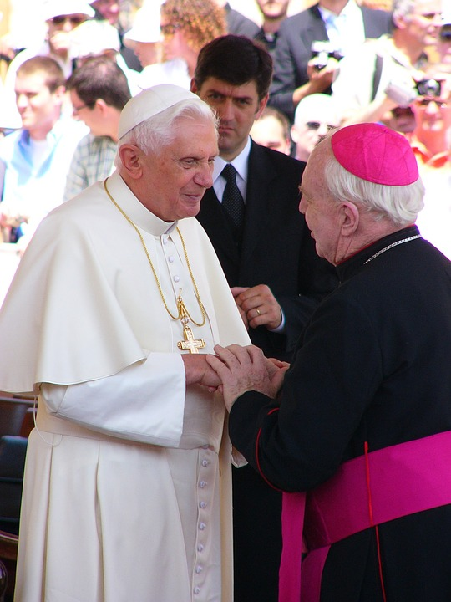
Key points about Pope Benedict:
Resigned on 11 February 2013
Dedicated the rest of his life to prayer and supporting Pope Francis and the Church
He loved books, writing, languages and playing the piano
Died on 31st December 2022 and his funeral will be on 5th January 2023
Pope Benedict Emeritus (1927-2022)

Slide 5
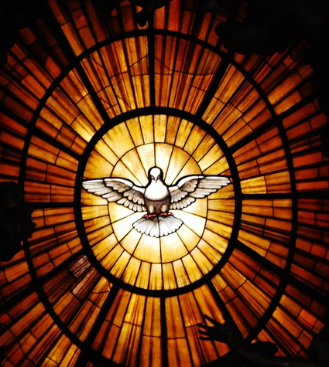
Do not be anxious about anything, but in every situation, by prayer and petition, with thanksgiving, present your requests to God. And the peace of God, which transcends all understanding, will guard your hearts and your minds in Christ Jesus.
Phil 4 6-7
Listen
Notes:
This image is from the Vatican where Pope Benedict lived. Reflect on this reading and what it means.

Slide 6
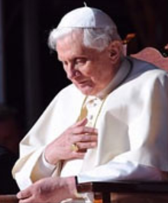
“And speaking of kindness, at this moment, my thought naturally goes to dear Pope emeritus Benedict XVI … We are moved as we recall him as such a noble person, so kind. And we feel such gratitude in our hearts: gratitude to God for having given him to the Church and to the world; gratitude to him for all the good he accomplished, and above all, for his witness of faith and prayer, especially in these last years of his recollected life. Only God knows the value and the power of his intercession, of the sacrifices he offered for the good of the Church.”
(Pope Francis)
Reflect: A prayerful life
Notes:
You may wish to discuss or reflect upon the following:
Why is prayer important?
What do you think Pope Francis meant by the value and the power of Pope Benedict’s prayer/intercession?
Do you think prayer makes a real difference?
Do you think prayer leads to kindness, charity or social action?
How might this have an impact on your life?
What would you like to pray for?

Slide 7
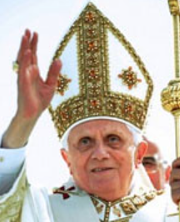
A prayer for the soul of Pope Emeritus Benedict XVI
Father, eternal shepherd, hear the prayers of your people for your servant Benedict, who governed your Church with love.
In your mercy, bring him with the flock once entrusted to his care to the reward you have promised your faithful servants.
Respond: Let us pray

Slide 8
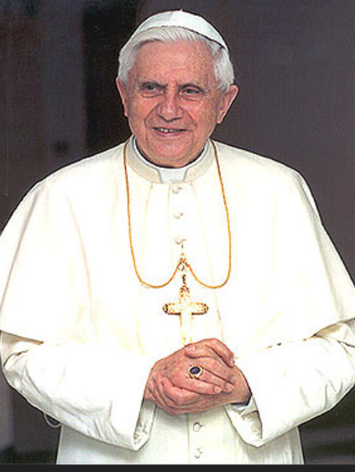
He did the work of Christ on earth.
May your Son welcome him into eternal glory.
May your servant whom you appointed high priest of your flock be counted now among the priests in the life of your kingdom.
Give your servant the reward of eternal happiness and let your mercy win for us the gift of your life and love.
May he rejoice in those gifts for ever with your saints.
Through Christ our Lord, Amen
Respond: Let us pray

Slide 9
References:
https://rcdow.org.uk/news/pope-emeritus-benedict-requiescat-in-pace/
https://www.vaticannews.va/en/vatican-city/news/2022-12/pope-emeritus-benedict-xvi-lombardi-papal-spokesman.html
https://www.vaticannews.va/en/pope/news/2022-12/pope-pays-tribute-benedict-xvi-s-witness-faith-prayer-kindness.html
https://en.wikipedia.org/wiki/Pope_Benedict_XVI
https://growingleaders.com/five-leadership-lessons-from-pope-benedict-xvi/
https://news.sky.com/story/pope-benedict-xvi-dies-resignation-of-gods-rottweiler-shocked-the-world-and-he-continued-to-be-controversial-12776084

