Slide 1



Care of Creation
KS1

Slide 2


Starter
Talk Partners:
How did you get to school today?
Notes:
Talk partners for 3 minutes
Gather responses

Slide 3

Starter
What ways of getting to school are the best for the environment?
Notes:
Talk partners for 3 minutes
Gather responses

Slide 4



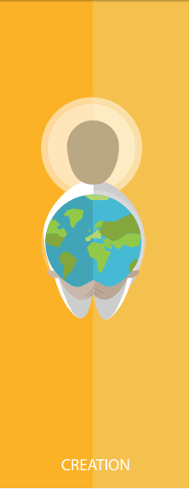



Catholic Social Teaching

Slide 5







Catholic Social Teaching

Slide 6

Care of Creation
‘God put people in the Garden of Eden to take care of it.’
Genesis 2:15

Slide 7

Care of Creation
‘Creation is a gift that God has given us, so we must care for it and use it for the benefit of all.’
Pope Francis, Laudato Si’ (paraphrased)

Slide 8
Care of Creation
‘What kind of world do we want to live in when we grow up?’
Pope Francis, Laudato Si’ (paraphrased)

Slide 9
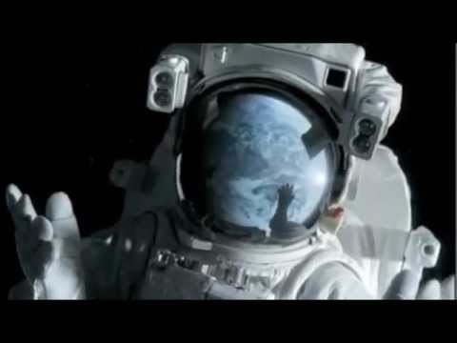
Care of Creation

Slide 10

Care of Creation
Our world is a wonderful place.
What do you love about our world?
What do you love about the environment?

Slide 11

Care of Creation
God made the world for us.
The world is everyone’s home.
We need to look after it.

Slide 12
Care of Creation
Being a steward of creation means being someone who cares for the world.

Slide 13
Care of Creation
What can we do to look after our world?
What can we do to be good stewards of creation?

Slide 14
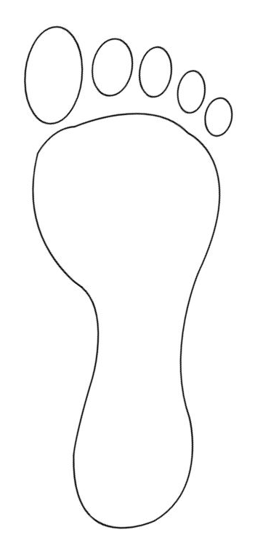
Main Activity
Think about what you could do to care for God’s creation.
How could you leave a good footprint on the Earth?
Draw a picture of your promise and complete:
To care for creation I will…

Slide 15
Plenary
What do you love about our world?
Think about your family, animals, plants, etc.
Write a prayer thanking God for it.
Dear God,
Thank you for…
Amen

