Slide 1
Care of Creation
Collective Acts of Worship

Slide 2
Starter

Slide 3
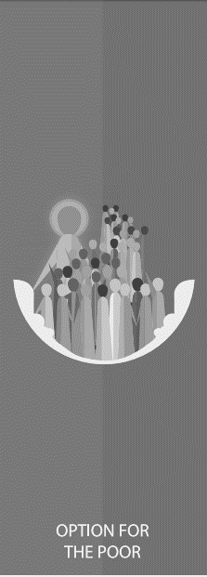
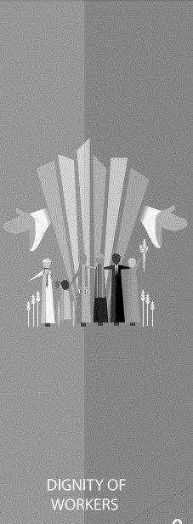
Catholic Social Teaching
Starter

Slide 4
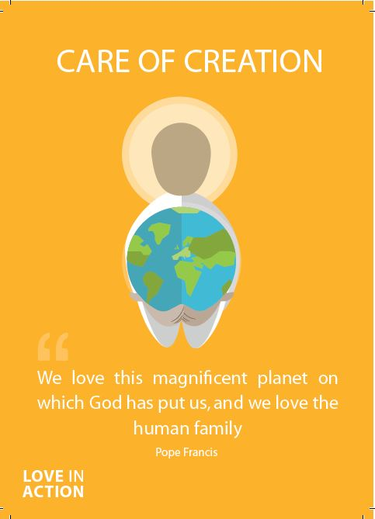
Care of Creation
As Christians, we are called to be good stewards of creation.
That means we are meant to look after the world that God created for us.
We must all work to leave our world in a better condition for the people who come after us.

Slide 5
Care of Creation
‘Creation is a gift, it is a wonderful gift that God has given us, so that we care for it and we use it for the benefit of all.’
Pope Francis
Laudato Si’
​

Slide 6
Care of Creation
‘Living our vocation to be protectors of God’s handiwork is essential to a life of virtue; it is not an optional or a secondary aspect of our Christian experience.’
Pope Francis
Laudato Si’
Think quietly:
What do you think Pope Francis means by this?

Slide 7
Care of Creation
Think of a time when you felt in awe at the beauty of creation.
What made you feel that way?
What more could you do to look after our world?

Slide 8
Care of Creation
Let us now listen to the Word of God.

Slide 9
Care of Creation
Read through one of more of the bible passages on the next few slides.
As a class, think about and discuss the meaning of each.​
How do the passages relate to Care of Creation?

Slide 10
Care of Creation
‘In the beginning, God created the Heavens and the Earth… God saw everything that He had made, and indeed, it was very good.’
Genesis 1:1-4

Slide 11
Care of Creation
‘In the beginning, God created the Heavens and the Earth… God saw everything that He had made, and indeed, it was very good.’
Genesis 1:1-4

Slide 12
Care of Creation
‘The Lord God put Man in the Garden of Eden to work it and take care of it.’
Genesis 2:15
​

Slide 13
Care of Creation
‘What kind of world do we want to leave to those who come after us, to children who are now growing up?’
Pope Francis
Laudato Si’

Slide 14
Care of Creation
What do these bible passages and quotes from Pope Francis tell you about how we should treat our world?
How do we know that God wants us to act in this way?

Slide 15
Care of Creation
“I think that…”
Notes:
Holding slide for discussion/feedback if required.

Slide 16
Care of Creation
Let Us Pray…

Slide 17
Care of Creation
Loving God,
We come together to thank you for our world. You created the Earth for us to live and prosper in. You taught us how to care for the world you created but we have not followed those laws..
Let us give thanks for the joy our world brings us and pray that we become good stewards of creation.

Slide 18
Care of Creation
We pray for those who work hard to care for our world
O God, help us to follow their example

Slide 19
Care of Creation
We pray for those who do not care for the Earth in the way they should.
O God, help us to teach others how You want us to live.

Slide 20
Care of Creation
We pray for those who will face the worst consequences for our actions.
O God, help us to help those in need.

Slide 21
Care of Creation
We pray that we may be able to care for our world and reverse the damage we have done.
O God, help us to work together.

Slide 22
Care of Creation
Amen

Slide 23
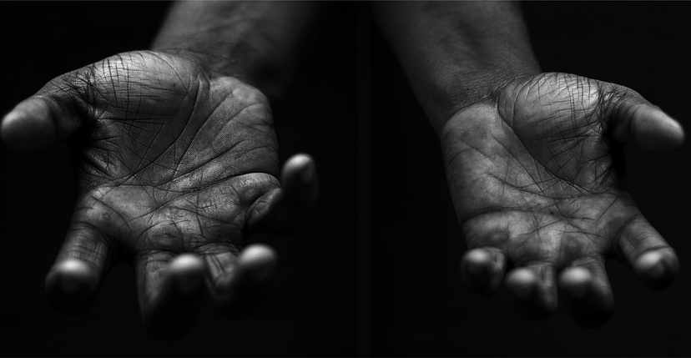
Care of Creation
Your Mission
Notes:
Using the Prayer Toolkit model, the mission ‘tasks’ on the following slide can be amended or supplemented as required.

Slide 24
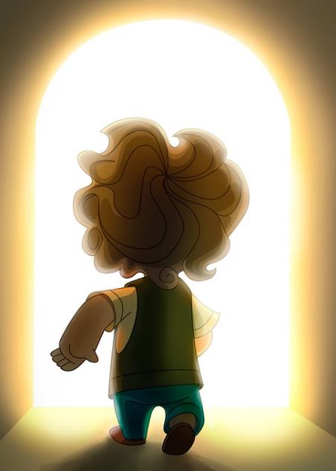
Care of Creation
What can your school do for the Harvest Festival?
Research:
World Day of Prayer for the Care of Creation (1st September).
COP27 (begins 7th November).

Slide 25
Care of Creation

