Slide 1
Community and Participation
KS1

Slide 2
Starter
Think about all the people you know.
Do you always look out for them?
Notes:
Talk partners for 3 minutes
Gather responses

Slide 3
Catholic Social Teaching

Slide 4
Catholic Social Teaching

Slide 5
Community and Participation
Your community is the people around you.
What communities are you a part of?
(Think about: your school, class, hobbies, sports, etc.)

Slide 6
Community and Participation
God loves us all.
He wants us to show that love to each other too.

Slide 7
Community and Participation
‘Love one another: just as I have loved you ... By this all people will know that you are my disciples.’
John 13:34-35

Slide 8
Community and Participation
‘You shall love your neighbour as yourself.’
Matthew 22:37-39

Slide 9
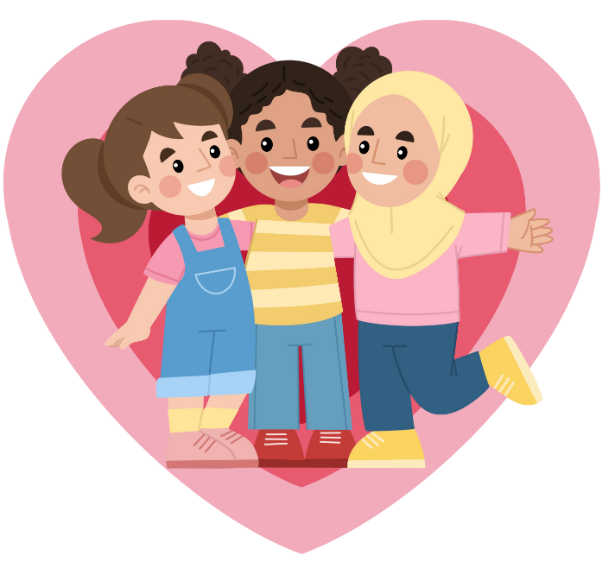
Community and Participation
Who is your neighbour?

Slide 10
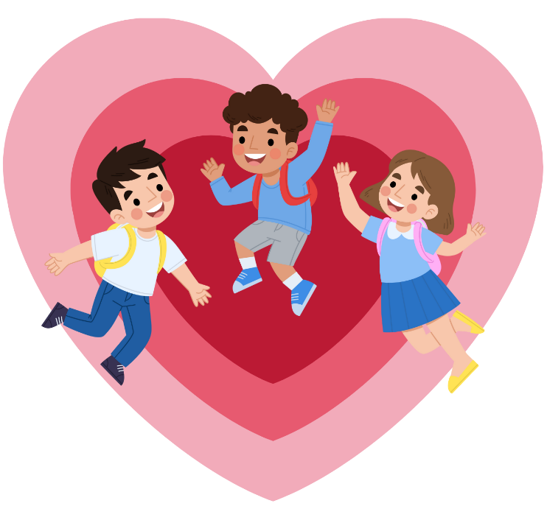
Community and Participation
Your neighbours aren’t just the people who live next door to you.
Your neighbours are everyone around you.
When was the last time you did something kind to your neighbour?

Slide 11
Main Activity
In the person, draw or write the names of your neighbours.
In the heart, draw or write ways that you could help those people.
Think about your friends, family, people in your school, people in your after school clubs.

Slide 12
Plenary
‘Help others when they are sad or angry – this is what Jesus wants you to do.’
Galatians 6:2
Can you think of a time you helped someone when they were upset?
Write or draw a picture of it.

