Slide 1



Community and Participation
LKS2

Slide 2


Starter
As humans, we are meant to live in community.
What is a ‘community’?
Notes:
Talk partners for 3 minutes
Gather responses

Slide 3
Starter
‘For where two or three gather in my name, there am I with them.’
Matthew 18:20
What do you think Jesus meant by this?
Notes:
Talk partners for 3 minutes
Gather responses

Slide 4







Catholic Social Teaching

Slide 5






Catholic Social Teaching

Slide 6
Community and Participation
A community is group of people who live, work or otherwise spend time together.
What communities are you a part of?
(Think about: your school, class, hobbies, sports, etc.)

Slide 7
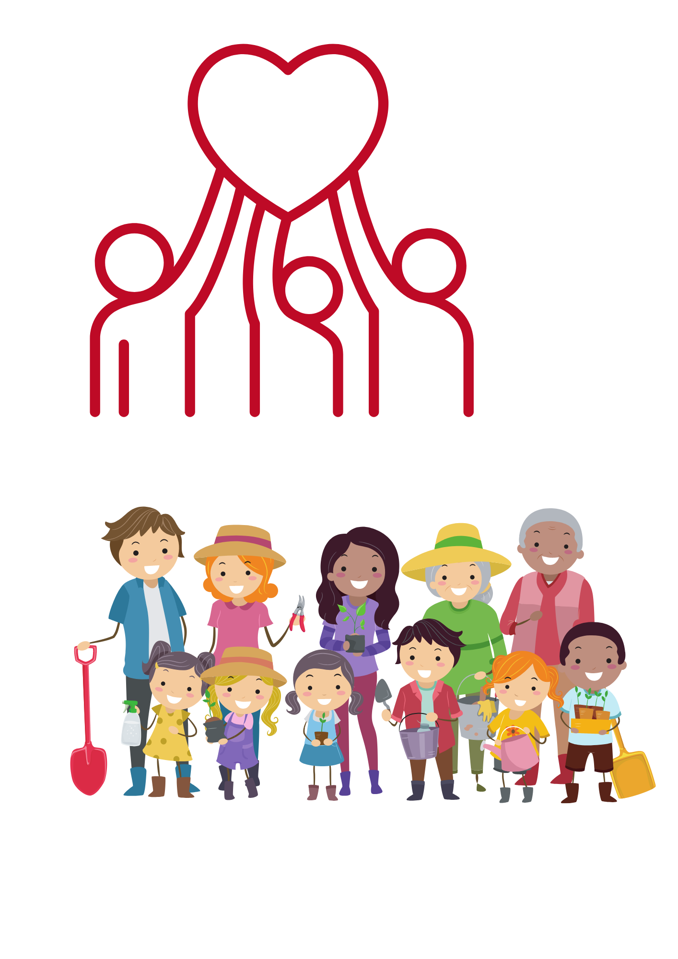
Community and Participation
As Christians, we are called to live in community with one another.
This means loving and taking care of those around us.

Slide 8
Community and Participation
We need to remember the dignity of all people and support one another.
We are called to look out for those around us and help them however we can.
We also need to use our gifts and talents to help others!

Slide 9

Community and Participation
‘Love one another: just as I have loved you ... By this all people will know that you are my disciples.’
John 13:34-35

Slide 10
Community and Participation
‘Lord, when was it that we saw you hungry and gave you food, or thirsty and gave you something to drink? And when was it that we saw you a stranger and welcomed you, or naked and gave you clothing? And when was it that we saw you sick or in prison and visited you?”
And the King will answer them: “Truly I tell you, just as you did it to one of the least of these who are members of my family, you did it to me.”’
Matthew 25:31-46

Slide 11
Community and Participation
‘You shall love the Lord your God with all your heart, and with all your soul, and with all your mind. This is the first and great commandment. And the second is you shall love your neighbour as yourself.’
Matthew 22:37-39
Who is your neighbour?

Slide 12

Main Activity
Think about your talents and skills.
Think about your school community and local area.
How could you use your talents to make your class, school and local communities better places?
How could you show God’s love to those around you?
Create some art (draw a picture, write a poem, compose a song) to show your ideas.

Slide 13
Plenary
‘Carry each other’s burdens, and in this way you will fulfil the law of Christ.’
Galatians 6:2
What do you think it means to ‘carry each other’s burdens’?
How does this relate to ‘Community and Participation’?

