Slide 1



Community and Participation
UKS2

Slide 2


Starter
‘For where two or three gather in my name, there am I with them.’
Matthew 18:20
What do you think Jesus meant by this?
Notes:
Talk partners for 3 minutes
Gather responses

Slide 3
Starter
As humans, we are meant to live in community.
How would you explain what a ‘community’ is?
Notes:
Talk partners for 3 minutes
Gather responses

Slide 4







Catholic Social Teaching

Slide 5






Catholic Social Teaching

Slide 6
Community and Participation
A community is group of people who live, work or otherwise spend time together.
What communities are you a part of?

Slide 7
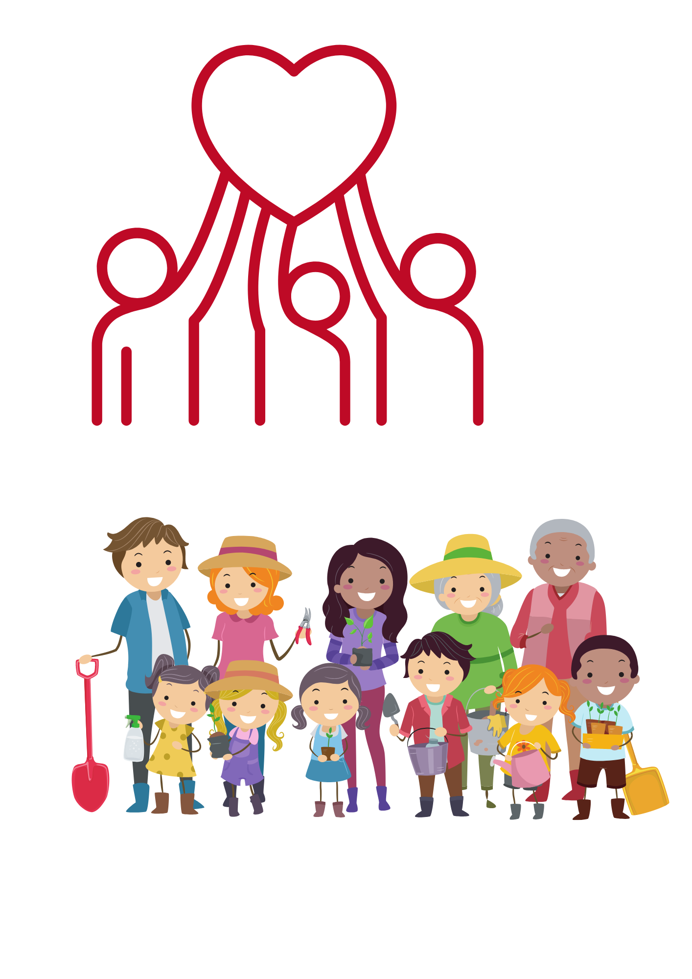
Community and Participation
As Christians, we are called to live in community with one another.
This means being active members of the world we live in.

Slide 8
Community and Participation
We need to remember the dignity of all people, support one another and recognise how our gifts and talents could be used to help others!
We are called to look out for those around us and help them however we can.

Slide 9

Community and Participation
‘Love one another: just as I have loved you ... By this all people will know that you are my disciples.’
John 13:34-35

Slide 10
Community and Participation
‘You shall love the Lord your God with all your heart, and with all your soul, and with all your mind. This is the first and great commandment. And the second is you shall love your neighbour as yourself.’
Matthew 22:37-39
Who is your neighbour?

Slide 11
Community and Participation
‘Lord, when was it that we saw you hungry and gave you food, or thirsty and gave you something to drink? And when was it that we saw you a stranger and welcomed you, or naked and gave you clothing? And when was it that we saw you sick or in prison and visited you?”
And the King will answer them: “Truly I tell you, just as you did it to one of the least of these who are members of my family, you did it to me.”’
Matthew 25:31-46

Slide 12
Community and Participation
‘Don’t be observers, but immerse yourself in the reality of life, as Jesus did.’
Pope Francis, World Youth Day, 2013
What do you think Pope Francis meant by ‘immerse yourself in life’?

Slide 13

Main Activity
Research a charity that helps the community in your local area and write about them.
Think about:
How do they help the community?
Why do they do what they do?
What could people in your community do to support the charity?

Slide 14
Plenary
‘Carry each other’s burdens, and in this way you will fulfil the law of Christ.’
Galatians 6:2
What do you think it means to ‘carry each other’s burdens’?
How could you support the people in your school or class community?
How would your ideas improve your school community?

