Slide 1



Community and Participation
Collective Acts of Worship

Slide 2
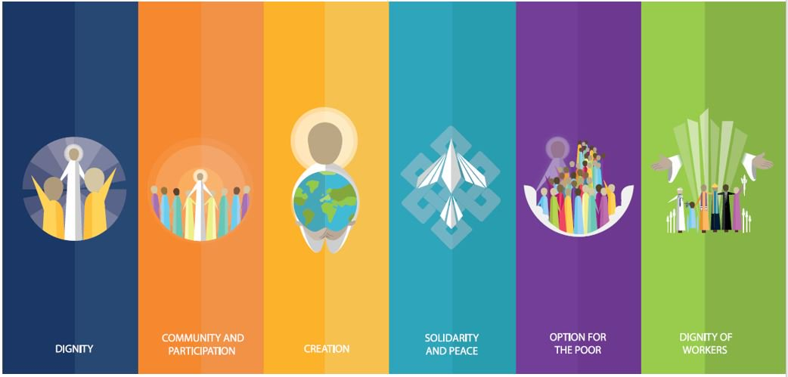

Starter

Slide 3






Catholic Social Teaching

Slide 4
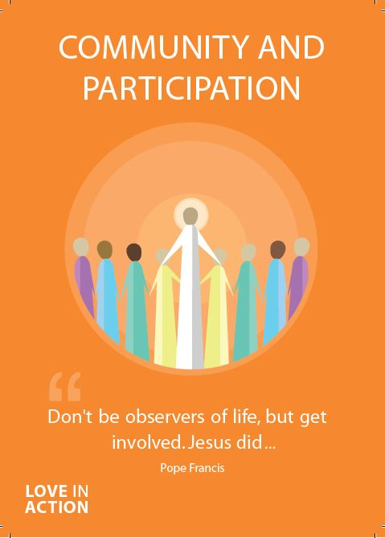
Community and Participation
As humans, we are made to live in community with one another.
This means being active members of the world we live in.
We are meant to look out for each other and build each other up.
This is how God wants us to live.

Slide 5
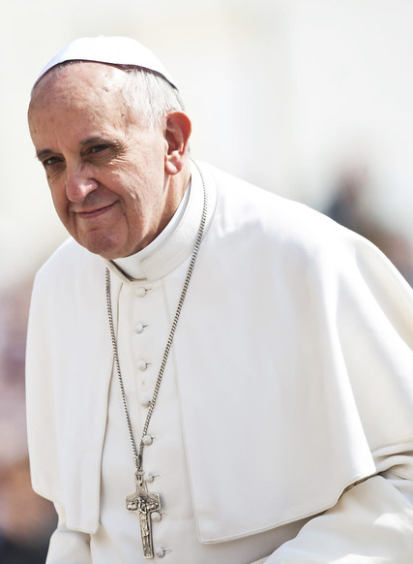
Community and Participation
‘Do we open ourselves to the Holy Spirit, so as to be an active part of our communities, or do we close in on ourselves, saying 'I have so many things to do, that's not my job’?’
Pope Francis​

Slide 6
Community and Participation
Living in community with others is more than simply living near people.
We need to recognise the dignity in other people and treat them as such.
We are also called to recognise our own gifts and talents and use them to make our communities better!

Slide 7
Community and Participation
Think of a time when you felt supported by the people in your community.
What did they do that made you feel that way?
What could you do to make other people feel supported by you?

Slide 8

Community and Participation
Let us now listen to the Word of God.

Slide 9
Community and Participation
Read through one of more of the bible passages on the next few slides.
As a class, think about and discuss the meaning of each.​
How do the passages relate to Community and Participation?

Slide 10
Community and Participation
‘Love one another: just as I have loved you ... By this all people will know that you are my disciples.’
John 13:34-35

Slide 11
Community and Participation
‘You shall love the Lord your God with all your heart, and with all your soul, and with all your mind. This is the first and great commandment. And the second is you shall love your neighbour as yourself.’
Matthew 22:37-39

Slide 12
Community and Participation
‘Don’t be observers, but immerse yourself in the reality of life, as Jesus did.’
Pope Francis, World Youth Day, 2013

Slide 13
Community and Participation
What do these bible passages and quote from Pope Francis tell you about how we should live in community?
How do we know that God wants us to act in this way?

Slide 14

Community and Participation
“I think that…”
Notes:
Holding slide for discussion/feedback if required.

Slide 15
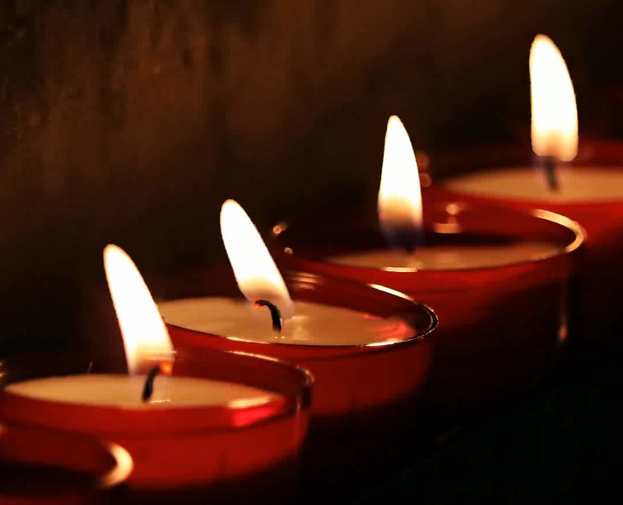
Community and Participation
Let Us Pray…

Slide 16
Community and Participation
Loving God,
We come together to thank you for our communities. You created us to live with each other and show Your love to those in need.
Let us give thanks for the joy that our communities bring us and ask You to help us make our communities better.

Slide 17
Community and Participation
We pray for those who do not feel a part of their communities.
O God, help us to show love to those who feel unloved.

Slide 18
Community and Participation
We pray for those who do not know how to ask for help.
O God, help us to reach out our hands to those in need.

Slide 19
Community and Participation
We pray that everyone feels comfortable, supported and loved in our communities.
O God, help us to spread Your love.

Slide 20
Community and Participation
We pray that we may be able to make our communities better places for all who live in them.
O God, help us to use the gifts You gave us for the benefit of others.

Slide 21
Community and Participation
Amen

Slide 22
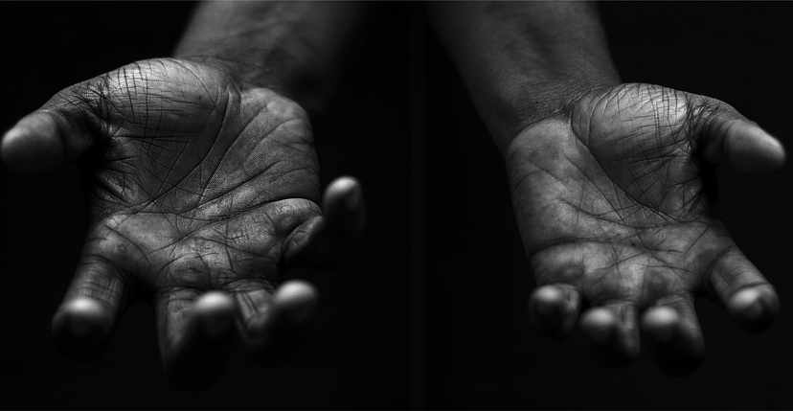
Community and Participation
Your Mission
Notes:
Using the Prayer Toolkit model, the mission ‘tasks’ on the following slide can be amended or supplemented as required.

Slide 23
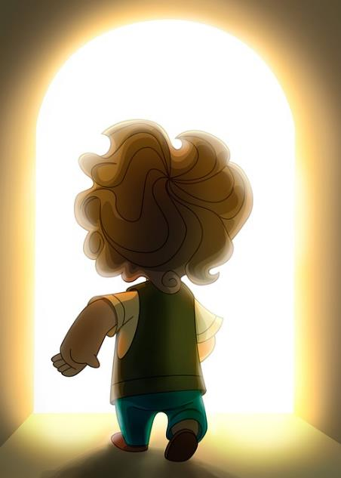
Community and Participation
Find out more about St Vincent de Paul.
Think about what you could do to support those in need in your community during Lent.
Research:
Fairtrade Fortnight
CAFOD Family Fast Day (3rd March).

Slide 24
Care of Creation

