Slide 1
Dignity
LKS2

Slide 2
Starter
Talk Partners:
Who is important?
Notes:
Talk partners for 3 minutes
Gather responses

Slide 3
Starter
Was this a good activity to do?
How would it feel to be treated as less important than someone else?
Notes:
Talk partners for 3 minutes
Gather responses

Slide 4
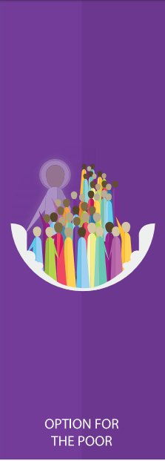
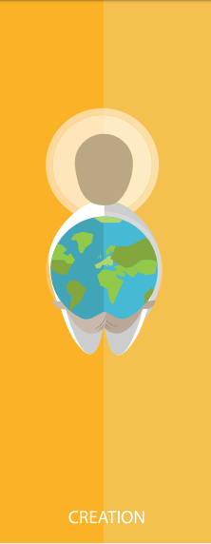
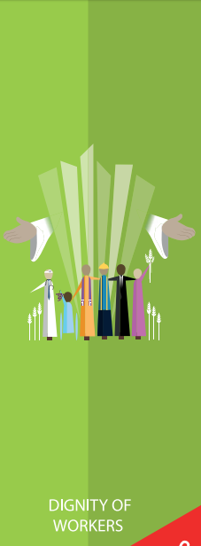
Catholic Social Teaching

Slide 5
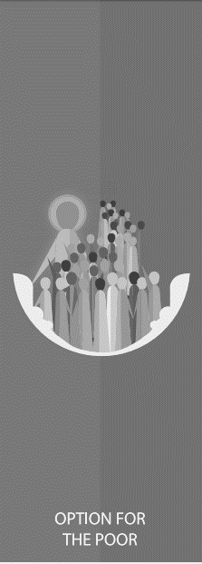
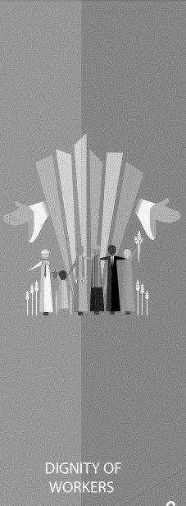
Catholic Social Teaching

Slide 6
Dignity
Treating someone with dignity means treating them with love, kindness and fairness.
Everyone should be treated with dignity because God made and loves everyone.
Notes:
Talk partners for 3 minutes
Gather responses

Slide 7
Dignity
Talk partners:
Why should we treat everyone with dignity?
What does treating everyone with dignity look like?

Slide 8
Dignity
‘So God created humankind in his own image, in the image of God he created them; male and female he created them.
…
God saw all that he had made, and it was very good.’
Genesis 1:27

Slide 9
Dignity
‘Every person is immensely holy and deserves our love.’
Pope Francis, Joy of the Gospel

Slide 10
Dignity
‘”You shall love your neighbour as yourself.” There is no commandment greater than this.’
Mark 12:31

Slide 11
Dignity
Think about the quotes on the previous slides.
What do they tell us about God’s plan for us?
How do they teach us how to live our lives?

Slide 12
Dignity
We’re going to read through this poem together.

Slide 13
Dignity
Everyone has different gifts and talents.
We are amazing, just the way God made us.
We are all extraordinary, just the way we are.
It is important to remember that those around us have special gifts and talents too.

Slide 14
Dignity
Why is it important to remember that everyone is better than OK?
What does that tell us about how we should treat everyone?

Slide 15
Main Activity
Use what you’ve learnt today to write your own I am Better Than OK poem.
Remember to;
Include the special talents you are proud of
Ask your friends and talk partner for help

Slide 16
Plenary
Think about the bible passages we read today and answer the questions:
How do we know that we should treat everyone with equal dignity?
What could you do to show the people around you God’s love?

