Slide 1
Dignity of Workers
KS1

Slide 2
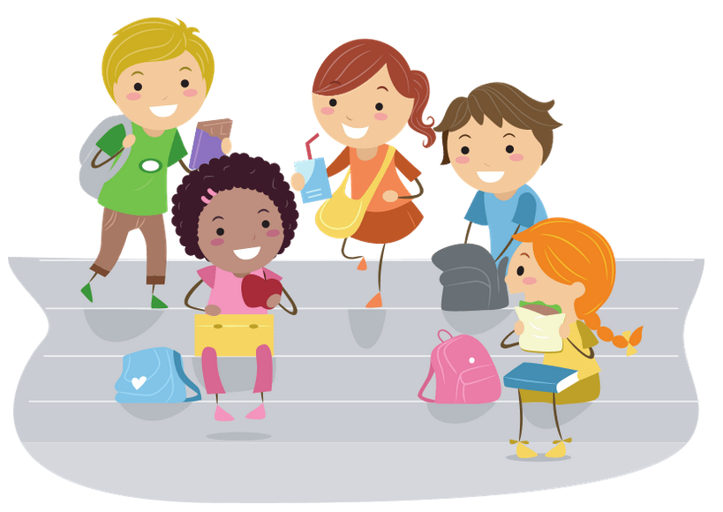
Starter
How would you feel if you weren’t allowed to have break time or lunch time?
Notes:
Talk partners for 3 minutes
Gather responses
Discuss why not having a break would be ‘unfair’ and what makes it ‘unfair’

Slide 3
Dignity of Workers
Notes:
These are all the Catholic Teaching Principles

Slide 4
Title
Notes:
This is the CST principle we will be learning about today: Dignity of Workers

Slide 5
Dignity of Workers
Being treated with Dignity means being treated fairly.

Slide 6
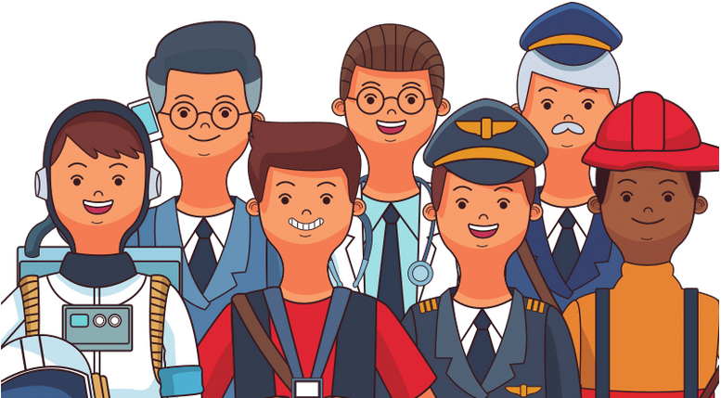
Dignity of Workers
When you grow up, you might want to have a job.
It’s important for your job to be fair to you.

Slide 7
Dignity of Workers
Which of these things do you think are fair?
Being given enough money
Not allowed to go to the toilet
Being allowed to rest if you’re poorly
Not being allowed to go on holiday
Being allowed to have lunch
Notes:
Read through them one-by-one and decide as a class.

Slide 8
Dignity of Workers
God loves everyone!
He wants everyone to feel loved and respected.
That means everyone should feel loved and respected at their job too!

Slide 9
Dignity of Workers
Enough money
Time off to go on holiday
Time off to get better when you are poorly
Break time
Not made to work too long or too hard
Knowing when you’re meant to work
Not being fired unfairly
Notes:
Add any others that the students thought of

Slide 10
Dignity of Workers
Have you seen this picture before?
You might have seen it at the supermarket.
Can you remember what foods you have seen it on?
Can you see two smaller words in this word?
What might it mean?

Slide 11
Dignity of Workers
Some people don’t get enough money for the work they do.
This is not fair.
Foods with the Fairtrade sticker on them mean that the people who made the food were given a fair amount of money.

Slide 12
Dignity of Workers

Slide 13
Main Activity
What do you want to be when you grow up?
Draw a picture of yourself, as a grown up, doing your job.
Then complete the sentences given to you by your teacher.

Slide 14
Plenary
What are the ‘Top 3 Fair Things’?
How can we promote/support fairness/dignity in school?
How can support fairness/dignity at home?

