Slide 1



Dignity of Workers
UKS2
Notes:
Teachers’ note: this session talks about ‘most’ adults having a job. Please consider whether this is appropriate for your class. Please be mindful of class demographics: children whose parents are unemployed, poorly treated by their place of work, etc.

Slide 2


Starter
Talk Partners:
What do you think the word ‘dignity’ means?
Notes:
Talk partners for 3 minutes
Gather responses

Slide 3
Starter
Treating someone with dignity means treating them with love, kindness and fairness.
Everyone should be treated with dignity because everyone is made in God’s image.
Notes:
Talk partners for 3 minutes
Gather responses

Slide 4





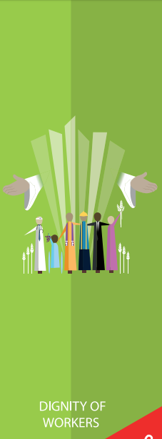

Dignity of Workers
Notes:
These are all the Catholic Teaching Principles

Slide 5






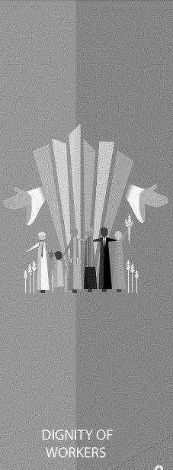


Title
Notes:
This is the CST principle we will be learning about today: Dignity of Workers

Slide 6
Dignity of Workers
Most people will have a job at some point in their lives.
Work is more than simply being able to earn money. It is about being able to support ourselves and our families.
Notes:
U6.5.5. Describe and explain, with examples, the different ways in which Christians’ bear witness to their beliefs now and in the past and make links with the life of a saint.
U6.5.6. Describe how one charity studied witnesses its Christian faith through its work.
R6.5.3. Reflecting on how the work of charities can support people facing injustice or persecution.
D6.6.1. Reflecting on the statement “Everyone should be concerned to create and support institutions that improve the conditions of human life” (CCC 1926). Consider how this challenges people to change.
D6.6.2. Considering the term ‘common good’, discuss why charities with different worldviews work to promote the same goals.

Slide 7
Dignity of Workers
Dignity of Workers is about everyone finding a role in society, finding something they are good at, and feeling important and needed because of that.
Why might this be important?

Slide 8

Dignity of Workers
‘Out of the ground, the Lord God caused to grow every tree that is pleasing to the sight and good for food . . . . Then the Lord God took the man and put him into the garden of Eden to work it and keep it’
Genesis 2:9,15
Notes:
Discuss the use of the word ‘man’. How does this show that times have changed?

Slide 9
Dignity of Workers
‘By the seventh day God had finished the work he had been doing; so on the seventh day he rested from all his work. Then God blessed the seventh day and made it holy, because on it he rested from all the work of creating that he had done.’
Genesis 2:2-3

Slide 10
Dignity of Workers
Dignity of Workers is also about making sure that people’s dignity is respected in work.
What things do you think everyone should have in their jobs?

Slide 11
Dignity of Workers
What things do you think everyone should have in their jobs?
In order to answer this question, we’re going to learn some history!

Slide 12
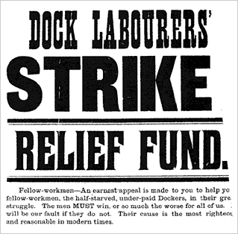
Dock Workers’ Strike, 1889
Today, there are laws in place to make sure people have a safe and fair place to work but in the 1800s, this wasn’t the case.
Bosses could be cruel. They didn’t pay their workers fairly; made people work in dangerous conditions; didn’t give them a steady job; didn’t allow them time off to rest, and would fire them if they had to take time off sick.

Slide 13
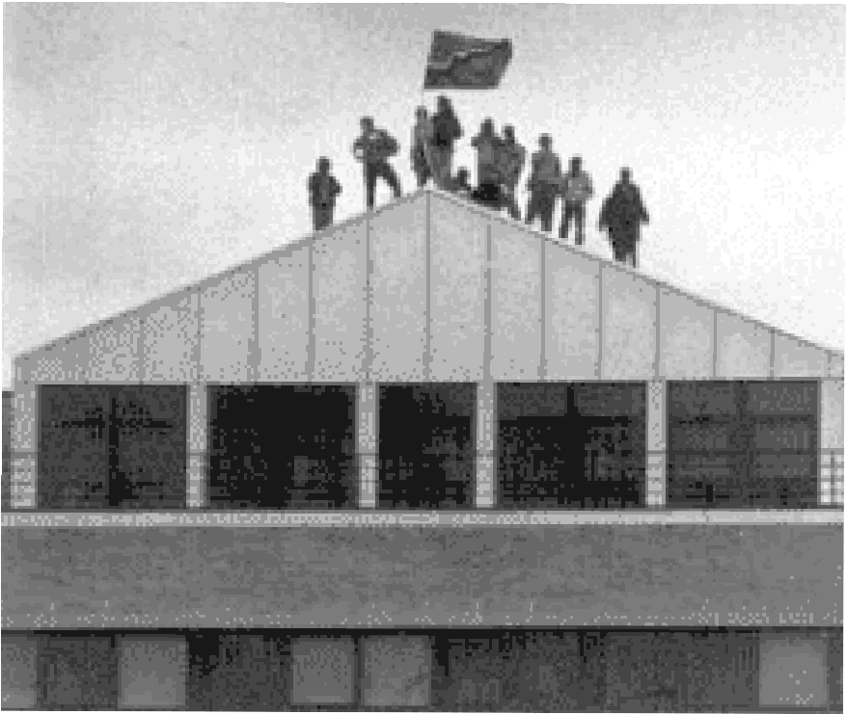
Dock Workers’ Strike, 1889
In 1889, 100,000 London Dock workers went on strike because of this.
They wanted a fair wage of 6 pence an hour and proper working contracts so people knew when they would be working and how much they would earn.
Notes:
Why did the dock workers feel it was necessary for them to go on strike?

Slide 14
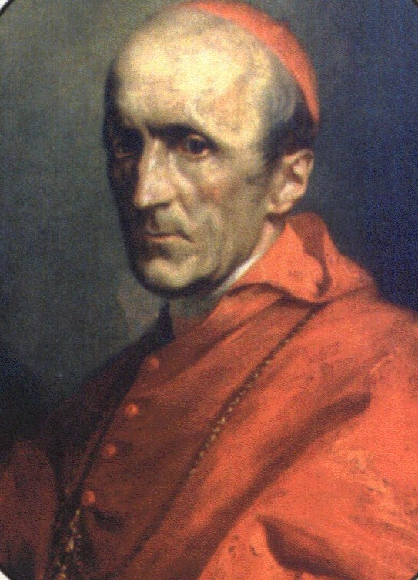
Dock Workers’ Strike, 1889
Cardinal Manning, the Archbishop of Westminster at the time, decided to support the dock workers and spoke up for them.
The Dockers won their strike and were allowed to protect their working conditions.
This led to the Pope writing a letter defending workers’ rights. His letter told governments to protect the rights of workers and told the Catholic Church to support the workers and respect their dignity .
Notes:
This was a lengthy process
Schools in London may wish to refer to how close the Docklands are to their school to local contextualisation
Rerum Novarum – birth of CST

Slide 15
Think Again
What things do you think give people dignity in their work?
Think about what the Dock Workers fought for.
Notes:
Gather responses before next slide

Slide 16
Dignity of Workers
Which of these contribute to the dignity of workers:
Fair wage
Free pizza
Time off to rest
Time off to recover from illness
Breaks during the work day
No toilet breaks
Limit on the time you’re expected to work
Knowing when you’re working
Insulted by your employer
Not being fired without a good reason

Slide 17
Dignity of Workers
Not everyone in the world has their dignity respected at work.
What could we do to support and advocate for them?
Notes:
What does ‘advocate’ mean?

Slide 18

Dignity of Workers
Around the world, farmers and farm workers are not paid a fair wage for the work they put in.
The Fairtrade Foundation works to combat this.
Notes:
Although most people in the UK have fair working conditions, there are a lot of people around the world who do not.
This is especially true for farmers and farm workers in Developing Countries who very rarely get a fair wage for the hard work they put in.
Most of the money from certain products (such as bananas and cocoa) goes to the supermarket owners rather than the people who grew and harvested the products
The Fairtrade Foundation was set up in 1992 to promote Fairtrade products in the UK

Slide 19
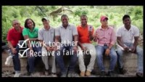
Dignity of Workers
Notes:
Although most people in the UK have fair working conditions, there are a lot of people around the world who do not.
This is especially true for farmers and farm workers in Developing Countries who very rarely get a fair wage for the hard work they put in.
Most of the money from certain products (such as bananas and cocoa) goes to the supermarket owners rather than the people who grew and harvested the products
The Fairtrade Foundation was set up in 1992 to promote Fairtrade products in the UK

Slide 20

Dignity of Workers
Notes:
Although most people in the UK have fair working conditions, there are a lot of people around the world who do not.
This is especially true for farmers and farm workers in Developing Countries who very rarely get a fair wage for the hard work they put in.
Most of the money from certain products (such as bananas and cocoa) goes to the supermarket owners rather than the people who grew and harvested the products
The Fairtrade Foundation was set up in 1992 to promote Fairtrade products in the UK

Slide 21
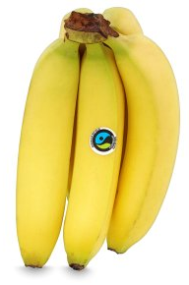
Dignity of Workers
Fairtrade products are often slightly more expensive than regular products.
This slight additional cost means that more money can go to the workers in Developing Countries who are usually paid significantly less for their work.
How would everyone committing to buying Fairtrade products help towards The Common Good?

Slide 22

Main Activity
Write a letter to the headteacher explaining why our school should use Fairtrade products as much as possible.
Use what you have learnt about Catholic Social Teaching to explain your reasoning.

Slide 23
Plenary
‘The hardworking farmer should be the first to receive a share of the crops.’
2 Timothy 2:6
What does this quote from the bible mean?
How does it argue for fair wages?

