Slide 1



Preferential Option for the Poor
UKS2

Slide 2



Starter
Fair Share Game
Notes:
You will need 10 paper money notes from the resource pack
Ask for 10 volunteers to stand in a line. This line represents the entire population of the UK. These 10 notes represent all of the wealth of the UK, so each one represents 10% of UK wealth.
Ask the group how the wealth should be divided up amongst the group and pass out the money. Why?
Then ask how they think it is divided up and redistribute the money. Why?
Then show them how it is actually divided:
4 people get 1 note to share between them (10% of UK wealth between 40% of people)
2 people get 1 note to share between them (10% of UK wealth between 20% of people)
2 people get 2 notes each (20% of UK wealth between 20% of people)
1 person gets 2 notes(20% of UK wealth between 10% of people)
1 person gets 4 notes (40% of UK wealth between 10% of people)

Slide 3
Starter
This is how the money in the UK is shared out – how does that make you feel?
Do you think this is fair?
How would you feel if you had to share one note with four other people?

Slide 4

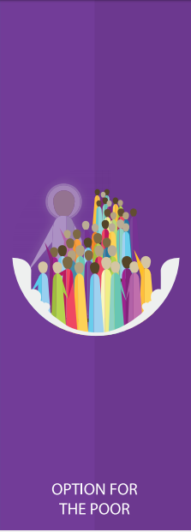





Catholic Social Teaching

Slide 5

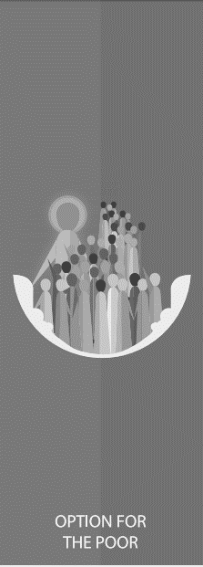





Catholic Social Teaching

Slide 6
Preferential Option for the Poor
What might the word ‘preferential’ mean?
What might it mean to give someone the ‘preferential option’?

Slide 7
Preferential Option for the Poor
The ‘preferential option’ means allowing someone to have the first choice. It means giving someone the best that is available; not just the scraps or leftovers.
Why is it important to give those in need the preferential option?

Slide 8

Preferential Option for the Poor
In the Gospels, Jesus shows a preferential option for the poor by putting them first. He gives them special importance by thinking of their needs and helping them have their rightful place in the world.

Slide 9
Preferential Option for the Poor
As Christians, we believe that those in need deserve the best.
This is because of everyone’s inherent dignity.
It is important that we advocate for those in need by listening to what they have to say and speaking up for them.

Slide 10
Preferential Option for the Poor
"If anyone is well off in worldly possessions and sees their sister or brother in need but closes their heart to them, how can the love of God be remaining in them?”
1 John 3.17-18

Slide 11
Preferential Option for the Poor
‘Looking at his disciples, he said: ‘Blessed are you who are poor, for yours is the kingdom of God. Blessed are you who hunger now, for you will be satisfied. Blessed are you who weep now, for you will laugh.’’
Luke 6:20-21

Slide 12
Preferential Option for the Poor
‘Speak up for those who cannot speak for themselves, for the rights of all who are destitute. Speak up and judge fairly; defend the rights of the poor and needy.’
Proverbs 31:8-9
Why are we called to advocate for those in need?

Slide 13

Preferential Option for the Poor

Slide 14

Preferential Option for the Poor
Caritas Westminster runs an Advent Giving Calendar every year to help people collect for their local food banks and homeless shelters.
How does the Advent Giving Calendar show a ‘preferential option for the poor’?

Slide 15

Main Activity
Write a piece that could be included in your school’s newsletter to encourage people to collect things for charity over Advent.
Think about including:
A list of suggestions (similar to the Caritas Advent Giving Calendar)
What the Bible tells us about giving to those in need
How this would offer a preferential option for the poor

Slide 16
Plenary
‘If anyone is well off in worldly possessions and sees their sister or brother in need but closes their heart to them, how can the love of God be remaining in them?’
1 John 3.17-18
Explain what you think is meant by this.

