Slide 1
Dear Lord,
As we start this topic, learning about love, and how it can flourish and sustains relationships, calling couples to come together as one in marriage - give us the gift of understanding and wisdom so we can learn and grow together.
We thank God for the beauty of love and the ability to love that God has provided us with.
Amen

Slide 2
The Call
Learning Objectives:
Know how we are made to love.
Understand what love is.
Investigate the opportunities and challenges of love in the modern world.

Slide 3
Starter​
Learned behaviour?
Think-Pair-Share​
God-given?
Why do humans
love?
Sexual desire?
Tradition?
Emotional connection craving?
Natural? The heart wants what it wants?
Need to fit in?
Bored?

Slide 4
Stretch &​
Challenge​
Out of the reasons
you have picked, which one would be the most ‘popular’
and which would be the most ‘controversial’?​

Slide 5
Read​
^{Genesis 1}
²⁶ Then God said, “And now we will make human beings; they will be like us and resemble us. They will have power over the fish, the birds, and all animals, domestic and wild, large and small.” ²⁷ So God created human beings, making them to be like himself. He created them male and female, ²⁸ blessed them, and said, “Have many children, so that your descendants will live all over the earth and bring it under their control.
Consider &
Answer
What does ’making them to be like himself’ mean?
Key Vocabulary:
Imago Dei – humans are able to know what is right and wrong and act upon this as God made humans in his image​
LO: Know how we are made to love.

Slide 6
Humans do not obtain the traditional attributes of the God of classical theism. Humans cannot be omnipotent, omniscient and omnipresent this is because they are simply not God and those words are words to describe God.
However, we are able to do as God does when it comes to love. Humans love because they were made to and for love.
Use this explanation to develop
your answer

Slide 7
Scripture​
Think-Pair-Share​
Answer
Humans are able to love because within them, given by God, they have the ability to incapsulate God’s love for them and share with others.
Remember, there are lots of different ways to show love as the Sacred Scripture shows love manifests in many different ways and almost always includes a form of sacrifice.
1. With your partner, name as many accounts as you can from the Bible that show love.
2. What different sacrifices can be seen in these acts of love?
LO: Know how we are made to love.

Slide 8
Watch​
Focus &
Listen
What Is Love?
LO: Know how we are made to love.
Notes:
https://www.youtube.com/watch?v=9tVkWYv484Y – Will Smith, what is love?
Students to brainstorm why humans love – this is to start a discussion and feed into what is love. The lesson deliberately does not start with ‘what is love’ because the aim is to highlight the range of ‘love’ young people are open to in today’s world.

Slide 9
So what is love?
LO: Understand what love is.

Slide 10
Where do we find love like this in the world?
LO: Understand what love is.

Slide 11
Scripture​
^{1 Corinthians 13: 4-7}
⁴ Love is patient and kind; it is not jealous or conceited or proud; ⁵ love is not ill-mannered or selfish or irritable;
love does not keep a record of wrongs;
⁶ love is not happy with evil, but is happy with the truth. ⁷ Love never gives up; and its faith, hope, and patience never fail.
Consider &
Answer
1. What could the word ‘love’ be changed to in
this passage?
2. Give examples of people who are like St Paul’s
description of love.
3. Give examples of ways in which the opposites of love are open to young people today.
4. What challenges might young people have when it comes to patience, kindness, truth and hope?
LO: Know how we are made to love.

Slide 12
Discuss how the different descriptions of love in 1 Corinthians 13 fit in with modern day society.
Give examples of how every day actions can show the different descriptions of love using the table in your booklet.

Slide 13
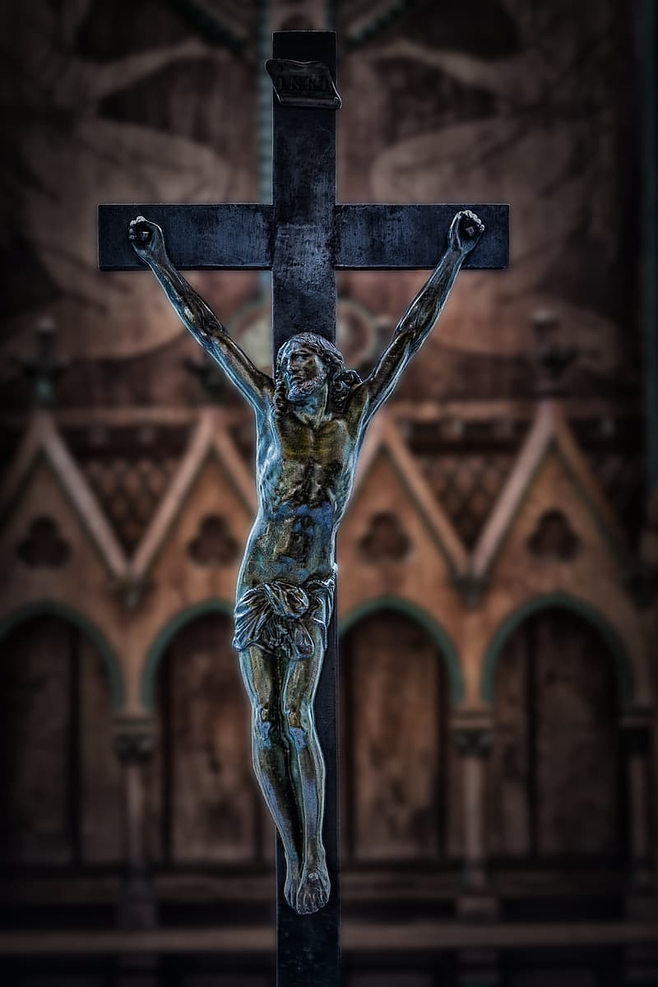
The ultimate act of love, as shown by Jesus at the crucifixion, is the sacrifice of one’s life.
When analyzing different loving relationships, sacrifice takes place in different way.
Think about the relationships
you and those
around you are a part of.
What sacrifices are made?
LO: Understand what love is.

Slide 14
1. How can you make a sacrifice for others in today’s world?
Opportunities -
2. What stops humans being able to sacrifice for others?
Challenges -
3. Do you think it is reasonable to truly sacrifice oneself for another in the busy, modern world?
If we understand love as
sacrifice...
LO: Evaluate how reasonable love is in the modern day.

Slide 15
Plenary​
Discuss these questions:
How are we created to love?
What is love?
What are the opportunities and challenges of love in the modern world?
Why was this lesson called ‘The Call?’

