Slide 1
Dear Lord, Thank you for the gift of forgiveness and the ability to sustain love in all the ways you have shown. We ask for the strength and courage to understand the journey of a marriage and to accept that with love, anything is possible. Amen

Slide 2
Love Remains
Learning Objectives:
Know how the Church responds to some of the challenges to families today.
Understand love’s role within families and how it sustains.
Investigate the development of divorce in the past century.

Slide 3
Starter​
Think-Pair-Share
& Watch​
1. Before watching the clip, what do you think the secret to a long and happy marriage is?
2. Discuss as a class and share views – what is the most popular view?
3. Watch the clip – how far do you agree with Annie and Dodie’s view on the secret to longevity?
4. If you could ask Annie and Dodie two questions about their married life, what would they be?
Notes:
Teacher to remind and reflect students on the basis of marriage being life-long.
https://www.youtube.com/watch?v=ZkJqRNtnR04
Highlight the link between Dodie and Annie’s lack of money for a Church wedding and the Marriage vs Wedding lesson 3 earlier in scheme of work.
The questions from [d] can also be fed back to the ‘Talk’ session with the couple coming in to school.

Slide 4
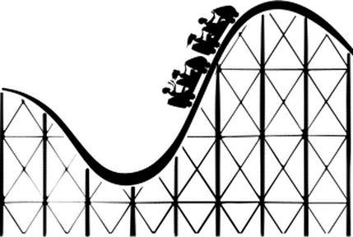
Discuss​
“…for better or worse…”
Consider &
Answer
The Catholic marriage vows reflect the purposes of marriage. Life-long being unbreakable and indissoluble in the eyes of God.
When looking at the vow: “…for better or worse…”; what do you think could be the ‘better’ and the ‘worse’ parts of life as a married couple?
Think-pair-share different examples of both and add to the table.
Better | Worse
LO: Know how the Church responds to some of the challenges to families today.
Notes:
This activity is to prepare for activity 2 – thinking about the challenges a couple may have in their lifetime. This discussion should be detailed and student-led. Examples of S&C answers would be – new jobs, a new job is usually seen as a good thing for a person but it can place extra pressure on a family eg. training to teach or training to become a doctor. Could also discuss pay progression and roles within the household.
Life is a rollercoaster – as is a life long relationship with ups and downs.

Slide 5
Stretch &​
Challenge​
Are there any
times when the ‘better’ can make a marriage harder?
Notes:
Examples of S&C answers would be – new jobs, a new job is usually seen as a good thing for a person but it can place extra pressure on a family eg. training to teach or training to become a doctor. Could also discuss pay progression and roles within the household.

Slide 6
Discuss​
Consider &
Answer
1. What thoughts does this image evoke?
2. What might be seen as the ‘light in the darkness’ in a marriage?
LO: Know how the Church responds to some of the challenges to families today.
Notes:
This activity should enable the students to think about realistic solutions to challenging situations. Leaning not just on the other people in the family but also those who have a pastoral duty within the Church.
Teacher has the opportunity to use the ready-made case studies or students create their own challenging circumstances.

Slide 7
The Catholic Church teaches that love sustains all and marriage is indissoluble. This is important when reflecting on life-long marriages. There are numerous challenges families will face in their life-time together.
When times are challenging, the Church asks the community to support those couples and families who may be struggling to stay together. Everything should be done to keep a family together. This includes counselling both individually and as a family. The embedding of mercy within relationships, strengthened by the Sacrament of Reconciliation is also important within Catholic marriages.
In extenuating circumstances, the Church supports a separation of a marriage. This would be in the case of sustained physical or mental abuse. Separation should be the final resort. Due to marriage being in-dissolvable divorce is not recognised in the Catholic Church.
Read​
& Consider
LO: Know how the Church responds to some of the challenges to families today.
Notes:
This activity should enable the students to think about realistic solutions to challenging situations. Leaning not just on the other people in the family but also those who have a pastoral duty within the Church.
Teacher has the opportunity to use the ready-made case studies or students create their own challenging circumstances.

Slide 8
Read​
The Catholic Church teaches that love sustains all. This is important when reflecting on life-long marriages. There are numerous challenges families will face in their life time together.
When times are challenging, the Church asks the community to support those couples and families who may be struggling to stay together. Everything should be done to keep a family together. This includes counselling both individually and as a family. The embedding of mercy within relationships, strengthened by the Sacrament of Reconciliation is also important within Catholic marriages.
In extenuating circumstances, the Church supports a separation of a marriage. This would be in the case of sustained physical or mental abuse. Separation should be the final resort. Due to marriage being in-dissolvable divorce is not recognised in the Catholic Church.
In pairs/groups, read through the couple case studies. There is space to create your own examples for couples E and F.
For each couple, discuss how the couple can overcome their issues in light of Church teaching. What do you think the couple should do? Complete the table in your booklet.
Consider &
Answer
Couple A:
Wife and husband are both very successful in their music careers. They have three children together and have been married a number of years. Rumours swell within their friendship groups and on social media that the husband has had multiple affairs with different women. The wife is unsure at what to do.
LO: Know how the Church responds to some of the challenges to families today.
Notes:
This activity should enable the students to think about realistic solutions to challenging situations. Leaning not just on the other people in the family but also those who have a pastoral duty within the Church.
Teacher has the opportunity to use the ready-made case studies or students create their own challenging circumstances.

Slide 9
Read​
The Catholic Church teaches that love sustains all. This is important when reflecting on life-long marriages. There are numerous challenges families will face in their life time together.
When times are challenging, the Church asks the community to support those couples and families who may be struggling to stay together. Everything should be done to keep a family together. This includes counselling both individually and as a family. The embedding of mercy within relationships, strengthened by the Sacrament of Reconciliation is also important within Catholic marriages.
In extenuating circumstances, the Church supports a separation of a marriage. This would be in the case of sustained physical or mental abuse. Separation should be the final resort. Due to marriage being in-dissolvable divorce is not recognised in the Catholic Church.
For each couple, discuss how the couple can overcome their issues in light of Church teaching. What do you think the couple should do? Complete the table in your booklet.
Consider &
Answer
Couple B:
Wife and husband are newlyweds. They are both Catholic and have been married for just under six months, moved in together after they were married and have been trying to have a baby. They have been unsuccessful so far. The couple are unsure about what they should do next.
LO: Know how the Church responds to some of the challenges to families today.
Notes:
This activity should enable the students to think about realistic solutions to challenging situations. Leaning not just on the other people in the family but also those who have a pastoral duty within the Church.
Teacher has the opportunity to use the ready-made case studies or students create their own challenging circumstances.

Slide 10
Read​
The Catholic Church teaches that love sustains all. This is important when reflecting on life-long marriages. There are numerous challenges families will face in their life time together.
When times are challenging, the Church asks the community to support those couples and families who may be struggling to stay together. Everything should be done to keep a family together. This includes counselling both individually and as a family. The embedding of mercy within relationships, strengthened by the Sacrament of Reconciliation is also important within Catholic marriages.
In extenuating circumstances, the Church supports a separation of a marriage. This would be in the case of sustained physical or mental abuse. Separation should be the final resort. Due to marriage being in-dissolvable divorce is not recognised in the Catholic Church.
For each couple, discuss how the couple can overcome their issues in light of Church teaching. What do you think the couple should do? Complete the table in your booklet.
Consider &
Answer
Couple C:
Wife and husband have been married for many years. The couple have four children who are all in their twenties. The husband is diagnosed with cancer and is told he will have to have long and gruelling treatment that cannot definitely cure him. The treatment he has been taking has made him irritable and both husband and wife have been arguing a lot.
LO: Know how the Church responds to some of the challenges to families today.
Notes:
This activity should enable the students to think about realistic solutions to challenging situations. Leaning not just on the other people in the family but also those who have a pastoral duty within the Church.
Teacher has the opportunity to use the ready-made case studies or students create their own challenging circumstances.

Slide 11
Read​
The Catholic Church teaches that love sustains all. This is important when reflecting on life-long marriages. There are numerous challenges families will face in their life time together.
When times are challenging, the Church asks the community to support those couples and families who may be struggling to stay together. Everything should be done to keep a family together. This includes counselling both individually and as a family. The embedding of mercy within relationships, strengthened by the Sacrament of Reconciliation is also important within Catholic marriages.
In extenuating circumstances, the Church supports a separation of a marriage. This would be in the case of sustained physical or mental abuse. Separation should be the final resort. Due to marriage being in-dissolvable divorce is not recognised in the Catholic Church.
For each couple, discuss how the couple can overcome their issues in light of Church teaching. What do you think the couple should do? Complete the table in your booklet.
Consider &
Answer
Couple D:
Couple have been together a few years and have decided to get married. Prior to the wedding both families seemed to get on. However, just after the wedding there seems to be a lot of pressure from the families of the couple. Some hurtful comments have been made and the couple have shared that they would like to move away from the family location. The family are not happy with their decision.
LO: Know how the Church responds to some of the challenges to families today.
Notes:
This activity should enable the students to think about realistic solutions to challenging situations. Leaning not just on the other people in the family but also those who have a pastoral duty within the Church.
Teacher has the opportunity to use the ready-made case studies or students create their own challenging circumstances.

Slide 12
”families are not
a problem;
they are first
and foremost an opportunity…”
Pope Francis
Address at the
Meeting of Families
in Santiago de Cuba
Think-Pair-Share:
1. Why might some think families are a ‘problem’?
2. What would be the best way to end the sentence from Pope Francis’ address?
3. What is your opinion on families and marriage as we come to the end of this topic?
LO: Understand love’s role within families and how it sustains.
Notes:
Think about the implications having a family has on a life.
Opportunity to: love, forgive, develop, grow, renew, please God etc. etc.

Slide 13
Read​
What do you think the rate of divorce is per 1000 men and women in the UK currently?
& Consider
On the continuum, place where you think it might be. Discuss as a class your reasons why you placed where you placed.
0
500
1000
7.5
LO: Investigate the development of divorce in the past century.
Notes:
Statistics are available from : https://www.ons.gov.uk/peoplepopulationandcommunity/birthsdeathsandmarriages/divorce/bulletins/divorcesinenglandandwales/2018
Latest data is for 2018
Class is to explore the issue of data and the reasons behind the data – how many marriages were there in 2018? That number not released. For 2016 number per 1000 was 8.9 for both men and women had a divorce. 2016: 242774 marriages and 106959 divorces, are those numbers relevant? Average duration of marriage of those getting divorced in 2018 was 12.5 years.
The reasoning behind why there has been less divorce is due to the lower numbers getting married – class to discuss the issues tying into this scheme of work, family life and fruitfulness within the family unit.

Slide 14
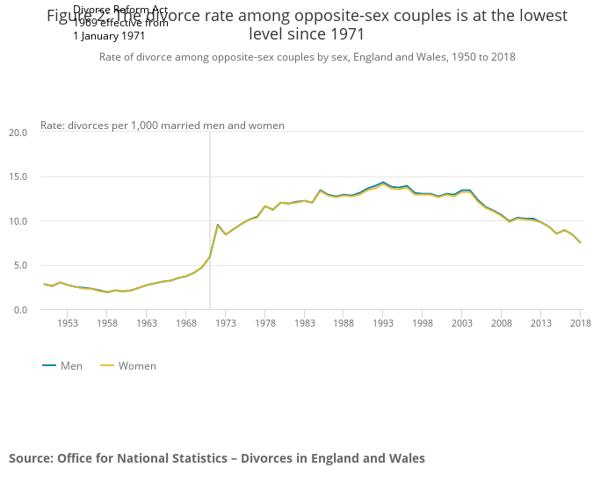
Read​
In 2018, 7.5 per 1000 men and 7.5 per 1000 women divorced. This is the lowest rate since 1971.
1. What could be the reasons for this?
2. Why might some be happy with these figures?
3. Why might the figures be of concern to some?
& Consider
LO: Investigate the development of divorce in the past century.
Notes:
Statistics are available from : https://www.ons.gov.uk/peoplepopulationandcommunity/birthsdeathsandmarriages/divorce/bulletins/divorcesinenglandandwales/2018
Latest data is for 2018
Class is to explore the issue of data and the reasons behind the data – how many marriages were there in 2018? That number not released. For 2016 number per 1000 was 8.9 for both men and women had a divorce. 2016: 242774 marriages and 106959 divorces, are those numbers relevant? Average duration of marriage of those getting divorced in 2018 was 12.5 years.
The reasoning behind why there has been less divorce is due to the lower numbers getting married – class to discuss the issues tying into this scheme of work, family life and fruitfulness within the family unit.

Slide 15
Plenary​
Think-Pair-Share:
Can love conquer all?
Write your own response in your booklet.
Notes:
This should be a longer discussion that delves into the challenges covered in the lesson. The teacher and students should not shy away from the view that this is hard to fully understand and practice. This should be part and parcel of the understanding of the importance of marriage and the surety that comes with joining together with someone for a lifetime.

