Slide 1
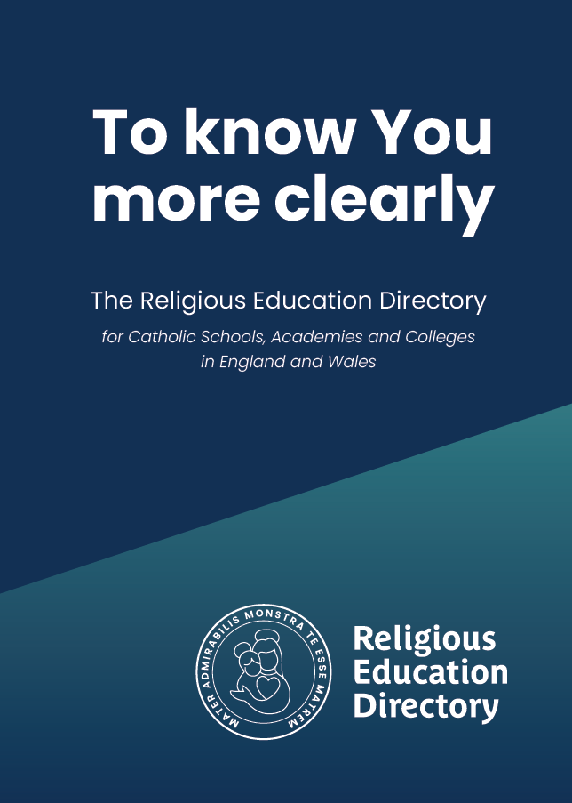
RED Theology Branch 2 – Prophecy & Promise
Subject knowledge CPD for RE Coordinators
November 2023

Slide 2
Primary RED Roadmap
The road to implementation
Notes:
JM

Slide 3
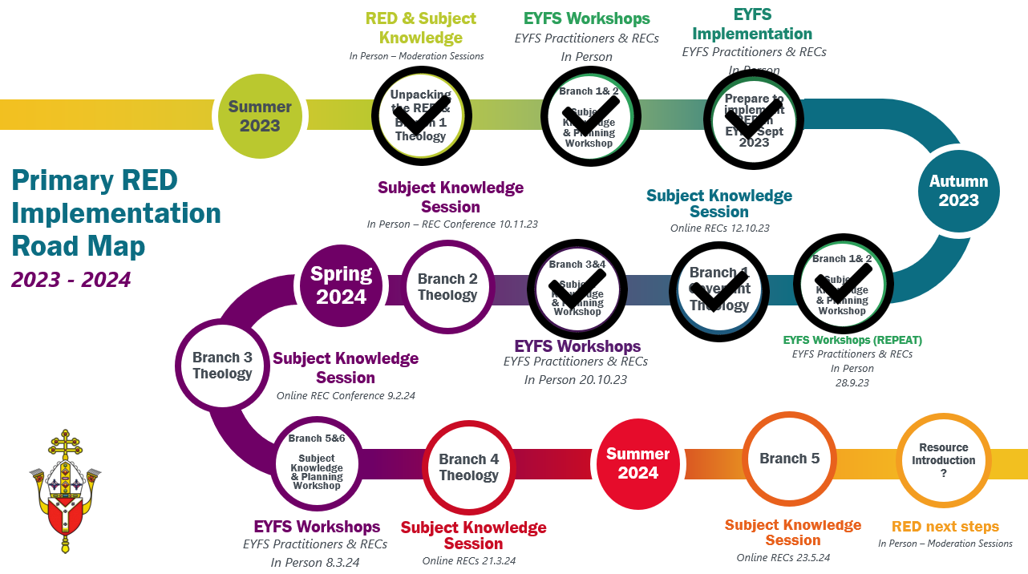

Slide 4
Curriculum branches
Desert to Garden
Galilee to Jerusalem
To the Ends of the Earth
Prophecy and Promise
Dialogue and Encounter
Creation and Covenant
Notes:
Lit year
Deep roots - wide branches

Slide 5
EYFS
Year 1
Year 2
Year 3
Year 4
Year 5
Year 6
PROPHECY & PROMISE
Mary had a baby called Jesus
Jesus Annunciation- Nativity
Nativity – visitation, Magnificat, Advent
Mass
Matthew’s nativity
Elijah & John the Baptist
David
Women in salvation history

Slide 6
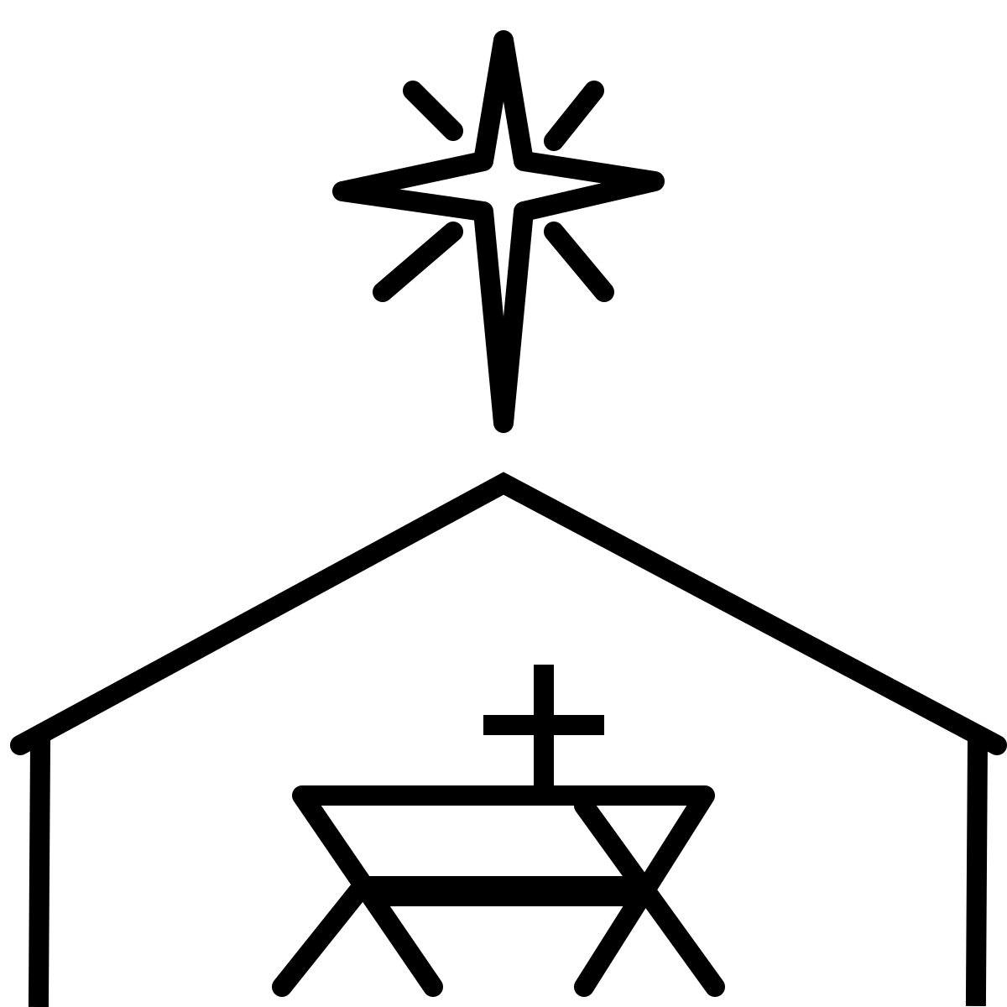
Branch 2 – Prophecy & Promise
Notes:
Branch 2 – Prophecy & Promise
In the letter to the Hebrews (Heb 1:1), we read: ‘In many and various ways, God spoke to our ancestors by the prophets’ and Branch 2 of the RED explores how the prophets speak of God reaching to his people, calling them back into a relationship with him. Throughout this branch, pupils will explore the Christian understanding of the teaching of the prophets as they point to the fulfilment of God’s promise in a messiah, Jesus Christ. The branch explores the expectant waiting for the Messiah through the Advent season and how this speaks to Christians today as they wait and prepare for Christ.. In Branch 2 ‘Prophecy and Promise’, we are introduced to the gospel infancy narratives of Luke and Matthew and the mystery of the incarnation and also encounter:
The birth of Jesus as foretold by prophets-linking to Advent
The genealogy of Jesus
the prophets Isaiah, Samuel and Elijah
David
Women – Sarah, Miriam, Deborah, Hannah, Esther
Mary’s fulfilment of OT prophecy
St Joseph’s perspective
Advent
the Nativity
the angels bringing the message of the birth of Jesus
Feast of Christ the King

Slide 7
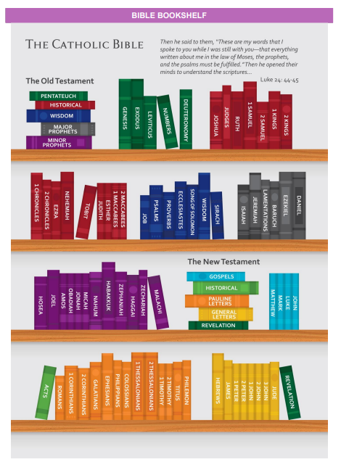
Bible Quiz Time!
Notes:
Before we delve into the mystery of the incarnation, let us remind ourselves of the structure of the Bible.
We know that the Church venerates sacred scripture as she venerates the Eucharist (CCC103) since the books of the Bible, though written by certain men, were inspired by God in order that he reveal himself in human words. As we heard in the Branch 1 Creation session, there are many different kinds of literature in the Bible such as poems, songs, historical accounts, symbolic stories, stories drawn for real life (e.g. the parables), letters, proverbs, genealogies and so on. The Old Testament is comprised of 46 books, organised into 5 categories: Pentateuch, Historical, Wisdom, Major Prophets, Minor Prophets. The New Testament comprises 27 books including the 4 Gospels, the Acts of the Apostles, epistles and the Book of Revelation. The Gospels are the heart of all scripture since they are the ‘principle source for the life and teaching’ of Jesus Christ, the Incarnate Word.

Slide 9
Notes:
The New Testament
Just like the Old Testament, the New Testament is best understood as a collection of various books which share a common vision regarding the centrality of Jesus as Christ, the Son of God. It is again important to remember that the books of the New Testament were written by different authors, at different times, in different circumstances in the life of the early Church. The 27 books of the New testament can be organised into several categories:
The Gospels: The New Testament begins with the four Gospels – Matthew, Mark, Luke, and John. These texts recount the life, teachings, death, and resurrection of Jesus. Matthew, Mark and Luke are known as the synoptic Gospels. The word synoptic means ‘seeing’ or ‘looking together’ and indeed these three Gospels are very similar recounting many of the same sayings and stories of Jesus with the same or similar words. One theory is that Mark was the first Gospel to be written and then subsequently used as a source by Matthew and Luke along with an unidentified source, ‘Q’. In contrast, the Gospel of John is quite different and contains few sayings or stories found in the synoptics, presenting a different, but complimentary, picture of Jesus.
Acts of the Apostles: The book of Acts picks up the story of the early Church following the resurrection and ascension of Jesus and tells of the activities of the apostles, particularly Peter and Paul. It is written by the same author as the Gospel of Luke.
Epistles (Letters): The New Testament includes a collection of letters written by early Christian leaders, including St. Paul and others, addressing various theological, moral, and practical issues within the Christian community. These epistles provide guidance and teachings for the faithful.
Pauline Epistles: These are letters attributed to the Apostle Paul and include works like Romans, Corinthians, Galatians, Ephesians, Philippians, Colossians, and more.
General (Catholic) Epistles: These are letters written by other apostles and include texts like James, 1 Peter, 2 Peter, 1 John, 2 John, 3 John, and Jude.
The Book of Revelation: The New Testament concludes with the Book of Revelation, which contains apocalyptic and prophetic visions and is often interpreted symbolically. It discusses the final judgment and the ultimate triumph of good over evil.

Slide 10
What is a prophet?
Message from God
Communicate to the People
Reminder of God’s covenant
Notes:
What is a prophet?
The Catholic understanding of a biblical prophet is a person who receives a divine message or revelation from God and is chosen to communicate that message to the people. Prophets play a significant role in the Old Testament, where they are seen as intermediaries between God and humanity, called to deliver God's word, guidance, warnings and promises and reminding society at the time of God’s covenant with them. Essentially, the prophets are people of the word, people who have spoken and while their word is with a lower-case w, their words seek to be an echo of the Word. Indeed, the Word is their sole passion yet is also the reason for their persecution (Jer 15:16-18 and / or Ezek 3:1-3).

Slide 11
What is a prophet?
Notes:
The word prophet comes from the Greek word phetes meaning ‘agent’, derived from a root word meaning ‘say’ with the preposition ‘pro’. In Greek, the preposition ‘pro’ can have three senses:
Temporal; before
Spatial; in front of
Representative; in place of
Christian tradition gives a particular place to the temporal sense, providing a meaning that points towards predictions and so the prophets became ‘those who spoke in advance’, predicting future events and particularly that of the coming of the Messiah and his mission. Biblical scholars also recognise that the alternative meanings are also important; the prophets essentially spoke in and for their time, bringing the Word of God to their contemporaries. As such, they can be considered as those who spoke ‘in front of’ the community, ‘in place of’ God. It is essential to read prophecy, initially, in its original context since for the prophets, what interests them is not divining the future but rather changing the present. Yet this does not mean that they are confined to their own time and history since they believe the future to be deeply connected to the will and initiative of God and the response of humanity. In fact, if the word of the prophets had eternal value, one prophet should have sufficed, but because the words of the prophets arose for a given era, there have been a great many, communicating in various ways as highlighted in the letter to the Hebrews (Heb 1:1-2) For the Church today, the Old Testament is read in the light of Christ crucified and risen (CCC129) and in this way, the books of the prophets reveal and point towards the person of God’s incarnate son, Jesus Christ.

Slide 12
Foretelling of the Messiah
“For to us a child is born, to us a son is given; and the government will be upon his shoulder, and his name will be called “Wonderful Counsellor, Mighty God, Everlasting Father, Prince of Peace.”
Isaiah 9:6
Isaiah
Notes:
Linking to this we have the foretelling of the birth of Jesus by prophets.
Isaiah, whose name means ‘salvation of Yahweh’ or ‘Yah saves’, is one of the major prophets in the Old Testament and is widely regarded as one of the greatest prophets of the Bible. The book of Isaiah presents a rich and comprehensive view of the kingdom of Judah and Jerusalem, and it speaks of much judgment, but it is also filled with messages of hope and restoration.
He was evidently from a distinguished Jewish family; his education can be seen in his impressive vocabulary and style. His work is comprehensive in scope and beautifully communicated.
When he speaks about Christ, Isaiah sounds more like a New Testament writer than an Old Testament prophet. His messianic prophecies are clearer and more explicit than those in any other Old Testament book. They describe many aspects of the Person and work of Christ in His first and second advents, and often blend the two together. The Old Testament has over three hundred prophecies about the first advent of Christ, and Isaiah contributes a number of them.
While Isaiah does not explicitly mention Jesus’ birth, he does predict that a virgin will conceive and give birth to a son who will be called Emmanuel (Isaiah 7:14). This prophecy was fulfilled when Jesus was born to Mary.
Similarly, there is Isaiah 9:6:
For to us a child is born, to us a son is given; and the government will be upon his shoulder, and his name will be called “Wonderful Counsellor, Mighty God, Everlasting Father, Prince of Peace.”
This passage also anticipates the Incarnation, with the fulfilment being seen in the Infancy narratives of Matthew 2 and Luke 1.

Slide 13
Foretelling of the Messiah
Quick Task
Read 1 Kings 17:7-16 and identify any links with the New Testament.
Elijah
Notes:
We also encounter the prophet Elijah, who is the archetypal prophet of the Old Testament. He appears in the wilderness and calls the people of Israel to return to God, calling out the corruption of Ahab, the king, who has begun worshipping Baal. At the end of his colourful life, he does not die but is taken up to heaven in a whirlwind or chariot of fire.
In the miracle of the flour and the oil, he shows God’s generosity, especially towards the poor, the widow, and her son, and, for Christians, this has parallels with Jesus’ feeding of the five thousand (Matt 14:13-21).
The Widow of Zarephath: 1 Kings 17:7-16
⁸ Then the word of the Lord came to him, saying, ⁹ “Go now to Zarephath, which belongs to Sidon, and live there; for I have commanded a widow there to feed you.” ¹⁰ So he set out and went to Zarephath. When he came to the gate of the town, a widow was there gathering sticks; he called to her and said, “Bring me a little water in a vessel, so that I may drink.” ¹¹ As she was going to bring it, he called to her and said, “Bring me a morsel of bread in your hand.” ¹² But she said, “As the Lord your God lives, I have nothing baked, only a handful of meal in a jar, and a little oil in a jug; I am now gathering a couple of sticks, so that I may go home and prepare it for myself and my son, that we may eat it, and die.” ¹³ Elijah said to her, “Do not be afraid; go and do as you have said; but first make me a little cake of it and bring it to me, and afterwards make something for yourself and your son. ¹⁴ For thus says the Lord the God of Israel: The jar of meal will not be emptied and the jug of oil will not fail until the day that the Lord sends rain on the earth.” ¹⁵ She went and did as Elijah said, so that she as well as he and her household ate for many days. ¹⁶ The jar of meal was not emptied, neither did the jug of oil fail, according to the word of the Lord that he spoke by Elijah.
His encounter with God in the gentle breeze is a beautiful image which links with Christian ideas of the Holy Spirit. Leading him to a mountain, God tells Elijah to anoint Hazael as the new King. He is significant to the gospel writers as comparisons can be made with Elijah and John the Baptist. Jesus himself describes John as the ‘Elijah who was to return’ (Matt 11:14), and John begins baptising in the Jordan, close to where Elijah was taken up to heaven.

Slide 14
Foretelling of the Messiah
David
Samuel
Notes:
The prophet Samuel is also included in Branch 2. The people want a king to protect them from their enemies. The prophet Samuel advises them to rely on God (1 Sam 8:11-18). However, the people persist, and Saul becomes the first king. However, Saul does not prove to be a worthy king and Samuel sets out to find his successor guided by God. David is not chosen because of his power. He comes from humble beginnings, working as a shepherd boy in Bethlehem. These facts are important to the writers of the gospels who see the parallels with Jesus’ birth. When David is anointed the spirit of the Lord is ‘mightily’ upon him, language echoed in Isaiah (61:1). David is a shepherd and in the story of Goliath he speaks of rescuing lambs from the jaws of predators. David is the king who unites the tribes of Israel and conquers Jerusalem, though he remains a shepherd king, caring for his people, rather than the king who demands from his people (the type of king Samuel warns about). In St John’s gospel (which pupils will study in Year Six) Jesus says, ‘I am the good shepherd’ (Jn 10:11) and describes how he nurtures, guides, and protects his flock. Pupils can play with possibilities about the type of king Jesus is and the type of king David is called to be. (Though reading the whole story of David shows he is deeply flawed.) God makes a covenant with David and promises that one of his descendants will have the throne established forever, which connects to the covenant with Abraham and with the universal kingship of Christ for Christians. Knowing this, pupils can recognise the significance of Jesus’ birthplace and that Joseph is descended from David. As he dies, David urges that the people remain faithful to the law and the covenant. David is significant as he is seen as the great king of the past, the one who unites the people, led them to victory and established a centre of political power in Jerusalem.
The first listeners of St Matthew’s gospel would have recognised that Bethlehem is the birthplace of King David. Bethlehem is also significant as in Hebrew ‘Beth’ means house and ‘lehem ‘means bread, so Matthew’s audience would recognise the symbolic significance of Jesus’s birthplace as the house of bread and a reference to the Eucharist, Jesus the Bread of Life.

Slide 15
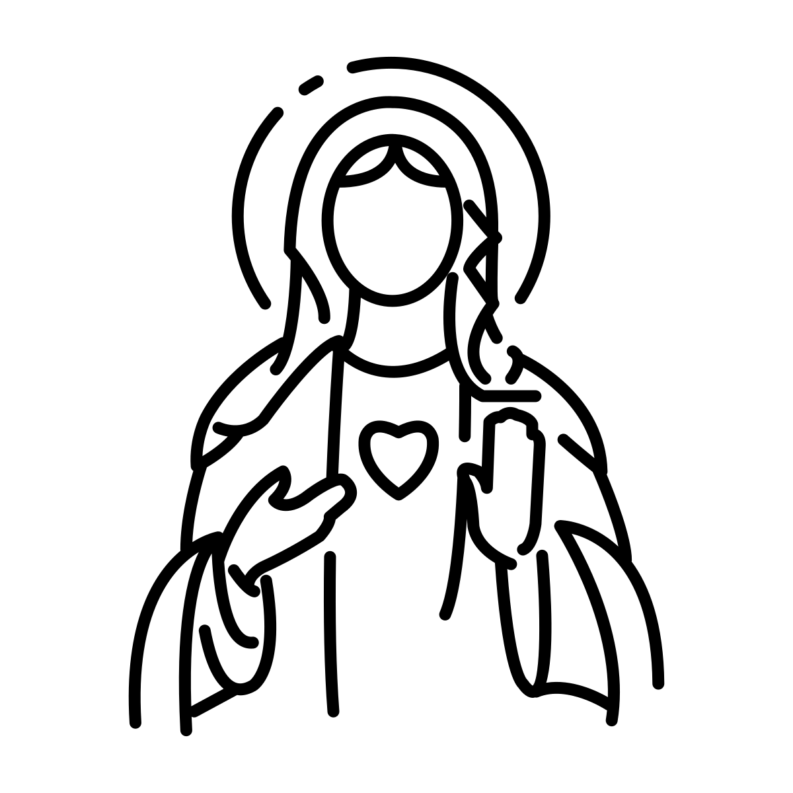
The Holy Women
Sarah
Rebecca
Rachel
Miriam
Deborah
Hannah
Judith
Esther
Notes:
The holy women: Sarah, Rebecca, Rachel, Miriam, Deborah, Hannah, Judith, and Esther are also in Branch 2 as being responsible for helping to keep alive the hope of Israel’s salvation.
Mary, of course, is distinct in being preserved from sin in order to give birth to the sinless Messiah. In the fullness of time the Holy Spirit completes in the Blessed Virgin Mary all the preparations for Christ’s coming among the People of God. By the action of the Holy Spirit in her, the Father gives the world Emmanuel: ‘God-with-us’. When the Church celebrates the Liturgy of Advent each year, she makes present this ancient expectancy of the Messiah, for by sharing in the long preparation for the Saviour’s first coming, the faithful renew their ardent desire for his second coming
The women listed feature at different points in the formation of Israel and subvert the expectations of their time. For Christians, a parallel exists between these women and Mary, who will change the course of history by her ‘yes’ to God. Mary is God’s mother because Jesus is fully God and fully human from the moment he is formed in Mary’s womb with her active consent. The Incarnation is a mystery of the Christian faith. She is his mother, therefore God’s mother and on the Cross Jesus gave Mary to be a mother to John, as the representative of the Church, and thus she is seen as the Mother of all Christians. Mary radically challenges the idea of a kingly Messiah in her prayer of the Magnificat.
Mary stands in a tradition of women who show that they are not passive onlookers in the history of salvation. Miriam is Moses’ sister and called a prophetess. She saves his life when he is a baby, placing him in the care of the pharaoh’s daughter. When the people of Israel cross the Red Sea, she leads the women in dance, singing and proclaiming the greatness of God. The name Mary is from Miriam. In the stories of Judith and Ester, both women lead their people to victory at a time of vulnerability. Albeit through some violent actions. Those who appear weak are made strong through their faith and hope. Sarah and Hannah both have sons when people believe they are too old, and both dedicate their sons to God.

Slide 16
The Mystery of the Incarnation
‘The Incarnation reveals that God is the eternal Father and that the Son is consubstantial with the Father, which means that the Son is of the same substance or essence as the Father. The Son became incarnate by the power of the Holy Spirit, and through the Virgin Mary, He became truly man.’
(CCC461)
Notes:
The Mystery of the Incarnation
The mystery of the incarnation stands at the foundation of the Christian faith and is central to our hope for salvation. In broad terms the Incarnation is the story of Jesus of Nazareth, the Son of God taking a human nature (while remaining simultaneously divine) and tends to be associated closely with the Gospel infancy narratives of Matthew and Luke yet summed up in John 1:14: ‘And the Word became flesh and lived among us, and we have seen his glory, the glory as of a father’s only son, full of grace and truth.’ The Incarnation serves as a the source of God’s revelation to his people, as God humbles himself to become man, identifying with the human condition in order to lead humanity to everlasting union with God. Through the incarnation, God reveals his great love and humility and Catholics are drawn into a deeper understanding of the mystery of the Trinity since ‘the Incarnation reveals that God is the eternal Father and that the Son is consubstantial with the Father, which means that the Son is of the same substance or essence as the Father. The Son became incarnate by the power of the Holy Spirit, and through the Virgin Mary, He became truly man.’ (CCC461)
In Jesus, the invisible God becomes visible and his love is poured out as the child in the manger at Bethlehem. As we explore the infancy narratives in this branch, we see Mary plays a central role in the mystery of the Incarnation and her ‘yes’ to God at Gabriel’s announcement secures her role as Mother of God, ‘theotokos’ - God bearer emphasising the closeness of Jesus and Mary in the Incarnation.

Slide 17
Luke’ Gospel
Written in Greek
~80AD
Written for gentiles
Notes:
Let’s take a look at the Gospels of Matthew and Luke:
Luke
It is generally agreed that Luke was written in Greek around the year 80, so about 50 years after the death of Jesus. Most scholars conclude that the author was a gentile (non-Jew) writing for a community predominantly made up of gentile Christians (Christians who were never Jews), evident from the main theme – salvation is for all, not just Jews. Luke also omits material overly reliant on knowledge of Jewish religion and culture. For example, at times Jesus is called ‘saviour’ rather than messiah.

Slide 18
Key Themes in Luke’s Gospel
Universality of Salvation
Compassion & forgiveness
Power of Prayer
Concern for the poor & marginalised
Holy Spirit
Place of Women
Notes:
Key themes in Luke
Universality of salvation: Jesus is the saviour of all people and this is seen in Luke tracing Jesus’ genealogy back to Adam, the parent of all and in Lk 2:29-32 Jesus is “a light of revelation to the Gentiles”.
Concern for the poor and marginalised
The Gospel is full of Jesus’ preference for the poor and the oppressed. The Magnificat (Mary’s song of praise) praises God who lifts up the lowly, fills the hungry with good things, scatters the proud, brings down the powerful and sends the rich away empty (Luke 1:46-55). After Jesus’ birth he is laid in a feeding trough for animals. The first witnesses are the lowest class of shepherds who live in the fields (Lk 2:1-20).
Compassion and forgiveness
In the key sermon in Luke 6 Jesus urges his disciples to be merciful, just as your Father is merciful (Lk 6:36) and further examples include the pardon of a sinful woman (Lk 7:36-50) and the story of Zacchaeus (Lk 19:1-10)
The Holy Spirit
The Spirit is a key player in Luke’s Gospel including the Spirit coming upon John [the Baptist] even before he is born (Lk 1:15) and Mary in the annunciation (Lk 1: 35).
The power of prayer
Jesus is constantly seen at prayer, especially at critical moments of his ministry such as when his reputation spreads (Lk 5:15-16), before he chose his apostles, heals and gives his principal teaching (Lk 6:12-13), and on the cross (Lk:23:34 and Lk 23:46). The Gospel also has parables about prayer (Lk 18: 1-14).
The place of women
Women play key roles in the Gospel. Much of Luke's material for the infancy narratives must have come originally from Mary, as opposed to Matthew's Gospel, which gives the account from Joseph's perspective. Mary, Jesus’ mother assents to God’s will, sings God’s praise, identifies with the poor and ponders things deeply in her heart (Lk 1:26-56; Lk 2:19; Lk 2:51). Elizabeth (Lk 1:39-45) and Anna (Lk 2: 36-38) proclaim Jesus’ true identity; women disciples are faithful to his death and Mary Magdalene and other women announce his resurrection (Lk 24:1-12).

Slide 19
Key Themes in Luke’s Gospel
A Gospel of Joy!
Notes:
A Gospel of Joy
Luke’s Gospel radiates joy from the promised birth of John [the Baptist] bringing great joy (Lk 1:14) and the baby leaping for joy in Elizabeth’s womb (Lk 1:44). Mary proclaims, “my spirit rejoices” (Lk 1:47) and we read Jesus’ birth is “good news of great joy” (Lk 2:10-11).

Slide 20
Luke’s Infancy Narrative
Appearance of an angel
Fear response
Divine message
Objection
Reassurance
Announcement Story
Notes:
The Infancy Narratives
The infancy narrative of Luke is found in the first two chapters of the Gospel of Luke and focuses on the birth and early life of Jesus Christ. It contains several key theological themes that are central to Luke's Gospel.
Luke’s Infancy narrative begins with two birth announcement stories. The term announcement story is a literary form found in the Old Testament and used when an important announcement such as the birth of a child is made to a believer. They generally share the following elements although not necessarily in this order or indeed all the elements present:
Appearance of an angel (a messenger, guardian or intermediary between God and humanity)
Fear response of person
The divine message:
Person addressed by name
Qualifying phrase describing the person
Person urged not to be afraid
Woman is to have a child
Name by which the child is to be called
Phrase interpreting the name
Future accomplishment of the child
Objection of the person
As sign to reassure the person

Slide 21
Quick Task
Take a look at Luke 1:5-25 & Luke 1: 26-38.
Can you identify these features in these texts?
What makes these announcement stories different?

Slide 22
Gabriel’s annunciation to Mary
Announcement to Zechariah
The angel came to her and said, “Peace be with you! The Lord is with you and has greatly blessed you!”
29 Mary was deeply troubled by the angel's message, and she wondered what his words meant. 30 The angel said to her, “Don't be afraid, Mary; God has been gracious to you. 31 You will become pregnant and give birth to a son, and you will name him Jesus. 32 He will be great and will be called the Son of the Most High God. The Lord God will make him a king, as his ancestor David was, 33 and he will be the king of the descendants of Jacob forever; his kingdom will never end!”
Notes:
So, we read in Luke 1:5-25 the announcement to Zechariah of the Birth of John the Baptist. A powerful contrast here is the response of Zechariah compared to Mary – Zechariah’s doubt and lack of trust renders him temporarily mute. This section of the Gospel reiterates the theological themes of the role of the faithful in God's plan and the importance of trust and obedience in response to God's message
This is followed immediately by the annunciation to Mary by the Angel Gabriel and we again see the elements of announcement story indicated. As we read this piece of scripture we see the scriptural basis of the Hail Mary, which reminds us that in praying to Mary, asking her intercession, we are brought closer to Jesus with whom she is so closely connected through her unwavering ‘Yes’, uttered in the name of all humanity as she ‘cooperated through free faith and obedience in human salvation.’ (CCC511) Mary’s openness to the work of the Holy Spirit allows for God’s work of redemption and offers salvation for all humanity.
Luke follows with the story of the Visitation and here we read Mary acclaimed by Elizabeth, at the prompting of the Spirit, even before the birth of her son, as "the mother of my Lord" and is followed by Mary’s great hymn of praise, the Magnificat (Luke 1:46-55) which speaks clearly to the themes social justice, hope in the reversal of fortunes and concern for the poor and marginalized. A reminder that God sent Jesus to be the saviour of all people. This song of praise is so important, it is included in the Divine Office and prayed at vespers (evening prayer) everyday.

Slide 23
Gabriel’s annunciation to Mary
The angel came to her and said, “Peace be with you! The Lord is with you and has greatly blessed you!”
29 Mary was deeply troubled by the angel's message, and she wondered what his words meant. 30 The angel said to her, “Don't be afraid, Mary; God has been gracious to you. 31 You will become pregnant and give birth to a son, and you will name him Jesus. 32 He will be great and will be called the Son of the Most High God. The Lord God will make him a king, as his ancestor David was, 33 and he will be the king of the descendants of Jacob forever; his kingdom will never end!”
Notes:
As we read this piece of scripture we see the scriptural basis of the Hail Mary, which reminds us that in praying to Mary, asking her intercession, we are brought closer to Jesus with whom she is so closely connected through her unwavering ‘Yes’, uttered in the name of all humanity as she ‘cooperated through free faith and obedience in human salvation.’ (CCC511) Mary’s openness to the work of the Holy Spirit allows for God’s work of redemption and offers salvation for all humanity.
Luke follows with the story of the Visitation and here we read Mary acclaimed by Elizabeth, at the prompting of the Spirit, even before the birth of her son, as "the mother of my Lord" and is followed by Mary’s great hymn of praise, the Magnificat (Luke 1:46-55) which speaks clearly to the themes social justice, hope in the reversal of fortunes and concern for the poor and marginalized. A reminder that God sent Jesus to be the saviour of all people. This song of praise is so important, it is included in the Divine Office and prayed at vespers (evening prayer) everyday.

Slide 24
HAIL MARY
Hail, Mary, full of grace,
the Lord is with thee.
Blessed art thou amongst women
and blessed is the fruit of thy womb, Jesus.
Holy Mary, Mother of God,
pray for us sinners,
now and at the hour of our death.
Amen.
Notes:
As we read this piece of scripture we see the scriptural basis of the Hail Mary, which reminds us that in praying to Mary, asking her intercession, we are brought closer to Jesus with whom she is so closely connected through her unwavering ‘Yes’, uttered in the name of all humanity as she ‘cooperated through free faith and obedience in human salvation.’ (CCC511) Mary’s openness to the work of the Holy Spirit allows for God’s work of redemption and offers salvation for all humanity.

Slide 25
The Visitation
Quick Task
Where do we see the themes of Luke’s Gospel expressed in the Magnificat?
Notes:
Luke follows with the story of the Visitation and here we read Mary acclaimed by Elizabeth, at the prompting of the Spirit, even before the birth of her son, as "the mother of my Lord" and is followed by Mary’s great hymn of praise, the Magnificat (Luke 1:46-55) which speaks clearly to the themes social justice, hope in the reversal of fortunes and concern for the poor and marginalized. A reminder that God sent Jesus to be the saviour of all people. This song of praise is so important, it is included in the Divine Office and prayed at vespers (evening prayer) everyday.

Slide 26
The Birth of John the Baptist
Quick Task
Highlight the links to prophecy and promise in the Benedictus.
Notes:
As the birth of John the Baptist follows, Luke’s theme of joy is reiterated: ‘Her neighbours and relatives heard that the Lord had shown his great mercy to her, and they rejoiced with her’ (Luke 1:58) and as Zechariah’s tongue is freed and John is named, he recites his prayer of thanksgiving (Luke 1:68-79) with the first verse a song of thanksgiving for the realisation of the messianic hopes of the Jewish people, recalling God’s covenants with David and Abraham and the second part addressed to John the Baptist who will go before the Lord to prepare his ways, preparing for the ministry of Jesus. The Benedictus is also used in the daily prayer of the Church during Lauds (Morning prayer).

Slide 27
The Birth of Jesus
Notes:
As Luke then proceeds to proclaim the birth of Jesus, the themes of Jesus’ birth for the marginalised and humble and joy and praise in praise of the arrival of the promised messiah is again emphasised in the appearance of the angels to the shepherd’s and their subsequent visit to the manger, responding in praise of God. With the Nativity we see the angels playing a significant part in the proclamation of God’s message in the gospels of St Matthew and St Luke. Angels are God’s messengers and protectors and point to the divine nature of Christ (CCC 333). We can introduce the first phrase of the ‘Gloria’ recognising it as the angels’ song of praise to God.
The song of the angels is repeated at Mass each Sunday in the form of the great song of praise and thanksgiving; the Gloria - which recalls the mystery of the Incarnation. In this prayer, we give praise to God by recalling how great he is and how worthy he is to be worshiped. Despite our sinfulness, God loved us enough to send His Son. Hence, our joy in praying the Gloria.
Glory to God in the highest,
and on earth peace to people of good will.
We praise you, we bless you, we adore you,
we glorify you,
We give you thanks for your great glory.
Lord God, heavenly King.
O God, almighty Father.
Lord Jesus Christ, Only Begotten Son,
Lord God, Lamb of God, Son of the Father,
you take away the sins of the world,
have mercy on us;
you take away the sins of the world,
receive our prayer;
you are seated at the right hand of the Father,
have mercy on us.
For you alone are the Holy One,
you alone are the Lord,
you alone are the Most High, Jesus Christ,
with the Holy Spirit,
in the glory of God the Father. Amen.

Slide 28
Matthew’s Gospel
Written in Greek
~85-90AD
Written for a Jewish community

Slide 29
The Genealogy of Jesus
Notes:
Matthew’s gospel begins with the genealogy of Jesus starting with Abraham, linking Jesus as the one who fulfils the covenant God made with Abraham. He wants to put the question of Jesus’ provenance in the correct light from the very beginning: the genealogy serving as a heading for the entire gospel.
This family tree helps us to understand not only the ancestral past of Jesus but also his identity and mission.
Matthew lists fourteen generations between Abraham and Jesus. Some pupils may be interested to know that the number seven signifies perfection or completeness in the Bible. As a multiple of seven, the fourteen generations indicate that the covenant with Abraham is complete in Jesus. By reading this genealogy, we see that Jesus was a direct descendant of King David and therefore also a fulfilment of the Old Testament prophecies.
Importantly the genealogy ends with a woman: Mary, who truly marks a new beginning and there being no reference to the fatherhood of Jesus in the account, instead we read: ‘Jacob was the father of Joseph the husband of Mary, of whom Jesus was born, who is called the Messiah.’ (Mt 1:16) Her child does not originate from man.

Slide 30
The Jesse Tree
Notes:
The genealogy gives context to the Jesse tree which has its tradition from Isaiah 11:1:
“A shoot shall come out from the stump of Jesse, and a branch shall grow out of his roots.”
Jesse was the father of David; Israel’s greatest king and Jesus is descended from the line of David. He is the branch God promised would grow from Jesse’s family tree.
We adorn a Jesse tree with illustrated ornaments that represent the people, prophesies, and events leading up to the birth of Jesus. The ornaments tell the story of God in the Old Testament, connecting the Advent season with the faithfulness of God across four thousand years of history.

Slide 31
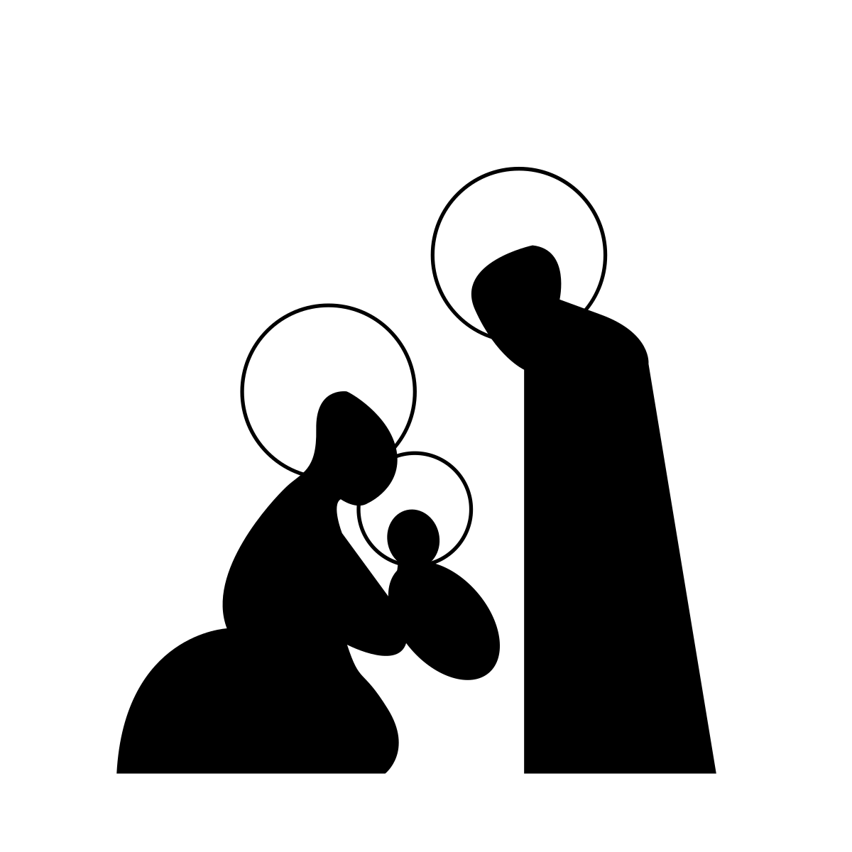
St Joseph
“Joseph, son of David, do not be afraid to take Mary as your wife, for the child conceived in her is from the Holy Spirit. 21 She will bear a son, and you are to name him Jesus, for he will save his people from their sins.” 22 All this took place to fulfil what had been spoken by the Lord through the prophet:
23 “Look, the virgin shall conceive and bear a son, and they shall name him Emmanuel,”
which means, “God is with us.” 24 When Joseph awoke from sleep, he did as the angel of the Lord commanded him; he took her as his wife and he named him Jesus.
Matthew 1:20-24
Notes:
Joseph has an important role to play in Branch 2. We investigate how Joseph put his trust in God when the angel appeared in his dream and how his decisions were informed by faith, hope, and love of God. He opens his heart to the Holy Spirit.
In Matthew’s gospel there is no account of the Annunciation but directly after the genealogy, he tells us that Joseph was not the father of Jesus and how Joseph wanted to withdraw from the contract with Mary because he felt himself unworthy of her.
The angel of the Lord appears to Joseph in a dream and tells him not to be afraid to take Mary as his wife, because she has conceived through the Holy Spirit. The angel also instructs Joseph to name the child Jesus, as he will save his people from their sins.
“Joseph, son of David, do not be afraid to take Mary as your wife, for the child conceived in her is from the Holy Spirit. ²¹ She will bear a son, and you are to name him Jesus, for he will save his people from their sins.” ²² All this took place to fulfil what had been spoken by the Lord through the prophet:
²³ “Look, the virgin shall conceive and bear a son, and they shall name him Emmanuel,”
which means, “God is with us.” ²⁴ When Joseph awoke from sleep, he did as the angel of the Lord commanded him; he took her as his wife and he named him Jesus.
Matthew 1:20-24
By accepting Mary as his wife, Joseph then becomes the legal father of Jesus who now belongs by law to the house of David. St Matthew gives us Joseph’s perspective, who as a descendant of David represents the link between the figure of Jesus and the Davidic promise.
St Matthew invites us to explore the message of the prophets as they point to the fulfilment of God’s promise in a messiah, Jesus Christ and the expectant waiting for the Messiah through the Advent season and how this speaks to Christians today as they wait for Christ.

Slide 32
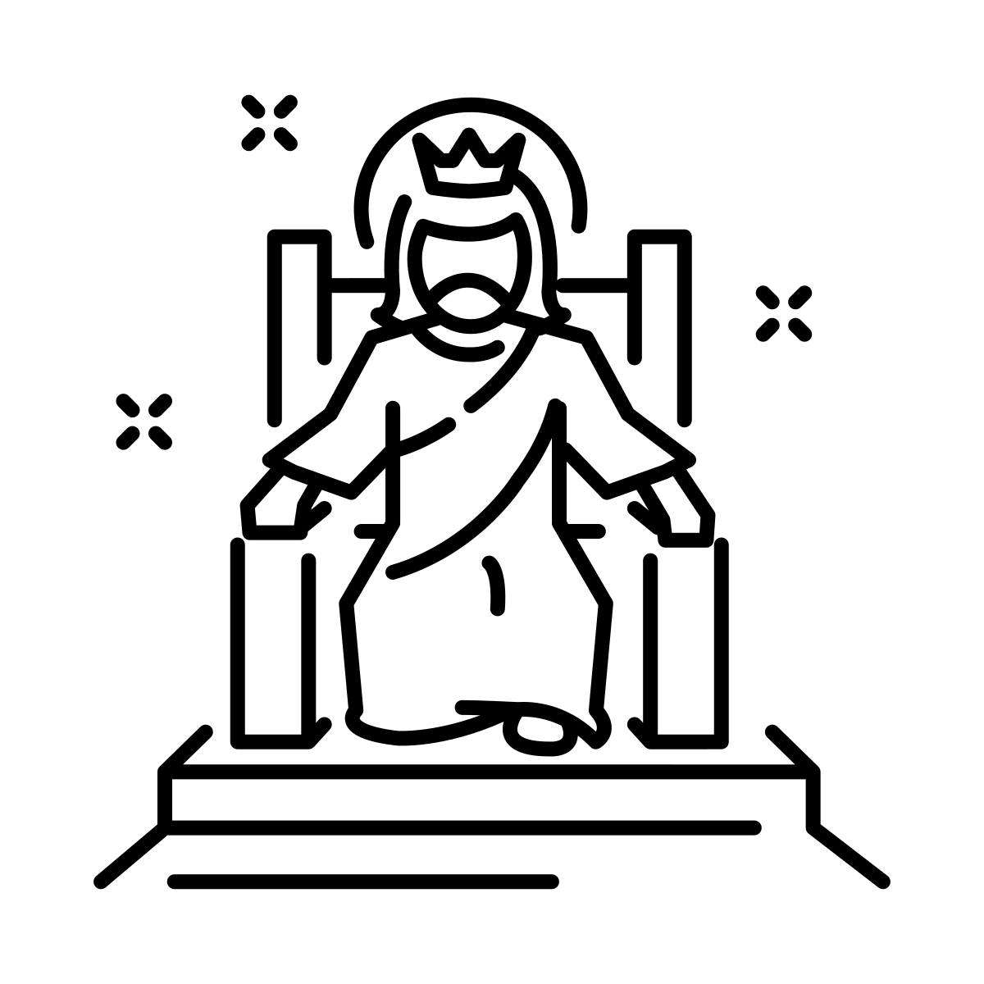
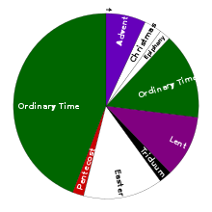
The Feast of Christ the King
Notes:
The Feast of Christ the King concludes the Church’s liturgical year. The year ends on a real high point and celebrates the Kingdom of God in all its richness before beginning the new Liturgical year with the reflective and penitential season of Advent. The Feast of Christ the King is also celebrated, in England and Wales, as National Youth Sunday.
The Solemnity of Christ the King was established in the twentieth century by Pope Pius XI after the First World War with the rise of nationalist political interests gaining ground across Europe, making absolute demands on the loyalty of their citizens. Pope St Paul VI affirmed the feast. We can contemplate on what sort of king Jesus is and how he is different to the earthly kings Elijah and John the Baptist criticise. Pope Benedict said that the power of Christ the King ‘is not the power of the kings or the great people of this world; it is the divine power to give eternal life, to liberate from evil, to defeat the dominion of death. It is the power of Love that can draw good from evil, that can melt a hardened heart, bring peace amid the harshest conflict and kindle hope in the thickest darkness. This Kingdom of Grace is never imposed and always respects our freedom… Choosing Christ does not guarantee success according to the world’s criteria but assures the peace and joy that he alone can give us’ (Pope Benedict XVI, on the feast of Christ the King, 22 November 2009).
It reasserts the sovereignty of Christ and the Church over all forms of government and to remind Christians of the fidelity and loyalty they owe to Christ, who by his Incarnation and sacrificial death on the cross has made them both adopted children of God and future citizens and heirs of the Kingdom of Heaven.

Slide 33
The Advent Wreath
Hope
Peace
Faith
Joy
Notes:
The liturgical season of Advent is the four weeks of preparation for the coming of Christ at Christmas. It is important to understand some of the symbols used during the Advent season, namely the Advent wreath. There are many Advent traditions including nativity plays, the Christmas crib and carols. Advent hymns celebrate Jesus as the coming Messiah (e.g., O Little town of Bethlehem; Long ago prophets knew; O come, divine Messiah; O come, O come Emmanuel).
The Advent wreath is a longstanding Catholic tradition that has been celebrated by Christians since the Middle Ages as part of their spiritual preparation for Christmas. The wreath is made up of evergreen branches, symbolizing eternal life, and four candles, representing the four weeks of Advent. The candles are lit one at a time on each of the four Sundays of the Advent season. The first candle represents hope, the second represents faith, the third represents joy, and the fourth represents peace. The Advent candles also remind us of the Scriptural figures with whom we prepare for the coming of Christ: the prophets, John the Baptist, and Mary. The circular shape of the wreath symbolizes God’s complete and unending love for us The Advent wreath helps us to spiritually contemplate the great drama of salvation history that surrounds the birth of God Incarnate, who comes to redeem the human race and make all things new. It also reminds us that the light of Christ will soon be arriving in the world.
For Christians, God’s act of emptying himself into our humanity in the incarnation is the foundation of Christian faith and hope for our salvation. In the Advent liturgies, Christians pray for the second coming of Jesus alongside preparing for Christmas. Advent is a time of preparation for Jesus’ incarnation at Christmas and for the second coming as King of the Universe.

