Slide 1
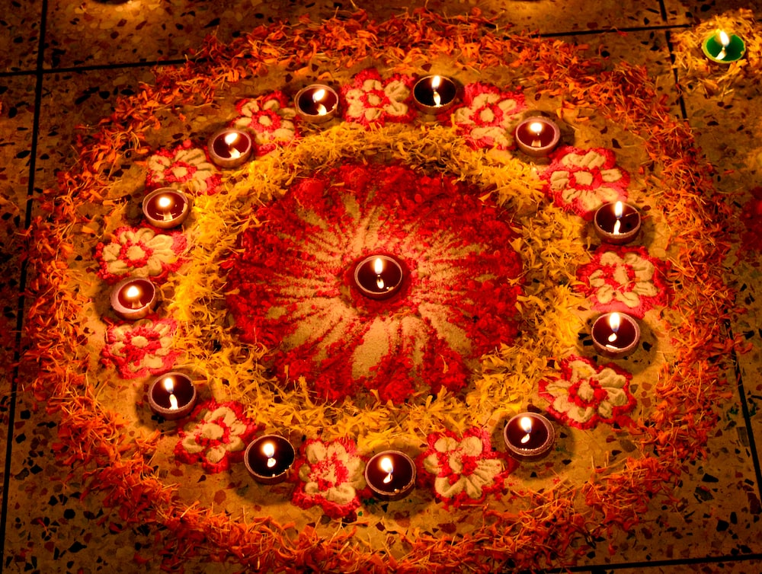
Diwali

Slide 2
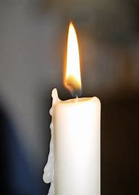
Lord,
Come and let your light shine through us so that through our actions we may be salt for the earth, a light in people's sight and that we might reach out to you in one another, especially those in need.
Amen
Opening Prayer
Notes:
con

Slide 3
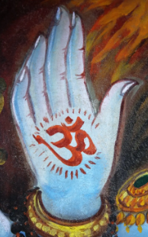
What do you already know about Hinduism?
Hinduism

Slide 4
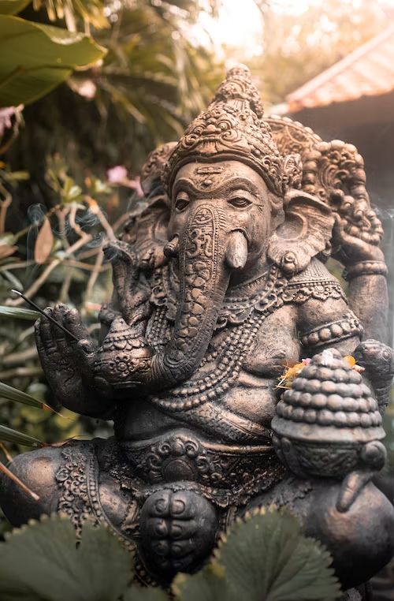
Hinduism is over 4,000 years old, making it one of the world's oldest religions.
It is made up of a variety of different religious beliefs and practices. It originated near the Indus River in India. The name 'Hindu' comes from the word Indus.
What is Hinduism?

Slide 5
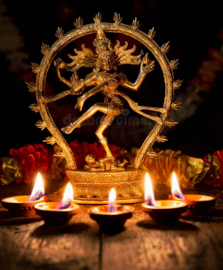
Central to Hinduism is the belief in a supreme God Brahman. Brahman is present everywhere and there is a part of Brahman in everyone. Brahman takes many forms, especially three forms called the Trimurti -
1. Brahma is the creator of the world and all creatures. He is usually shown with four heads.
2. Vishnu is the preserver of the world. His role is to return to the earth in troubled times and restore the balance of good and evil. He has blue skin and four arms.
3. Shiva is the destroyer of the universe. Shiva destroys the universe in order to re-create it. Shiva has blue skin, a third eye and carries a trident.
Hindus believe that life is a cycle of birth, death, and rebirth. They also believe that the next life depends on how the previous life was lived.
What do Hindus believe?

Slide 6
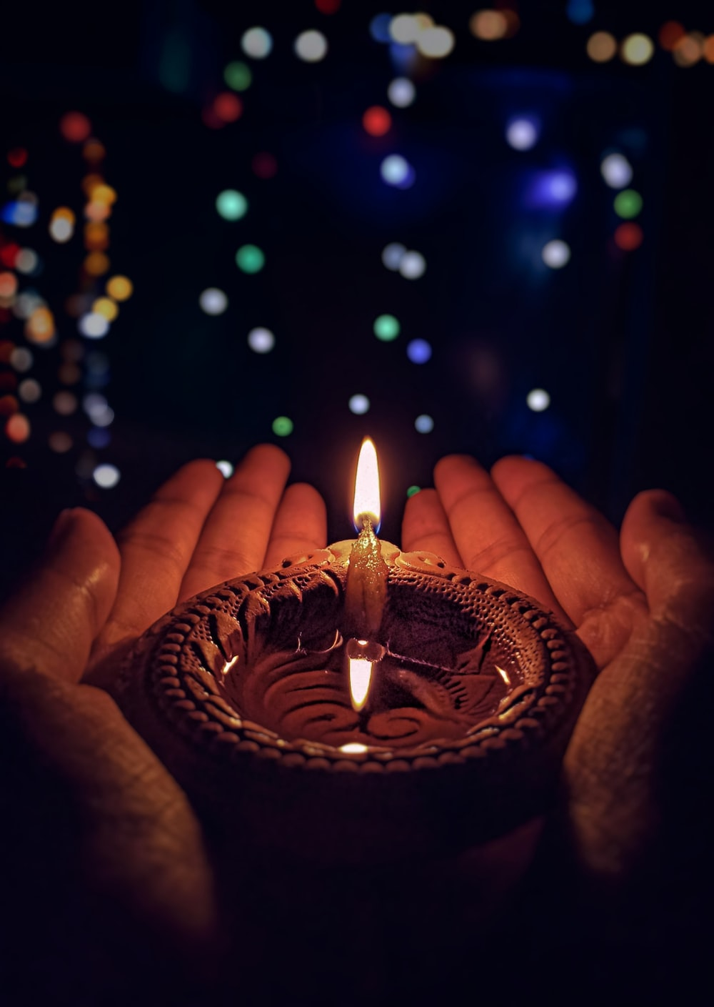
Diwali is the five-day Festival of Lights, celebrated by millions of Hindus, Sikhs and Jains across the world.
It marks the start of the Hindu New Year. The exact dates change each year and are determined by the position of the moon but it usually falls between October and November.
What is Diwali?

Slide 7
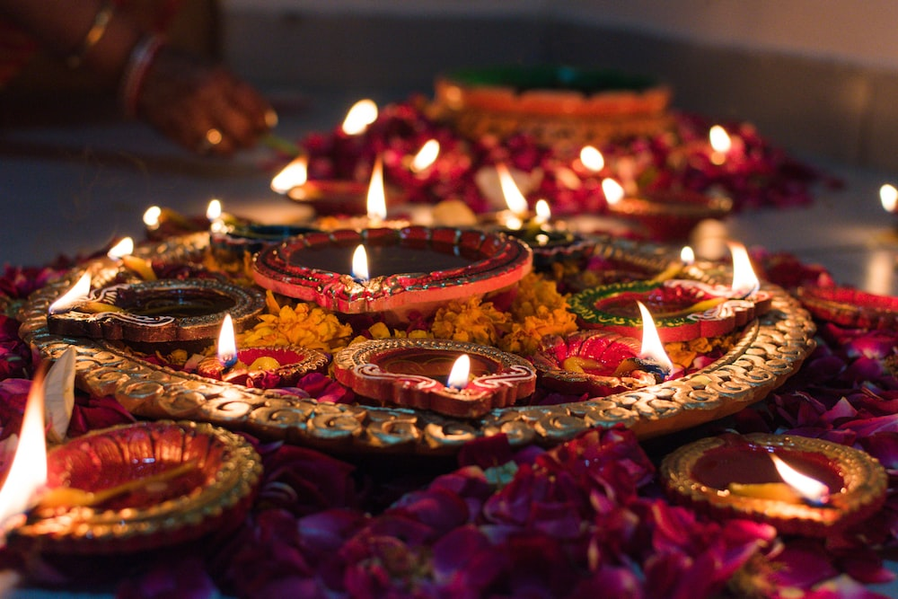
The word Diwali means “row of lights.”
During this festival, people decorate their homes with lights and oil lamps.
For many people, Diwali honours the Hindu goddess of wealth, Lakshmi. The lights and lamps are said to help Lakshmi find her way into peoples’ homes, bringing prosperity in the year to come!
What is Diwali?

Slide 8
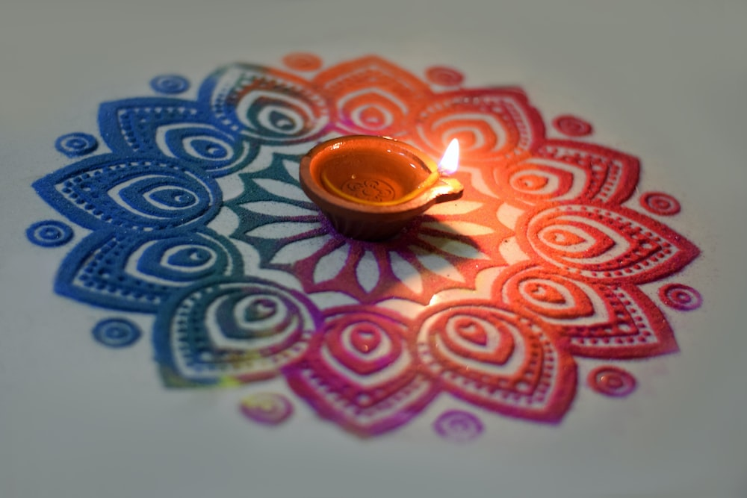
Diwali is a time to have fun with friends and family! People exchange gifts and sweets, enjoy delicious feasts, watch firework displays and wear new clothes. It’s a time to clean and decorate your home, too.
Rangoli is a popular Diwali tradition –– beautiful patterns made using colourful powders and flowers. People draw rangoli on the floor by the entrance of their homes to welcome the gods and bring good luck!
What is Diwali?

Slide 9
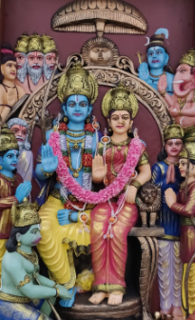
There are a number of stories to explain how the festival started. One of the most common is the story of Rama and Sita, which is retold each year during Divali. Lord Rama was a prince who married a beautiful princess, Sita. His father wanted Rama to become king, but his mother didn’t agree. She wanted Rama’s brother, Bharat, to have that honour. Rama and Sita were told that they must leave the kingdom for 14 years. Another brother, Lakshman, went with them.
The Story of Rama and Sita

Slide 10
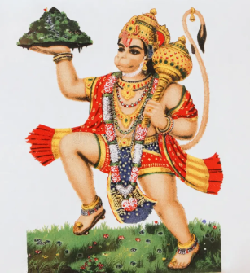
Eventually, the old king died. Knowing and honouring his father’s wishes, Bharat went to a far-off forest where he found Rama and Lakshman and invited them to return as king and queen. But they had promised to stay away for 14 years and Rama insisted they must be true to their word. So they stayed in the forest where, one day, an evil demon named Ravana captured Sita and carried her off to an island. Here he imprisoned her in his palace. Rama and Lakshman searched for her. A bird told them where she was being held. With the help of Hanuman, the monkey general, Rama went to the castle where there was a huge battle. Eventually, Rama killed the demon king with a golden arrow and rescued Sita.
The Story of Rama and Sita

Slide 11
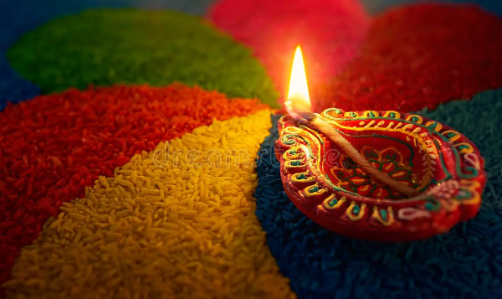
After 14 years, it was time for Rama to return home. Towards the end of their journey, the night was very dark, with no moon to light the path ahead. So to help King Rama and Queen Sita find their way, all their people placed small lamps outside their houses. This is one of the reasons why small clay lamps are lit every year at Diwali.
The Story of Rama and Sita.

Slide 12
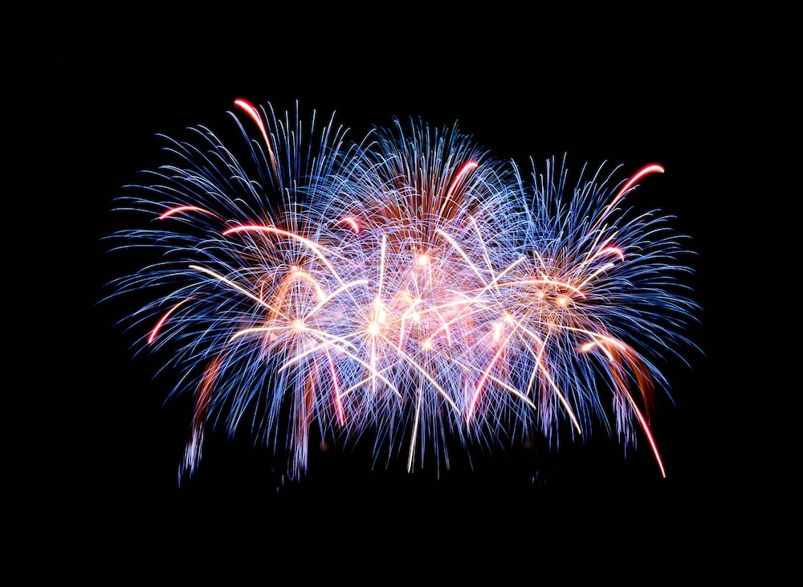
Lamps are lit and windows and doors are left open
Huge fireworks displays
Decorating buildings with fancy lights
Spring-cleaning the home
Wearing new clothes
Exchanging gifts (often sweets and dried fruits) and preparing festive meals
How is Diwali celebrated?

Slide 13
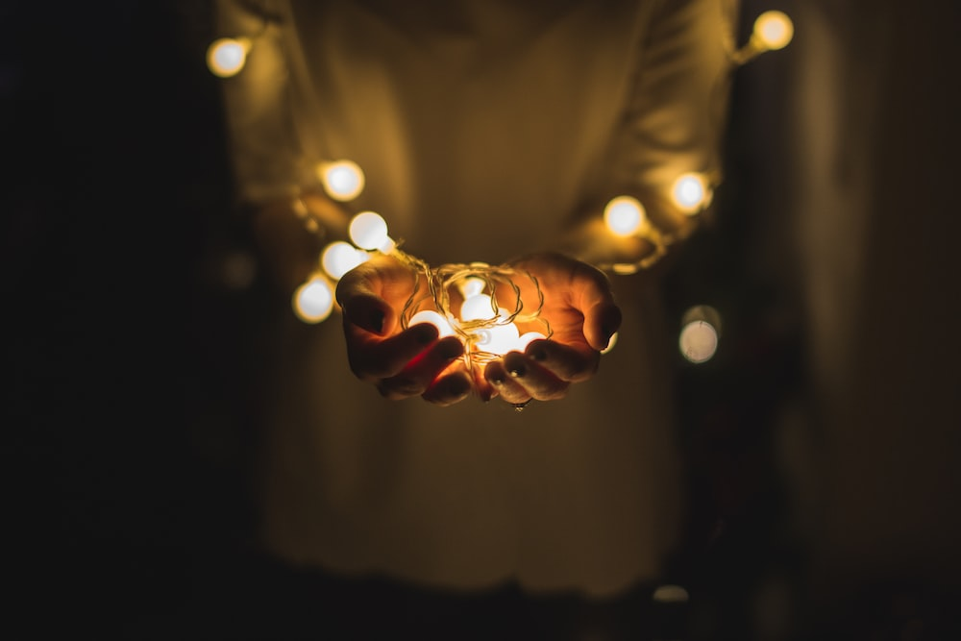
During Diwali, Hindus invite the light of prosperity into their lives.
Reflect upon the following questions which are linked to today’s assembly:
Who is the guiding light in your life?
Are you the guiding light for others?
Reflection

Slide 14
Heavenly Father,
May we all love each other as you first loved us.
May we act with compassion, kindness, humility, gentleness, and patience toward one another, living in harmony.
Lord, lead us to take what you’ve given us – love, mercy, grace, forgiveness – and spread those in this world.
May your love bind us together in perfect unity.
All this I pray through your Son Jesus Christ.
Amen
Closing Prayer

