Slide 1
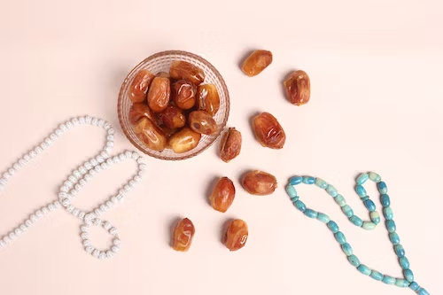
Ramadan

Slide 2
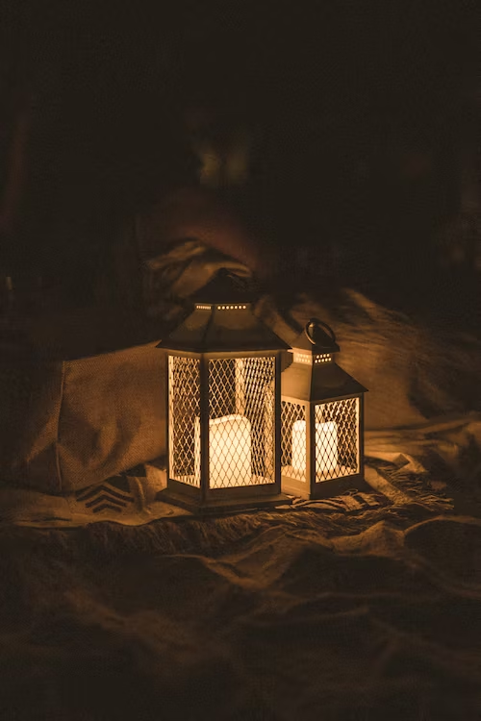
Lord,
You have made all of us alike, yet different in so many ways.
We come from many different backgrounds. Many of us have different customs and speak different languages.
Each and every one of us has a different way of reacting to any given situation. Help us to show respect for all those who have entered our lives and accept them for who they really are.
Amen
Opening Prayer
Notes:
con

Slide 3
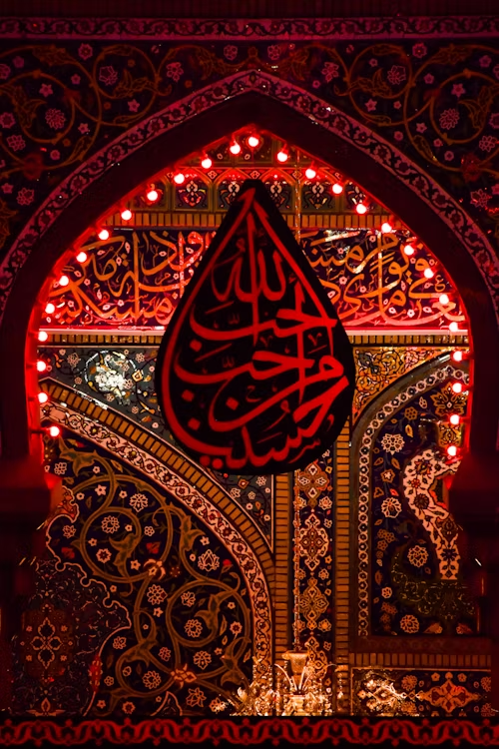
What do you already know about Islam?

Slide 4
The word 'Islam' in Arabic means submission to the will of God.
Followers of Islam are called Muslims. Muslims believe there is one true God Allah (the Arabic word for God).
What is Islam?

Slide 5
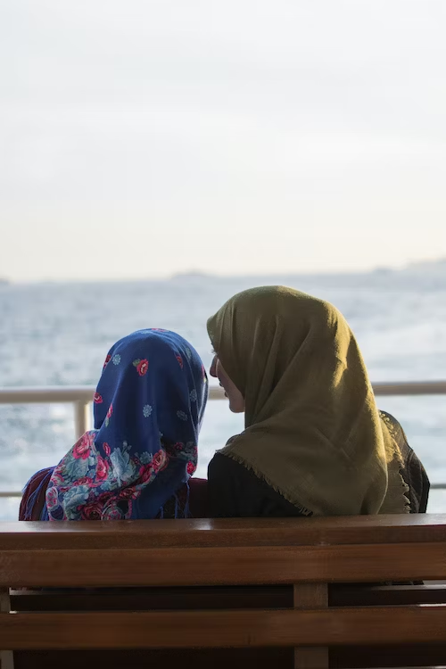
Islam is a religion that believes in one God, called Allah, and that Muhammad is his final messenger.
The holy book of Islam is the Qur'an, which contains the words of God.
Islam has five pillars, which are the basic duties of every Muslim: declaration of faith, prayer, charity, fasting, and pilgrimage.
When possible Muslims pray five times a day, facing the direction of Mecca, the holiest city in Islam.
Muslims gather to pray in a mosque.
Some Muslim women wear a hijab (headscarfs) in obedience to the commandments of Islam that instructs men and women to dress modestly.
Facts about Islam

Slide 6
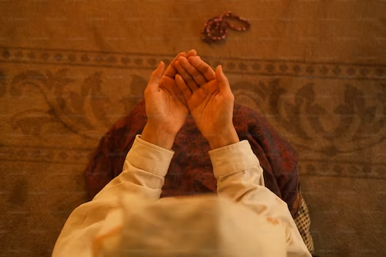
Ramadan is a very important time in the Islamic calendar.
During the month of Ramadan, Muslims won't eat or drink between dawn and sunset. This is called fasting.
Fasting is important during Ramadan as it Muslims believe it allows to devote themselves to their faith and come closer to Allah, or God.
What is Ramadan?

Slide 7
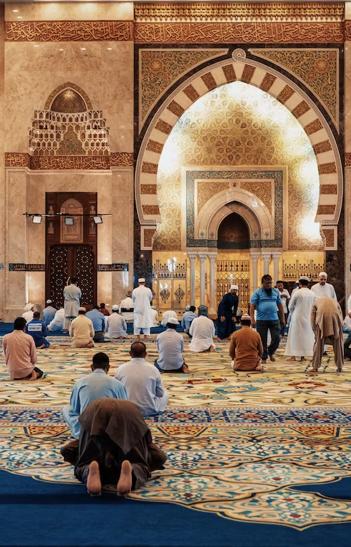
Ramadan is celebrated by more than a billion Muslims all over the world and is a time that many use to feel closer to Allah, perform good deeds, spend time with their loved ones, give up bad habits, and pray.
Ramadan lasts for over a month. The date changes every year because Islam follows the lunar calendar, which is based on the cycles of the moon.
During the month of Ramadan, Muslims will fast which means they won’t eat or drink between sunrise and sunset. Young children, women who are pregnant, the elderly, people who are ill and those travelling are exempt from fasting.
Facts about Ramadan

Slide 8
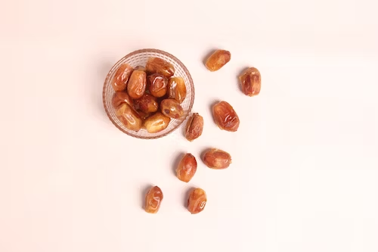
Those fasting will have one meal just before sunrise and another directly after sunset.
Many Muslims join with family and friends to break their fast (iftar) for the day with dates as the prophet Muhammad was quoted saying, ‘When one of you is fasting, he should break his fast with dates;’
Often Muslims will attempt to read the whole Qur’an, at least once, during Ramadan, and special services take place at mosques where the Qur’an is read.
The end of Ramadan is marked by a big celebration known as Eid ul-Fitr, which means ‘the Festival of the Breaking of the Fast’. Muslims will wear their finest clothes, exchange gifts, spend time with friends and family, give money to charity, and thank Allah for the strength he gave them during Ramadan.
Facts about Ramadan

Slide 9
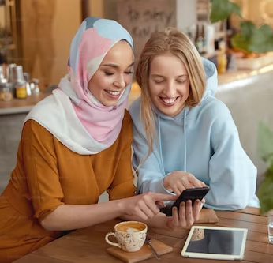
If you have a Muslim friend or neighbour you could wish them a happy Ramadan. The most common greeting during Ramadan is ‘Ramadan Mubarak’ which means ‘blessed Ramadan’.
Some also say ‘Ramadan Kareem’ which translates to ‘generous Ramadan.’
Greetings in Ramadan

Slide 10
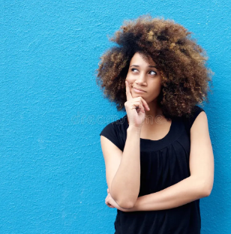
During Ramadan, Muslims fast to focus their minds of God.
Reflect upon the following questions which are linked to today’s assembly:
What distraction do you have in your life?
Could you give up a distraction for a day?
What positive action could replace these distractions?
Reflection

Slide 11
Heavenly Father,
May we all love each other as you first loved us.
May we act with compassion, kindness, humility, gentleness, and patience toward one another, living in harmony.
Lord, lead us to take what you’ve given us – love, mercy, grace, forgiveness – and spread those in this world.
May your love bind us together in perfect unity.
All this I pray through your Son Jesus Christ.
Amen
Closing Prayer

