Slide 1
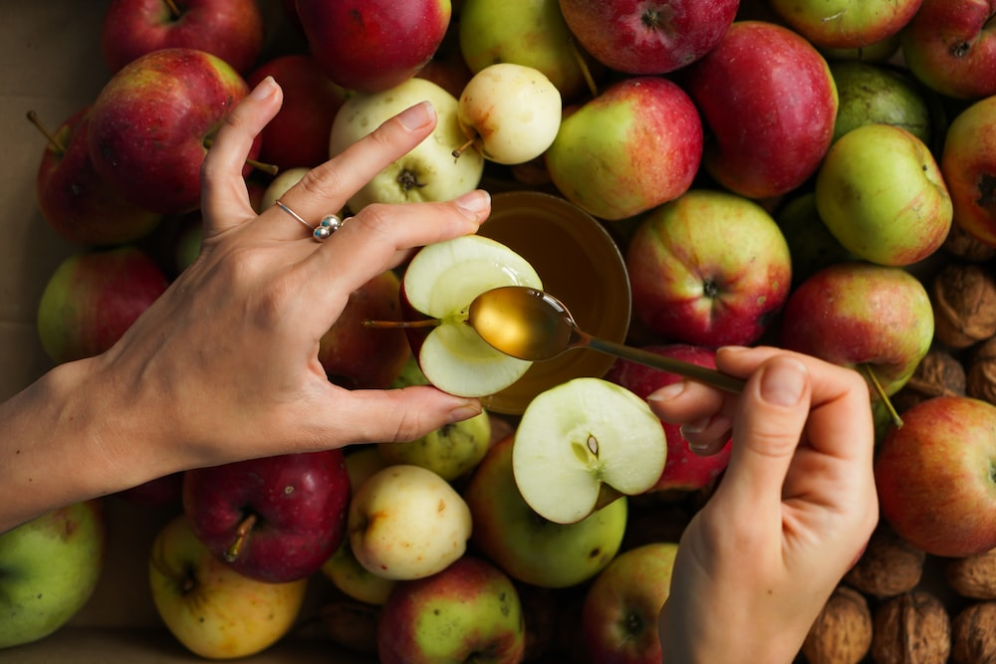
Rosh Hashanah

Slide 2
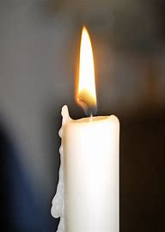
Prayer of St Francis of Assisi
Lord, make me an instrument of your peace. Where there is hatred, let me sow love; where there is injury, pardon; where there is error, the truth; where there is doubt, the faith; where there is despair, hope; where there is darkness, light; and where there is sadness, joy.
O Divine Master, grant that I may not so much seek to be consoled, as to console; to be understood, as to understand; to be loved, as to love. For it is in giving that we receive; it is in pardoning that we are pardoned; and it is in dying that we are born to eternal life.
Amen.
Opening Prayer
Notes:
con

Slide 3
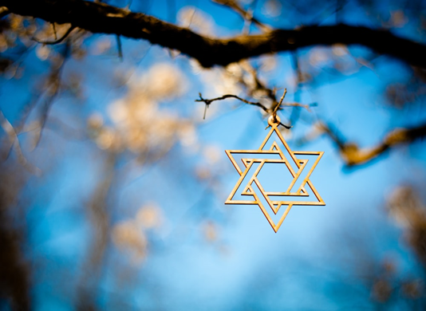
What do you already know about Judaism?
Judaism

Slide 4
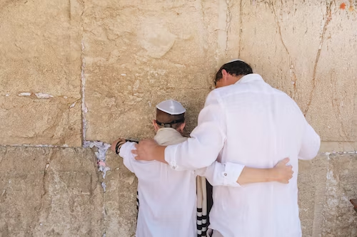
Judaism is the world's oldest Abrahamic religion.
It is almost 4,000 years old. There are about 15 million followers.
The followers of Judaism are called Jews.
The laws and teachings of Judaism come from the Torah, the first five books of the Hebrew Bible.
What is Judaism?

Slide 5
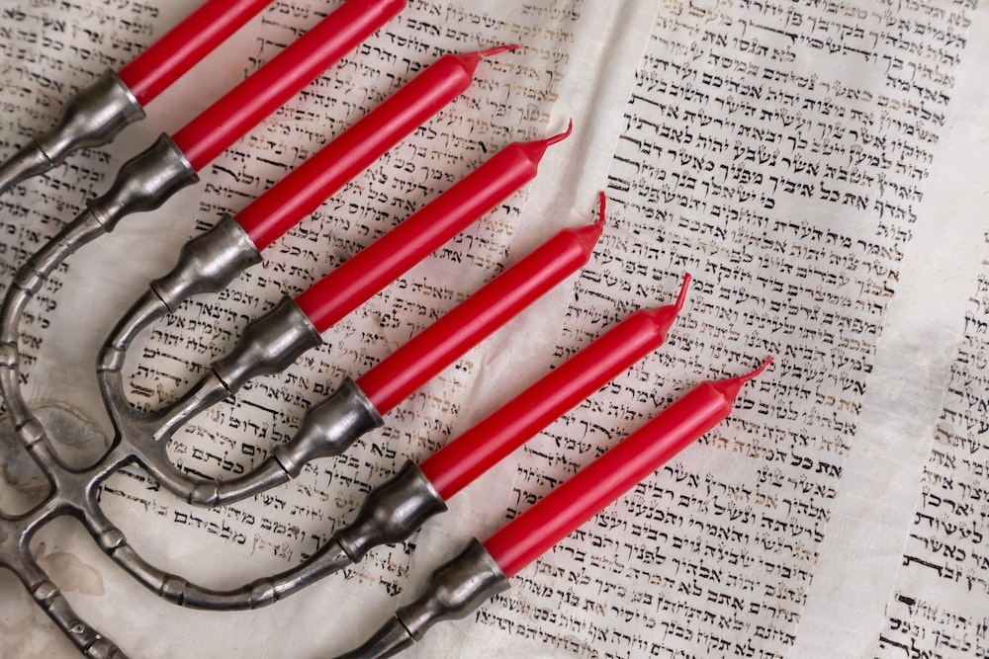
The Jewish place of worship is called a synagogue.
Jews believe in one God, as expressed in the Shema, the Jewish declaration of faith -
'Hear, O Israel: The LORD our God, the LORD is one. Love the LORD your God with all your heart and with all your soul and with all your strength. These commandments that I give you today are to be on your hearts. Impress them on your children. Talk about them when you sit at home and when you walk along the road, when you lie down and when you get up. Tie them as symbols on your hands and bind them on your foreheads. Write them on the doorframes of your houses and on your gates.'
The Jewish place of worship is called a synagogue.
For Jews, Israel is regarded to be the land promised to them by God.
Facts about Judaism

Slide 6
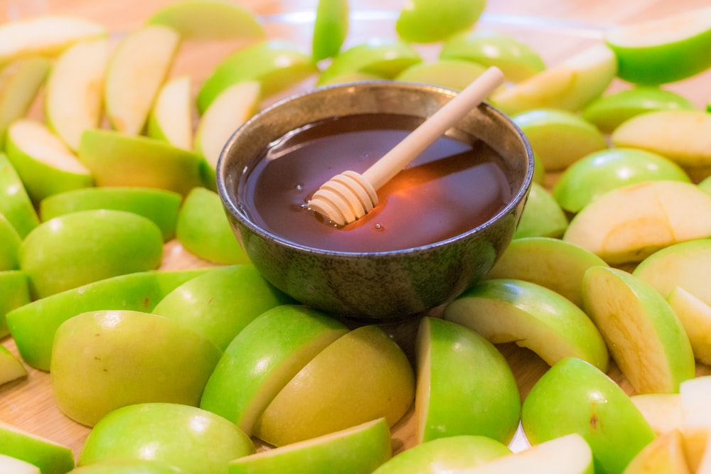
Rosh Hashanah is a special festival that celebrates Jewish New Year. It literally means 'head of the year’.
To Jewish people, it also marks the
anniversary of the creation of the world.
Festive gatherings with family and friends are a tradition during this holiday. Also traditional are meals that feature sweet foods. They also eat apples dipped in honey to represent the hope of a sweet new year.
What is Rosh Hashanah?

Slide 7
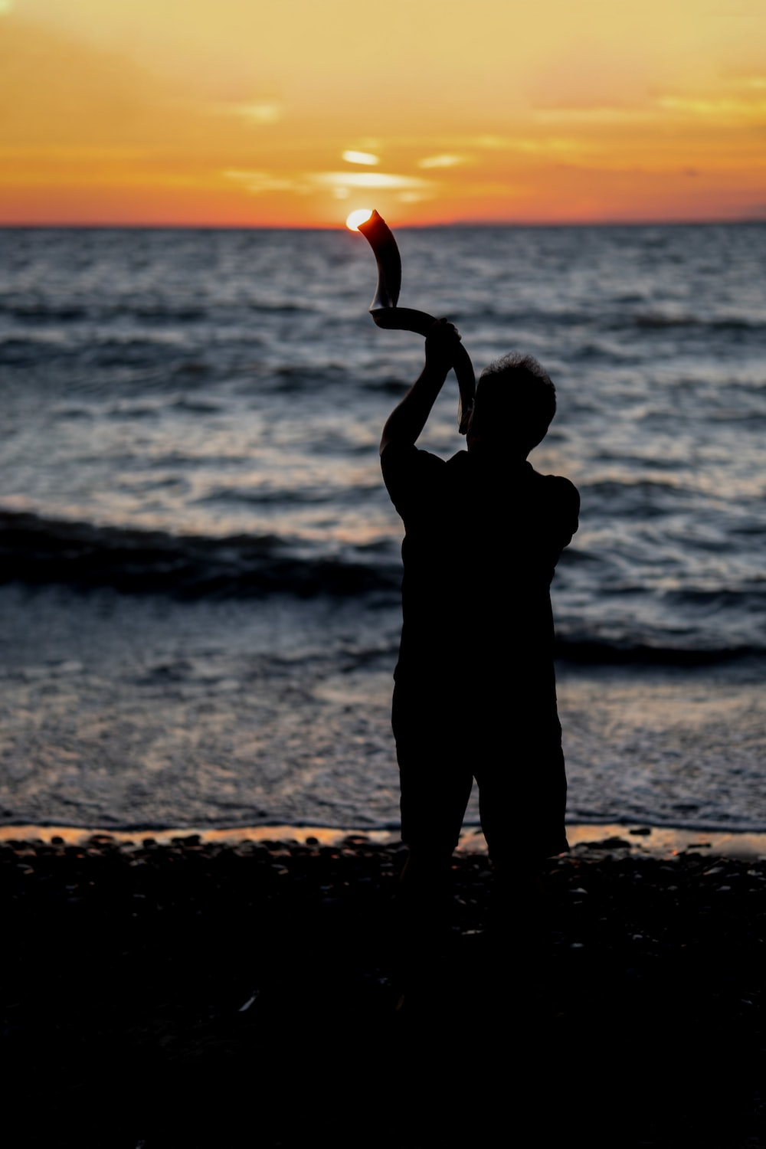
Rosh Hashanah is a joyous holiday, but it also is a serious one. Work is not allowed on the holiday. Most of the day is spent praying in the synagogue, the Jewish house of worship.
The service at the synagogue includes the sounding of the shofar, a trumpet made of a ram’s horn. The shofar is blown to symbolise a call for repentance.
What is Rosh Hashanah?

Slide 8
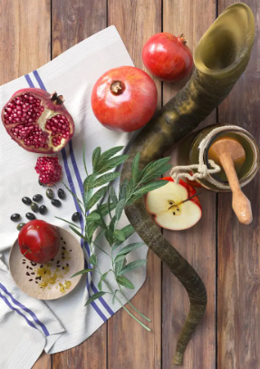
During Rosh Hashana people take time to review the mistakes they made in the past year.
They also plan the changes they hope to make in the new year.
What is Rosh Hashanah?

Slide 9
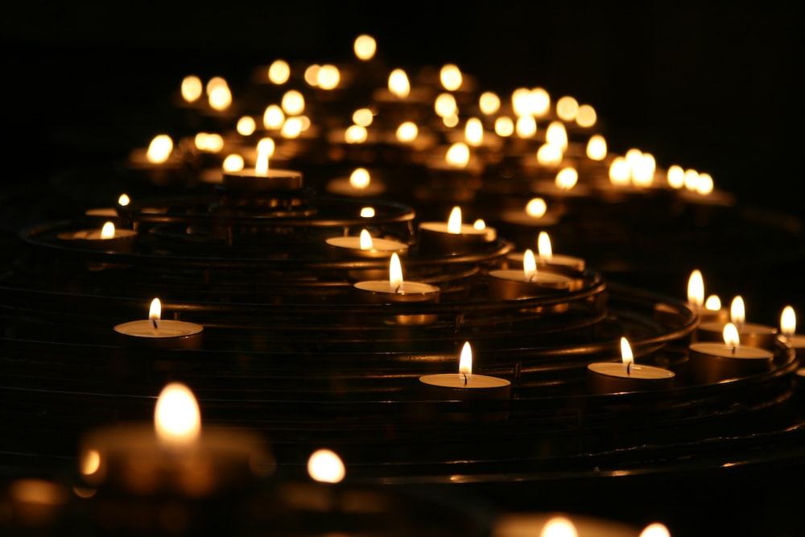
During Rosh Hashanah Jews reflect on the previous year and what they could do to improve.
Play some quiet music. Listen to the music and spend the next few minutes reflecting on these questions linked to today’s assembly:
What could I have done differently today?
Am I using my time wisely?
Am I living true to myself?
Are there things I’d like to improve about myself?
Reflection

Slide 10
Heavenly Father,
May we all love each other as you first loved us.
May we act with compassion, kindness, humility, gentleness, and patience toward one another, living in harmony.
Lord, lead us to take what you’ve given us – love, mercy, grace, forgiveness – and spread those in this world.
May your love bind us together in perfect unity.
All this I pray through your Son Jesus Christ.
Amen
Closing Prayer

