Slide 1
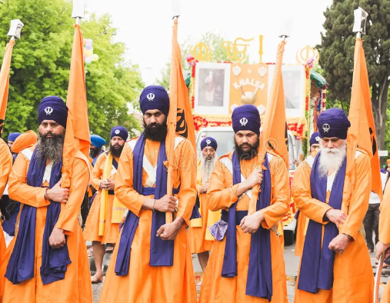
Vaisakhi

Slide 2
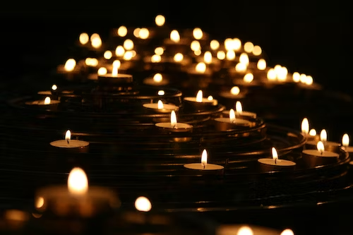
Lord,
Grant us the wisdom to all walk together through life.
Let us work together with understanding
and compassion in our hearts.
Let us not be rude or ignorant towards one another,
and instead light the way to your heavenly kingdom.
Amen
Opening Prayer
Notes:
con

Slide 3
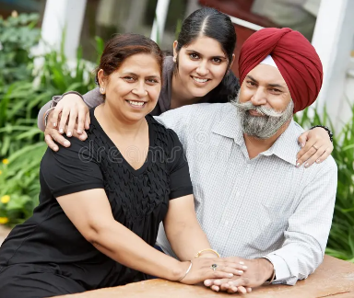
What do you already know about Sikhism?

Slide 4
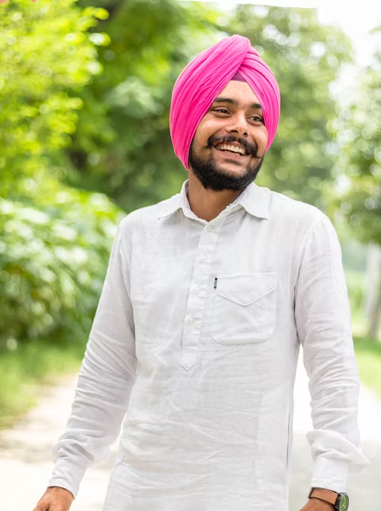
Sikhism was founded by Guru Nanak around 500 years ago in a place called the Punjab. This is an area which spans part of India and Pakistan in South Asia today.
Sikhs believe in one God who guides and protects them. They believe everyone is equal before God. Sikhs believe that your actions are important and you should lead a good life. They believe the way to do this is:
Keep God in your heart and mind at all times
Live honestly and work hard
Treat everyone equally
Be generous to those less fortunate than you
Serve others
What is Sikhism?

Slide 5
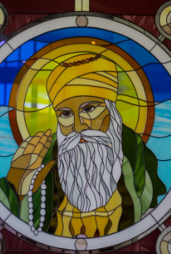
Guru Nanak is the founder of Sikhism. Guru means ‘Teacher’. Sikhism is still based on his teachings and those of the nine Sikh Gurus who followed him.
The Sikh community of men and women is known as the Khalsa which means the 'Community of the Pure’. In order to become a Sikh and join the Khalsa, people need to follow the Five Ks
The 5 Ks are 5 physical symbols worn by Sikhs They are:
Kesh (uncut hair)
Kara (a steel bracelet)
Kanga (a wooden comb)
Kaccha - (cotton underwear)
Kirpan (steel sword)
Facts about Sikhism

Slide 6
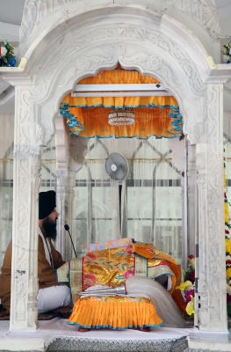
The Sikh holy book is called the Guru Granth Sahib. The tenth Guru, Guru Gobind Singh, said that after him there would be no other living gurus. Instead, Sikhs could look at their holy book for guidance. This is why Sikhs call their holy book a Guru.
The Guru Granth Sahib is a collection of lessons from the ten gurus as well as Sikh, Hindu and Muslim saints. It is written in Punjabi and is greatly respected by all Sikhs as the living word of God. It is kept on a raised platform under a canopy in the Sikh place of worship. All Sikhs take off their shoes when they are near it
The Sikh place of worship is called a Gurdwara which means 'Gateway to the Guru'. A Gurdwara is any building where the Guru Granth Sahib is kept.
In the UK, Sikhs usually go to the Gurdwara on Sundays. During the services they listen to teachings based on the Guru Granth Sahib. They also chant and say prayers from the gurus. The service ends in a langar (a shared meal). Everyone is welcome to share the meal.
Facts about Sikhism

Slide 7
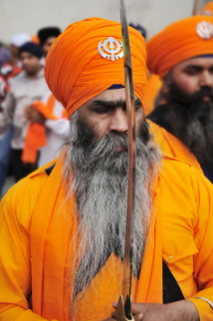
In 1699, Sikhs from all over the Punjab gathered together to celebrate the local harvest festival of Vaisakhi. The tenth guru, Guru Gobind Singh, came out of a tent carrying a sword. He asked anyone who was prepared to give their life for their religion to step forward.
A young man stepped forward and went into the tent with Guru Gobind Singh. Then Guru Gobind Singh came out of the tent alone with his sword covered in blood and asked for another volunteer. This happened four times until five Sikhs had gone into the tent.
Everyone was very worried that five men had died. However, they all came out of the tent alive and wearing turbans. The five men became known as the Panj Piare or 'Beloved Five’.
Guru Gobind Singh then baptised all the men into the Khalsa. He said some prayers and sprinkled them all with sugar water called amrit. These five men became the first members of the Khalsa (Sikhism).
What is the story of Vaisakhi?

Slide 8
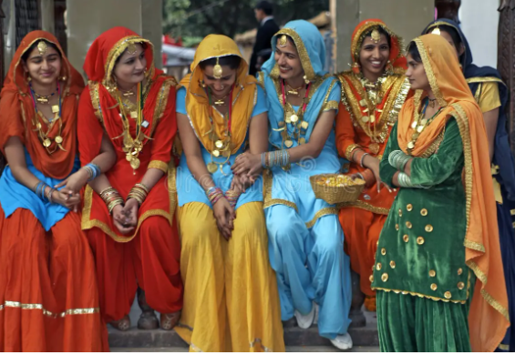
Vaisakhi, also called Baisakhi, is the festival which celebrates the founding of the Sikh community, the Khalsa, in 1699.
Vaisakhi is a spring festival which happens on the 13th or 14th April every year. In 2024 Vaisakhi takes place on Saturday 13th April.
It was originally a harvest festival in the Punjab until it became Sikhism's most important festival.
On Vaisakhi, Sikhs go to the Gurdwara in the morning for a service. Afterwards, they have a procession through the streets with lots of singing, chanting and colourful clothes. The procession is called the Nagar Kirtan. In the evening, Sikhs have a special meal with family and friends.
What is Vaisakhi?

Slide 9
At Vaisakhi, Sikh’s remember how the first followers of Guru Gobind Singh were willing to loose their lives to stand up for their faith.
Reflect upon the following questions which are linked to today’s assembly:
What beliefs are important to you?
Would you be willing to defend these beliefs?
Reflection

Slide 10
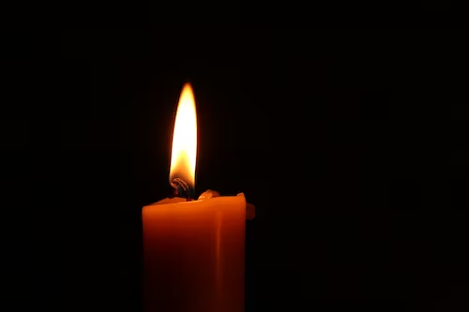
Heavenly Father,
May we all love each other as you first loved us.
May we act with compassion, kindness, humility, gentleness, and patience toward one another, living in harmony.
Lord, lead us to take what you’ve given us – love, mercy, grace, forgiveness – and spread those in this world.
May your love bind us together in perfect unity.
All this I pray through your Son Jesus Christ.
Amen
Closing Prayer

