Slide 1
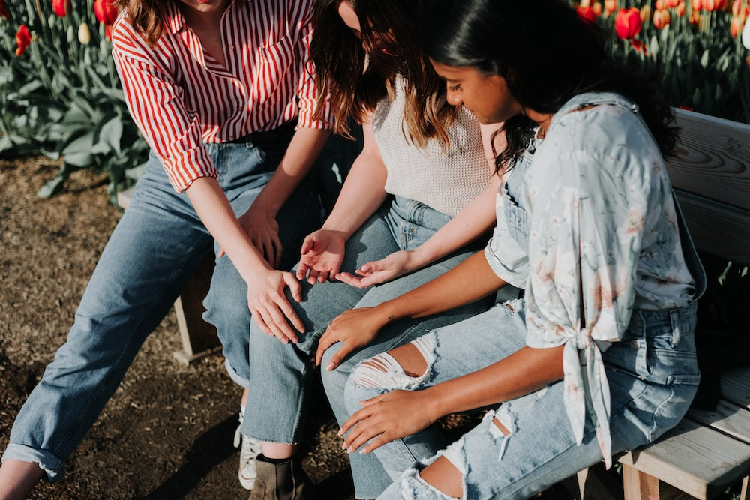
Racial Justice Sunday 2024

Slide 2
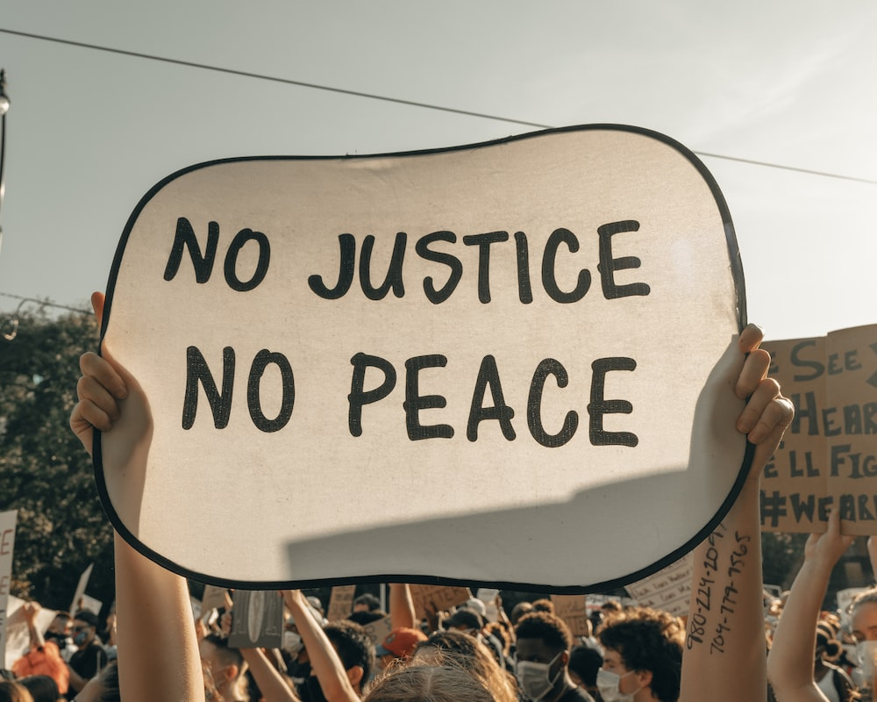
What does it mean to be just?
Before we begin…

Slide 3
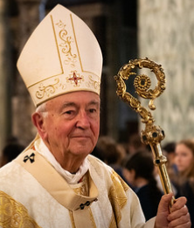
This year the bishops in our country said that we should
See one another in
the life of the Church
Why is this important?

Slide 4
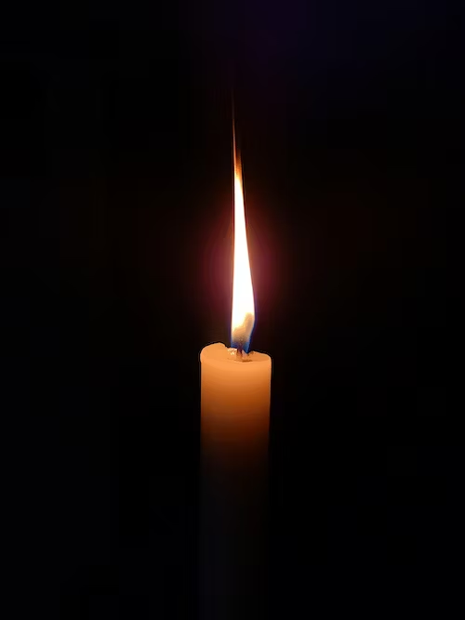
Lord, as we gather together,
we thank you for creating us in your image and likeness.
Help us to remember that we are all your children and
may we see you in all the people we meet.
Thank you for the saints of every race and culture who show us how Jesus wants us to live.
Help us to follow their example and to work for your Church so that all are loved and welcomed.
In Jesus’ name, we pray. Amen.
Gather

Slide 5
A reading from the first Book of Samuel
But the Lord said to Samuel, “Do not consider his appearance or his height, for I have rejected him. The Lord does not look at the things people look at. People look at the outward appearance, but the Lord looks at the heart.”
The Word of the Lord - Thanks be to God.
Listen

Slide 6
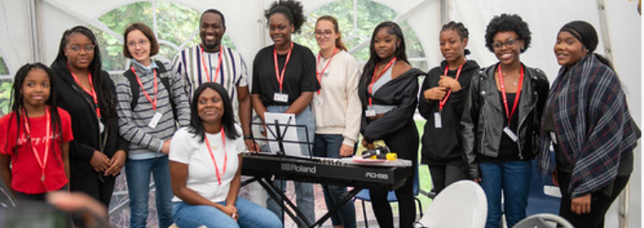
Do you judge people by their appearance or their heart?
How can you help to make sure that everyone feels included and welcome in your school?
Mission

Slide 7
We pray for people of all races, that they will be treated fairly.
Lord hear us…
Lord graciously hear us
We pray for those who feel hurt or sad because of racial injustice.
Lord hear us…
Lord graciously hear us
Let us pray

Slide 8
We pray for the leaders in our country and in our Church that they will act to bring about racial justice.
Lord hear us…
Lord graciously hear us
We pray for each one of us, that we work together to eradicate racial injustice
Lord hear us…
Lord graciously hear us
Let us pray

Slide 9
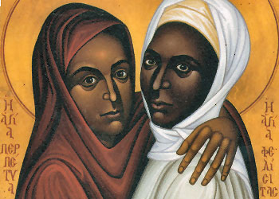
‘Seeing one another in the life of the Church’
In your form time this week, or for hw, find out about a Catholic saint from South America, Asia or Africa.
Use what you produce to create a class or school display and then send a photo to your Diocesan Advisor with a brief description.
ST. PERPETUA AND ST. FELICITY

